Slide 1

The decision making process and the application of
value judgments
Francis Ruiz
Senior Adviser (Health Economics) – NICE International
April 2014
© NICE 2014

Slide 2
Process matters! The “ideal situation”…?
NICE © Copyright, 2011/12
Principles | Putting them into practice…
Independence | “Arm’s length” from government, payers, industry and professional groups; strong and enforced conflict of interest policies
Transparency | Meetings open to the public; material placed on the web; decision criteria and rationale for individual decisions made public
Inclusiveness | Wide and genuine consultation with stakeholders; willingness to change decision in light of new evidence
Scientific basis | Strong, scientific methods and reliance on critically appraised evidence and information
Timeliness | Decisions produced in reasonable timeframe; minimise delays in publishing decisions
Consistency | Same technical and process rules applied to all cases
Legal framework | Reference in country’s legal framework; institutional role in informing coverage and payment decisions
Regular review | Regular updating of decisions and of methods

Slide 3

NICE: Evidence assessment to decision making (“Appraisal”)…
HEALTHCARE
PROFESSIONAL
GROUPS
Published evidence
PATIENTS AND SERVICE USERS
identification, critical appraisal and synthesis of clinical and economic evidence
POLICY
MAKING: evidence, values, UK reality
NHS; PUBLIC SECTOR
Unpublished evidence; expert input; industry submissions
ACADEMIA
INDUSTRY
University group or professional association/Royal College
Standing (or ad hoc) independent advisory committee/expert group

Slide 4
Stakeholder engagement…
“Scoping”
Submission
Consultation
Assessment
Review
“Appraisal”
“Decision”
Notes:
Pharmacists
Psychiatrists
Surgeons
Paediatricians
Pharmacologists
PAMs
Healthcare industry
GPs
Physicians
Radiologists
Patient/carer lay reps
Health economists
NHS management
Nurses
+ professional and patient/carer experts

Slide 5
What are stakeholders?
A large constituency
Those responsible for delivering the care (professionals, managed care programmes).
Those receiving it (consumers or patients and their caregivers).
those financing it (governments, health insurers, the public, and employers).
those managing care (policy makers, public health services).
those monitoring care
Employers
Pharmaceutical/device industry

Slide 6
Why involve stakeholders? (1)
Evidence is imperfect
  Varying quality
  Complex to interpret
  May not address appropriate outcomes
HTA based decisions/recommendations are constructed through a deliberative process
  Evidence rarely translates directly into recommendations
  Process includes consideration of evidence quality, weighing harms & benefits
  Also includes preferences, values, judgments
  A process that should be inclusive…

Slide 7
Why involve stakeholders? (2)
HTA outputs are interventions
  Aim at improving outcomes
  Excluding stakeholders’ perspective jeopardizes uptake
The process needs to be transparent
  Conflicts of interest need disclosing
  Involving the public opens the process to scrutiny
HTA outputs can have “policy status”
  E.g. linking recommendations to contractual obligations and / or “pay-for-performance” incentives
  Guidance can challenge professional freedom and commercial interests (e.g. drug companies) → may take legal action

Slide 8
NICE “Social value judgements”: principles for the development of NICE guidance
Principles that NICE should follow in designing the processes it uses to develop its guidance and in developing individual pieces of guidance.
Mainly about the judgements that NICE and its advisory bodies should apply when making decisions about the effectiveness and cost effectiveness of interventions, especially where such decisions affect the allocation of NHS resources.
The current (2008) edition of Social Value Judgements is the second and it pre-dates the Equality Act 2010. The Act's requirements now govern NICE's approach to applying social value principles when considering legally protected groups.
Eight principles – together fulfil the requirements of ‘accountability for reasonableness’.

Slide 9
SVJ on…Evidence
NICE should not recommend an intervention (that is, a treatment, procedure, action or programme) if there is no evidence, or not enough evidence, on which to make a clear decision. But NICE’s advisory bodies may recommend the use of the intervention within a research programme if this will provide more information about its effectiveness, safety or cost (Principle 1).

Slide 10
SVJ on…individual choice
Although NICE accepts that individual NHS users will expect to receive treatments to which their condition will respond, this should not impose a requirement on NICE’s advisory bodies to recommend interventions that are not effective, or are not cost effective enough to provide the best value to users of the NHS as a whole (Principle 5).

Slide 11
SVJ on…Responding to comments and criticism
NICE should consider and respond to comments it receives about its draft guidance, and make changes where appropriate. But NICE and its advisory bodies must use their own judgement to ensure that what it recommends is cost effective and takes account of the need to distribute health resources in the fairest way within society as a whole (Principle 6).

Slide 12
Role of cost effectiveness in NICE guidance
“Those developing clinical guidelines, technology appraisals or public health guidance must take into account the relative costs and benefits of interventions (their ‘cost effectiveness’) when deciding whether or not to recommend them.” (Principle 2, SVJ, NICE 2008)
BUT
“Decisions about whether to recommend interventions should not be based on evidence of their relative costs and benefits alone. NICE must consider other factors when developing its guidance, including the need to distribute health resources in the fairest way within society as a whole.” (Principle 3) → Equity issues!
See: http://www.nice.org.uk/media/C18/30/SVJ2PUBLICATION2008.pdf
Notes:
SVJ → Social Value Judgements: Principles for the Development of NICE Guidance describes the principles that NICE should follow in designing the processes it uses to develop its guidance and in developing individual pieces of guidance. It is mainly about the judgements that NICE and its advisory bodies should apply when making decisions about the effectiveness and cost effectiveness of interventions, especially where such decisions affect the allocation of NHS resources. The current edition of Social Value Judgements is the second. It was published in July 2008, replacing the first edition, which was published in 2005.

Slide 13
Why exploring equity is important for decisions
Decisions in health and health policy will often reflect issues beyond efficiency
Should we provide equal access to those with equal need?
Should we provide different access to those with differing need?
Do we have an accurate idea of need:
  capacity to benefit, burden of disease, availability of alternatives…?

Slide 14
NICE cost-effectiveness threshold
1
x
x
Rituximab for follicular lymphoma
Imatinib for chronic myeloid leukaemia (blast phase)
Probability of rejection
Trastuzumab for early stage HER-2 positive breast cancer
x
0
10
20
30
40
50
Cost per QALY (£’000)
Notes:
Note that the NICE threshold is based on expert consensus: commissioners and economists
However:
International benchmarking – WHO guidance on 1-3 GDPs per capita range

Slide 15
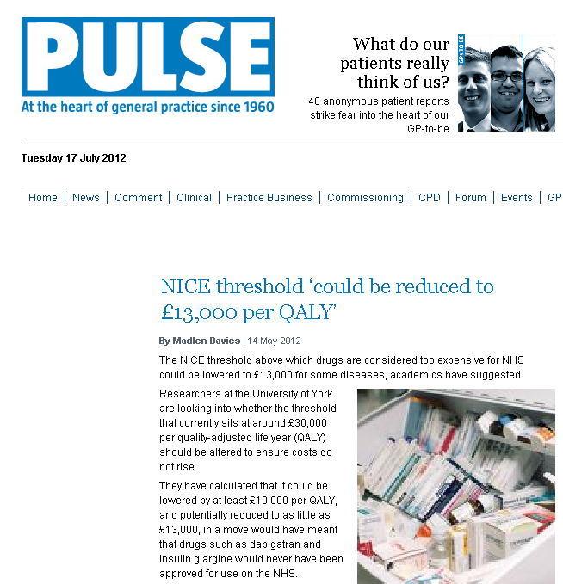
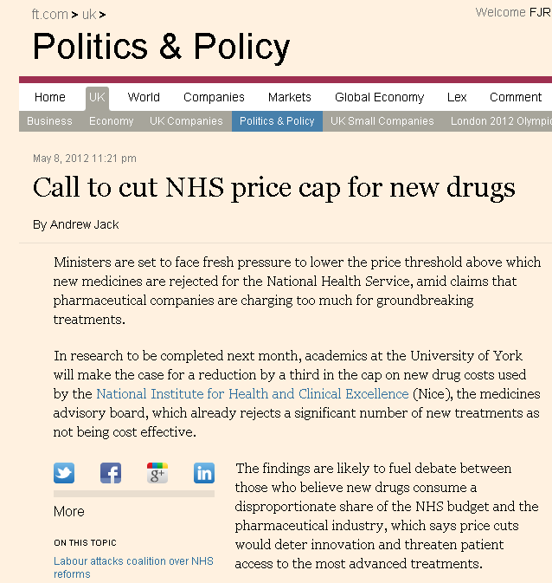
What will be the threshold in future???
In 2010, University of York, Imperial College and Office of Health Economics begins project on the empirical estimation of NHS cost effectiveness threshold
Research supported by the Medical Research Council
Final report now available…
Builds on econometrics work by Martin et al (2008) using NHS “Programme Budgeting” data:
  Information on NHS spending in 23 broad programmes of care
  Explores relationship between local spending on particular types of care and health outcomes
See: Martin S, Rice N, Smith PC. Does health care spending improve health outcomes? Evidence from English programme budgeting data. J Health Econ 2008; 27: 826-42

Slide 16
“The Government has agreed with industry that the baseline cost effectiveness threshold should be kept at a level consistent with the current range (£20,000 per QALY up to £30,000 per QALY subject to the application, in individual cases, of a number of modifying factors)” [Ongoing consultation on “value based assessment”)
Notes:
Published January 2013

Slide 17
Most decision-makers don’t use a fixed threshold… why?
Effectiveness
Extent of
uncertainty &
Irreversibility of decision
Cost-
effectiveness
NICE
DECISIONS
Making Judgements
Legal and
policy
constraints
Other social
values: ethics,
equity, rights
Practicalities of
implementation

Slide 18
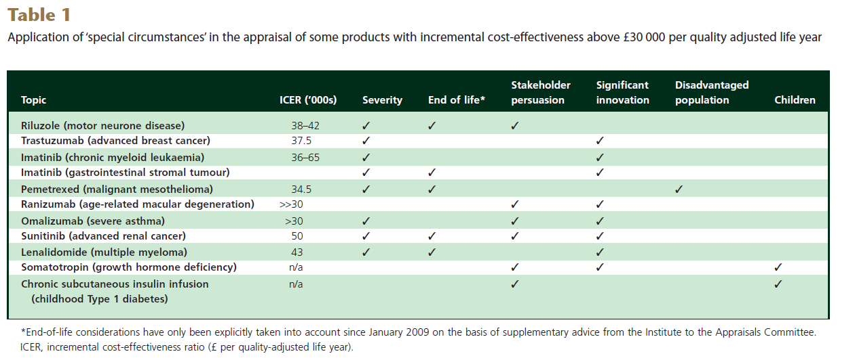
Application of ‘special circumstances’
Rawlins, Barnett, Stevens Br J Clin Pharmacol 2010

Slide 19
Question: what value judgments matter to you and your setting?

Slide 20
From evidence to setting standards and improving quality: going beyond
HTA to implementation
Clinical Trials and Evidence Reviews
Clinical Guidelines and Health Technology Assessment
“Clinical Pathways” of Care / “quality standards”
Medical education and professional training
Performance management
Budget management
Provider payment mechanisms incl. case-based payment
Communication of entitlement to patients and their families
Clinical audit and provider benchmarking
Provider regulation and accreditation

Slide 21

Thank you… Any Questions?
(francis.ruiz@nice.org.uk)
Follow us on twitter: @nice_intl

