Slide 1
Starter Question
Think about a personal relationship you have had (romantic or friendship). Why did/do you feel committed to that person? How did you know if the other person was committed?
Did you know?
By 2012, minority groups will make up one-third of the workforce
47 percent of the jobs filled by women
The workforce is aging
More and more employees are foreign-born

Slide 2
Four Types of Employees
Task Performance
High Low
Stars | Citizens
Lone Wolves | Apathetics
Organizational Commitment
Low High

Slide 3
Organizational Commitment
Organizational commitment is an employee’s desire to remain a member of the organization.
Organizational commitment influences whether an employee stays in the organization (retained) or leaves to pursue another job (turns over).
Withdrawal behavior are the actions that uncommitted employees perform to avoid work situation
Affective commitment – a desire to remain a member of an organization due to an emotional attachment to, and involvement with, that organization.
Continuance commitment - a desire to remain a member of an organization because of an awareness of leaving costs
Normative commitment - a desire to remain a member of an organization due to a feeling of obligation.
Focus of commitment refers to the various people, places, and things that can inspire a desire to remain.

Slide 4
Loyalty
Building embeddedness can foster as can increasing investment
Embeddedness summarizes a person’s:
Links to the organization and the community
His/her sense of fit with that organization and community
What he/she would have to sacrifice for a job change.
Total amount of investment (in terms of time, effort, energy, etc.) an employee has made in mastering his work role or fulfilling his organizational duties.

Slide 5
Identification
Organizational identification is an attachment to an organization (commitment and loyalty) that leads to many positive outcomes:
Employee work satisfaction increase
Absenteeism goes down
Turn over decreases
Productivity goes up
Meaningfulness of work increases
Identification is not stable, but varies over time depending on the level and context of organizational communication
For example, being at a conference vs. being in a sales situation

Slide 6
Withdrawal Behaviors
Exit - active, destructive response by which an individual either ends or restricts organizational membership.
Voice - an active, constructive response in which individuals attempt to improve the situation.
Loyalty - a passive, constructive response that maintains public support for the situation while the individual privately hopes for improvement.
Neglect - defined as a passive, destructive response in which interest and effort in the job declines.

Slide 7
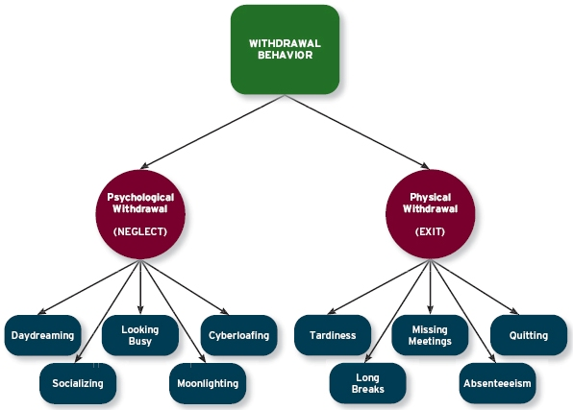
Psychological & Physical Withdrawal (warm-chair syndrome)

Slide 8
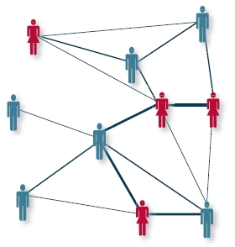
A Social Network Diagram
The erosion model suggests that employees with fewer bonds will be most likely to quit the organization.
The social influence model suggests that employees who have direct linkages with “leavers” will themselves become more likely to leave.

