Slide 1
Individual and Group Decision Making
Chapter Twelve

Slide 2
Models of Decision Making
Decision making
identifying and choosing alternative solutions that lead to a desired state of affairs
Notes:
Decision making
identifying and choosing alternative solutions that lead to a desired state of affairs

Slide 3
Models of Decision Making
The Rational Model
proposes that managers use a rational four-step approach to decision making.
Notes:
The rational model proposes that managers use a rational, four-stage sequence
when making decisions (see Figure 12–1 ). According to this model, managers
are completely objective and possess complete information to make a decision.

Slide 4
The Rational Model
Identify the Problem or Opportunity
Problem – exists when the actual situation and the desired situation differ
Opportunity - represents a situation in which there are possibilities to do things that lead to results that exceed goals and expectations
Generate Alternative Solutions
For routine decisions alternatives are readily available through decision rules
Notes:
Identifying the Problem or Opportunity
Problem – exists when the actual situation and the desired situation differ
Opportunity - represents a situation in which there are possibilities to do things that lead to results that exceed goals and expectations
Generating Solutions
For routine decisions alternatives are readily available through decision rules

Slide 5
Rational Model
Evaluate Alternatives and Select a Solution
Is the potential solution ethical?
Is it feasible?
Will it remove the causes and solve the problem?
Notes:
Evaluate Alternatives and Select a Solution
Is the potential solution ethical?
Is it feasible?
Will it remove the causes and solve the problem?

Slide 6
Rational Model
Implement and Evaluate the Solution
After solution is implemented, the evaluation phase is used to evaluate its effectiveness
Optimizing – producing the best possible solution
Notes:
Implement and Evaluate the Solution
After solution is implemented, the evaluation phase is used to evaluate its effectiveness
Optimizing – producing the best possible solution

Slide 7
Summarizing the Rational Model
The quality of decisions may be enhanced
It makes the reasoning behind a decision transparent
If made public, it discourages the decider from acting on suspect considerations
Notes:
1. The quality of decisions may be enhanced, in the sense that they follow more
logically from all available knowledge and expertise.
2. It makes the reasoning behind a decision transparent and available to scrutiny.
3. If made public, it discourages the decider from acting on suspect considerations
(such as personal advancement or avoiding bureaucratic embarrassment).

Slide 8
Nonrational Models of Decision Making
Nonrational models
Attempt to explain how decisions are actually made
Decision making is uncertain
Decision makers do not possess complete information
Difficult for managers to make optimal decisions
Notes:
Nonrational models
Attempt to explain how decisions are actually made
Decision making is uncertain
Decision makers do not possess complete information
Difficult for managers to make optimal decisions

Slide 9
Simon’s Normative Model
Bounded rationality
represents the notion that decision makers are “bounded” or restricted by a variety of constraints when making decisions
Satisficing
choosing a solution that meets some minimum qualifications, one that is “good enough”.
Notes:
Bounded rationality
represents the notion that decision makers are “bounded” or restricted by a variety of constraints when making decisions
Satisficing
choosing a solution that meets some minimum qualifications, one that is “good enough.”

Slide 10
Simon’s Normative Model
Most frequent causes of poor decision making
Poorly defined processes and practices
Unclear company vision, mission, and goals
Unwillingness of leaders to take responsibility
Lack of reliable, timely information
Notes:
Most frequent causes of poor decision making
Poorly defined processes and practices
Unclear company vision, mission, and goals
Unwillingness of leaders to take responsibility
Lack of reliable, timely information

Slide 11
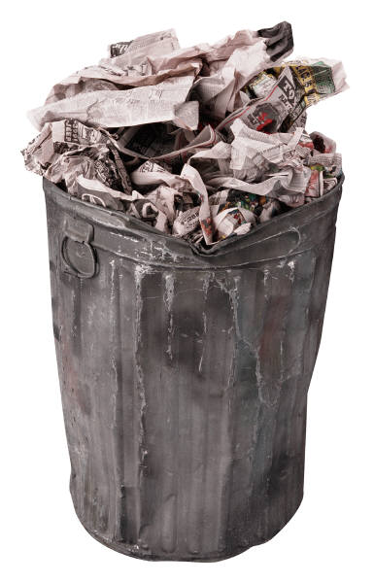
Garbage Can Model
Garbage Can Model
decision making is sloppy and haphazard
decisions result from complex interaction of four independent streams of events: problems, solutions, participants and choice opportunities
Notes:
Garbage Can Model
decision making is sloppy and haphazard
decisions result from complex interaction of four independent streams of events: problems, solutions, participants and choice opportunities

Slide 12
Implications of the Garbage Can Model
More pronounced in industries that rely on science-based innovations
Many decisions are made by oversight
Political motives frequently influence decision makers
Important decisions are more likely to be solved
Notes:
More pronounced in industries that rely on science-based innovations
Many decisions are made by oversight
Political motives frequently influence decision makers
Important decisions are more likely to be solved

Slide 13
Integrating Rational and Nonrational Models
A simple context is stable, and clear cause-and-effect relationships can be discerned, so the best answer can be agreed on
In a complicated context, there is a clear relationship between cause and effect, but some people may not see it, and more than one solution may be effective
Notes:
1. A simple context is stable, and clear cause-and-effect relationships can be discerned, so the best answer can be agreed on. This context calls for the rational model, where the decision maker gathers information, categorizes it, and responds in an established way.
2. In a complicated context, there is a clear relationship between cause and effect, but some people may not see it, and more than one solution may be effective. Here, too, the rational model applies, but it requires the investigation of options, along with an analysis of them.

Slide 14
Integrating Rational and Nonrational Models
In a complex context, there is one right answer, but there are so many unknowns that decision makers don’t understand cause-and-effect relationships.
In a chaotic context, cause-and-effect relationships are changing so fast that no pattern emerges.
Notes:
3. In a complex context, there is one right answer, but there are so many unknowns that decision makers don’t understand cause-and-effect relationships. Decision makers therefore need to start out by experimenting, testing options, and probing to see what might happen as they look for a creative solution.
4. In a chaotic context, cause-and-effect relationships are changing so fast that no pattern emerges. In this context, decision makers have to act first to establish order and then find areas where it is possible to identify patterns so that aspects of the problem can be managed. The use of intuition and evidence-based decision
making, both of which are discussed later in this chapter, may be helpful in this situation.

Slide 15
Decision-Making Biases
Judgmental heuristics
rules of thumb or shortcuts that people use to reduce information processing demands.
Notes:
Judgmental heuristics
rules of thumb or shortcuts that people use to reduce information processing demands.

Slide 16
Decision-Making Biases
Availability heuristic
Representativeness heuristic
Confirmation bias
Anchoring bias
Overconfidence bias
Hindsight bias
Framing bias
Escalation bias
Notes:
There are both pros and cons to the use of heuristics. There are eight biases that affect decision making: (1) availability, (2) representativeness,
(3) confirmation, (4) anchoring, (5) overconfidence, (6) hindsight, (7) framing, and (8) escalation of commitment. Knowledge about these biases can
help you to avoid using them in the wrong situation.

Slide 17
Question?
From January to October, Jamie's work performance was at best mediocre. In November and December, he significantly picked up his performance and did an excellent job. His supervisor evaluated him as an outstanding performer. This can be explained partially due to the:
Escalation of commitment effect.
Representativeness heuristic.
Nominal group effect.
Availability heuristic.
Notes:
The correct answer is “D” – availability heuristic.
AACSB: Group-individual dynamics Bloom's Taxonomy: Application
Difficulty: Hard Page: 335

Slide 18
Evidence-Based Decision Making
Evidence-based decision making (EBDM)
represents a process of conscientiously using the best available data and evidence when making managerial decisions
Notes:
Evidence-based decision making (EBDM)
represents a process of conscientiously using the best available data and evidence when making managerial decisions

Slide 19
A Model of Evidence-Based Decision Making (EBDM)
Notes:
Figure 12–2 illustrates a five-step model of EBDM. You can see that the process begins by gathering internal and external data and evidence about a problem at hand. This information is then integrated with views from stakeholders (e.g., employees, shareholders, customers) and ethical considerations to make a final decision. All told, the process shown in Figure 12–2 helps managers to face hard facts and avoid their personal biases when making decisions. EBDM’s use of relevant and reliable data from different sources is clearly intended to make any decision-making context more explicit, critical, systematic, and fact-based.

Slide 20
Seven Implementation Principles
Treat your organization as an unfinished prototype
No brag, just facts
See yourself and your organization as others do
Evidence-based management is not just for senior executives
Notes:
Treat your organization as an unfinished prototype
No brag, just facts
See yourself and your organization as others do
Evidence-based management is not just for senior executives

Slide 21
Seven Implementation Principles (cont.)
Like everything else, you still need to sell it
If all else fails, slow the spread of bad practice
The best diagnostic question: What happens when people fail?
Notes:
Like everything else, you still need to sell it
If all else fails, slow the spread of bad practice
The best diagnostic question: What happens when people fail?

Slide 22
Why Is It Hard to be Evidenced-Based?
There’s too much evidence.
There’s not enough good evidence.
The evidence doesn’t quite apply.
People are trying to mislead you.
You are trying to mislead you.
The side effects outweigh the cure.
Stories are more persuasive anyway.
Notes:
There’s too much evidence.
There’s not enough good evidence.
The evidence doesn’t quite apply.
People are trying to mislead you.
You are trying to mislead you.
The side effects outweigh the cure.
Stories are more persuasive anyway.

Slide 23
General Decision-Making Styles
Value orientation
reflects the extent to which an individual focuses on either task and technical concerns or people and social concerns when making decisions
Tolerance for ambiguity
extent to which a person has a high need for structure or control in his life
Notes:
Decision-making styles – combination of how individuals perceive and respond to information
Value orientation
reflects the extent to which an individual focuses on either task and technical concerns or people and social concerns when making decisions
Tolerance for ambiguity
extent to which a person has a high need for structure or control in his life

Slide 24
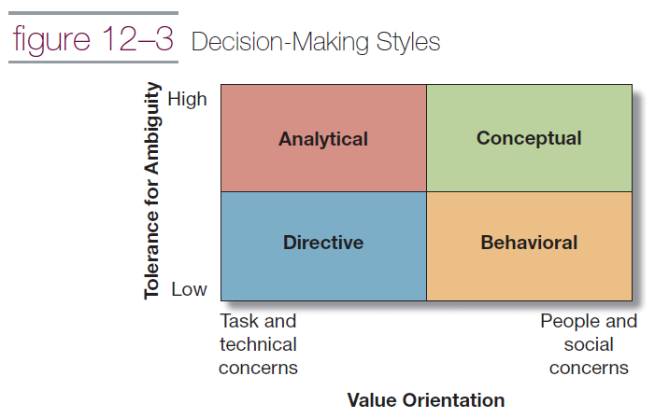
Decision-Making Styles
Notes:
When the dimensions of value orientation and tolerance for ambiguity are combined, they form four styles of decision making (see Figure 12–3): directive, analytical, conceptual, and behavioral.

Slide 25
The Role of Intuition in Decision Making
Intuition
represents judgments, insights, or decisions that “come to mind on their own, without explicit awareness of the evoking cues and of course without explicit evaluation of the validity of these cues”.
Notes:
Intuition represents judgments, insights, or decisions that “come to mind on their own, without explicit awareness of the evoking cues and of course without explicit evaluation of the validity of these cues”.

Slide 26
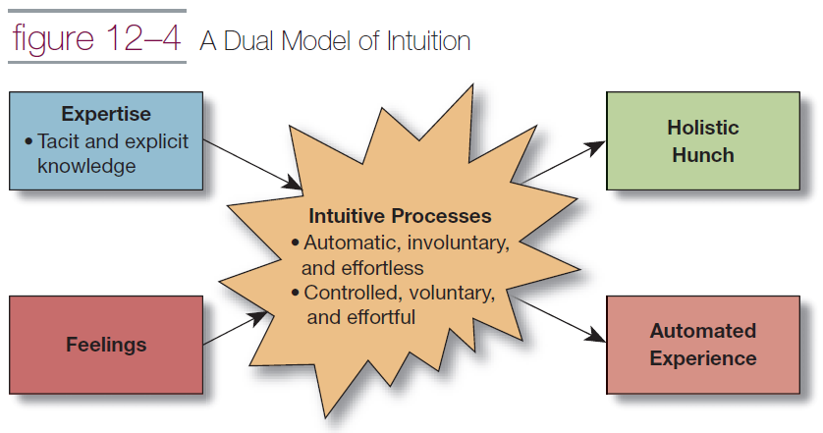
A Model of Intuition
Notes:
In figure 12–4, intuition is represented by two distinct processes. One is automatic, involuntary, and mostly effortless. The second is quite the opposite in that it is controlled, voluntary, and effortful. Research reveals that these two processes can operate separately or jointly to influence intuition. These intuitive processes are influenced by two sources: expertise and feelings (see Figure 12–4).

Slide 27
A Model of Intuition
Holistic hunch
judgment that is based on a subconscious integration of information stored in memory
Automated experiences
choice based on a familiar situation and a partially subconscious application of previously learned information related to that situation
Notes:
Holistic hunch
judgment that is based on a subconscious integration of information stored in memory
Automated experiences
choice based on a familiar situation and a partially subconscious application of previously learned information related to that situation

Slide 28
Road Map to Ethical Decision Making: A Decision Tree
Decision tree
graphical representation of the process underlying decisions and it shows the resulting consequences of making various choices
Notes:
Decision tree
graphical representation of the process underlying decisions and it shows the resulting consequences of making various choices

Slide 29
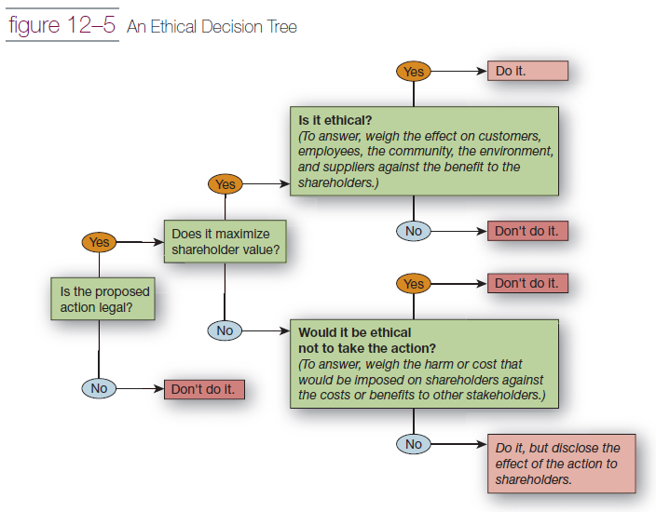
An Ethical Decision Tree
Notes:
Decision trees are used as an aid in decision making. Ethical decision making frequently involves trade-offs, and a decision tree helps managers navigate through them. The decision tree shown in Figure 12–5 can be applied to any type of decision or action that an individual manager or corporation is contemplating.

Slide 30
Group Involvement
Minority dissent
extent to which group members feel comfortable disagreeing with other group members, and a group’s level of participation in decision making
Notes:
Minority dissent
extent to which group members feel comfortable disagreeing with other group members, and a group’s level of participation in decision making

Slide 31
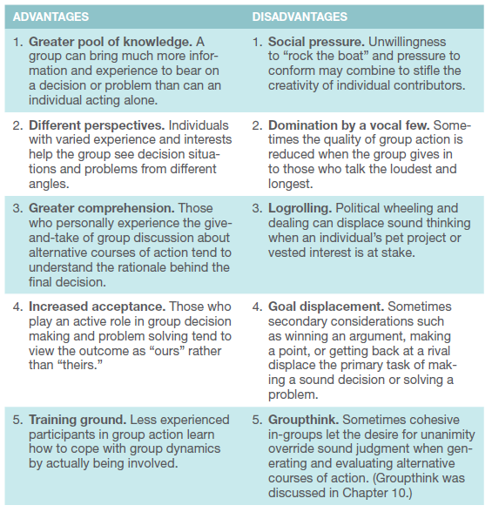
Advantages and Disadvantages of Group-Aided Decision Making
Notes:
Including groups in the decision-making process has both pros and cons (see Table 12–2 ). Advantages must be balanced with the disadvantages listed in Table 12–2 .

Slide 32
Group Problem Solving Techniques
Consensus
reached when all members can say they either agree with the decision or have had their ‘day in court’ and were unable to convince the others of their viewpoint. Everyone agrees to support the outcome.
Brainstorming
process to generate a quantity of ideas
Notes:
Consensus
reached when all members can say they either agree with the decision or have had their ‘day in court’ and were unable to convince the others of their viewpoint. Everyone agrees to support the outcome.
Brainstorming
process to generate a quantity of ideas

Slide 33
Rules for Brainstorming
Defer judgment
Build on the ideas of others
Encourage wild ideas
Go for quantity over quality
Be visual
Stay focused on the topic
One conversation at a time
Notes:
Defer judgment
Build on the ideas of others
Encourage wild ideas
Go for quantity over quality
Be visual
Stay focused on the topic
One conversation at a time

Slide 34
Group Problem Solving Techniques
Nominal Group Technique
process to generate ideas and evaluate solutions
Delphi technique
process to autonomously generate ideas from physically dispersed experts
Notes:
Nominal Group Technique
process to generate ideas and evaluate solutions
Delphi technique
process to autonomously generate ideas from physically dispersed experts

Slide 35
Group Problem Solving Techniques
Computer-aided decision making
a variety of computer, software, and electronic devices to improve decision making
allows managers to quickly obtain larger amounts of information from employees, customers, or suppliers around the world
Chauffeur-driven systems, group-driven electronic meetings
Notes:
Computer-aided decision making
a variety of computer, software, and electronic devices to improve decision making
allows managers to quickly obtain larger amounts of information from employees, customers, or suppliers around the world
Chauffeur-driven systems, group-driven electronic meetings
Chauffeur-driven systems ask participants to answer predetermined questions on electronic keypads
Group-driven meetings are conducted in special facilities equipped with individual workstations that are networked to each other

Slide 36
Creativity
Creativity
process of using intelligence, imagination, and skill to develop a new or novel product, object, process, or thought
Notes:
Creativity
process of using intelligence, imagination, and skill to develop a new or novel product, object, process, or thought

Slide 37
The Creativity Stages
Preparation
Concentration
Incubation
Illumination
Verification
Notes:
The preparation stage reflects the notion that creativity starts from a base of knowledge
During the concentration stage, an individual focuses on the problem at hand.
Incubation is done unconsciously. During this stage, people engage in daily activities while their minds simultaneously mull over information and make remote associations.
Associations generated in this stage ultimately come to life in the illumination stage.
Finally, verification entails going through the entire process to verify, modify, or try out the new idea.

