Slide 1
Earned Value Project Management: a powerful tool for software projects
Grete Kikas Tallinn University of Technology Healthcare Technology

Slide 2
Topics
What is Earned Value Project Management?
Why it is powerful tool for software projects?

Slide 3
Background
Different studies estimate that a significant number of software development projects are in chaos.
74%* of software development projects do not meet schedule, cost or scope constraints.
52.7%* of projects will cost 189% of their original estimates.
The average overrun is 222% of the original time estimate. (Standish Group report 2004)
Sample size: 8380 projects
Notes:
* Respondents were IT executive managers. The sample included large, medium, and small companies across major industry segments, e.g., banking, securities, manufacturing, retail, wholesale, heath care, insurance, services, and local, state, and federal organizations. The total sample size was 365 respondents and represented 8,380 applications. In addition, The Standish Group conducted four focus groups and numerous personal interviews to provide qualitative context for the survey results.

Slide 4
What is Earned Value Project Management?
Earned value management (EVM) is a project management technique for measuring project performance and progress in an objective manner. (Wikipedia)

Slide 5
What is Earned Value Project Management: utilities
Notes:
E.Kim et al (2003)

Slide 6
Why it is powerful tool for software projects? (1)
EVM is useful tool to integrate the three critical elements of project management:
Scope
Time
Cost management.

Slide 7
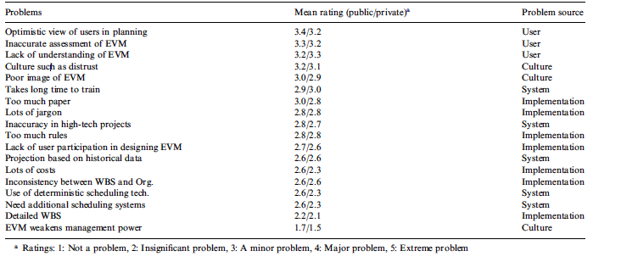
What is Earned Value Project Management: problems
Notes:
E.Kim et al (2003)

Slide 8
The concept of EVM
Features of any EVM implementation include:
Project plan
Budget Cost of Work Scheduled (BCWS)
Budget Cost of Work Performed (BCWP)
The concept of EVM requires that the project has been planned and has a known Planned Value and Accumulated Cost.

Slide 9
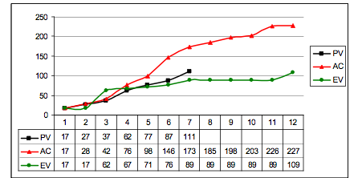
Why it is powerful tool for software projects? (2)
Example of EVM on a project that was late and over budget
Notes:
Cost Performance Index (CPI) greater than 1 is good (under budget):
< 1 means that the cost of completing the work is higher than planned (bad);
= 1 means that the cost of completing the work is right on plan (good);
> 1 means that the cost of completing the work is less than planned (good or sometimes bad).

Slide 10
Formulas:
Cost Variance (CV) = Earned Value (EV) – Actual Cost (AC)
Cost Performance Indicator (CPI) = EV/AC
Schedule Variance (SV)= Earned Value (EV) – Planned Value (PV)
Schedule Performance Indicator (SPI) = EV/PV

Slide 11
References
The Standish Group Report. Chaos. (2004)
Wikipedia. [ https://en.wikipedia.org/wiki/Earned_value_management ]
E.Kim, W.G. Wells, M.R. Duffey.(2003).A model for effective implementation of Earned Value Management methodology

Slide 12
Thank you!

