Slide 1
Strategic Planning
Communication Tool
Notes:
This slide deck is for use when talking to senior leadership teams about strategic planning and the associated products (Four Year Plans and Long Term Investment Plans in particular).
While we encourage people not to alter the content of the slides; the deck itself should be tailored by adding, removing and changing the order of slides to suit the particular conversation that you want to have with your senior leadership team or other staff.

Slide 2
What is Strategic Planning?
Strategic planning is the process through which the leadership team sets the direction for the agency and its wider sector, and makes decisions on what it will do and how it will organise itself and allocate resources to achieve these over the medium and long term.
It is where the leadership team:
Sets the vision for what the agency will look like in the medium and long term
Sets out how the agency adds value to New Zealand now and in the future, including through its relationship with its Crown Entities and management of non-departmental funding
Identifies how the agency will deliver Government and ministerial priorities
Considers the strategic context in which the agency is operating including environmental scan and service demand pressures
Sets out the pathway for how the agency will deliver this value
Provides “line of sight” for all the different parts of the agency – both operational and functional so that everyone is pulling in the same direction
Identifies dependencies and who the agency needs to work with to deliver value
Identifies what could impact on the achievement of the strategy and plans, and how the agency will manage these
Creates the feedback loop to identify what is working and what is not working and how the agency will respond

Slide 3
Strategic planning involves having challenging conversations and making decisions
Strategic planning means:
Identifying and making strategic trade-offs
Making decisions to stop doing some things
Making decisions to change the way some things are done
this is hard…
Things that can help are:
Using a PIF Review and Lead Reviewer to provide an external lens and support for senior leaders
Using the PIF Self Review as a way of having these conversations, SSC Performance Review Managers can come in to help
Bringing in an external facilitator

Slide 4
Strategic Planning is about the process and decisions not the products
It’s about identifying how the agency will create increasing value for its customers and New Zealanders...
over the short, medium and long-term…
and applying different lens…
which will result in different products with different audiences and levels of detail
By identifying…
What are the agency’s strategic objectives and who are its customers? (why does it exist?)
Long-term
Workforce
ICT
Investments and Assets
Contract management
Financial
Strategic Intentions
Medium-term
Four Year Excellence Horizon
Long-term
What interventions (outputs, services, funding, asset provision and regulation) does the department plan to deliver?
Long-term Investment Plan
Medium-term
Four Year Plan
Short-term
Estimates
Long-term
How will the department organise and manage its people and other resources to deliver?
Medium-term
Internal Plans
Short-term

Slide 5
Strategic planning is a multi-year cycle...

Slide 6
...which results in a number of products
Product | What is it? | When is it due? | Audience
Strategic Intentions (SOI) | Agencies are required to publish and present to Parliament information on their strategic intentions. | At least every three years unless required by the Minister or there is significant change | Parliament and the Public
Long-term Investment Plan | These describes an agency’s or sector’s investment journey subject to their long term vision and goals. It shows what will be invested in and how investment will occur in order to support the delivery of an agency’s or sector’s strategy. | At least every three years with the first set due December 2015 | Senior Leadership Team and Corporate Centre
Four Year Plan | These provide a medium-term perspective of departments in the context of their longer-term vision, the sector they work with or are responsible for, and how they will get there. | Annually in November | Responsible Minister(s) and Senior Leadership Team
Estimates | These are a record of Ministers’ spending intentions and how they plan to use the appropriations; and provide the information that Parliament needs to understand the funding sought in appropriation bills, and to set the basis for holding Ministers and departments accountable for their performance. | Annually in May | Parliament and the Public
Annual Business Plan / Output Plan | Sets out in more detail what the department intends to deliver over the course of the year. Provides the basis for in-year performance monitoring. | Not required but usually produced annually in June | Minister and Internal Management
Annual Report | How the department discharges its accountability to members of Parliament and the public they represent. It is the key resource for the Responsible Minister and for the financial review of the performance and current operations of each department conducted by select committees. | Annually in October | Parliament and the Public

Slide 7
But at least once a year a senior leadership team should step back and review…
How have we gone?
How are we tracking? Are we still on track?
Has anything changed in our external environment?
Do we have any new information?
Has anything changes in our internal environment?
Do our strategic intentions need revising? (as per the PFA requirements, this question needs to be kept top of mind as triggers can occur at any time)
Does our Four Year Excellence Horizon need revising?
Leading to: what are our priorities and plan for
our strategic planning process this year?

Slide 8
The Performance Improvement Framework helps your strategic thinking
It helps your Strategy Development:
Reviews using the Performance Improvement Framework help agencies define their near- and medium-term strategy through creation of a Four-year Excellence Horizon
This describes what an agency’s greatest contribution to New Zealand can be in the next four years
The gap between where an agency is in the present and where it hopes to be in four years is its performance challenge
From this work, an agency can make strategic choices about where to focus its attention, and the attention of its people
The external lens of independent Lead Reviewers can help stretch the thinking of senior leadership teams
This will strengthen and support your Four Year Plan
It helps you think about your Customer:
PIF reviews help agencies orient their thinking around who their customers are, and how they are delivering value to them – and value over time
It helps you review your Operating Model:
PIF reviews consider how well an agency has described its operating model
For more guidance on operating models go to the PIF website: http://www.ssc.govt.nz/pif
Keep it fresh:
Strategic planning, like a Four-year Excellence Horizon, is not static – it will need to be weighed against what’s happening in your environment, and within your organisation.
Ideally you’d do this at least once a year to be sure it is still as relevant as possible to support the performance lift you’re aiming at

Slide 9
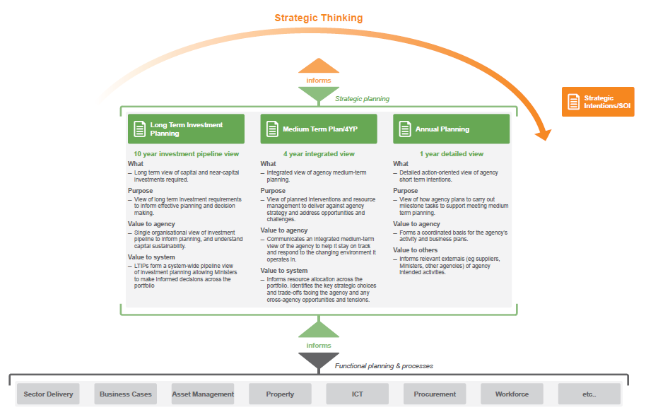
Strategic planning covers a number of different time horizons

Slide 10
Long-term Investment Plans are strategic plans setting out an agency’s investment journey over the long-term
A Long Term Investment Plan is where the senior leadership team of an investment-intensive department:
Provides reliable insights to the department’s long-term planning and thinking (i.e., over at least a 10 year horizon) at least every 3 years
Applies an investment management lens to describe the department's investment journey toward achieving their long-term vision and goals, including medium-term intentions.
Explains the rationale for the department’s capital expenditure programme, asset performance, asset disposals, lease arrangements, and "as-a-service" type investments that it considers necessary to meet its strategic intentions over the planning period
Explains how they have evaluated options and trade-offs, how the preferred choices represent best value, and the extent to which the preferred choices are affordable
Reveals the expected impact of investment intentions on the department’s 10 year forecast financial statements i.e., affordability, asset condition and functionality, service potential
Guidance is on-line at: http://www.treasury.govt.nz/statesector/investmentmanagement/think/ltip/guidance

Slide 11
Four Year Excellence Horizons:
Describe an agency’s performance challenge
Set out what it will take for the organisation to be the best it can for New Zealand in the medium term
Start with the question: “what is the contribution New Zealand needs from this agency?”
Identifies the gap between where you are today and where you’d like to be in the medium term
Are produced by the Lead Reviewers but are owned by the agency – the agency can change elements of it where they disagree
Should be a key input in the Four Year Plan process (a Four Year Plan should set out how an agency will respond to their performance challenge)
Should be referred back to regularly and refreshed or updated as required

Slide 12
Four Year Plans are integrated strategic plans that look out over the medium-term
A Four Year Plan is where the senior leadership team:
provides insight into the department’s medium-term planning and thinking at a particular point in time
sets out what the department will look like in (at least) four years time
brings together the different parts (operational, functional and non-departmental) to create an integrated picture of how the strategic objectives will be achieved
creates line-of-sight from the why (strategic objectives) to the what (interventions) to the how (resources)
brings together all the major roles and responsibilities of the department; including system and sector leadership, its Crown Entities and its non-departmental funding
provides a road map to help the department to stay on track and enable it to respond to the changing environment it operates in
provides assurance to the Government on the sustainability, and risks to the sustainability, of the department and its associated funding (including non-departmental funding) and balance sheet
helps inform government resource allocation and decision-making (including Budget decision-making) by demonstrating the value created with existing expenditure and resources, and by identifying the strategic choices and trade-offs facing departments
sets the direction for annual and more detailed planning

Slide 13
What a Four Year Plan looks like can vary from agency to agency
The Four Year Plan Guide outlines a set of questions to help agencies with their strategic planning thinking – they do not represent a check-list
How a department articulates its Four Year Plan is up to the department and will depend on the department’s circumstances and where it is at on it’s strategic planning cycle
Four Year Plans represent a snap-shot of where a department’s strategic planning is at
There are likely to be elements of the strategic planning thinking that have been determined and others that are still under consideration – the Four Year Plan should be clear about where the thinking is settled / decisions have been made, where it isn’t and what the process is for resolving any unsettled elements
A Four Year Plan should be a living document that is updated accordingly as strategic planning decisions are made – this does not mean revising the entire document every time an element of the strategic plan is updated
A Four Year Plan should be an integrated medium-term document but it can be supported by supporting documents or material that provides more detail

