Slide 1
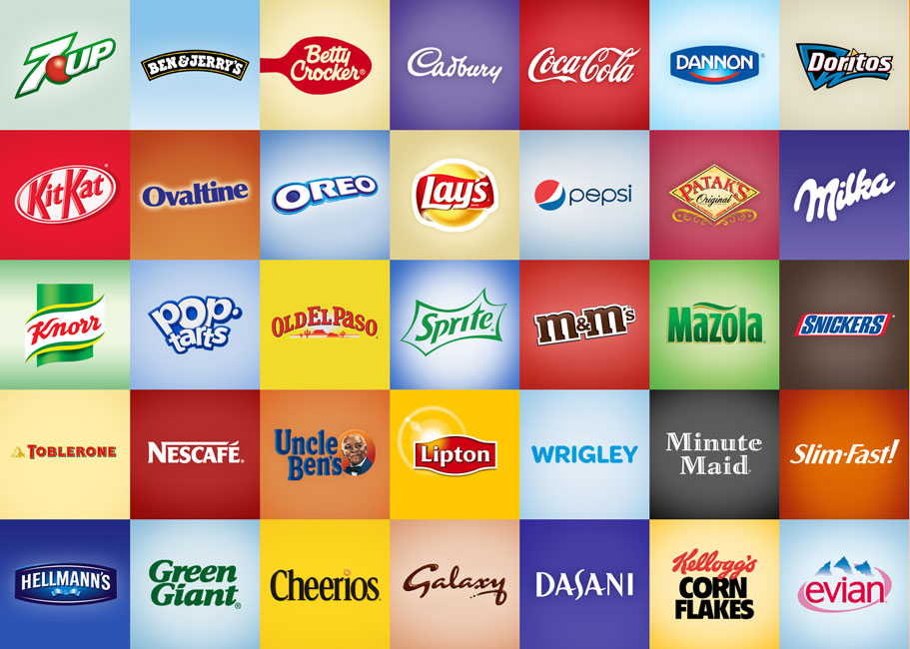
Marketing for Leaders
Building the Living, Breathing Brand

Slide 2
Part 1: How to build your brand equity system?

Slide 3
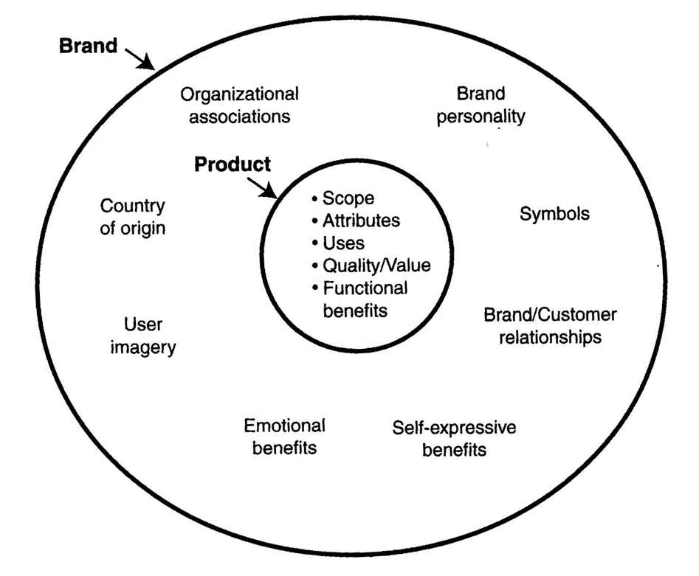
Brand is not just a product

Slide 4
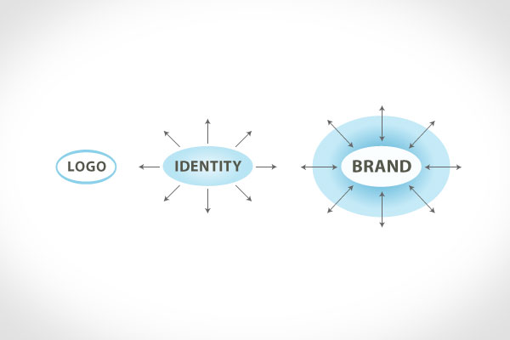
Brand is not just a logo nor identity

Slide 5
What’s brand?
Activity: Who’re you?
Describe yourself by:
Kind of food
Home appliance
Car
Sport
Country

Slide 6
Brand Architecture:
Corporate Brand
Product Brand: Pros/Cons
Family Brand (Umbrella Brand): Pros/Cons.
Virgin Group
Unilever
Vodafone
Coca cola
Dove
Chipsy
Apple
Automotive industry.
Lipton
Johnson & Johnson
Starbucks
Fedx
Facebook

Slide 7
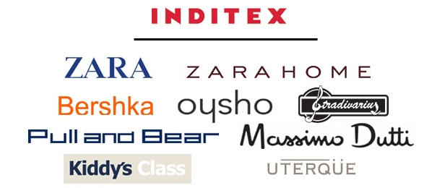
Brand Architecture:

Slide 8
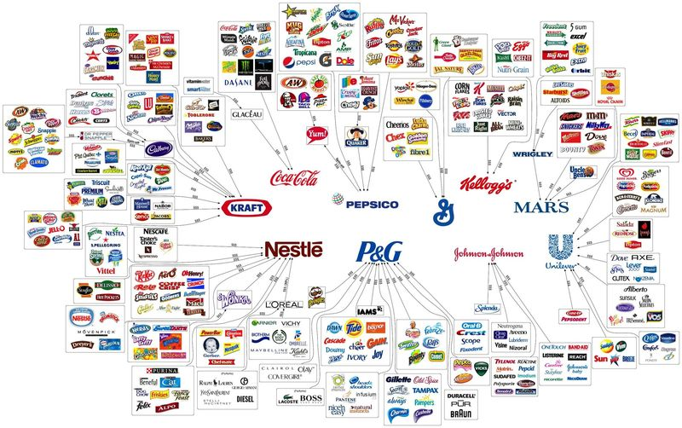
Brand Architecture:

Slide 9
Brand Portfolios:
Cash-Cows
Low-End Entry Level
Flankers (Fighters)
High End Prestige

Slide 10
What’s branding?
It’s s the marketing practice of creating a name, symbol or design that identifies and differentiates a product from other products.
“Branding is the art of aligning what you want people to think about your company with what people actually think about your company.”

Slide 11
Branding vs marketing
Marketing may contribute to a brand, but the brand is bigger than any particular marketing effort. The brand = remains after the marketing has swept through the room. It’s what sticks in your mind associated with a product, service, or organization—whether or not, at that particular moment, you bought or did not buy.
The brand is ultimately what determines if you will become a loyal customer or not.
The marketing may convince you to buy a particular Toyota, but it is the brand that will determine if you will only buy Toyotas for the rest of your life.

Slide 12
Branding vs Marketing
Is branding a cost centre ?
On the surface, yes, but the return is loyalty.
The return is
-Sales people whose jobs are easier and more effective,
-Employees who stay longer and work harder,
-Customers who become ambassadors and advocates for the organization.

Slide 13
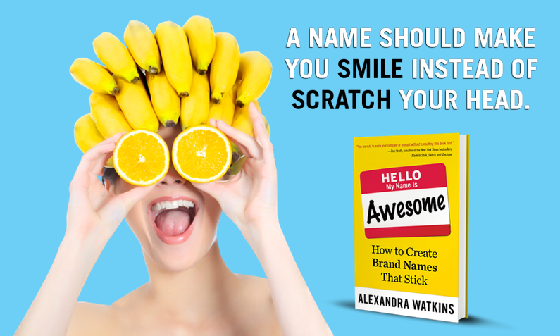
How to create a brand name?
DIFFERENTIATED
MEANINGFUL
LONGEVITY
IMAGERY
EMOTIONAL
MUSICAL
TRADEMARK-ABLE

Slide 14
doN’TS IN BRAND NAMES:
SPELLING-CHALLENGED: Twyxt – Houzz - Svbtle
COPYCAT: Yammer
RESTRICTIVE: 24-Hour Fitness – 99c – Diapers.com
ANNOYING: combinations of initials.
TAME: unimaginative , descriptive: Cloud Now - DocuSign
CURSE OF KNOWLEDGE: Mzinga – Eukanuba – SPQR restaurant
HARD TO PRONOUNCE: Xobni

Slide 15
Part 2: How to build your brand identity?

Slide 16
Brand Identity system
WHAT’S BRAND IDENTITY
BRAND IDENTITY TRAPS
BRAND IDENTITY PERSPECTIVES
THE IDENTITY STRUCTURE
VALUE PROPOSITION

Slide 17
Brand Identity system
WHAT’S BRAND IDENTITY
BRAND IDENTITY TRAPS
BRAND IDENTITY PERSPECTIVES
THE IDENTITY STRUCTURE
VALUE PROPOSITION

Slide 18
Brand Identity definition
A unique set of brand associations that the brand strategist aspires to create or maintain.
These associations represent what the brand stands for and imply a promise to customers from the organization members.
It should help establish a relationship between the brand and the customer by generating a value proposition involving functional, emotional, or self-expressive benefits”

Slide 19
Domestic/ Honest/ Genuine/ Cheerful
Brand Personality
Sincerity
Excitement
Competence
Sophistication
Ruggedness
Tough/ Strong/ Outdoorsy
Daring/ Spirited/ Imaginative/
Up-to-date
Glamorous/ Presentation/ Charming/ Romantic
Reliable/ Responsible/ Dependable/ Efficient

Slide 20
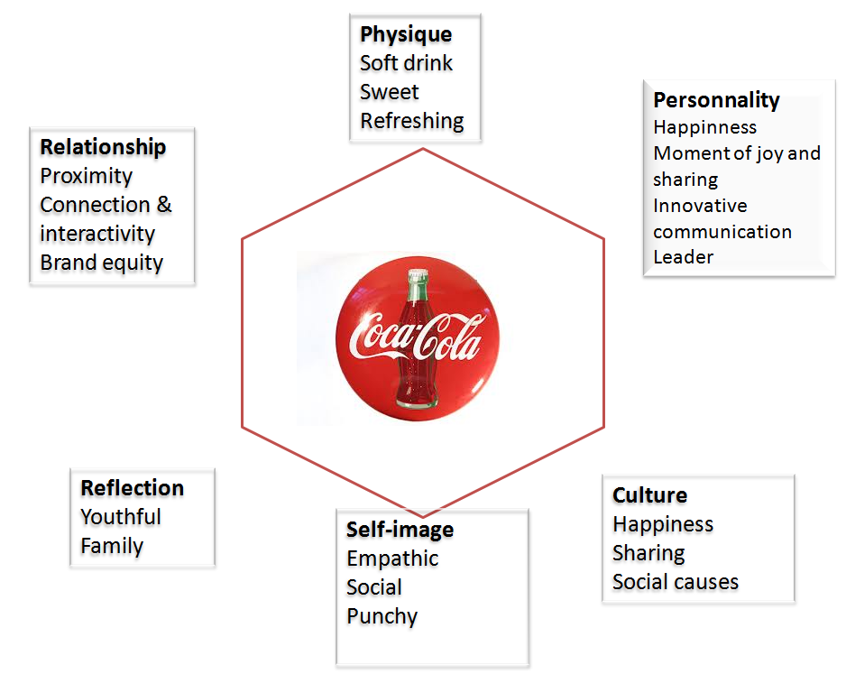

Slide 21
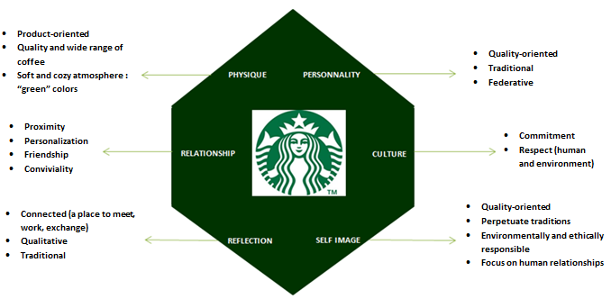

Slide 22
Brand Identity system
WHAT’S BRAND IDENTITY
BRAND IDENTITY TRAPS
BRAND IDENTITY PERSPECTIVES
THE IDENTITY STRUCTURE
VALUE PROPOSITION

Slide 23
Brand Identity Traps
Brand Identity traps
Brand Image Trap
Brand Position Trap
Product attributes fixation trap
External Perspective Trap

Slide 24
1. Brand Image Trap
Brand image is how customers perceive the brand
Brand Image | Brand Identity
passive and looks to the past | Should be active and look to the future, reflecting associations aspired for brand
Tends to be tactical | Should be strategic, reflecting a business strategy leading to sustainable advantage
Might not be salient | Should reflect brand’s enduring qualities

Slide 25
1. Brand Image Trap
A brand image trap results when efforts to go beyond the brand image are lacking.
The brand image becomes the brand identity rather than just one input to be considered
Tommy Hilfiger once removed the logo of their shirt to introduce some new design in the market. They did not realize that the identity of the brand as perceived by the customer was a shirt with logo on it. The new strategic move did not go so well, that they had to come back to the logo. This is an answer that Image is a subset of brand identity but not the brand identity.
Companies have to focus on more than what their customers want, but also reflect the soul and vision of the brand.

Slide 26
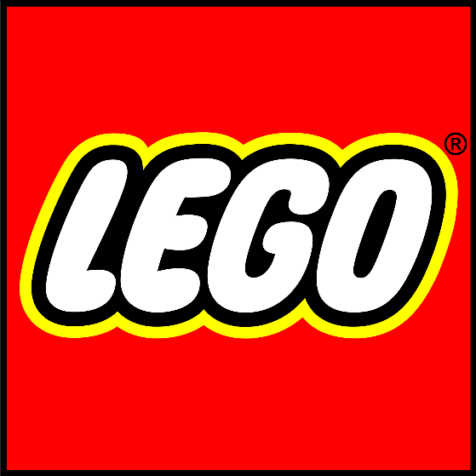
1. Brand Image Trap
Brand Image Trap will be avoided by making sure that the LEGO Group develops innovative toys, which suit the target audience and remains focus on the soul and vision of the brand.
In that connection it is not enough “just” to know what the customers want, but just as important to maintain the brand vision and mission.
Thus the LEGO Group has to focus on developing toys that make the target audience inspire to explore and challenge their creative potentials

Slide 27
2. Brand position Trap
The brand position trap occurs:
occurs when the search for brand identity becomes the search for brand position, stimulated by a practical need to give objectives to the developing of communications.
In that connection the goal becomes an advertising tag line rather than a brand identity.
This trap reduces the progress of a full brand identity, as the management.
There is often no space to consider brand personality, organizational associations, or brand symbols.
i.e.: Protector is not known as a brand, but by it’s positioned as “the strong paint”.

Slide 28
3. External perspective Trap
Most of brand strategies position the brand identity creation as an entirely external oriented process. Something that gets the customers to buy.
The external perspective trap occurs:
when firms fail to realize the role that a brand identity can play in helping an organization understand its basic values and purpose is hard to expect employees to make a vision happen if they do not understand and buy into that vision.
Gillette, in the organization they encourage the employees to grow beard so that they can test the quality of the product and whether its attributes are in relation the brand identity.
Notes:
Most of the brand strategists position the brand identity creation as an entirely external oriented process, something that gets the customers to buy. The external perspective trap occurs when firms fail to realize the role that a brand identity can play in helping an organization understand its basic values and purpose.t is hard to expect employees to make a vision happen if they do not understand and buy into that vision.

Slide 29
4. Product attribute fixation Trap
A brand is clearly more than a product or a service. Focusing your entire strategy and brand identity on the attributes of your product is an erroneous strategy, especially on a long-term.
Complications:
Failure to differentiate
Easy to copy
Assume a rational consumer
Limit brand extension strategies.
Notes:
Most of the brand strategists position the brand identity creation as an entirely external oriented process, something that gets the customers to buy. The external perspective trap occurs when firms fail to realize the role that a brand identity can play in helping an organization understand its basic values and purpose.t is hard to expect employees to make a vision happen if they do not understand and buy into that vision.

Slide 30
Brand Identity system
WHAT’S BRAND IDENTITY
BRAND IDENTITY TRAPS
BRAND IDENTITY PERSPECTIVES
THE IDENTITY STRUCTURE

Slide 31
Brands Model:
Bonding
Advantage
Performance
Relevance
Presence
Nothing else beats it?
Can it offer something better than others?
Can it deliver?
Does it offer something to me?
Do you know about it?

Slide 32
Brand asset valuator Model:
Brand Stature (past performance):
1. Esteem: How the brand is regarded?
2. Knowledge: How familiar/ intimate consumers with the brand?
Brand Strength (future):
3. Differentiation: Different from others.
4. Relevance: Breadth of brand’s appeal: Does it offer me something?
Niche / Unrealized potential
Leadership
New / Unfocused
Eroding
Brand Strength
Brand Stature

Slide 33
Aaker Model:
Brand Identity System
Brand as product
Brand as organization
Brand as Person
Brand as symbol

Slide 34
Brand as a product
Perspective | Description
Product Scope | - Associations with product class: - With what product(s) the brand is associated? Baskin Robbins → Ice Cream Compaq → Computers HP Jet line → Printers (ink jet, laser jet)
Product Attributes | - Functional/Emotional Benefits - A product related attribute can create a value proposition by offering something extra (like features or services) or better
Quality / Value | Value is closely related to quality; it enriches the concept by adding the price dimension.

Slide 35
Users | The Brand can be positioned also by a type of users (Gerber: Babies, Mobacco: Men’s wear –Classic--, Avon: female elegant)
Country of Origin | One of the strategic options is to associate the brand with a country or region that will add credibility to it (Swatch Watches: Swiss)

Slide 36
Brand as an organization
It focuses on attributes of the organization rather than those of the product or the service such as:
Innovation
Drive for quality
Concern for the environment
Culture
Values
Programs of the company
Vision
Global Vs. Local
Organizational attributes usually apply to set of products not only one product, so that if any competitor can compete to one product will not be able to compete to the organizational attributes

Slide 37
Brand as a person: brand personality
A brand can be perceived as being competent, impressive, trustworthy, fun, active, humorous, casual, formal, youthful or intellectual.
Brand personality:
Can help create self-expressive benefit that the customer can express his/her own personality through this brand
Brand personality = the basis of a relationship between the customer and the brand
May help communicate a product attribute and contribute to a functional benefit (Michelin man’s strong personality)

Slide 38
Brand as a symbol
Anything that represents the brand can be a symbol, including programs such as the Ronald McDonald House for McDonald’s .
Symbols involving visual imagery can be memorable and powerful:
Nike’s “Swoosh”
McDonald’s golden Arches
Kodak Yellow
Coke Classic can or bottle
Each strong visual image captures much of its respective brand’s identity
Connections between the symbol and the identity elements have been built up over time.

Slide 39
Brand Identity system
WHAT’S BRAND IDENTITY
BRAND IDENTITY TRAPS
BRAND IDENTITY PERSPECTIVES
THE IDENTITY STRUCTURE
VALUE PROPOSITION

Slide 40
Identity structure
CORE IDENTITY:
The timeless essence of the brand, it’s the center that remains after you peel away the layers of an onion, like:
Michelin: advanced technology tires for the driver who is knowledgeable about tires
Johnson & Johnson: trust and quality in over the center medicines
It includes the elements that make the brand unique and valuable, value proposition and credibility
Extended identity
Core identity

Slide 41
Identity structure
EXTENDED IDENTITY:
It’s the elements that provide texture and completeness.
- A larger extended identity means a stronger brand, one that is more memorable, interesting and connected to your life.
. An interesting person with whom you are involved personally or professionally would require a much more complex description.
Extended identity
Core identity

Slide 42
Brand Identity system
WHAT’S BRAND IDENTITY
BRAND IDENTITY TRAPS
BRAND IDENTITY PERSPECTIVES
THE IDENTITY STRUCTURE
VALUE PROPOSITION

Slide 43
Value Proposition
Value Proposition
Emotional Benefits
Self Expressive Benefits
Functional Benefits

Slide 44
Value proposition is not ..
It’s not a slogan or a catch phrase. This is not a value proposition:
“L’Oréal. Because we’re worth it.”
It’s not a positioning statement. This is not a value proposition:
“America’s #1 Bandage Brand. Heals the wound fast, heals the hurt faster.”
Positioning statement is a subset of a value proposition, but it’s not the same thing.

Slide 45
How to create a value proposition statement?
Headline: What is the end-benefit you’re offering, in 1 short sentence. Can mention the product and/or the customer. Attention grabber.
Sub-headline or a 2-3 sentence paragraph: A specific explanation of what you do/offer, for whom and why is it useful.
3 bullet points: List the key benefits or features.
Visual. Images communicate much faster than words. Show the product, the hero shot or an image reinforcing your main message.

Slide 46
How to create a value proposition statement?
Value Proposition Statement should answer:
What product or service is your company selling?
What is the end-benefit of using it?
Who is your target customer for this product or service?
What makes your offering unique and different?

Slide 47
How to create a value proposition statement?
Boosters for Value Proposition:
No long-term contract cancel anytime.
Free Installation / Free Setup.
Money Back guarantee.
Customizable.
Free Shipping / Fast Shipping.

Slide 48
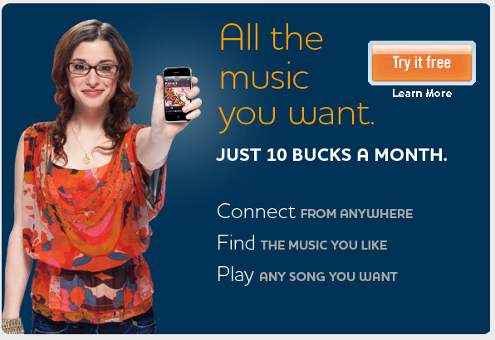
Examples for value proposition:

Slide 49
How to create a Positioning statement
WHAT: (the category) The ONLY motorcycle manufacturer…
HOW: (point of differentiation) …that makes big, loud motorcycles…
WHO: (audience segment) …for macho guys (and macho “wannabees”)…
WHERE: (marketing geography) …mostly in the United States…
WHY: (need state) …who want to join a gang of cowboys…
WHEN: (underlying tend) …in an era of decreasing personal freedom.

Slide 50
Class activity guess the brand

Slide 51
How to: pictionary style
1. Have the class circle around the blackboard. They’ll need to have a clear view.
2. Name randomly a student’s name to come up. Provide he/she with the marker
Round 1: whisper to them a brand, any brand. Try to use well-known brands to make it easy for the students to identify. (remember, no words!)
Start from easy to harder ones.
Each student will have 30 seconds to try to give the message. Award candy to whomever guesses the drawing.

Slide 52
How to: pictionary style
Round 2: give the students just a product class or any product (i.e.: shoes)
They’ll need to think of a brand in the product class.
When they explain to the rest, they need to do it in 2 steps:
A. make a drawing of the product class or product, so they can associate the brand.
B. make a drawing of the brand. They may use more than one brand to make the students guess even more.

