Slide 1
Personal Branding
Licensed under Creative Commons
Attribution – ShareAlike 4.0 International

Slide 2
Branding is more than this:

Slide 3
Branding is…
…a promise to deliver value.

Slide 4
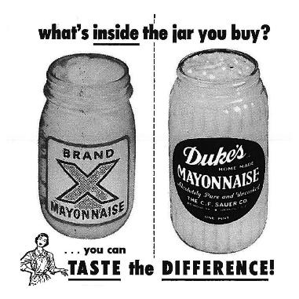
That value comes from:
Trust & familiarity
Who the company collaborates with
Source: south.unc.edu
Source: technabob.com

Slide 5
Your personal brand works the same way
How do you build
people’s trust in you?
Who do you collaborate with?
Source: cheezburger.com
Source: www.jisc.ac.uk

Slide 6
Effective brands understand their strengths
The hacker
The hustler
The designer
Builds things
Comes up with unexpected solutions to problems
Will bend rules if it’s valuable to do so
Sells things
Enjoys presentations, debates and public speaking
Excels at coming up with arguments
Designs things
Shows empathy for the customer experience
Is highly resilient and open to other people’s ideas
Notes:
Context: These three “personal brands” were identified by Steve Blank as the essential, complementary roles needed in an innovative startup team.
Task: Each student spends 60 seconds considering which of these “brands” best describes them.
On the Personal Branding handout, have students note the brand they identify with the most (the handout can be found in the Entrepreneurial Thinking Toolkit)
Give each student either a green, blue or red sticker, depending on which brand they identify with the most
Hint: After students have made their decision, survey the room to see which personal brands were most and least common. If there is a significant lack of one of the brands. point out that, because it is scarce, this brand is highly valuable. Then point out that we often adopt different brands depending on needs of the context we work in. Some students may therefore wish to change their stated brand based on what the market is telling them is valuable.

Slide 7
Effective brands are concise
One sentence:
What value can you offer a startup team?
One sentence:
What do you need from your teammates?
Notes:
Have students record both sentences on the “Personal Branding” handout.

Slide 8
Let’s network!
Over the next six minutes, talk with three potential collaborators.
Only talk with people who have a different personal brand than you (as identified by your stickers).
You have 60 seconds to pitch your brand and 60 seconds to listen to your potential collaborator’s pitch.
Record notes on the sheet provided.
Notes:
Handout: “Using Your Personal Brand to Form Groups”—which can be found in the same area of the Entrepreneurial Thinking Toolkit as this PowerPoint deck.

Slide 9
Let’s
pivot!
Notes:
A pivot is a “change in strategy without a change in vision.” Entrepreneurial people are constantly pivoting the language they use to describe themselves in order to better communicate their value to potential collaborators.
Based on your experiences with the activity so far, what could you do to improve how you present your personal brand? For example:
Perhaps you’re a hacker rather than a hustler?
Maybe you need to change some of the words you use to describe yourself?
Perhaps you need more or different evidence to support and explain your brand?

Slide 10
Let’s network!
Over the next ten minutes, talk with five other potential collaborators.
Only talk with people who have a different personal brand than you (as identified by your stickers).
You have 60 seconds to pitch your brand and 60 seconds to listen to your potential collaborator’s pitch.
Record notes on the sheet provided.

Slide 11
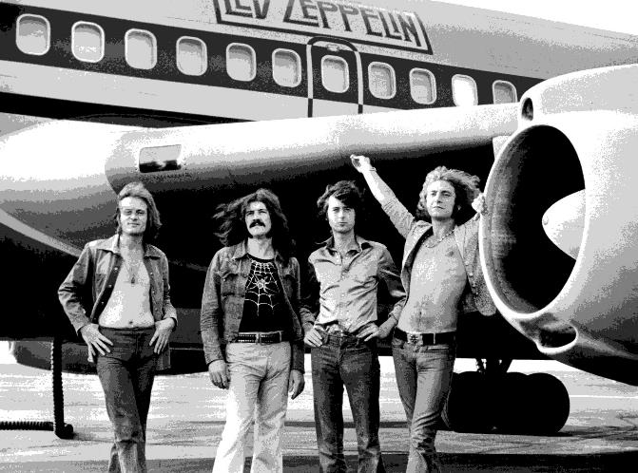
Time to form your startup!
Two to four people with COMPLEMENTARY brands
Notes:
Led Zeppelin rose to dominate 1970s rock music because each member of the band brought something unique to the whole. Students need to approach collaboration with that same mindset.

