Slide 1
Marketing & Advertising Product Development & Life-Cycle
Mr. Arbiter

Slide 2
New Product Development
New Product Development is the life blood of an organization
As important as it is, it is also very risky and we know that many, many new products fail
There are two ways to obtain new products:
New Product Development
Acquisition

Slide 3
Tough Odds
New Products face tough odds
The failure rate for new products is 90%
Annually over 30,000 new consumer products are launched
Industrial products do much better with failure rates as low as 30%

Slide 4
Some Lessons Learned
RCA lost $580 million on Selecta Vision Video Disks
Texas Instruments lost $660 million before finally withdrawing from the consumer computer business
Iridium lost over $5 billion on its satellite- based wireless phone system

Slide 5
Some Reasons for Product Failure
Good idea but the Company overestimated market size
Poor product design
Incorrectly positioned
Incorrectly priced
Poorly advertised

Slide 6
Idea Generation
Business Analysis
Product Development
Test Marketing
Commercial-ization
Idea Screening
Concept Development and Testing
Marketing Strategy Development
New Product
Development

Slide 7
Idea Generation
Idea Generation ≠ Product Development
A company may go through 3,000 ideas before coming up with one viable idea
One brainstorming session for Prudential Insurance Company resulted in over 1,000 new ideas of which only 12 were ever pursued

Slide 8
Internal Idea Sources
Formal Research & Development Programs
Intraprenurial Programs
3M 15% Rule
Texas Instruments IDEA Program (Speak & Spell)
Cisco, Google, Whole Foods

Slide 9
External Idea Sources
Customers
Legos
Skin-so-Soft
Electronic Arts
Focus Groups
Competitors
Suppliers
Outsource Developers

Slide 10
Idea Development Systems
Successful idea generation demands that the process be structured and ongoing
In order for companies to maintain this process, they develop idea management systems that channel ideas to one central location
The Idea management approach creates an innovative culture in the organization and a larger number of ideas

Slide 11
Idea Screening
The purpose of idea generation is to develop many ideas. Conversely, the purpose of idea screening is to reduce that large number to a small one, eliminating the majority before they enter the development process
A well developed Idea Development System will have a streamlined approach for eliminating the vast majority of new product ideas

Slide 12
Concept Development
Ideas that are not screened out may go through a more formal concept development procedure
Often, the original concept bears no resemblance to the ultimate product
Once a concept enters development, it can be transformed into various product concepts.

Slide 13
Chrysler Electric Car
After more than 10 years of research & development, Chrysler is putting its research into Concept Development and will develop the following concept strategies:
Concept 1-Monderatley priced subcompact
Concept 2-Medium priced sports compact
Concept 3-Very low-priced “green car.”
Concept 4-High priced SUV with broad appeal

Slide 14
Concept Testing
Usually in a “focus group” setting, consumers are shown a picture and/or a concept statement for each concept.
They are also asked a series of questions about both the general topic of electric cars and the specific topics relevant to the Concept.

Slide 15
Examples of Concept Questions
Do you understand the concept of electric vehicles?
Do you believe the manufacturer’s claims about gas mileage?
What would be a reasonable price to charge for the car?
What features would you expect to see in an electric vehicle?

Slide 16
Marketing Strategy Development
After a concept is selected, a marketing strategy statement is developed.
The strategy statement is in three parts:
Target market and planned product positioning
Planned price, distribution strategy and marketing budget
Long-run sales, profit goals and ongoing marketing mix strategy

Slide 17
Business Analysis
Once a product concept and marketing strategy are proposed, the company does a thorough review and analysis to determine the product’s financial attractiveness
The analysis, among other things, looks at the projected financial returns to determine if they match the company’s objectives and risk tolerance

Slide 18
Product Development
Having satisfied the business analysts, the product begins to finally take shape
The R&D department and/or Engineering Dept. builds a prototype of the new product
The prototype serves several purposes
Excites potential consumers
Provides a medium for safety and market testing
Serves as a model for literature and promotions

Slide 19
Test Marketing
Depending on the product, test marketing can range from none to long-term financial commitments for extensive testing programs.
While test marketing is very expensive, it is often small in comparison with making a major mistake
Frito-Lay did 18 months of market testing before introducing baked potato chips

Slide 20
Commercialization
Only after all of the other steps have been completed successfully can a company make the final decision to launch the new product.
Companies may choose either limited “rollouts” or if possible national or global rollouts of new products.

Slide 21
Local or Regional Rollouts
One final test of a new product’s strength and potential might take place at a local or regional rollout
The advantages of a regional rollout are that the product can be pulled back if it fails to produce the desired result
Proctor and Gamble can rollout a product in over 35 distinct markets at one time producing worldwide acceptance overnight

Slide 22
Product Life Cycles
Product Development
Introduction
Growth
Maturity
Decline

Slide 23
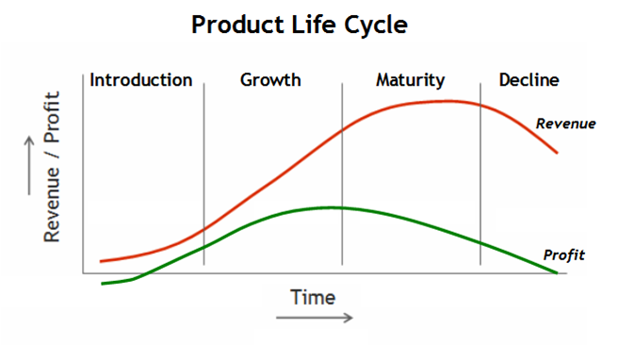

Slide 24
Introduction Stage
During the introduction stage, there are no profits.
While revenue is very scarce and slow growing, the company is spending vast amounts on development
Revenue is nearly flat and the “profit” curve shows a loss.

Slide 25
Growth Stage
During the growth stage we see that revenues are increasing and profits are beginning to level off.
This is a period of market acceptance
Let’s look at the Diffusion of Innovation Curve and see how it fits into this paradigm.

Slide 26
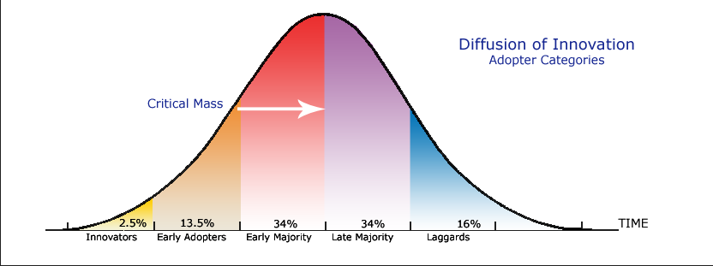
Diffusion of Innovation Curve

Slide 27
Juxtaposition of Life-Cycle and Diffusion of Innovation
Life-Cycle
Diffusion of Innovation

Slide 28
Maturity
This is a period of slowdown in sales growth as consumers have obtained this product.
Profits level off and begin to decline, often as a result of price decreases to maintain competitive advantage.
Some products never grow up.
Tabasco Sauce is over 140 years old

Slide 29
Decline
This is the period when sales drop of significantly and profits drop off sharply
Some products die fast and some die slowly

Slide 30
Special Life-Cycles
Style
A basic and distinctive mode of expression
Fashion
A currently accepted or popular style in a given field
Fad
A fashion that enters quickly, is adopted with great zeal, peaks early, and declines very quickly

Slide 31
