Slide 2
BRAND PERSONALITY
A set of human characteristics that are associated with a brand name
Personality how the brand behaves
Companies uses brand personality to identify with their ideal consumers

Slide 4
The concept of brand personality is useful because of following reasons :
Enriches understanding
Helps gain an in depth understanding of consumer perceptions and attitudes towards the brand
Can provide more insight than is gained by asking about perceptions

Slide 5
Contributes to a differentiating identity
Can differentiate brands especially where brands are similar in product attributes
In , fact can define not only the brand but the product class , context and experience

Slide 6
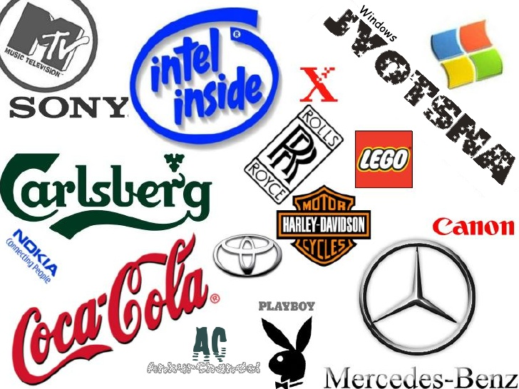
EXAMPLES

Slide 7
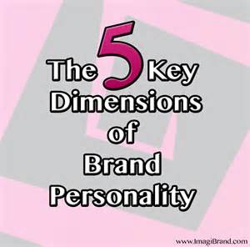

Slide 8
SINCERITY
EXCITEMENT
COMPETENCE
SOPHISTICATION
RUGGEDNESS

Slide 9
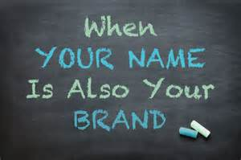
1. SINCERITY
A brand personality demonstrates "sincerity" when consumers consider it down-to-earth, honest, genuine or cheerful.
Brands that are presented as sincere may appeal to customers who want to purchase products that feel familiar and comfortable.

Slide 10
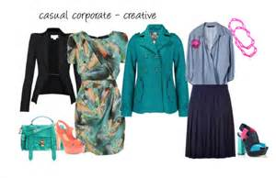
2. EXCITEMENT
Consumers think of brands that create "excitement" as daring, spirited, imaginative and cutting-edge.
The excitement brand personality appeals to individuals who want to add a sense of adventure to their lives or who already live exciting lifestyles.

Slide 11
3. COMPETENCE
Brands known for "competency" create images of reliability, intelligence, success, responsibility, dependability and efficiency.
Companies that market their brands as competent can compete with brands marketed for their excitement by presenting an alternative value

Slide 12
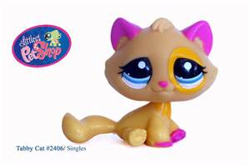
4. SOPHISTICATION
Companies that market a brand as "sophisticated" hope to appeal to consumers who want to feel charming, glamorous, elegant and romantic.
Brands in this category, such as Rolex or Harrods, may also present themselves as being decidedly upper-class

Slide 13
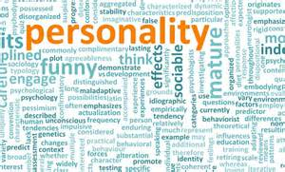
5. RUGGEDNESS
Consumers who identify themselves as outdoorsy, tough and strong want goods or services that will endure.
They gravitate toward the practical, but demand more than competence. These buyers embrace brands they perceive as "rugged

Slide 14
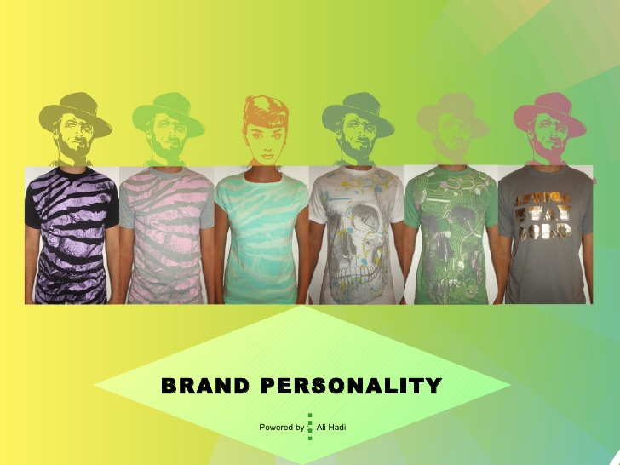
Formulation a brand personality

Slide 15
Steps for formulation of brand personality
A. Plan for Personality
B. Create a Voice
C. Give your business a persona
D. Choose a Set of Identifiers
E. Create a Style Guide

Slide 16
A. Plan for Personality
1. Traditional and established
Traditional and established brands tend to have a more formal personality and use strong
colors, typefaces and symmetry to communicate a message.
2. Modern and high energy.
Modern and high-energy brands tend to use
brighter colors, trendy design techniques
and have a light tone.

Slide 17
Create a Voice
The words that you used to determine your brand personality will also help to create
your voice. A brand voice is the way you speak to your customers.

Slide 18
Give your business a persona
Persona- The role that one assumes or displays in public or society; or personality, as distinguished from the inner self.
it can be male or female, young or old, light or
Serious. Develop guidelines to create consistency
in expressing the benefits of your business.

Slide 19
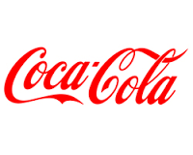
Choose a Set of Identifiers
Part of identity and personality comes in the design process. Your company logo and website are the two biggest identifiers for most customers
1. Color
2. Typography
3. Images
4. Shape
5. space

Slide 20
Create a Style Guide
Once you decide what your brand personality looks like,
write it down and create a scrapbook of images that link
to that personality. Create a brand style guide that details
everything about your business including voice, images,
color palette, typography options, copy and tone guidelines,
and usage standards.

Slide 21
Difference between brand personality and brand image
Brand image | Brand personality
1.It refers to perception about the brand in mind of public. | It refers to a set of human characteristics that are attributed to a brand name. It is something to which a person can relate.
2. Brand image denotes the tangible benefits and attributes of brand. | It indicate emotional association of brand.
3. The general meaning of brand image is HOW MARKET PERCEIVES YOU. | It includes all the tangible and intangible traits as beliefs, values, attitudes, interests,.

Slide 22
4. Brand image is the total personality of the brand. It is the set of perception that the consumer have in mind about particular brand. | Brand personality not only include the personality features and characteristics but also the demographical feature like age, gender, class, etc.
5. Brand image is just a development of perception. | Brand personality helps in development of brand equity.
6. Brand image represents the OTHER VIEW. | It represents the internal and external characteristics of brand name.
7. Brand image helps to understand the total consumers perception about the brand so its nature is appearance oriented. | Brand personality helps in making differentiation among the brands specifically when they are alike.

Slide 23
8.It signifies WHAT THE BRAND CURRENTLY STAND FOR, how it is viewed by the customer. | Brand personality indicates the kind of relationship customer has with the brand.

