Slide 1
Course Name : Principles of Marketing Code : MRK 152 Chapter : Eight
Developing New Products
and Managing the Product Life-Cycle

Slide 2
New Product Development
New Product Development is the development of original products, product improvements, product modifications, and new brands through the firm’s own product development efforts.

Slide 3
New Product Development Process

Slide 4
New product Development Process Conti…..
Idea Generation – systematic search for new product ideas.
Sources of ideas:
Internal Idea Sources – includes formal research and development
External Idea Sources – distributors, suppliers, competitors, online collaborative, customers etc.

Slide 5
New product Development Process Conti…..
Idea Screening: Screening new product ideas in order to spot good ideas and drop poor ones as soon as possible.
Concept Development and Testing: is detailed version of the new – product idea stated in meaningful consumer terms.
Concept Development and Testing: is testing new product concepts with a group of target consumers to find out if the concepts have strong consumer appeal.

Slide 6
New product Development Process Conti…..
Marketing Strategy Development:
Step 1
Step 2
Step 3
Target market
Price
Long-run sales
Planned value proposition
Sales
Market share
Profit goals
Distribution
Marketing budget
Profit goals
Marketing mix strategy

Slide 7
New product Development Process Conti…..
Business Analysis: Business analysis is review of the sales, costs, and profit projections for a new product to find out whether these factors satisfy the company’s objectives.
Product Development: is developing the product concept into physical product in order to ensure that the product idea can be turned into a workable market offering.

Slide 8
New product Development Process Conti…..
Test Marketing: is the stage of new product development in which the product and marketing program are tested in realistic market settings.
Commercialization: involves introducing a new product into the market.

Slide 9
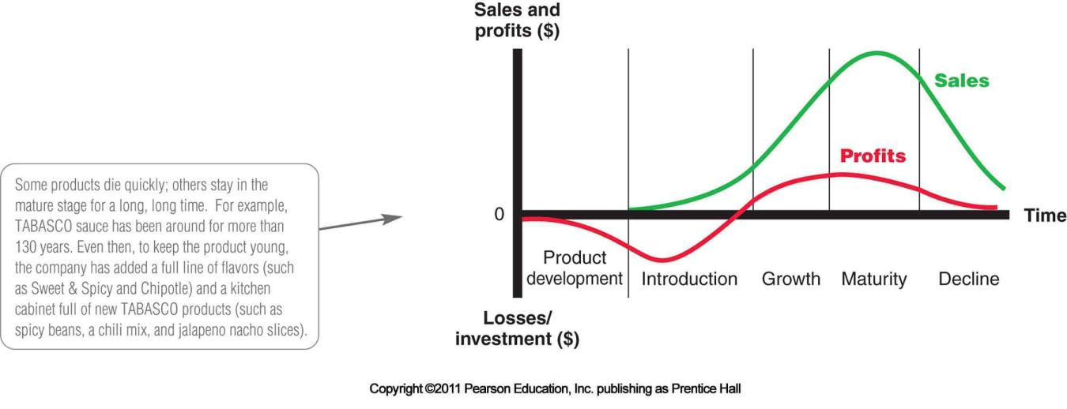
Product Life Cycle

Slide 10
Product Life Cycle
Introduction is a period of slow sales growth as the product is introduced in the market. Profits are nonexistent in this stage because of the heavy expenses of product introduction.
Growth is a period of rapid market acceptance and increasing profits.

Slide 11
Product Life Cycle Conti….
Maturity is a period of slowdown in sales growth because the product has achieved acceptance by most potential buyers. Profits level off or decline because of increased marketing outlays to defend the product against competition.
Decline is the period when sales fall off and profits drop.

Slide 12
Product Life-Cycle Characteristics, Objectives, and Strategies

Slide 13
Thank You!

