Slide 1
Consumer Behavior

Slide 2
What is Consumer Behavior?
“Describes how consumers make purchase decisions and how they use and dispose of goods and services, and also analyzes the factors that influence purchase decisions.”

Slide 3
The Decision-Making Process
Problem Recognition
Information Search
Evaluation of Alternatives
Purchase
Post-Purchase Behavior

Slide 4
Problem Recognition
Difference between ideal state and actual state
Nike
College

Slide 5
Information Search
Internal Search
External Search
How much research?
Perceived risk
Knowledge
Prior experience
Interest
What resources aided you in choosing a college?

Slide 6
Evaluation of Alternatives
Evaluative criteria
Leads to the Formation of an Evoked Set
College

Slide 7
Purchase Decisions
Where to buy?
When to buy?

Slide 8
Post-purchase Behavior
Expectation comparison
“Buyers remorse”
Post-purchase anxiety
Cognitive dissonance
Can marketers do anything about it?

Slide 9
Involvement
High v. Low Involvement
High
Low
Routine Problem Solving
Milk
Limited Problem Solving
Restaurant
Extended Problem Solving
Cars

Slide 10
Involvement & Marketing
Low Involvement
Leader
Make quality product available and advertise it
Challengers
Break buying behaviors
High Involvement
Leaders
Make info available
Challengers
Comparative advertising

Slide 11
Marketing Mix
Situational Influences
Psychological Influences
Consumer Decision-Making Process
Sociocultural Influences
Personal influence
Product
Price
Place
Promotion
Purchase task
Social surroundings
Physical surroundings
Temporal effects
Antecedent states
Motivation
Personality
Perception
Learning
Values, Beliefs & Attitudes
Lifestyle
Problem identification
Information search
Evaluation of alternatives
Purchase decision
Post-purchase behavior
Reference groups
Family
Social class
Culture/Subculture

Slide 12
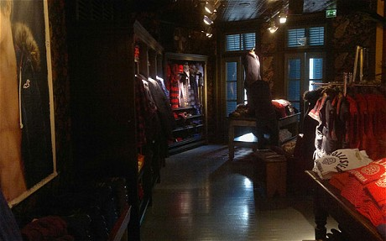
Situational Influences
Purchase task
Social surroundings
Physical surroundings
Temporal effects
Antecedent states
Source: www.telegraph.co.uk

Slide 13
Psychological Influences
Motivation
Personality
Perception
Learning
Values, Beliefs & Attitudes
Lifestyle

Slide 14
Motivation & Personality
Maslow’s Hierarchy of Needs
Must tune products to specific need-level
Personality
“A person’s consistent behaviors or responses to recurring situations.”
National character
Self—concept
Actual self v. Ideal self

Slide 15
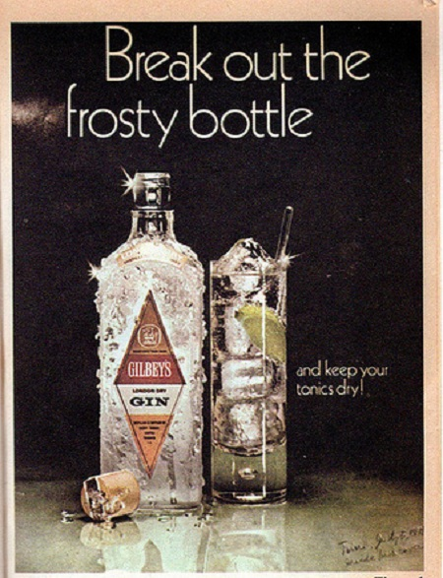
Perception
“The process by which an individual selects, organizes, and interprets information to create a meaningful picture of the world.”
Selective perception
Exposure v. comprehension v. retention
Subliminal perception
Perceived risk
Source: http://www.impactlab.net

Slide 16
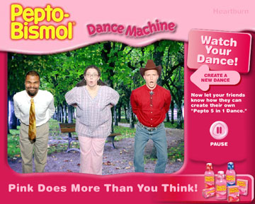
Learning
Behavioral (Experiential) Learning
Drive + Cue + Response → Reinforcement
Cognitive (Conceptual) Learning
Making a connection between two or more ideas
Brand Loyalty
Source: www.adweek.com

Slide 17
Top 20 Brands with Most Loyal Facebook Fans
1. St. Jude’s Hospital
2. Facebook
3. Google
4. Walt Disney World
5. Aldi
6. Xbox
7. Starbucks
8. Google Chrome
9. Duncan Hines
10. Adobe Photoshop
11. Tim Horton’s
12. Hershey
13. In-N-Out Burger
14. Dove Chocolates
15. NFL
16. Portillo’s
17. Bravo
18. Dineyland
19. Dollar Tree
20. AMC Theater
Source: http://blog.louddoor.com/blog/bid/259992/Top-20-Brands-with-the-Most-Loyal-Fans-on-Facebook/

Slide 18
Brand Loyalty- College Students
Brand Keys Inc. survey
Based on Customer Loyalty Index (16,000 people)
Looked at students’ habits before and after graduation
Almost 5,000 students and post-grads surveyed
Students’ attitudes changed because of new environment and more income

Slide 19
Brand Loyalty-College Students
Results
Most loyal to
Least loyal to
Other notables:

Slide 20
Values, Beliefs, & Attitudes
Values
What is important?
Beliefs
“An organized pattern of knowledge that an individual holds as true.”
Attitudes
“Learned tendency to respond consistently toward a given object.”
Shaped by beliefs and values

Slide 21
Involvement & Psychological Influences
Decision-making- High-involvement
Beliefs → attitude → behavior
Decision-making- Low-involvement
Beliefs → behavior → affect

Slide 22
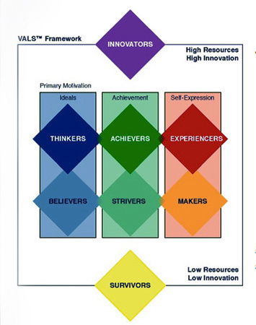
Lifestyle
Based on people’s activities, interests, and opinions
VALS program
Discusses 8 lifestyles
Based on resources and self-orientation
Action, principles, and status
Source: http://www.e-flux.com

Slide 23
Sociocultural Influences
Personal influence
Reference groups
Family
Social class
Culture/Subculture

Slide 24
Personal Influence
Opinion Leaders
Direct or indirect influence
Word of mouth

Slide 25
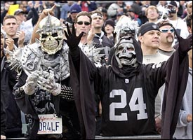
Reference Groups
Formal and informal groups that influence the buying behavior of the individual
Two broad classifications
Primary
Secondary
Three types
Membership group
Aspiration group
Dissociative group
Source: http://wwwinsidesocal.com

Slide 26
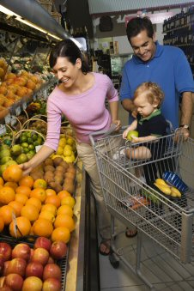
Family Influence
Consumer Socialization
Family Life Cycle
Family Decision Making
Source: http://foodhelp.wa.gov

Slide 27
Social Class
Divisions within society along values, interests, and behavioral lines
Upper, middle, and lower classes
Share certain characteristics

Slide 28
Culture/Subculture
Subcultures are divisions of people with homogenous characteristics
Age groups
Ethnic groups

