Slide 1
Strategic Market Planning in a Nutshell
Graham Austin, Ph.D.
23 May, 2013

Slide 2

Who'da thunk this would be a wildly successful product?

Slide 3
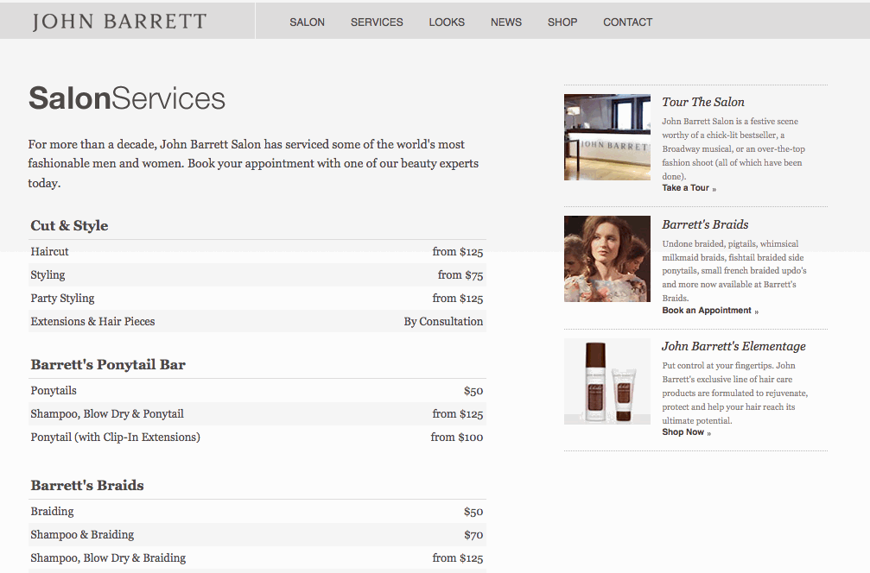
Or this?

Slide 4

Or this?

Slide 5
How did they do it?
Strategic planning

Slide 6


Marketing geniuses
1963
2013

Slide 7
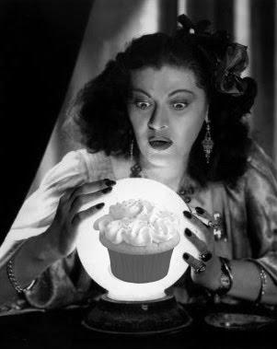
Marketing strategy
A plan of action for
identifying and
analyzing a target
market and
developing a marketing
mix to meet the needs
of that market.

Slide 8
In other words, marketing is
Putting the right product in the right place, at the right price, at the right time
Simple, right?

Slide 9
Marketing Mix = The 4 Ps
The marketing mix is comprised of
Products
Pricing
Promotions
Distribution (f.k.a. Place)

Slide 10
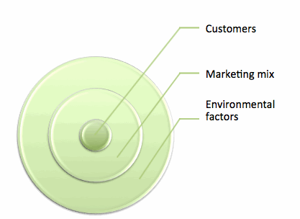
The way the pieces fit together

Slide 11
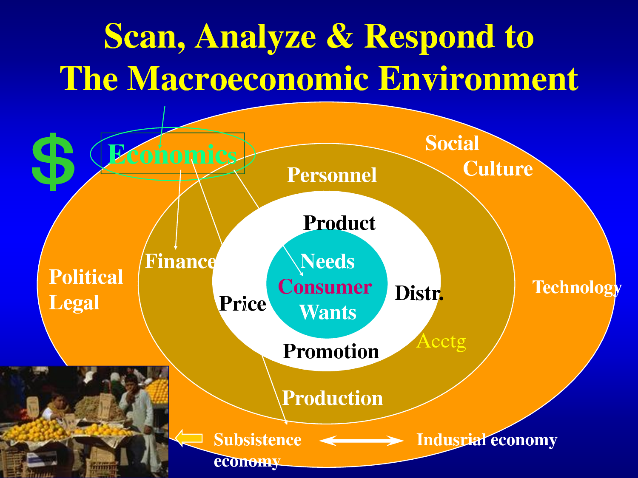
Ugly, but informative...

Slide 12
Words of wisdom
Consumers don't know what they want. They only want what they know.

Slide 13

What can we control?
Marketers can control only the marketing mix.

Slide 14
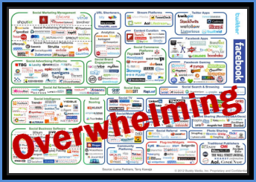
Don't despair!
With hard work, good thinking, smart decision making, good timing, and good luck, it's possible to be successful in the incredibly dynamic modern marketplace.

Slide 15
Marketing concept
A philosophy that an organization should try to provide products that satisfy customers’ needs through a coordinated set of activities that also allows the organization to achieve its goals.

Slide 16
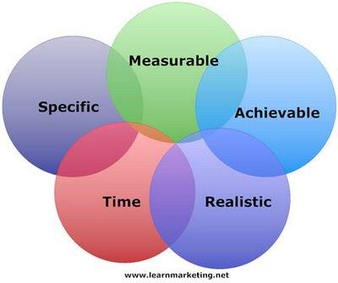
Goals should be SMART

Slide 17
Marketing plan
A written document that specifies the activities to be performed to implement and control the organization’s marketing activities.

Slide 18
Environmental analysis: STEEPLE
You have to consider the following environments, that can (and will) affect your business:
Sociocultural
Technological
Economic
Ecological
Political
Legal
Ethical

Slide 19
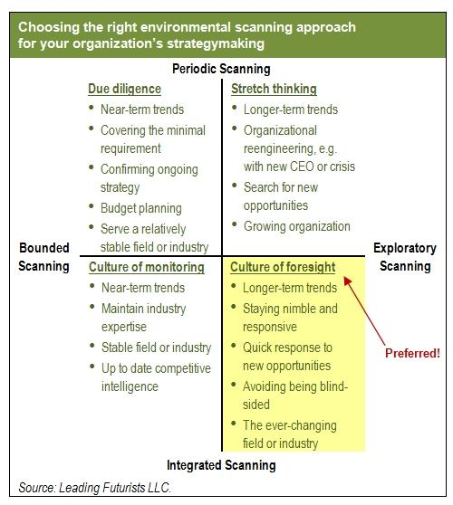
A scanning matrix

Slide 20
Internal analysis
Core competencies are things a firm does extremely well, which sometimes give it an advantage over its competition.
This is an excellent overview of core competencies, including examples

Slide 21
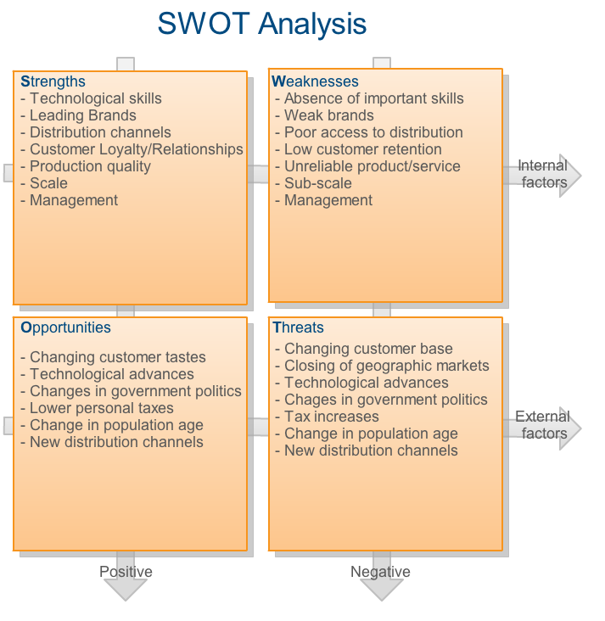
SWOT: A snapshot

Slide 22
Competitive advantage
The result of a company’s matching a core competency to opportunities it has discovered in the marketplace (i.e., a strategic window).

Slide 23
Marketing research
The systematic design, collection, interpretation, and reporting of information to help marketers solve specific marketing problems or take advantage of marketing opportunities.
Marketresearch.com

Slide 24
Benefits of market research
Facilitates strategic planning
Assess opportunities/threats
Ascertain potential for success
Determine feasibility

Slide 25
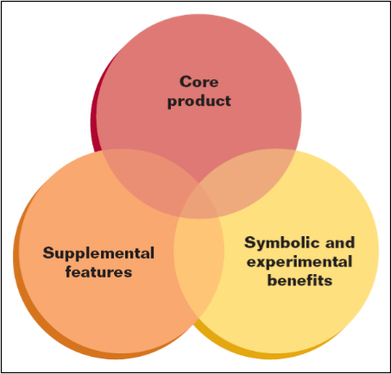
What is a product?
Good
Service
Idea

Slide 26
Product line & product mix
Item -- specific version of product
Line -- closely related items viewed as a unit
Mix -- total group of products
Width of mix -- number of lines
Depth of mix -- number of different products in line

Slide 27
Where do new product ideas come from?
Customers
Employees
Distributors
Competitors
R & D
Consultants
Good ol’ entrepreneurial creativity

Slide 28
Why products fail
Failure to match product to needs
Failure to send right message
Technical/design problems
Poor timing
Overestimate market
Ineffective promotion
Insufficient distribution

Slide 29

So what makes a product a success?
Fills consumer needs and wants
Differentiation from substitute / competitors’ products
Provides a benefit
to a large number of
people
Packaging!

Slide 30
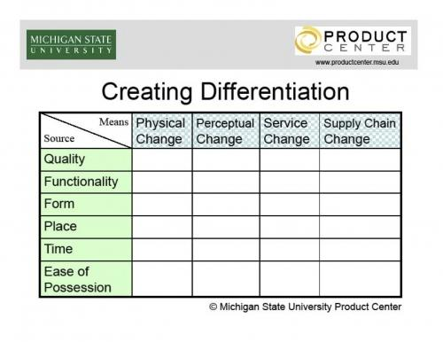
Differentiation
Make sure your product is different and better (in some way) than your competitors'!

Slide 31
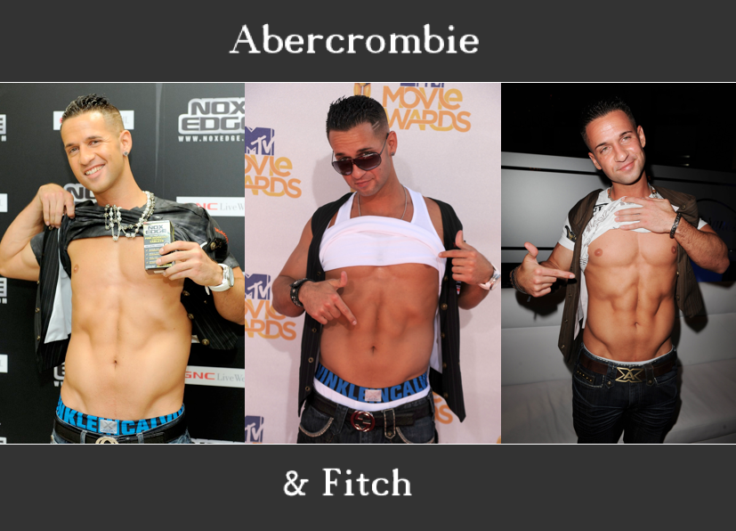
Product positioning
Product positioning
Creating and maintaining a certain
concept of a product in customers' minds.
Perceptual Mapping
Repositioning

Slide 32
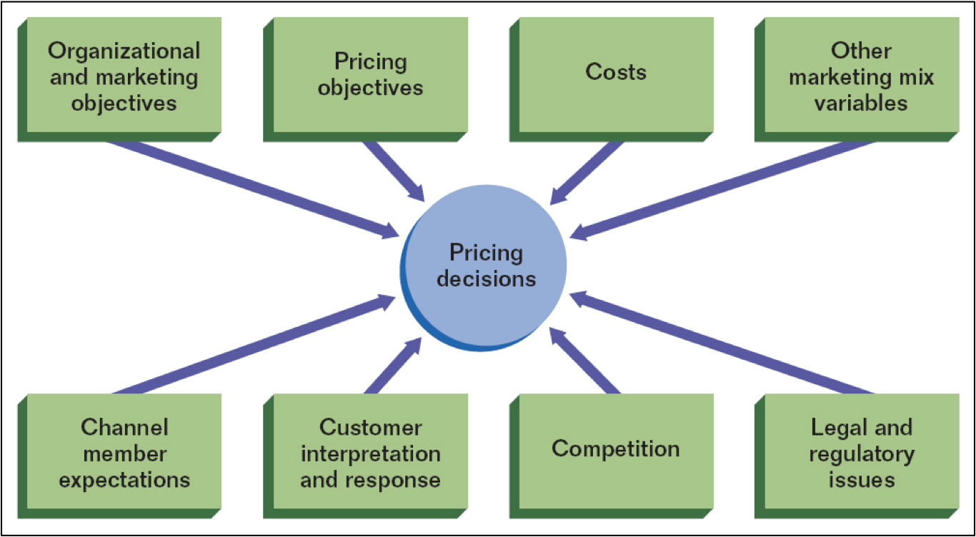
Factors that affect pricing decisions

Slide 33
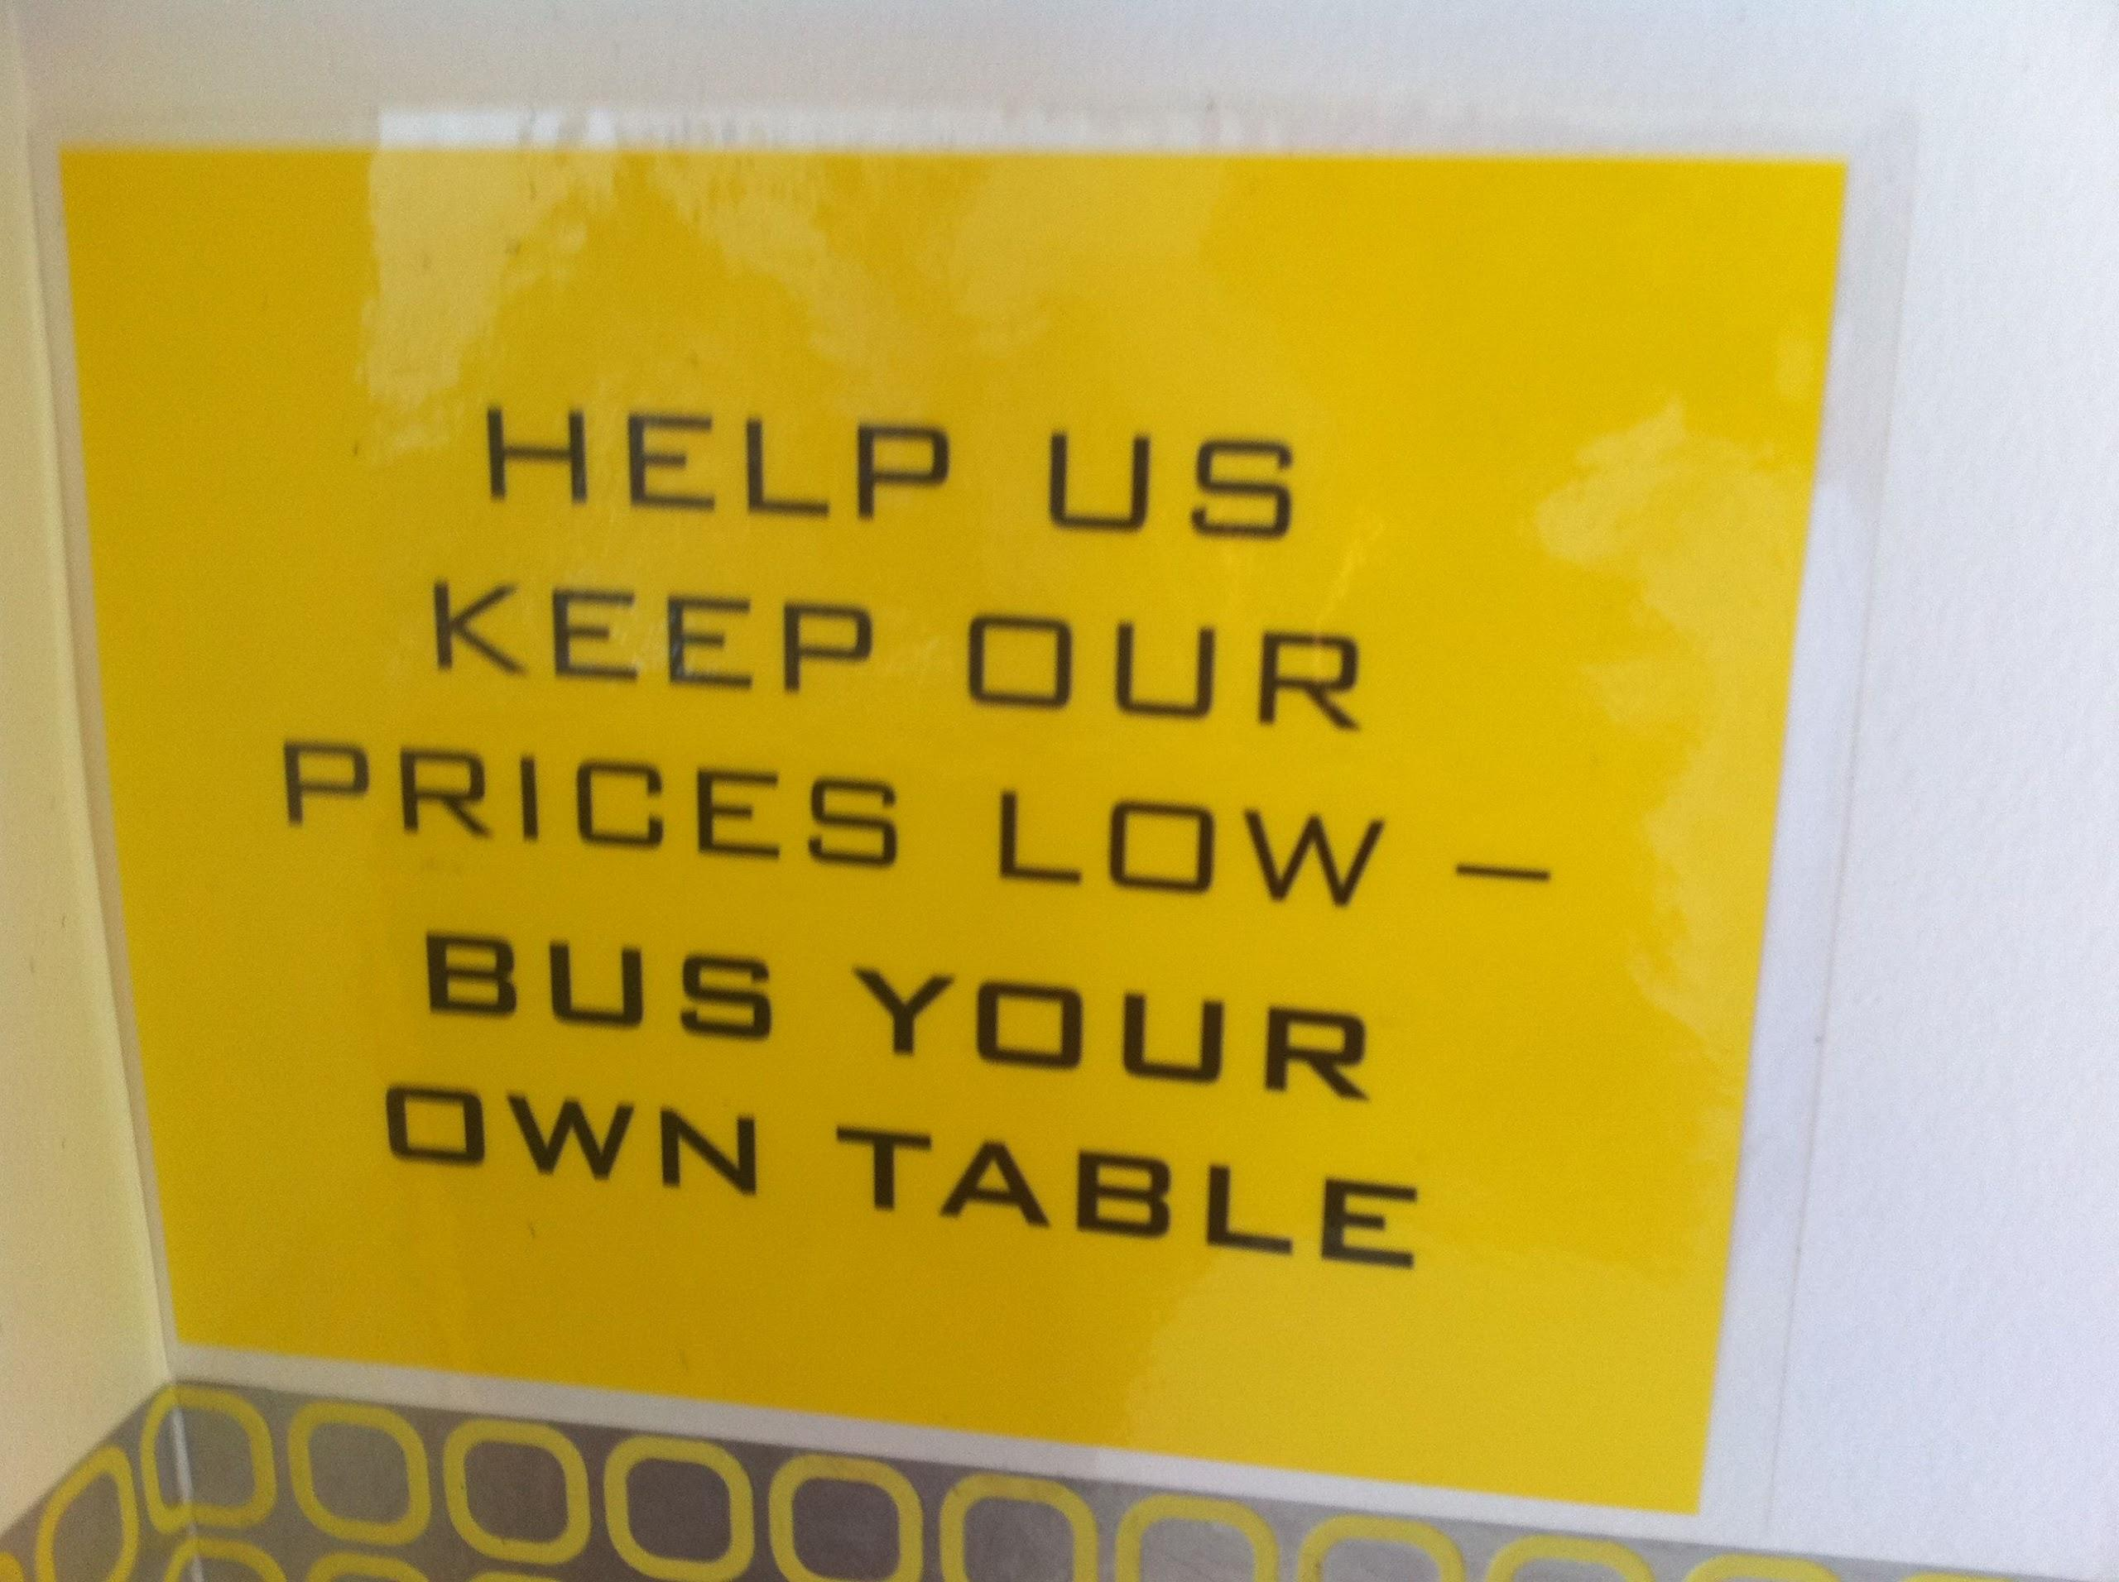
Development of pricing objectives
Pricing objectives -- goals that describe what your firm wants to achieve through pricing

Slide 34

Pricing objectives
Survival
Profit
Return on Investment (ROI)
Market Share
Cash Flow
Status Quo
Product Quality

Slide 35

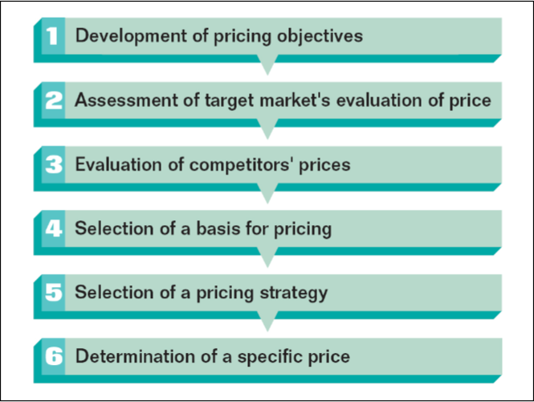
Stages For Establishing Prices
Copyright © Houghton Mifflin Company. All rights reserved.

Slide 36
Stages for establishing prices

Slide 37
Pricing strategies
Differential Pricing – different prices to different buyers for the same product
New-Product Pricing
Product-Line Pricing – establishing prices of multiple products within a product line
Psychological Pricing – influence customer perception to make a product’s price attractive
Professional Pricing – fees set by professional standards in your particular field
Promotional Pricing

Slide 38
Distribution
You need to consider:
geographic coverage
  how far do you want to go? local, regional, national, global...
  you can target specific markets, such as cities >100,000 population
channels of distribution
  direct, wholesale, retail...
logistics
  transportation costs, tax laws, personnel...

Slide 39

That's all, folks!
Now, onto the Q&A

