Slide 1
Customer-Driven Marketing Strategy: Creating Value for Target Customers

Slide 2
Market Segmentation
Market Targeting
Differentiation and Positioning

Slide 3
Market Segmentation
Dividing a market into smaller groups with distinct needs, characteristics, or behavior that might require separate marketing strategies or mixes

Slide 4
Market Targeting
The process of evaluating each market segment’s attractiveness and selecting one or more segments to enter.

Slide 5
Differentiation
Actually differentiating the market offering to create superior customer value.

Slide 6
Positioning
Arranging for a market offering to occupy a clear, distinctive, and desirable place relative to competing products in the minds of target consumers.

Slide 7
Designing a Customer-Driven Marketing Strategy
Select customers to serve
Decide on a value proposition
Segmentation
Divide the total market into smaller segments.
Differentiation
Differentiate the market offering to create superior customer value.
Create value for targeted customers
Targeting
Select the segment or segments to enter.
Positioning
Position the market offering in minds of target customers.

Slide 8
Market segmentation

Slide 9
Market Segmentation
Geographic segmentation
Dividing a market into different geographical units such as nations, provinces, regions, parishes, cities, or neighborhoods.
Examples
World region or country: Western Europe, Middle East, Pacific Rim, China, India, Canada, Mexico, North America
Country region: East Asia, South Asia, North Asia
Density: Urban, suburban, exurban, rural

Slide 10
Market Segmentation
Demographic segmentation
Dividing the market into groups based on variables such as age, gender, family size, family life cycle, income, occupation, education, religion, race, generation, and nationality.
Examples
Age: Under 6, 6-11, 12-19, 20-34, 35-49, 50-64, 65+
Gender: Male, female
Family life cycle: Young, single; married, no children; married with children; single parents, unmarried couples; older, married, no children under 18; older, single; other
Income: Under $20,000; $20,000-$30,000; $30,000-$50,000; $50,000-$100,000; $100,000-$250,000; $250,000 and over

Slide 11
Gender segmentation
http://www.daisyrock.com/
Daisy Rock offers a complete line of smaller, lighter, professional-quality guitars with fun shapes and glossy finishes geared toward women.

Slide 12
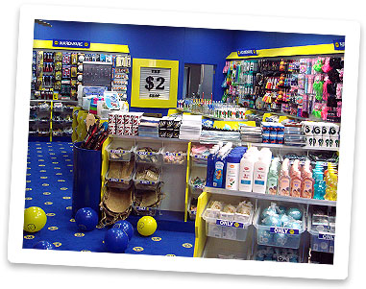
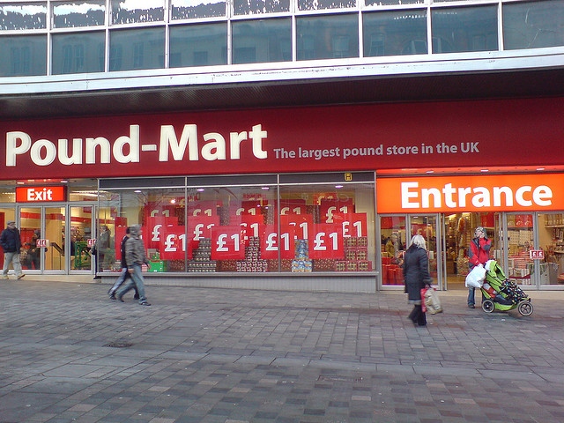
Income segmentation
Many retailers-such as pound and dollar stores-successfully target low- and middle-income groups. The core market for such stores is families with incomes under $30,000.

Slide 13
Market Segmentation
Psychographic segmentation
Dividing a market into different groups based on social class, lifestyle, or personality characteristics.
Examples
Social class: Lower lowers, upper lowers, working class, middle class, upper middles, lower uppers, upper uppers
Lifestyle: Achievers, strivers, survivors
Personality: Compulsive, gregarious, authoritarian, ambitious

Slide 14
Lifestyle segmentation
Surfing lifestyle: Roxy, Quicksilver

Slide 15
Market Segmentation
Behavioral segmentation
Dividing a market into groups based on consumer knowledge, attitudes, uses, or responses to a product.
Examples
Occasions: Regular occasion; special occasion; holidays; seasonal
Benefits: Quality, service, economy, convenience, speed
User status: Nonuser, ex-user, potential user, first-time user, regular user
User rates: Light user, medium user, heavy user

Slide 16
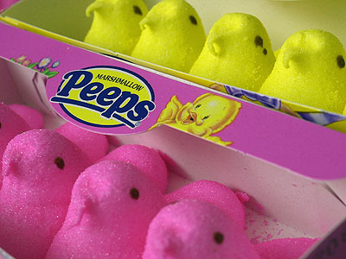
Occasion segmentation
http://www.marshmallowpeeps.com/
Peeps creates different shaped marshmallow treats for special holidays when it captures most of its sales but advertises that Peeps are “Always in Season” to increase the demand for non-holiday occasions.

Slide 17
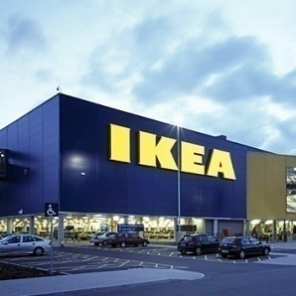
Segmentation International Markets
Intermarket segmentation
Forming segments of consumers who have similar needs and buying behavior even though they are located in different countries.
Coca-Cola: World’s teen
IKEA: global middle class
Lexus: global elite

Slide 18
Can we use multiple segmentation bases?

Slide 19
Can we use multiple segmentation bases?
Yes.
It can help companies to identify and better understand key customer segments, target them more efficiently, and tailor market offerings and messages to their specific needs.

Slide 20
Requirements for Effective Segmentation
Measurable: not too hard to identify and measure
Accessible: effectively reached and served
Substantial: large or profitable enough to serve
Differentiable: worthy to separate segments
Actionable: possible to develop separate marketing programs

Slide 21
Market Targeting

Slide 22
Market Targeting
Target market = A set of buyers sharing common needs or characteristics that the company decides to serve.

Slide 23
Market Targeting
Evaluating Market Segment
Three factors:
Segment size and growth
Segment structural attractiveness: competitors, substitute products, power of buyers, powerful suppliers
Company objectives and resources

Slide 24
Market Targeting
Selecting Target Market Segments
Company must decide which and how many segments it will target.
Target selection strategies:
Undifferentiated(mass) marketing
Differentiated(segmented) marketing
Concentrated(niche) marketing
Micromarketing

Slide 25
Target Selection Strategies
Undifferentiated(mass) Marketing
A market-coverage strategy in which a firm decides to ignore market segment differences and go after the whole market with one offer.
Focuses on what is common in the needs of consumers rather than on what is different.

Slide 26
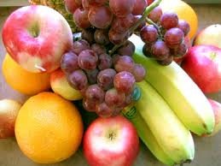
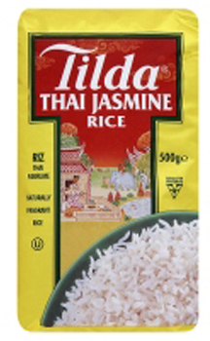
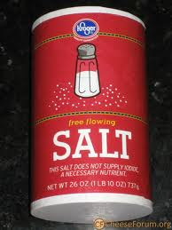

Slide 27
Target Selection Strategies
Differentiated(segmented) Marketing
A market-coverage strategy in which a firm decides to target several market segments and designs separate offers for each.

Slide 28
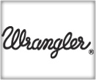
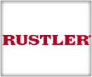
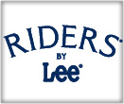
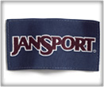
Differentiated(segmented) Marketing
VF Corporation

Slide 29
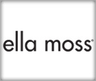
Differentiated(segmented) Marketing
Five major segments:
Jeanswear
Imagewear (workwear)
Outdoor
Sportwear
Contempolary Brands

Slide 30
offers top-of-the-line gear and apparel for diehard outdoor enthusiasts, especially those who prefer cold weather activities
creates footwear, apparel and accessories for skate, surf and snowboarders the world over

Slide 31
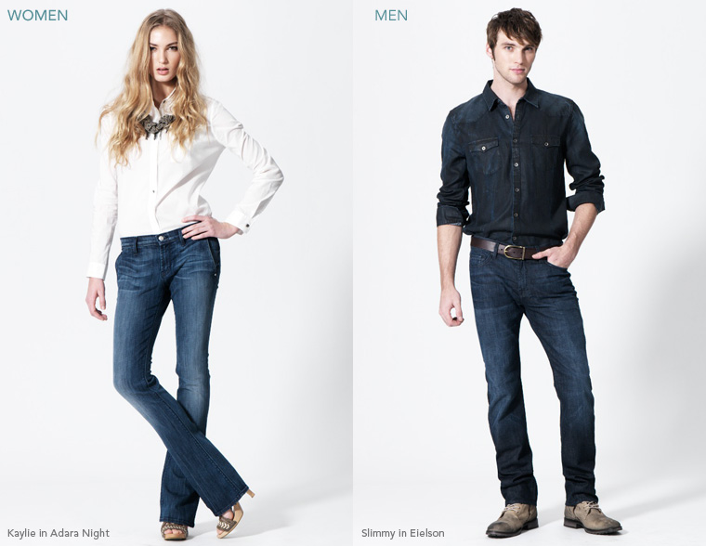
supplies premium denim and accessories sold in boutiques and high-end department stores

Slide 32
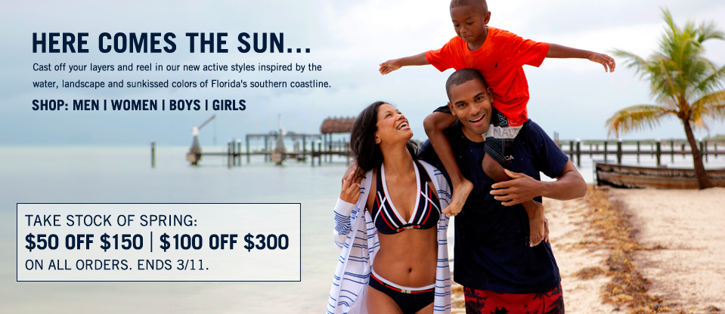
focuses on people who enjoy high-end casual apparel inspired by sailing and the sea.
Nautica products offer refined, casual classics that are always crisp, clean and distinct.

Slide 33
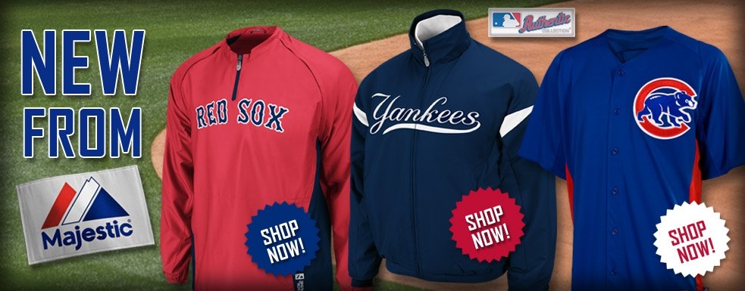
produce the highest-quality athletic wear and do it for every Major League Baseball club, the National Basketball Association, most major colleges and universities, and sports fans everywhere

Slide 34
Target Selection Strategies
Concentrated(niche) Marketing
A market-coverage strategy in which a firm goes after a large share of one or few segments or niches.
Through concentrated marketing, firms achieves a strong market position because of its greater knowledge of consumer needs in the niche it serves and special reputation it acquires.

Slide 35
Target Selection Strategies
Concentrated(niche) Marketing
Niching lets smaller companies focus their limited resources on serving niches that may be unimportant to or overlooked by larger competitors.

Slide 36
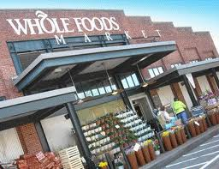
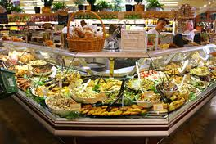
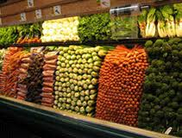
Whole Foods Market offers organic, natural, and gourmet foods where Wal-Marts can’t serve well.

Slide 37
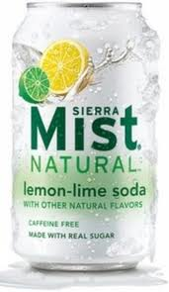
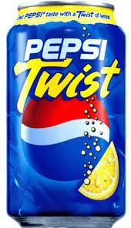
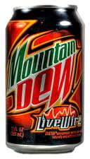
In contrast, some megamarketers develop niche markets to create sales growth.
Pepsi has introduced several niche products, Sierra Mist quickly blossomed and now is the number-two lemon-lime soft drink behind Sprite, and Code Red and Livewire have revitalized the Mountain Dew brand.

Slide 38
Small businesses are realizing riches from serving small niches on the Web.
Web niching is paying off handsomely for Zappos, which began selling shoes online—only shoes and only online, and its CEO/Founder Tony Hsieh

Slide 39
Target Selection Strategies
Micromarketing
The practice of tailoring products and marketing programs to the needs and wants of specific individuals and local customer groups-includes local marketing and individual marketing.

Slide 40
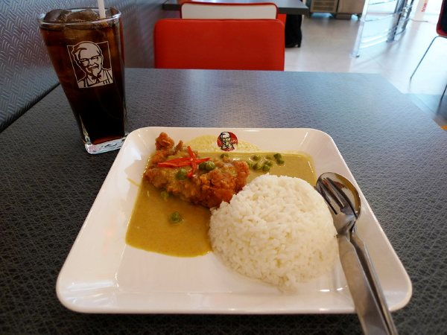
Micromarketing
Local Marketing
Tailoring brands and promotions to the needs and wants of local customer groups--cities, neighborhoods, and even specific stores.

Slide 41
Micromarketing
Individual Marketing
Tailoring products and marketing programs to the needs and preferences of individual customers-also labeled “one-to-one marketing,” “customized marketing,” and “markets-of-one marketing.”

Slide 42
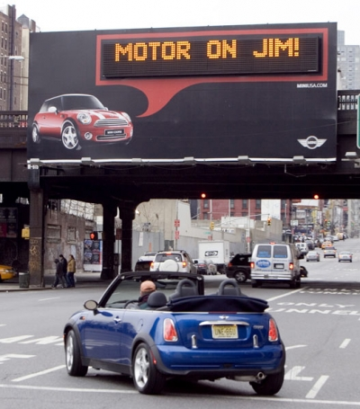
MINI uses personalized billboard messages to greet MINI drivers in selected cities. As the new MINI owners passes by, the personalized key fob contacts the billboard database, which then transmits a message automatically.

Slide 43
Marketing Targeting Strategies
Undifferentiated (mass) marketing
Differentiated (segmented) marketing
Concentrated (niche) marketing
Micro(local or individual) marketing
Targeting broadly
Targeting narrowly
* Factors company should consider when choosing a market-targeting strategy:
Company resources
Product availability
Product life-cycle stage
Market variability
Competitors’ marketing strategies

