Slide 1

Green marketing: is new paradigm of marketing
Institute of Sectoral Management
Anastasia Petukhova
Moscow, 2015

Slide 2


Contents
Basics of green marketing
  Definitions
  Green consumer
  Eco-labeling
  Eco-innovation
  Greenwashing
Case study
Conclusion

Slide 3

Green is mainstream

Slide 4
Green marketing pie
Personality
Sociality
Publicity

Slide 5
Models of Green Consumers
U.S.
U.K.

Slide 6
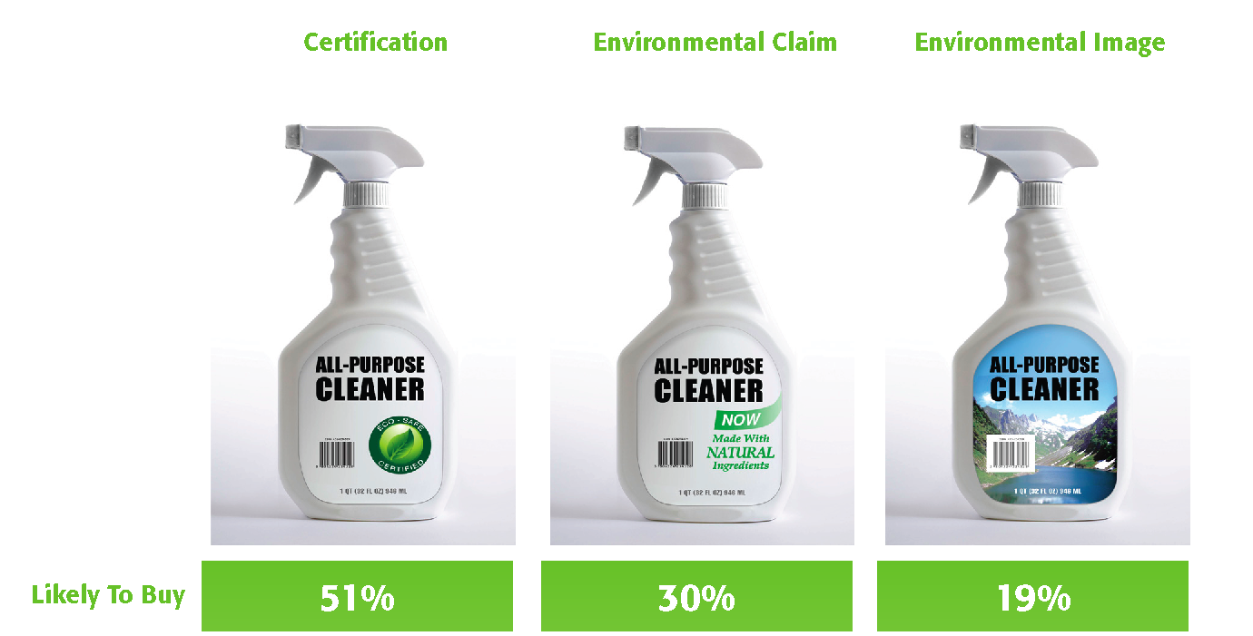
Consumer purchasing behavior

Slide 7












Eco-labeling
Northern Europe
1989
Germany
1972
Canada
1988
U.S.
1989
Japan
1990
Australia
1991
Brazil
1992
Korea
1992
Israel
1993
China
1993
Russia
2001
Kenya
2009

Slide 8


Sustainable product innovation
Sustainable technology development
Environmental improvement factor
Eco-innovation
Product eco-redesign

Slide 9

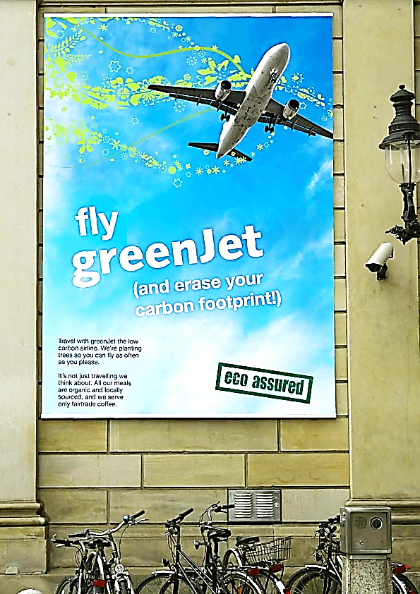

Greenwashing

Slide 10

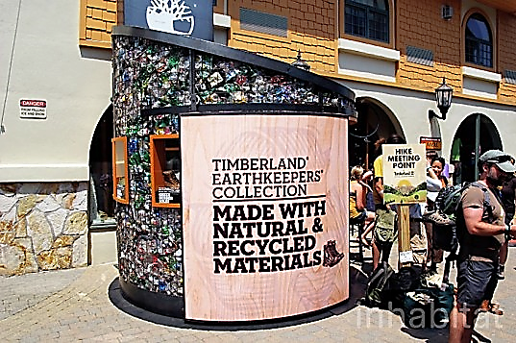
The Timberland Company
Enjoying the outdoors to the fullest, and leaving it the way you found it.

Slide 11

Conclusion

Slide 12

Thank you for attention!

