Slide 1
E-Government
E-Government Development Index
Alhaji Salieu Kanu Mansaray

Slide 2
GOVERNANCE
Taa Kuru orthankas su maseebo man Govment!
May the Almighty protect us from the vengeance of government

Slide 3
E-Government
What is it?
Efficient Government
Electronic Government
Everybody Government
Everything Government
Effective Government
Effortless Government
Notes:
E-Government is the use of electronic technologies by government to deliver services and interact with its citizens. The United Nations has since 2003 published a bi-annual report on the adoption of E-Government by its 193 member states. The EGDI is based on a comprehensive survey which assesses the national websites of all member states as well as their e-government policies and strategies. The assessment rates the e-government performance of countries relative to one another.

Slide 4
E-Government
What is it?
Electronic Government
Notes:
E-Government is the use of electronic technologies by government to deliver services and interact with its citizens. The United Nations has since 2003 published a bi-annual report on the adoption of E-Government by its 193 member states. The EGDI is based on a comprehensive survey which assesses the national websites of all member states as well as their e-government policies and strategies. The assessment rates the e-government performance of countries relative to one another.

Slide 5
E-Government
Efficient Government
Electronic Government
Everybody Government
Everything Government
Effective Government
Effortless Government
All of The Above!
Notes:
E-Government is the use of electronic technologies by government to deliver services and interact with its citizens. The United Nations has since 2003 published a bi-annual report on the adoption of E-Government by its 193 member states. The EGDI is based on a comprehensive survey which assesses the national websites of all member states as well as their e-government policies and strategies. The assessment rates the e-government performance of countries relative to one another.

Slide 6
E-Government
E-Government is the use of electronic technologies by government to deliver services and interact with its citizens.

Slide 7
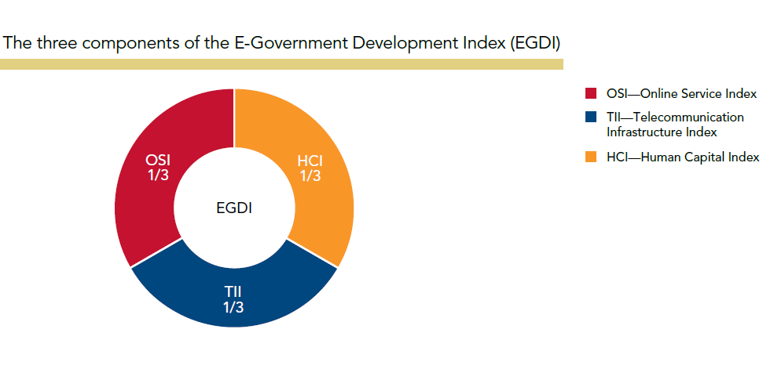
E-Government Development Index (EGDI)
How is it measured?

Slide 8
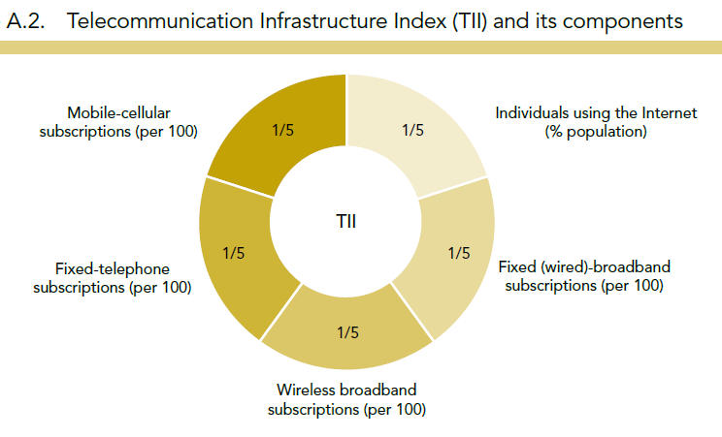
E-Government Development Index (EGDI) How is it measured?

Slide 9
E-Government Development Index (EGDI) How is it measured?

Slide 10
E-Government Development Index (EGDI)
Online Services Index
How is it measured?
National website
The National portal
e-Services portal
e-Participation portal

Slide 11
E-Government Development Index (EGDI)
How is it measured?
Key Public Services Ministries
Ministry of Education,
Ministry of Labour
Ministry of Social Services
Ministry of Health
Ministry of Finance
Ministry of Environment (Ministry of Lands, Country Planning and the environment)

Slide 12
EGDI – Top Countries
Notes:
bottom 8 of the ranking for the 2nd time in four years;
dropping 25 places since 2004 and 19 places since 2005.
While West Africa, Africa and global average indices have been increasing year on year,
Sierra Leone’s EGDI has been on a ten year decline from an index of 0.1720 in 2004 to 0.1329 in 2014.

Slide 13
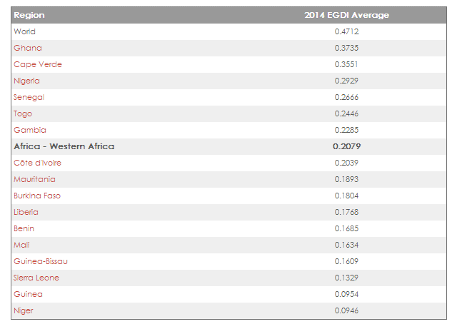
Sierra Leone on the EGDI West Africa

Slide 14
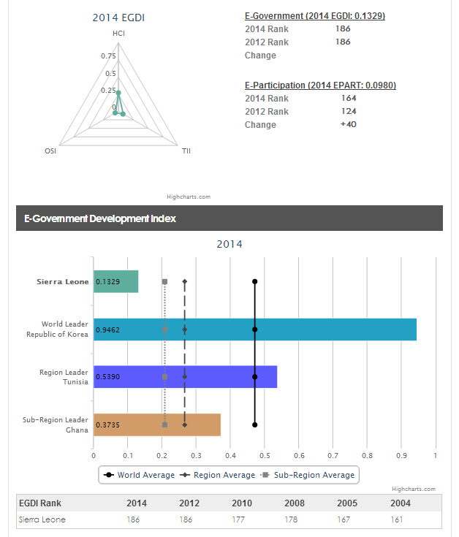
Sierra Leone on the EGDI

Slide 15
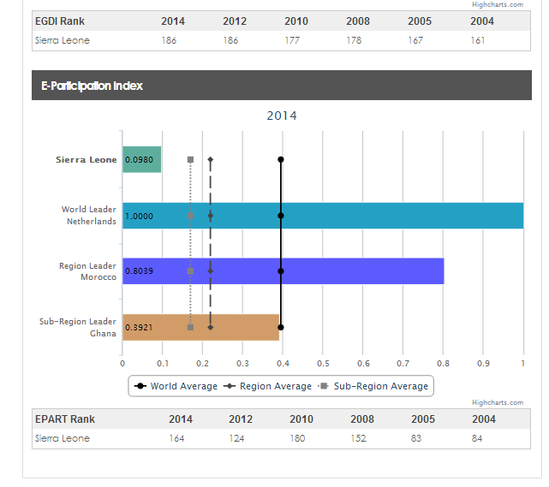
Sierra Leone’s E-Participation Ranking

Slide 16
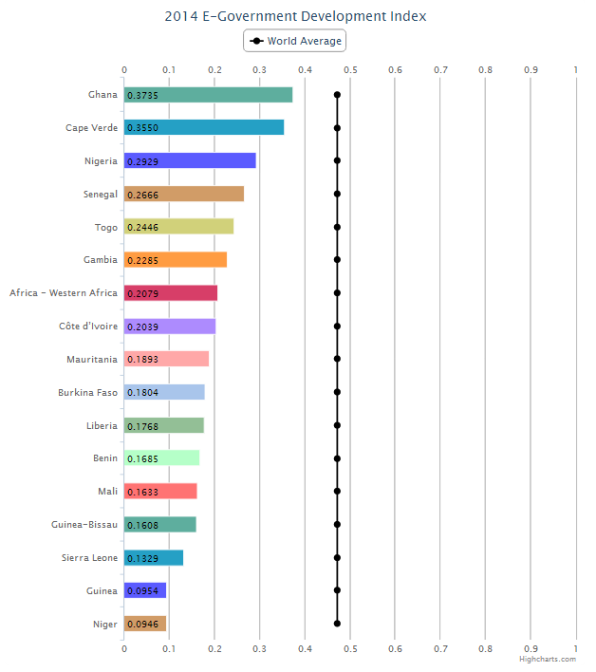
Sierra Leone on the EGDI

Slide 17
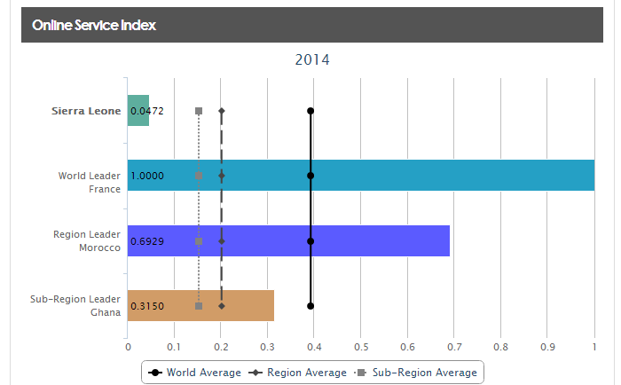
Sierra Leone on the EGDI

Slide 18
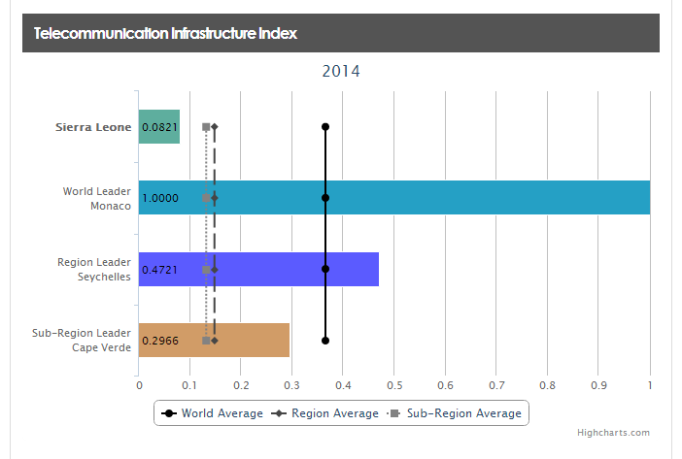
Sierra Leone on the EGDI

Slide 19
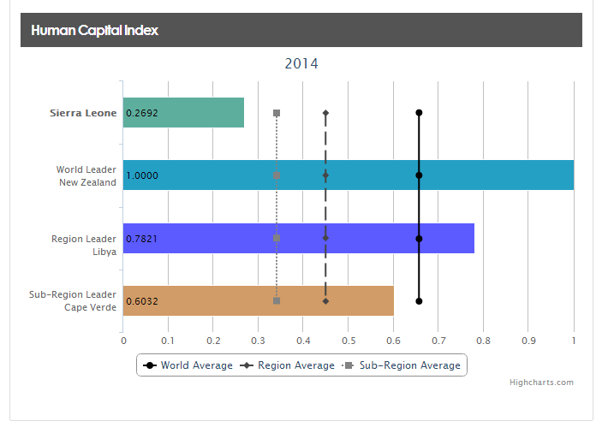
Sierra Leone on the EGDI

Slide 20
E-Government Development Index (EGDI)
Our rankings are wrong!
Government Efforts
Human Capital Index
12% of GOSL on Education
Telecommunications Infrastructure
Submarine Fibre Optic Cable
96% drop in price!
National Fibre Optic Cable
Online Service Index ???

Slide 21
E-Government Development Index (EGDI) Telecommunication Infrastructure Index– A Peer Review

Slide 22
E-Government Development Index (EGDI) Telecommunication Infrastructure Index– A Peer Review

Slide 23
E-Government Development Index (EGDI) Telecommunication Infrastructure Index– A Peer Review

Slide 24
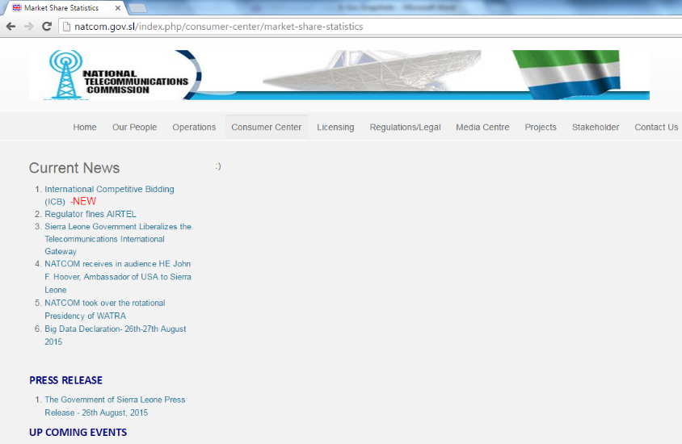
E-Government Development Index (EGDI) Telecommunication Infrastructure Index– A Peer Review

Slide 25
E-Government Development Index (EGDI)
E-Government Development Index and other Benchmarking Indices
World Bank Doing Business Index
Research Findings
A very high correlation coefficient between the EDGI and the Doing Business indices

Slide 26
E-Government Development Index (EGDI)
Reasons for our Low Ranking
Inefficient Data Collection and Reporting
Unavailability of an E-Government Strategy
Lazy Management of online assets
ICT Phobia
Lack of awareness of ranking implications

Slide 27
E-Government Development Index (EGDI)
Solutions
E-Government Unit
E-Government Strategy
E-Government Act
Whole Of Government Involvement
Restart Now!

Slide 28
Significant E-gov Development Partners
UNDP
World Bank
DFID
ISAID
KOICA

Slide 29
Mamo Nou!
Thank You

