Slide 1
E-Government
Lecturer’s Name : Dr Norazila Bt. Mat
Group 12 :
M.Aswin Hendrayadi A138745
Marwan Pribadi A138749
Mohamad Azri Azhar A136687
Wong Wai Kit A137052
Abu Na’im Roslim A135785

Slide 2
Definitions of E-Government
The use of digital technologies to transform government operations in order to improve effectiveness, efficiency, and service delivery.
'Electronic Government' (or in short 'e-Government') essentially refers to ‘The utilization of Information Technology (IT), Information and Communication Technologies (ICTs), and other web-based telecommunication technologies to improve and/or enhance on the efficiency and effectiveness of service delivery in the public sector.’ (Jeong, 2007)

Slide 3
Objectives of E- Government
Strategic Objective
Support and simplify governance for both citizens and government and also for businesses.
Internal Objective
Facilitate a speedy, transparent, accountable, efficient and effective process for performing government administration activities. Significant cost savings (per transaction) in government operations could be the result.
External Objective
Fulfill the public as needs and expectations satisfactory on the front-office side, by simplifying the interaction with various online services.

Slide 4
Role of E-Government in a Country
Pushing information over the Internet. Example : regulatory services, general holidays, public hearing schedules, issue briefs, notifications, etc.
Two-way communications between the agency and the citizen, a business, or another government agency. In this model, users can engage in dialogue with agencies and post problems, comments, or requests to the agency.

Slide 5
Role of E-Government in a Country
Conducting transactions. Examples: lodging tax returns, applying for services and grants.
Governance. Examples: To enable the citizen transition from passive information access to active citizen participation by:
Informing the citizen
Representing the citizen
Encouraging the citizen to vote
Consulting the citizen
Involving the citizen

Slide 6
Effects of E- Government on Public Administration
The ultimate goal of the E-Government is to be able to offer an increased portfolio of public services to citizens in an efficient and cost effective manner.
E-government allows for government transparency.
Government transparency is important because it allows the public to be informed about what the government is working on as well as the policies they are trying to implement.

Slide 7
Effects of E- Government on Public Administration
Advantages :
Speed, efficiency, and convenience
Allows citizens to interact with computers to achieve objectives at any time and any location, and eliminates the necessity for physical travel to government agents sitting behind desks and windows.

Slide 8
Effects of E- Government on Public Administration
Online access to public services
E-government helps simplify processes and makes access to government information more easily accessible for public sector agencies and citizens.
Democratization
Greater citizen participation. people from all over the country can interact with politicians or public servants and make their voices heard.

Slide 9
Effects of E- Government on Public Administration
To increase internal efficiency in public administration.
To create new services.
Information sharing among Institution.
High Performance in teamwork.
Environmental governance.

Slide 10
Effects of E- Government on Public Administration
The main disadvantages concerning e-government is the lack of equality in public access to the internet, reliability of information on the web, and hidden agendas of government groups that could influence and bias public opinions.

Slide 11
Effects of E- Government on Public Administration
Disadvantages
Difficult access for disabilities
An e-government site that provides web access and support often does not offer the "potential to reach many users including those who live in remote areas, are homebound, have low literacy levels, exist on poverty line incomes

Slide 12
Effects of E- Government on Public Administration
False sense of transparency and accountability
Online governmental transparency is dubious because it is maintained by the governments themselves. Information can be added or removed from the public eye.

Slide 13
Effects of E- Government on Public Administration
Cases of confidentiallity, copyrights and protection of public information
Potentially lead to a lack of privacy for civilians as their government obtains more and more information on them.

Slide 14
Effects of E- Government on Public Administration
Overloaded information
Gaps result from unequal availability opportunities
Costly

Slide 15
E-Government in Malaysia
As one of the strategies to achieve Vision 2020, Multimedia Super Corridor (MSC) has been introduced to accelerate Malaysia’s entry into Information Age.
Electronic Government (e-Government) was initiated in Malaysia on 24 February 2004.
The Vision of e-Government is to transform administrative process and service delivery through the use of IT and multimedia.

Slide 16
E-Government in Malaysia
The myGovernment Portal (www.gov.my) could be described as one-stop source of Malaysian government information and services for the citizens.
The digital government plays an important role to provide public service a fast, easy and with integrity information at a click.

Slide 17
E-Government in Malaysia
The Malaysian Administrative Modernization and Management Planning Unit (MAMPU) is promoting the use of e-Government among the public.
Among the online services provided under the website include :
Zakat
Loan and quit rent payments

Slide 18
Current E- Government Projects
E-Services
Project Monitoring System (SPP II)
Generic Office Environment
E-Procurement
E-Syariah
Electronic Labour Exchange
E-Land
E-Courts
Human Resource Management

Slide 19
E-Government in Malaysia
“E-Government is well advanced and has become an integral component of a much broader service delivery agenda in Malaysia”

Slide 20
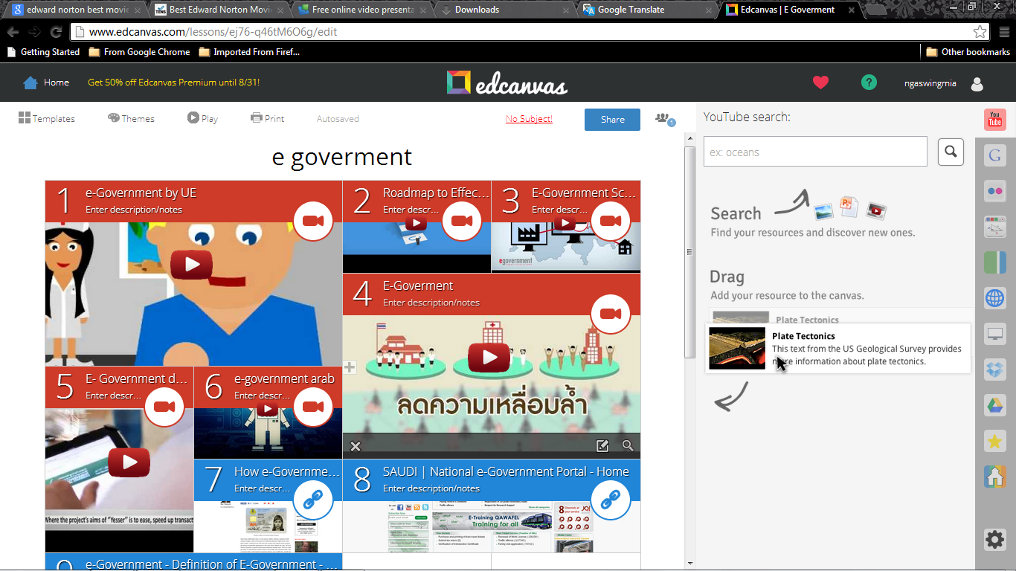
Thank you very much
You can also looking the relate topic in our ‘edcanvas’

