Slide 1

Georgia’s Successful Journey to e-Government
E-government Development in Georgia
Irakli Gvenetadze
LEPL Data Exchange Agency
Ministry of Justice of Georgia

Slide 2
UN E-Government
Survey 2014
GEORGIA | Rank 2014 | Rank 2012 | Rank 2010 | Rank 2008
E-Government | 56 | 72 | 100 | 100
E-Participation | 66 | 73 | 132 | 143/

Slide 3
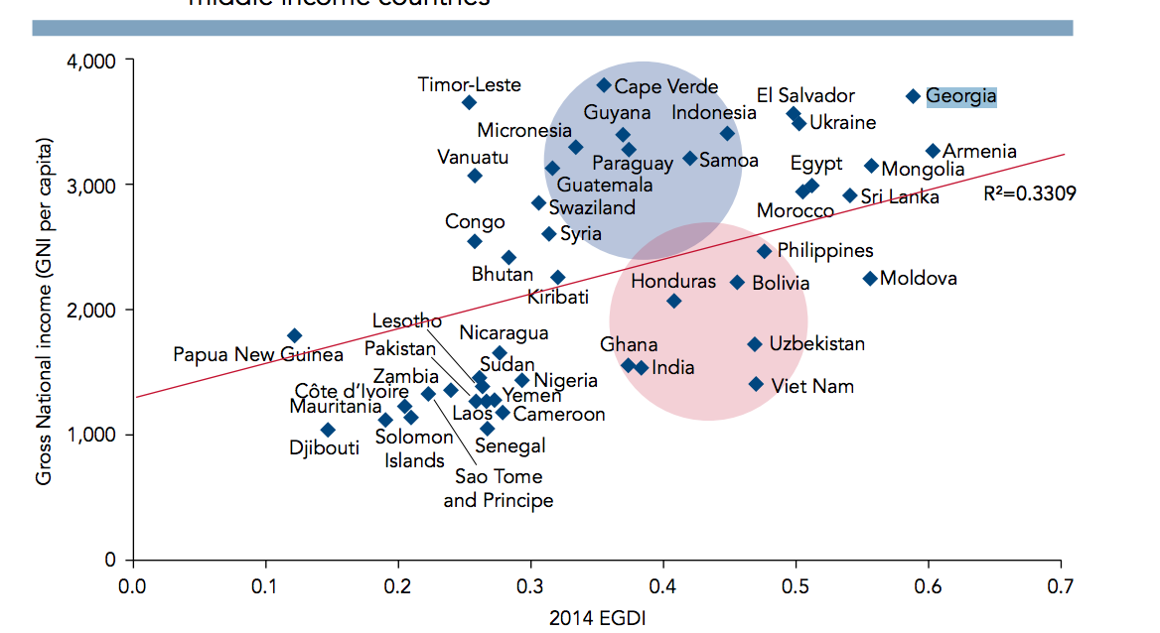
Relation between EGDI and National income (GNI per capita), lover-middle income countries

Slide 4
IT Crucial to Deliver Reform Benefits
In Georgia, reforms were taking place actively since 2004. Main attention was paid to business process optimization and transparency in organization processes.
Reform
Efficiency
Time
Cost
Transparency
Accountability
Availability
INFORMATION TECHNOLOGIES

Slide 5
Implemented Projects
Property registration, e-abstracts,
Business Registry
Civil Registry
e-ID and e-signature
Biometrical Passport
e-filing system in the Ministry of Finance of Georgia- 90 % of taxpayers are actively using this system;
Automation of tax and customs systems (the process is ongoing as reforms taking place in this direction require changes in business processes);
Case management system of tax dispute resolution;
Central data storage and reporting system;
Electronic Treasury project. e-treasury
Cash register management automation project-planned for next year;
Electronic system for writing out VAT invoices;
Automation of the Ministry of Internal Affairs;
Case management program for Ombudsman;
Computerization of schools. Schools are equipped with computers and by the end of the this year all schools (2300) will be connected to internet;
Netbooks for all first graders
Student Information System-ongoing;
National school exam on-line
Automated case management system for court system; project is in decisive phase and system is being introduced in offices
Centralized criminal case management is being introduced;
e-Procurement;
e-Auction of state property;
e-Auction of real estate of Tbilisi City Hall;
Automation project of Enforcement Bureau
e-notary project;
Electronic directory system for state newspaper and legislative base – Official Gazette;
Automation project of Social Subsidies Agency
Real Time Gross Settlement System of National Bank
Investment Management System of National Bank
Core Banking System of National Bank
Chancellery automation project is being implemented in all large ministries.
Criminal case management system

Slide 6


Where Georgia Started from
Business Registry - 2006
Create information systems
Digitalize internal information resources
Automate information flows
Create data centers
Establish connection between agencies and regional offices

Slide 7
Recurring Problems
Limited budget
Shortage of qualified personnel
Infrastructure expensive
Data incompatibility
No standards
No security

Slide 8
GGN –
Georgian Governmental Network
Design and tender procurement - 2006
Contract signed Sept. 1, 2007
100 governmental offices connected by the end of 2007
More than 500 governmental offices connected in 2008
Since 2009, more than 1,000 governmental connections including schools
Government connected throughout Georgia with no investment, only paid 25% of commercial prices for internet and telephone.

Slide 9
DEA –
Data Exchange Agency
Due to the abovementioned problems, the need for establishment of an entity with relevant authority became inevitable, which would support the following activities:
Development and coordination of E-Governance
Development of legal and regulative framework
Ensure information and cyber security
Establishment of the integrated data exchange system and ensure access to information resources
Parliament of Georgia adopted a law on the establishment of “Legal entity of public law under the Ministry of Justice of Georgia - Data Exchange Agency” on the basis of which since 1 January 2010, Data Exchange Agency (DEA) started its activities.

Slide 10
“ARCHITECTURE”
OF E-GOVERNANCE SERVICES

Slide 11
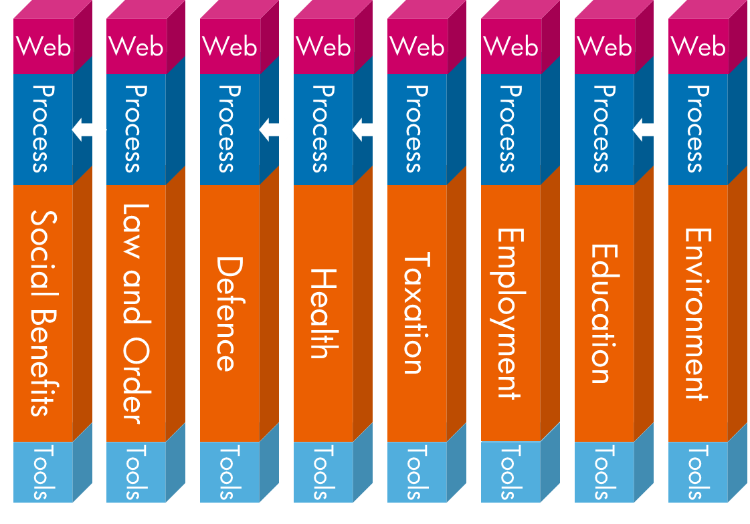
Organization Centric

Slide 12
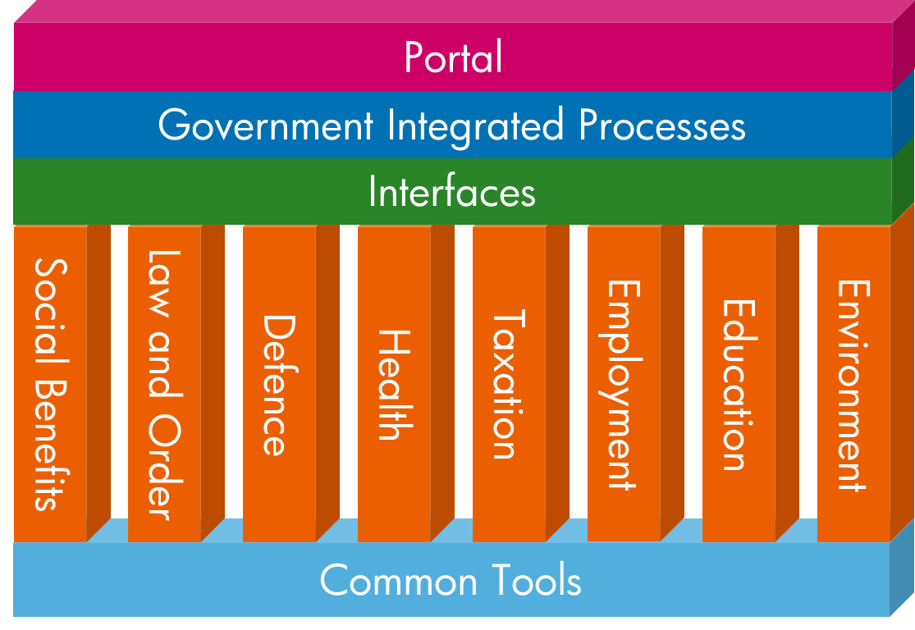
Citizen centric

Slide 13

Data Exchange Infrastructure
Data Exchange Agency
Ministry of Justice
Ministry of Health
Ministry of Internal Affairs
Citizen
Ministry of Finance
Ministry of Education
Business
Bank
Other ministries
Response
Request
Request
Response

Slide 14
G3 – Georgian Governmental Gateway

Slide 15
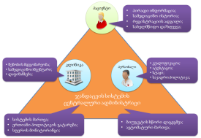
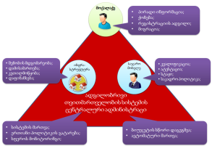
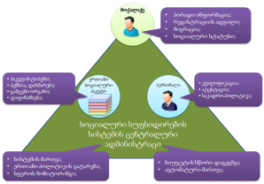
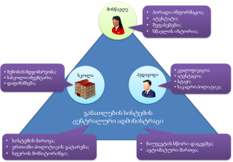
Connected Government
Receive Information in Real Time
Proper Planning of State Budget
Effectively Distribute Resources
Health Care and Social Security
Monitor Results
Municipalities
Agriculture
Data Exchange Agency
Georgian Government Gateway
Education
Redundancies Eliminated

Slide 16

Citizen’s centric System
Unified Automated Statistical Data
Automated Data Processing
State E-Governance System
Medical Service
Education
Migration, Registration
Property
Demographic and other Personal Data
Economic Activities
CITIZEN
Social Condition
State Development Planning, Forecast
Effective Public Policy

Slide 17
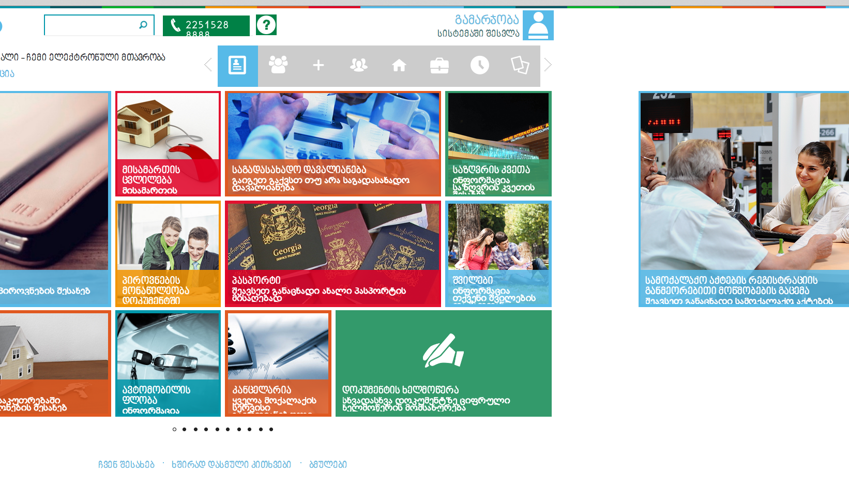
my.gov.ge – Citizen’s Portal

Slide 18
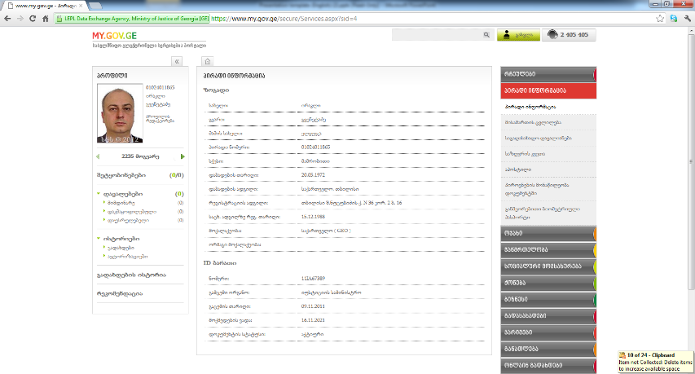
Citizen’s personal page

Slide 19
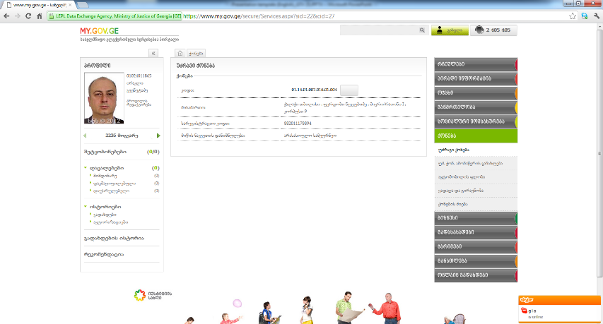
Property

Slide 20
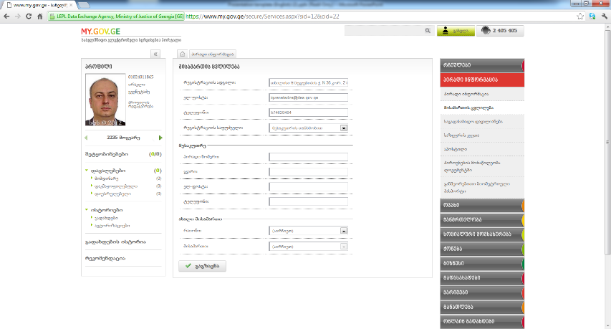
Citizen’s Address of Registration

Slide 21
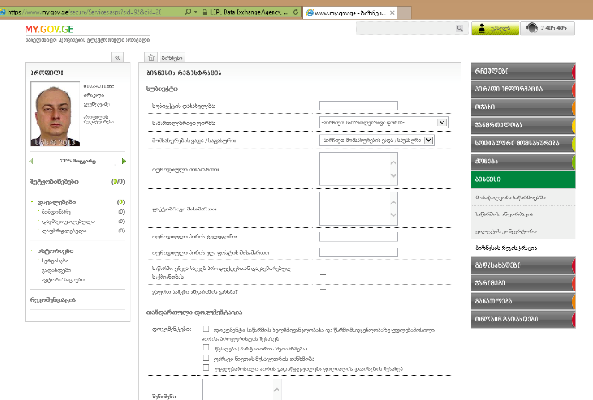
Online Business registration

Slide 22
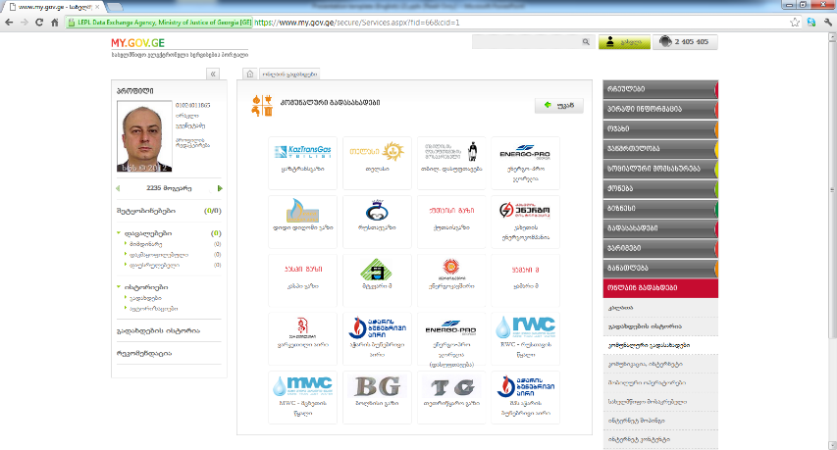
Utility Payments

Slide 23
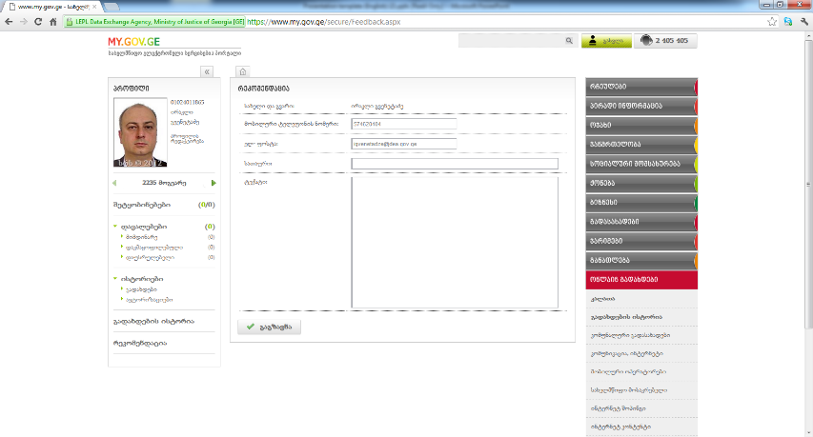
Recommendation to Improve Services

Slide 24
DEA
Joint document exchange system
Guaranteed electronic delivery system
Citizen’s portal
Trade facilitation System– TFS

Slide 25
Trade facilitation System – TFS
Trade Facilitation System
See Ports
Shipping Lines
Forwarder Companies
Tax & Custom
Terminals
Banks & Insurance Companies
Railway
Suppliers
International Traders

Slide 26
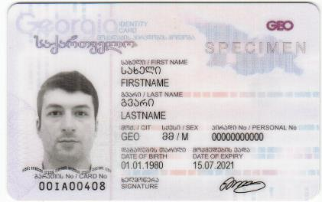
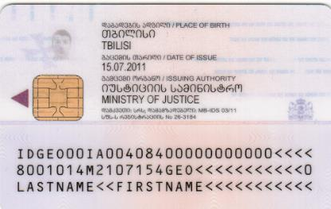
E-ID card

Slide 27

Public Service Hall - Tbilisi

Slide 28
E-Government Legislative Framework
e-Document and e-Signature law – 2007
Law on Creation of Data Exchange Agency –2010
Law on Unified Information Registry –2011
Law on Information Security – 2012
Law on Personal Data Protection – 2012

Slide 29
Law of Georgia On Unified State Registry of Information
Aim of the Law: establishment of a unified state registry of registers, databases, services and information systems within the public sector of Georgia
A supplementary act – Instruction on standards and procedures of working with the Registry of Registers, as well as manual on the use of web-portal
Categories of information to be submitted:
  Establishment of a registry or service (initial registration)
  Significant amendment of a registry or service
  Merger, division, revocation, deletion, transfer or archiving a registry or service
Data Exchange Agency as implementer

Slide 30
Information and Cyber Security
AVAILABILITY INTEGRITY CONFIDENTIALITY
Information Security
Education
CERT Georgia
Policy
Cyber Security
Network monitoring
Reaction to incidents
Accessibility test
Increase of
self-consciousness
Standards
Audit
Awareness

Slide 31

CYBER SECURITY STRATEGY OF GEORGIA
Basic Principles – Cyber Security Strategy
  Whole-of-Government Approach.
  Public-private Cooperation.
  Active International Cooperation.
Cyber Security Strategy – Main Domains
  Research and analysis
  New legislative framework
  Institutional coordination for ensuring cyber security
  Public awareness and education
  International cooperation

Slide 32
Information and Cyber Security Legislative Framework
Cyber Security Strategy of Georgia 2013 -2015
Cyber Crime chapter on Crime Code. Update 2010
Protecting Personal Information Law. 2012
Information Security Law. 2012
Minimal Requirements
Information Asset Management
Information Security Audit Body Accreditation
Information Security Audit Requirements
Information Security Officer Requirements
CERT.GOV.GE Regulation
Network Sensor Configuration
List of Critical Information Subjects

Slide 33
Information Security Activities
Projects
1. Support to Implement Information Security Since 2010
2. Review Info Sec Documents of Critical Infrastructure’s Since 2012
3. Localize ISO 27000 Series Standards Since 2011
ISO 27001,27002, ,27003,,27004, ,27005, ,27011(1,3)
4. Developing Other Standard and Guidelines Since 2012
Awareness
1. Media Campaign Since 2012
2. Annual GITI Regional Conference (Cyber Security Day) 2008-2012
Training Course
Information Security: Introduction, Implementation, Internal Audit Since 2012
Cyber Security: Introduction

Slide 34










Computer Emergency Response Team
CERT.GOV.GE
The Cyber security Executing Arm Of The UNITED NATIONS
SPECIALISED AGENCY of The International Telecommunication Union (ITU)
FIRST is an international confederation of trusted computer incident response teams who cooperatively handle computer security incidents and promote incident prevention programs.
The Trusted Introducer - a.k.a. TI - is the trusted backbone of the Security and Incident Response Team community in Europe
Partners:
CERT-EE

Slide 35

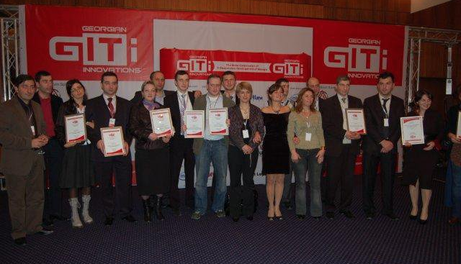
GITI – Georgian It Innovation Event

Slide 36
Thank you for your attention!
    LEPL Data Exchange Agency
    Ministry of Justice of Georgia
    www.dea.gov.ge; www.my.gov.ge; www.cert.gov.ge;

