Slide 1
E-government development in Russia: future perspectives and trends
Evgeny Styrin, Ph.D., Senior Research Analyst,
Andrey Zhulin, Director
Center for Government Activity Analysis,
Institute of Public and Municipal Administration,
State University Higher School of Economics
Moscow, Russia, June 28-29, 2011

Slide 2
The structure of presentation
Key milestones in Russian e-government development
Key elements in Russian E-government System
Future Challenges

Slide 3
Administrative reform (2004-2010)
Radical scenario (NPM initiative)
Result oriented budgeting
Client orientation
Services and functions
Division of execution and control functions
Quality approach
Government as a Learning organization
How to reach these goals with ICT?

Slide 4
Legal framework for E-Russia
Law “Additional guarantees on citizens information rights” – 1994
12 years discussion without Law on “Information rights of citizens”
Administrative reform – Government’s Order -2005 – administrative procedures (included information delivery issues)
Government’s Order “Federal information resources access provision” – 2003 (clear requirements)

Slide 5
Key milestones in Russian
E-government system development
Okinawa charter of global information society (2000)
Federal Program “E-Russia (2002-2010)” – 3 editions
Regional Informatization Conception and Action Plan (2006-2008)
Information Society Development Strategy (2008)
E-government System Project (2010) – Strategic guide for “Rostelecom” in e-government implementation
Federal Program Information Society (2011-2020)

Slide 6
Legal framework for “E-Russia”
“About Digital signature” – Federal Law – 2002, 2011(new edition)
“About Public Procurement” – Federal Law – 2005
“About Personal Data” – Federal Law – 2006
Prime Minister’s Order “About Bringing New Information Systems into Service” – 2009
“About Access to Public and Municipal Authorities Information” – Federal Law – 2009
“About Public and Municipal Services” – 2010
“E-government System Project” – 2010
“About National Payment System” – 2011

Slide 7
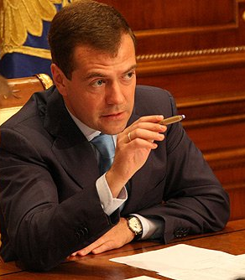




Federal Program
«Information Society 2011 – 2020»
«The priority: Strategic
IT development».
D. Medvedev
Russian Federation Federal Assembly Message. November 2009.
Information Society Development –
creating new opportunities in life of society, business and Government through ICT
Opportunities
New advantages and technologies
Current border of ICT potential
Integration
Interoperability
Computerization
New Quality of Life Обеспечение нового качества жизни:
Federal Program «Information Society» and 10 years of work,
All power branches and authorities governance levels (Federal, Regional, Municipal)
Active participation of business and society
Effectiveness
Notes:
7

Slide 8















Strategic Directions of Federal Program
Federal Program Directions
Quality of life and business environment improvement
E-State and Public Administration Efficiency increase
ICT-market development. Digital Economy
Bridging digital divide. Information Society Infrastructure creation
Security and Safety in Information Society
Digital Content development and National Heritage Preservation
E-democracy
National Software
M-Government
IT-Skills for Civil Servants
Ku--frequency
E-Commerce
Museums Online
E-Region
E-Services
Apps.gov
Broadband Internet Access
ERP.gov
Technological Transfer
FP «Information Society 2011-2020»
Notes:
8

Slide 9
Russia is focused on e-services
“Rostelecom” as a single e-government infrastructure operator
Concentrated on federal level governance
Federal One Stop Shop Portal – www.gosuslugi.ru - 150 interactive e-services on federal and regional level up to 2011 (including passport issue, tax declarations)
Develop ICT infrastructure and multichannel integration based on architectural approach
859 federal 7800 regional and 6732 municipal services are described in Public Services Register (back-office for one stop shop portal)
9

Slide 10
Focus on e-services - E-government in a narrow sense
5 stages of services provision officially approved – Federal Government Official Plan
  Information about the services (December 2009)
  E-forms (download) (December 2009)
  E-forms filling online – back office integration(2011)
  Follow the process of service provision online(2012-2013)
  Transactional e-services (2015)
Governance: each Ministry becomes responsible for certain number of services (74 most valuable services including passport exchange, tax declaration, license permit, etc)

Slide 11
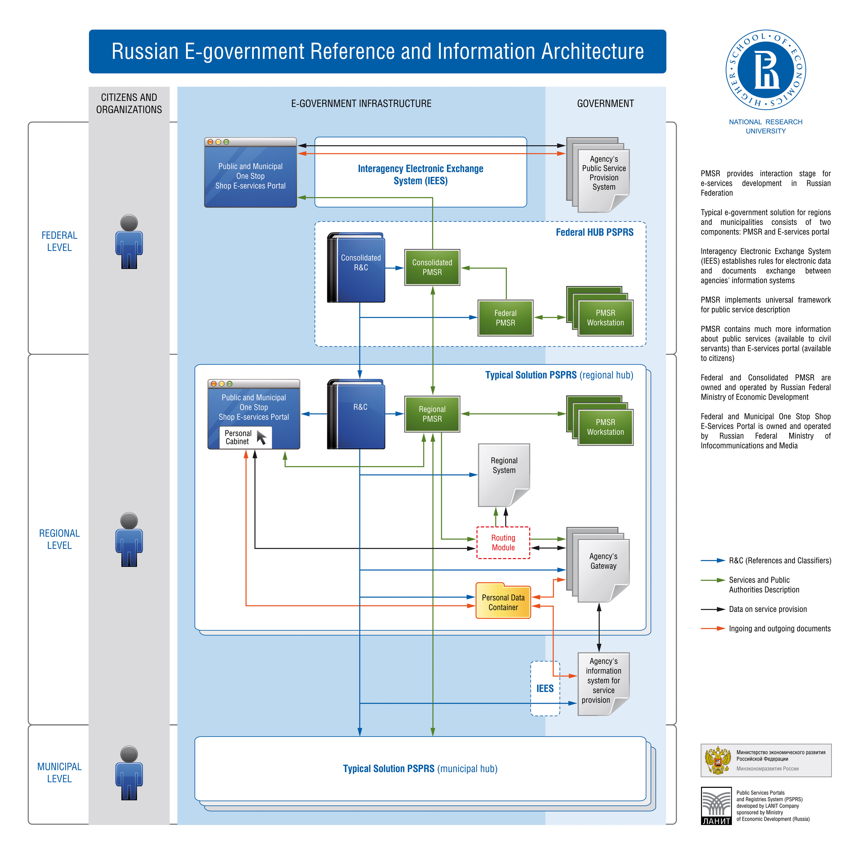

Slide 12
What else? New trends and first steps made
PPP in E-government
Social Media
Open Data and Data Meshup
Open Government
Cloud Computing

Slide 13
Key E-government Elements
?= Public Private Partnership
?
?
Federal Government
Regional Governments
?

Slide 14
PPP-opportunities
By applications which can be profitable to business – transport, discounts
By payments – banks which can issue e-card as a part of salary projects (the cost of access to e-government to citizens)
Establish regional “E-card” company as owned by bank and regional authority
Issue as many cards as possible (cheaper)
Establish integration between e-gov infrastructure operators (Rostelecom) and regional “E-card” companies

Slide 15
More questions on collaboration
What is the time of cards issuance, reissuance including cases of cards loss?
Who owns the card – Federal JSC “E-card” or Regional JSC “E-card” or Banks
Should Regional “E-card” company be owned by regional authorities and/or banks (who shares costs of building e-card infrastructure)?.
Conflicts resolution between regional and federal JSC “E-card”- lack of recommendations
Conflict between multi issuance and getting profits
To issue a card costs up to 30 USD (depends on a region)

Slide 16
Open Data Synopsis
Open Data: available for public use
Linked Data: easy to integrate
Visualization: easy to understand data
Mashups: enrich meaning of data
Provenance: make mashups accountable
Data.gov - project
Notes:
The general idea for data-gov project is to mashup open government data and deliver data to end users via visualizations

Slide 17
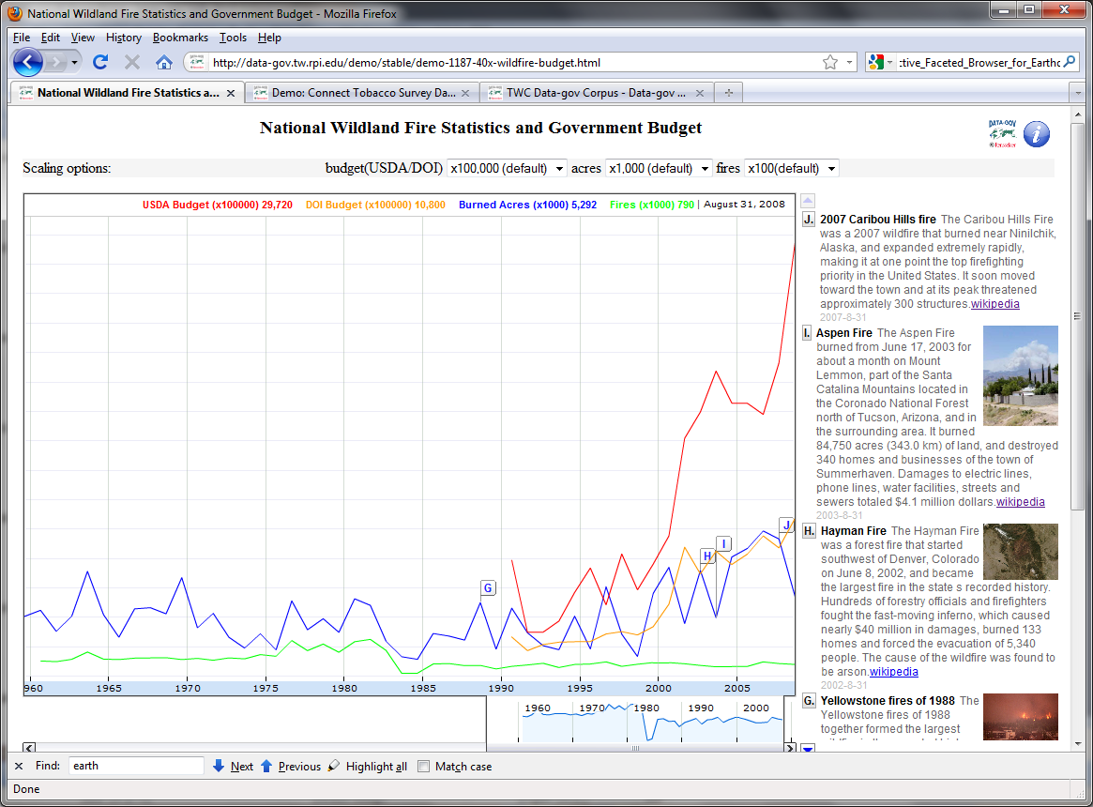

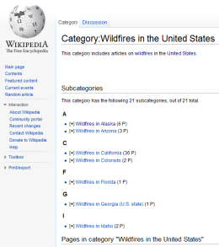


Social Mashup: US Wildland Fire
17
Category:Wildfires
In The United States
Budget on wildfire
“DOI” and “USDA”
(OMB)
Wildland fire
(NIFC)
[Temporal Mashup] Data.gov (statistics+ budget) + Wikipedia (famous fires)
Created by Li Ding, researcher at RPI, http://data-gov.tw.rpi.edu/demo/stable/demo-1187-40x-wildfire-budget.html
Notes:
This demo links data.gov datasets with Wikipedia data.
From the screen, we may associate budget increase with both statistics of wileland fire and big fires published on wikipedia.

Slide 18
Unanswered questions...
Transforming government...
  ...services?
  ...customer service?
  ...relationships with citizens?
  ...information provision? Transparency?
  ...through the way public organizations’ work?
      .....not yet

Slide 19
Social Media - A Critical look...
Social media assumptions are driving expectations
Some terms need reinterpretation in the “context” of government
    Friends & fans
    Community
    Dialogue
    Interaction & collaboration
    Evaluation & measurement
Notes:
Technology assumptions are driving expectations
Social media and Web 2.0 have certain principles (e.g., participatory role of user in development process, harnessing collective intelligence through both participation and user-generated content.)
Ideas about “real time” as citizens see it in the marketplace. “Real time” in government depends on the context (e.g., service context, participation context, etc.)

Slide 20
Social Media Use
Mass communication
  Announcing events, new programs, emergency response
Service delivery
  Answering questions (in comment sections)
  Driver’s Manual Video (download from iTunes)
  New Child Care policy videos (educating social workers)
Participation/Engagement
  Contests – How to improve IT? (e.g., IdeaScale)
  Blogging – Greenversations; Getting to know government
  Blogging – “side effects” political influence on conversation with society
  Wiki – City of Colorado using Wiki for open public meetings
Notes:
This is not a focus on “campaigning” which is often a popular example,
This is a focus on the “work of government” on a day to day basis

Slide 21
Public Value in Open Government
transparency – access to information about the actions of government officials or operation of government programs that enhances accountability or influence on government.
participation – frequency and intensity of direct involvement in decision making about or operation of government programs or in selection of or actions of officials.
collaboration – frequency or duration of activities in which more than one set of stakeholders share responsibility or authority for decisions about operation, policies, or actions of government
Financial – impacts on current or future income, asset values, liabilities, entitlements, or other aspects of wealth or risks to any of the above.
• Political – impacts on a person’s or group’s influence on government actions or policy, on their role in political affairs, influence in political parties or
prospects for public office.
• Social – impacts on family or community relationships, social mobility, status, and identity.
• Strategic – impacts on person’s or group's economic or political advantage or opportunities, goals, and resources for innovation or planning.
• Ideological – impacts on beliefs, moral or ethical
commitments, alignment of government actions or
policies or social outcomes with beliefs, or moral or
ethical positions.
• Stewardship – impacts on the public’s view of
government officials as faithful stewards or guardians of the value of the government in terms of public trust,
integrity, and legitimacy.

Slide 22
Cloud Computing- Definition
Cloud Computing: Cloud computing is a model for enabling ubiquitous, convenient, on-demand network access to a shared pool of configurable computing resources (e.g., networks, servers, storage, applications, and services) that can be rapidly provisioned and released with minimal management effort or service provider interaction. (NIST Working Definition of Cloud Computing published by the U.S.Government's National Institute of Standards and Technology)

Slide 23
Delivery Models
Software as a Service (SaaS): The consumer uses an application, but does not control the operating system, hardware or network infrastructure on which it's running.
Platform as a Service (PaaS): The consumer uses a hosting environment for their applications. The consumer controls the applications that run in the environment (and possibly has some control over the hosting environment), but does not control the operating system, hardware or network infrastructure on which they are running. The platform is typically an application framework.
Infrastructure as a Service (IaaS): The consumer uses "fundamental computing resources" such as processing power, storage, networking components or middleware. The consumer can control the operating system, storage, deployed applications and possibly networking
“Rostelecom” will propose SaaS to municipalities (26 000)

Slide 24
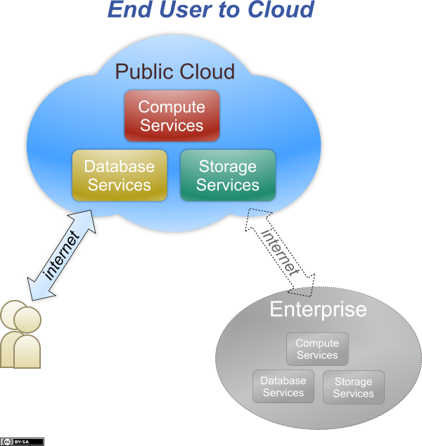

Slide 25
Key success factors for cloud computing
Identity: The cloud service must authenticate the end user.
An open client: Access to the cloud service should not require a particular platform or technology.
Security: Security (including privacy) is a common requirement to all use cases, although the details of those requirements will vary widely from one use case to the next.
SLAs: Although service level agreements for end users will usually be much simpler than those for enterprises, cloud vendors must be clear about what guarantees of service they provide.

Slide 26
The gap to reach the challenge
Open Government
E-services
Russian
E-government
PPP
Social Media
Cloud Computing

Slide 27
Conclusions
E-government as a leadership challenge and priority increase
Regions will continue to play a key role in successful e-government development in Russia
E-government Strategy revision and tasks clarification is unavoidable
Federalism challenges in e-government (partnerships, competition, profits, governance and power, legal framework)
Partnerships and Collaboration mechanisms Demands for further e-government development

Slide 28
Thank you for your attention!
Questions???
E-mail:
estyrin@hse.ru
estyrin@gmail.com

