Slide 1
Human Capital: Education and Health in Economic Development
INTRODUCTION
Widespread belief that human capital is key to development
Numerous channels through which human capital can foster development Numerous reasons to argue that state intervention is needed to support human capital programs
are crucial to address a big myth:
There is no clear empirical record of impact of human capital investment as source of growth
Human capital investment is not a panacea: “incentives matter”
Lecture Outline
Introduction
I‐Specificity and role of human capital in economic development
I‐1‐Human capital approach
I‐2‐Endogenous nature of human capital
I‐3‐Potential for multiple equilibria: justification of public intervention.
II‐Human capital as a panacea?
II‐1 stylized facts: human capital improvement without development
II‐2 Why is human capital not a magic bullet?
Conclusion

Slide 2
I‐Specificity and role of human capital in economic development
I‐1‐Human capital approach
Analogy with physical capital
‐Accumulation: flows on stock
‐Depreciation ‐Return to education: decreasing?
‐Investment decision based on costs and benefits analysis
I‐Specificity and role of human capital in economic development
1-2: Endogenous nature of human capital
A-Investment in human capital as determinant of development
-More productive labor force (better and greater L)
-Creation of a class of educated leaders in government and business: possibly producing better institutions
-Impact on fertility: lower population growth
-Employment and income earning opportunities for teachers, health workers, school/hospitals and producers, construction workers; textbooks & medicine producers ….
-Encouraging modern attitudes in population

Slide 3
Specificity and the role of human capital in economic development
1-1-Human Capital Approach
Analogy with physical capital
-Accumulation: flows on stock
-Depreciation
-Return to education: decreasing?
-Investment decision based on costs and benefits analysis
1-2-Endogenous nature of human capital
A-Investment in human capital as a determinant of development
-More productive labor force (better and greater L)
-Creation of a class of educated leaders in government and business: possibly producing better results
-Impact of fertility: lower population growth
-Employment and income-earning opportunities for teachers, health workers, school/hospitals and construction workers; textbooks and medicine producers ….
-Encouraging modern attitudes in population
Investment in human capital as a consequence of development
Greater income available to finance human capital accumulation: capital was the constraint:
-arbitrage between food and investment in human capital
-arbitrage between education and labor
-arbitrage between quantity and quality of children
Modernization requires greater human capital (greater returns)
-Technology advances require upgrade of skills

Slide 4
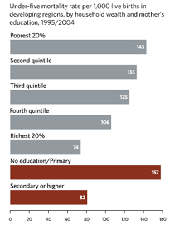
Modernization increases the valorization of human capital:
-New activities require education: readings ---
-Child labor is less acceptable
B-Mutual enforcing impact of investment in various aspects of human capital
Education gives
-awareness of health
-problems and cures
*Better health is indispensable for school attendance and school performance
*Lower benefits of education investment in child in poor health
So two dimensions are complementary!
Empirical regularity: multiple equilibria
-equilibrium with low education and health
-equilibrium with high education and health
I-Specificity and role of human capital in economic development
1-3 Potential for multiple equilibria: justification of public intervention
A-Positive Externalities and Complementarities features

Slide 5
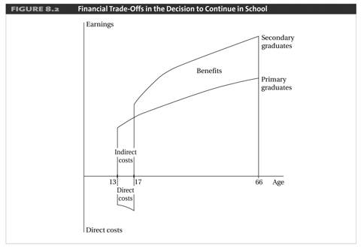
Positive externalities of individual investment in education: investment and greater benefits of social interaction are
-positive externalities of individual investment in health:
-less contagion potential
Both investments are characterized by O-Ring Effects
Both investments are characterized by complementarities:
-Cost of investment declines with the number of investors
-Benefits of investment increases with the number of investors
I-Specificity and the role of human capital in economic development
1-3-Potential for multiple equilibria: justification for public intervention
B-Financial Trade-off
Arbitrage between Child Labor and Child Education

Slide 6
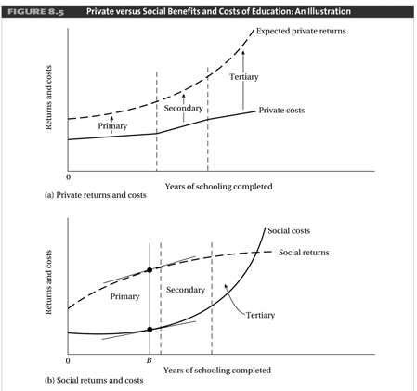
C-Failure of credit and labor markets
It is privately profitable to have a child work
-shortages of labor during the harvest season
-monitoring problems induce failure of the labor market
-capital market failure: impossible to borrow to finance education
However, it is socially costly: but no one has an incentive to be the first/only one to stop child labor.
D-Benefits and Costs are not fully internalized: justifies intervention.

Slide 7
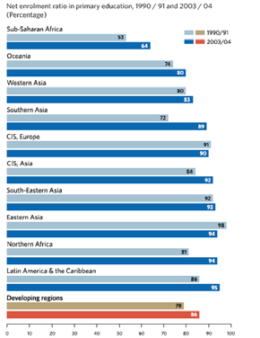
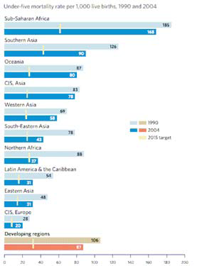
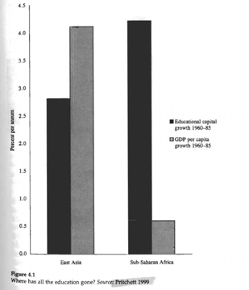
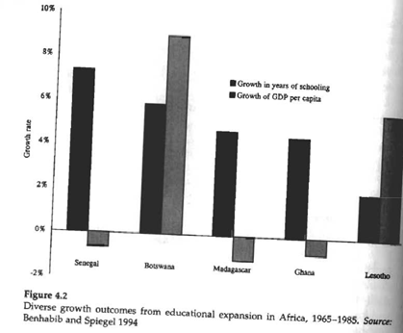
Trend –the increase in human capital indicators
Trend = the increase in human capital indicators
No positive association between human capital accumulation and economic growth. Empirically hardly any correlation: or not robust to the correction of endogeneity.
Worse: decline of growth can be occur even with high human capital accumulation

Slide 8
II-2-Why is human capital not a magic bullet
A-Incentives are crucial
Human capital investment is the result of a cost/benefit analysis.
-Even if costs are zero, need to have positive benefits
‐in some circumstances benefits are negative and so is employment: frustration
-in some circumstances private benefits are positive but social benefits are negative:- corruption;-international;-emigration
B-Benefits of human capital spending depend on complementary elements
In the health and education system: quality versus quantity
-Availability of books, medicine and beds
-Presence and quality of professors and doctors
-Even if free, there are hidden costs
-Opportunity cost of time
-Transportation costs
-Cultural distance
In the economy
-job opportunity: unemployment is preferred to downgrading
-O-Ring effects
-Institutions: corruption can divert resources targeted to human capital
C-Inappropriate human capital investment systems in LDCs [A: Over-investment]
(see diagram)

Slide 9
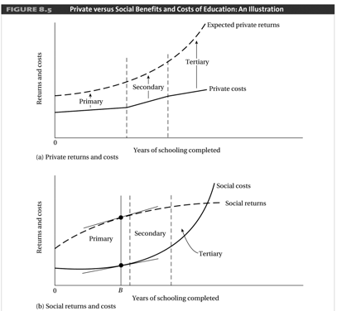
C-Inappropriate human capital investment systems in LDCs [B: Misallocation]
Education
-Urban bias in high-end universities (in law) although the focus should be on practical courses useful in poor rural communities
-Greater pay off would be in Primary and Secondary education
Health
-Urban bias in capital-intensive hospital although the focus should be on mobile cheap units for rural areas.
C-Inappropriate human capital investment systems in LDCs [C: Inappropriate Focus]
Education
-Diversion of research from important local problems and goals

Slide 10
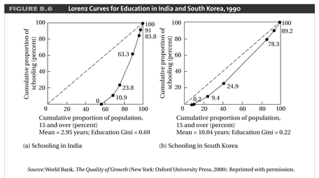
-Development of appropriate technology
-Promotion of low-cost preventive health care
-Construction of low-cost housing, hospitals, schools …
-Teaching of sophisticated mathematical models of nonexistent competitive economies instead of problems of poverty…
Health
Bias toward rich-type of diseases: preference to specialize in heart diseases while tropical medicine is considered a second-rate specialty.
D-Amplification of existing inequality
-System in LDCs typically amplify existing inequality.
-System in LDCs is typified by subsidization of the richest groups.
(see diagram below)
-Brain drain- those privileged to not even stay to contribute to the development of their country? Problem: Should we not invoke Brain Push for some of the flight of the educated people who have to flee to save life and limb! (see diagram below)

Slide 11
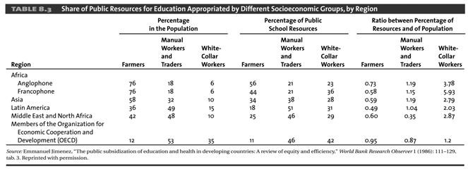
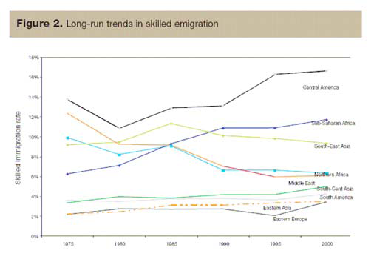

Slide 12
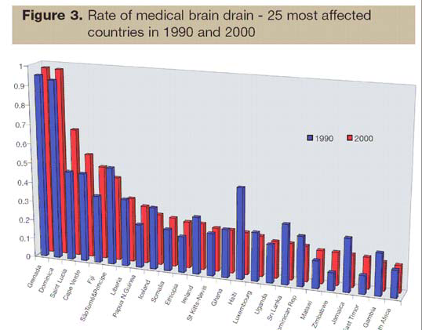
Conclusion
Before simplistically pouring aid focused on health and education, there needs to be a
-Crucial to look at benefits and incentives of individuals
-Otherwise outcomes may be very disappointing
Spending is seldom a panacea
As well as focusing on expenditures, there is need to maximize pay-offs
Context (institutions, income constraints) is crucial
In any case, incentives are crucial:
-mosquito nets are quite often used as wedding dress material!
-officials have incentives to divest the money to projects from which they or their relatives (university and high-end hospitals in the capital city).

