Slide 1
Chapter 1
The Hospitality Industry and You

Slide 2
What Is Hospitality?
Many peoples’ definition of hospitality extends only to restaurants and hotels
In reality, it goes far beyond this and includes any organization that provides food, shelter and other services to people away from home
When viewed in this light, the hospitality industry can be quite large and far reaching
Also, the numerous career opportunities become readily apparent

Slide 3
What Is Hospitality?
Students considering entering the field of hospitality should take into consideration all of the types of businesses that hospitality encompasses but also, the various career streams in functional areas across segments (such as accounting, finance, marketing, human resources, etc.)
One of the common threads that binds all segments together is the service orientation that exists – one must possess this in order to be successful

Slide 4
What Is Hospitality?
An interesting note: Over the last 10 years, other types of businesses have begun to recognize the unique combination of skills that hospitality students possess – the combination of sound business and management along with a service orientation
As a result, other industries have begun to recruit hospitality graduates including health care and retail

Slide 5
What Is Hospitality?
This is a particularly exciting time to be associated with the industry given the ample career opportunities, the economy, new developments, emerging markets, internationalization of companies and concepts, etc.
The industry faces certain challenges, too, which will be discussed throughout the course

Slide 6
Primary Sectors
So, what are some of the primary sectors within the hospitality industry? They include:
Lodging (not just limited to traditional hotels)
Foodservice (not just limited to restaurants)
Gaming operations
Private clubs
Theme parks
Destination management companies

Slide 7
Primary Sectors (continued)
Meetings and conventions (planning and operations)
Managed park environments (natural)
Resorts
Senior living
Managed services
Consulting services

Slide 8
The Manager’s Role
The role of the manager is critical in creating the environment in which the following will occur:
Making the guest feel welcome
Making things work for the guest
Maintaining a profitable (or “fiscally responsible”) operation
A degree in hospitality management is designed to allow students to be effective in these areas

Slide 9
How To Prepare For A Career In The Hospitality Industry
Work your way up through an organization
No guarantee
Only learn one way
Earn a general degree or degree in the liberal arts
May not provide as quick, or direct, access to opportunities
Earn a general business or management degree
Provides the good sound business knowledge but may not be specific enough

Slide 10
Why Do Students Study Hospitality Management?
Personal work experience
Family background
Contact with other students
Enjoy people, food, travel, etc.
Opportunities for employment and advancement
Desire to own their own business
Desire to be independent

Slide 11
Employment Opportunities
Most segments of the hospitality industry are projected for continued growth in the number of management positions
Opportunity to advance as companies grow
Some segments are greatly outpacing the average
New and emerging segments of the industry
Growth in franchise opportunities
Increasing interest in food and travel as population ages

Slide 12
COMBINING EDUCATION AND WORK EXPERIENCE
The prevailing philosophy in hospitality education is that the best way to the top is through a strategic combination of education and experience
The education component is self-explanatory – it is the result of past results and future expectations
The experience component is two-fold
Some of the opportunities will come from the department through internships, etc.
Other opportunities will come from your own initiatives looking for summer jobs and part time work—be strategic about how you choose your jobs and how you progress

Slide 13
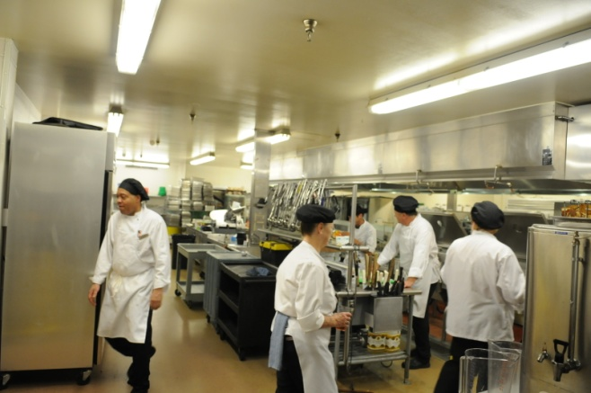
COMBINING EDUCATION AND WORK EXPERIENCE
Not all learning comes strictly from classroom learning and/or on-the job learning
There are other opportunities for learning about your chosen profession. These include:
Field trips
Student projects
Student clubs
Sales blitzes

Slide 14
STUDENT CLUBS
Eta Sigma Delta, International Hospitality Management Society
As a traditional honor society, it meets the standards of the Association of College Honor Societies; hospitality students in their junior year with a 3.0 or better grade point average are eligible for membership
Others: Wine clubs, Restaurant associations, Club managers associations, Travel and Tourism Research Association, etc.

Slide 15
LEARNING STRATEGIES FOR THE WORKPLACE
Try to understand the organization
Formal organization
Informal organization
Try to understand the physical plant
Work flow
Guest flow
Try to understand the different functional areas
Back-of-the-house
Front-of-the-house
Try to work in each

Slide 16
GETTING A JOB
Newspapers (not!)
Web sources
Friends
Family
University placement office
Job postings
Networking
Cold calling

Slide 17
WHAT DO EMPLOYERS LOOK FOR?
Dedication and commitment
Desire to serve others
Decision making skills
Communication skills
Experience
Involvement
Technical skills
See An Employer’s View….

Slide 18
GOALS AND OBJECTIVES
Income
Professional status
Potential job satisfaction
Skilled jobs v. unskilled jobs
Others considerations: Hours, Level of responsibility, Work environment, Mentoring

Slide 19
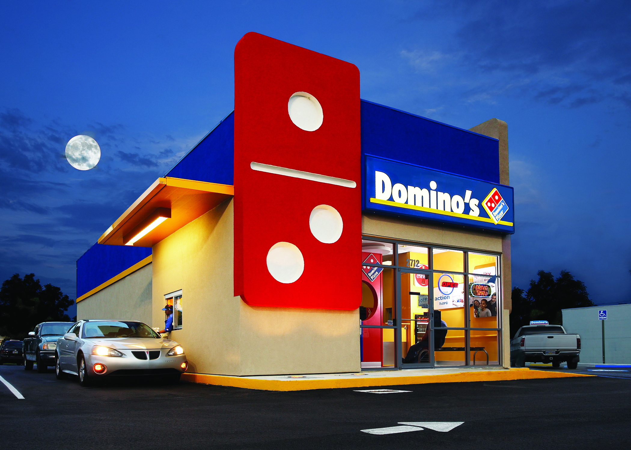
OUTLOOK FOR HOSPITALITY
The outlook for the industry is very positive but there are several trends/factors that are affecting how the industry operates and the products and services that are offered to customers

Slide 20
OUTLOOK FOR HOSPITALITY
The effects of September 11th and other recent events have resulted in:
Travel restrictions
Safety and security issues
Cost of operations
Government regulations
Destinations that have been affected

Slide 21
OUTLOOK FOR HOSPITALITY
Polarization
Limited Service versus Service Intensive organizations
Has led to growth in certain segments of the industry (luxury hotels, limited service restaurants)
Has generally been positive for the industry as a whole as well as for consumers

Slide 22
OUTLOOK FOR HOSPITALITY
Accelerating Competition
Competition across segments has increased dramatically
International competition has also increased
Competition had led to more emphasis on creating specialized niches and better management practices
Factors include: Cost of money and demand for specific services

Slide 23
OUTLOOK FOR HOSPITALITY
Service is the Difference
Service is more and more what brings customers back (or prevents them from returning)
Companies that provide excellent service inevitably lead their segments
Not limited to hospitality

Slide 24
OUTLOOK FOR HOSPITALITY
Value Consciousness
Customers are getting smarter and more selective
Customers look for value in all hospitality experiences and purchases
Value doesn’t mean the lowest price
Customers also tend to balance time and money spent

Slide 25
OUTLOOK FOR HOSPITALITY
Technology
The hospitality industry has been slow in terms of adapting to new technologies but the industry has made some inroads
Perhaps the segment that is the most advanced is the airline industry, both in terms of on-line interaction with customers as well as up-to-the-minute pricing
New technologies are being introduced every year

Slide 26
OUTLOOK FOR HOSPITALITY
Empowerment
Empowerment is the act of providing additional levels of responsibility to both employees and managers
This has been the result of cost cutting efforts but also as a result of trying to improve customer satisfaction
It has been able to happen because of the new “breed” of employees as well as improved technology and communication

Slide 27
OUTLOOK FOR HOSPITALITY
Diversity
Hospitality organizations are becoming more diverse in response to changes in society as well as demographic shifts and becoming more aware of the importance of a diverse organization
Many companies have established themselves as leaders in this area

Slide 28
OUTLOOK FOR HOSPITALITY
Concern with Security
Concern for personal security and safety has resulted in destinations, organizations and society in general attempting to provide a greater level of safety for travelers
Examples include airline marshals, hotel security forces, cameras, and increased education

Slide 29
OUTLOOK FOR HOSPITALITY
Concern with Sanitation
Increases in food-borne illness has resulted in a raised concern on the part of consumers
Raised concerns in the US probably began with the Jack-in-the Box incident in the 1970s
More recent incidents have also raised questions about the quality of the food supply and even the water supply (e.g., bottled water)

Slide 30
OUTLOOK FOR HOSPITALITY
Sustainability
Going “green” is not new, but it reflects industry-wide focus on corporate responsibility
Most hotels encourage guests to reuse towels and many have embraced low-cost changes such as lighting
Guests prefer to support businesses that are concerned about the industry

Slide 31
OUTLOOK FOR HOSPITALITY
Globalization (Last but not least)
Globalization is perhaps one of the greatest factors affecting the industry as it impacts every facet of operations including:
Competition
Work force
Travel patterns
Company alliances, etc.

