Slide 1
Does Ownership Structure Matter?
Sheridan Titman
University of Texas
Notes:
Push looking at policy differences affecting ownership structure rather than institutions – why America is great!

Slide 2
Observations
Capital Assets are held in a variety of ownership structures
Public Corporations
Private Family Businesses
Private Equity Partnerships
Master Limited Partnerships
REITs
Notes:
The mix of these structures change over time and differ across countries. Differences in institutional differences across countries is clearly interrelated to differences in ownership structure. For those of us that think about whether institutional differences matter, we should be thinking a bit more carefully about ownership structure.

Slide 3
How do these structures differ?
Taxes
Liquidity
Governance
Public structures tend to use less debt

Slide 4
Questions
Why do we observe different ownership structures?
Diversity of asset types or diversity of investor types?
What is the relation between asset characteristics and ownership structures?
Are some structures more appropriate for some assets?
Why are some assets held in multiple structures?

Slide 5
Worldwide Plaza
825 Eighth Ave, New York
2 million sf
Buyers | Date
Equity Office | Oct 1998
Blackstone | Feb 2007
Macklowe Properties | Feb 2007
George Comfort & Sons JV DRA Advisors JV RCG Longview JV Feil Organization | Jul 2009
American Realty Capital New York Recovery REIT | Oct 2013
Notes:
Equity office actually bought it from Blackstone in 1998. It is likely that these transactions resulted in 10s of millions in fees and transferred between almost all of the ownership structures. Hard to come up with incentive and information issues that would justify the transfers.

Slide 6
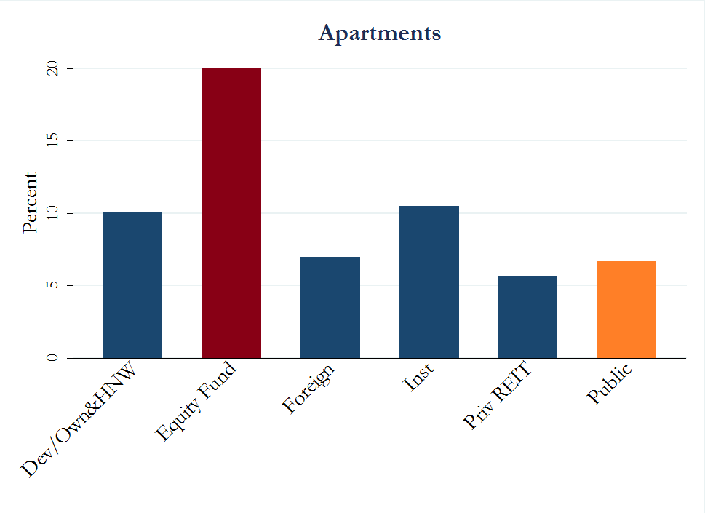
Percentage of Properties Bought for Renovation (value weighted) (Data Source: RCA)

Slide 7
Occupancy Rate (Data Source: RCA)
 | Offices |  |  | Apartments
 | Less than 50% | 95% and More |  | Less than 50% | 95% and More
Public | 3.5% | 62.4% |  | 2.5% | 50.1%
Equity Fund | 8.5% | 38.2% |  | 1.9% | 46.1%

Slide 8
More Questions
Why does the popularity of different structures change over time and across countries?
investor characteristics, taxes, regulations, and institutional differences

Slide 9
Number of Firms Listed on U.S. Exchanges Data Source: CRSP

Slide 10
Total Market Cap of Firms Listed on U.S. Exchanges Data Source: CRSP
(Y axis is in Log)

Slide 11
LBO Volume (Data Source: SDC Platinum)

Slide 12
More Questions
How do shocks to ownership structure affect
Firm size
Vertical integration and diversification
The nature of competition

Slide 13
Bigger Question
Does any of this really matter?
Is there a link between how assets are owned and how they are managed?
Do some structures facilitate innovation better than others?
Do policy choices that influence ownership structure affect efficiency and innovation?
Or is this just a side-show?
Does ownership structure play a role in the link between institutional structure and economic development?

Slide 14
Main Idea
Policy
Ownership Structure
Industrial Organization
Innovation

Slide 15
M&M Theorem
Value = Discounted Cash Flows
Ownership structure affects value by influencing discount rates and/or cash flows
M&M – if ownership structure does not affect cash flows or discount rates, then ownership structure is irrelevant
In reality there are tradeoffs between cost of capital and efficiency
E.g., Family ownership might have higher capital costs and lower agency problems

Slide 16
Cost of Capital/Efficiency Tradeoff
Cost of capital
Efficiency
Taxes (can favor private)
Liquidity and the winners curse (favors public)
Analyst coverage
Short-sales constraints
Listing and compliance costs (favors private)
Mark to market risk (favors private)
Economies of scale (favors public, but not always)
Incentives (favors private)

Slide 17
Cost of Capital Shocks and Efficiency
Policy choices affect the relative capital costs of alternative ownership structures
shift ownership structures to either more or less efficient forms
Influence activities in ways that have positive or negative externalities
Influence innovation

Slide 18
Policies Initiatives That Influence Ownership Structure
The Revenue Act of 1978 included a provision (Section 401K), which created Defined Contribution Pension plans
In 1978, the US Labor Department relaxed ERISA restrictions, under the "prudent man rule," allowing corporate pension funds to invest in private equity
The Small Business Investment Incentive Act of 1980 made it easier to form limited partnerships with large numbers of investors

Slide 19
More Policy Initiatives
1982 SEC rule 10b-18 provided corporations with a "safe harbor" from liability when they repurchase common stock
1986 Tax Reform Act affected the cost of capital of alternative ownership structures by
Reducing the top tax bracket from 50% to 28%
Limiting the ability of passive investors to deduct losses from private investments and partnerships from labor income
Rulings between 1987 and 1994 facilitated publicly traded pass through ownership structures (MLPs and REITs) that can be used to hold real estate and energy assets

Slide 20
Implications of Tax and Regulatory Changes
Made institutional private equity more attractive
Facilitated the financing of new firms
Decreased the benefit of internal capital markets, reducing the benefits of vertical integration and diversification
Made (tax shelter) limited partnerships (retail private equity) less attractive
Increased the attractiveness of REITs and MLPs

Slide 21
Interesting Observation
Time lag between tax and regulatory changes and ownership structure changes
Coordination problems with two sided markets
Corporate finance choices
Investment choices

Slide 22
More Recent Shocks
Pre-crisis events that may have created a “credit bubble”
Securitization – turning BBB credit into AAA credit
The Asian savings glut – increasing the demand for debt
Increased the attractiveness of private ownership
Optimal debt ratios of private entities are higher
Hence, reductions in the cost of debt facilitates migration from public to private entities

Slide 23
Total LBO Volume and CDO Issuance Shivdasani & Wang (2011 JF)

Slide 24
Net Purchase of Large Offices by Investor Type (Data Source: RCA)

Slide 25
Worldwide Plaza
825 Eighth Ave, New York
2 million sf
Buyers | Date
Equity Office | Oct 1998
Blackstone | Feb 2007
Macklowe Properties | Feb 2007
George Comfort & Sons JV DRA Advisors JV RCG Longview JV Feil Organization | Jul 2009
American Realty Capital New York Recovery REIT | Oct 2013
Notes:
Equity office actually bought it from Blackstone in 1998. It is likely that these transactions resulted in 10s of millions in fees and transferred between almost all of the ownership structures. Hard to come up with incentive and information issues that would justify the transfers.

Slide 26
Preliminary Thoughts on Ownership Structure and Innovation
Shocks to ownership structure can lead to consolidation
Innovations resulting from economies of scale
Shocks to ownership structure can facilitate focus and new entrants
Innovations resulting from knowledge spillovers

Slide 27
Anecdotes
Arbitraging ownership structure shocks and inadvertent innovation
The storage locker business
Pipelines

Slide 28
B. Wayne Hughes Net Worth $2.4 Billion

Slide 29
Performance of Public Storage (PSA) Relative to the S&P 500

Slide 30
How did Mr. Hughes get so rich?
Prior to 1986, storage units were held by families and limited partnerships
1986 Tax Reform Act changed the optimal ownership structure of storage units from partnerships to REITs
Mr. Hughes got rich by arbitraging the cost of capital difference between the private and public real estate markets

Slide 31
But, does it matter?
The transformation from private to public entities created a much bigger entity
Establishment of a brand
Market power
Economies of scale in information technology
Units are priced in real time – a bit like how hotels and airlines price their products
National reservation system

Slide 32
Real Estate Recap
Changes in the legal and tax environment changed the ownership structure of real estate firms
Increased concentration of assets led to economies of scale
Innovation
Branding
Pricing power

Slide 33
Size, focus and innovation
The storage example illustrates a link between size and innovation
Economies of scale
But there is also evidence that a vibrant mix of small focused firms can also facilitate innovation
An example from the oil and gas industry

Slide 34
Richard Kinder Net Worth $6 Billion

Slide 35
Performance of Kinder Morgan Relative to the S&P 500

Slide 36
How did Mr. Kinder get so rich?
Prior to the 1990s, most pipelines were owned by large energy companies
The 1986 tax reform act and other changes decreased the cost of capital to MLPs relative to corporations
Mr. Kinder essentially arbitraged the cost of capital difference between MLPs and corporations

Slide 37
But, does it matter?
Taking pipelines out of the major oil companies
Removed a potential conflict of interest
Led to better utilization
Made it easier for smaller E&P firms to get their gas to market

Slide 38
Policy shocks and the Ownership Structure of Oil and Gas Firms
Policy changes increased the focus of large oil and gas companies
some spun off their pipelines into MLPs, sold off their domestic onshore oil and gas properties to focus on very large offshore projects
Facilitated by the MLP structure, which acquired the pipelines,
and the emergence of private equity that funded start ups that acquired the domestic onshore assets and new service businesses (e.g., drilling and fracking)

Slide 39
Ownership Shocks and the Fracking Boom
Led to the emergence of an entrepreneurial environment in Houston that resembled the environment in Silicon Valley,
Generating the same type of innovation
Lots of small focused companies that were developing new drilling and fracking technology --- engineers moving between firms sharing information about best practices etc.
Substantial cost reductions

Slide 40
Summary and Questions
Policy changes around the 1980s had big effects on ownership structure
Private equity financed start ups
Publicly traded pass-through vehicles
Changes in ownership structure influences industrial structure
consolidation, less competition and more innovation (in the real estate example)
a fracturing of ownership, more competition, and again more innovation (in oil and gas)

Slide 41
Two Concluding Questions
How do cross-country institutional differences affect ownership structure?
To what extent does this explain cross-country productivity differences
Are there good examples of ownership shocks with negative consequences?

