Slide 1
Enterprise systems DT211/4
Enterprise Resource planning

Slide 2
What is ERP?
Enterprise Resource Planning:
Is a software system that takes an enterprise approach to integrating and optimising business processes across departments (finance, HR, sales, etc).
Provides consistent information for timely decision-making and performance measurement

Slide 3
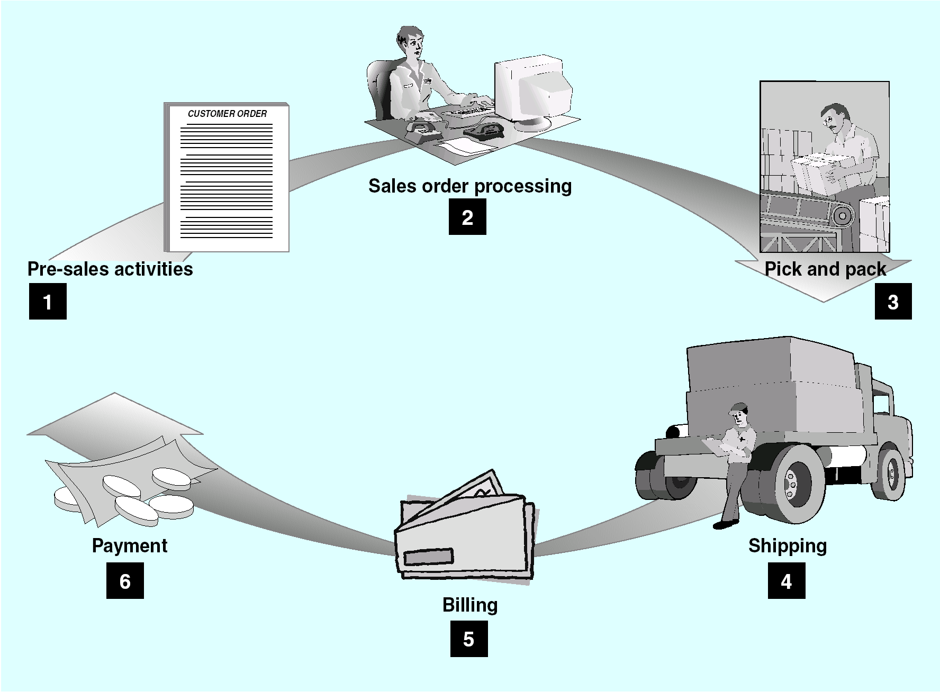
Example of a business process: purchase order process …

Slide 4
Purchase and payment process
Presales activity
1. Determine requirements and complete purchase requisition.
Automatically generate the purchase requisition based on quantity on-hand, quantity-on-order, and expected demand.
© L. Gray, CNU

Slide 5
Purchase and payment process
2: Prepare and record purchase order.
Assists the buyer in identifying sources of supply for the requested item, analyzing vendor quotes,
comparing vendor prices, terms, and past performance
3. Receive and record goods.
Compare quantity ordered to quantity received.
Routes goods to the function that requested them or directs them the warehouse for immediate sale. It also records vendor performance data.

Slide 6
Purchase and payment process
4: Receive vendor invoice, match with purchase order and receiving report; record payable.
If the three-way match fails, the enterprise system notifies the proper personnel to ensure timely reconciliation of differences.
5. Prepare and record cash payment and update accounts.
Uses vendor and account payment data to schedule payments in accordance with terms of sales agreement.

Slide 7
Methods to perform the purchase order process.
The non automated approach:
using a telephone would require the agent to:
take the ordered items
provide pricing information
estimate delivery date
Check availability of credit for the caller
This process would require a number of phone calls and more than one operator.

Slide 8
Example of Inefficient methods to perform the purchase order process.
If the purchase order process is semi-automated:
take the ordered items
provide pricing information
estimate delivery date
Check availability of credit for the caller
then some of the above steps could be done via an information system; e.g. record purchase order… however such a non “fully” integrated system would require the use of multiple computer systems.
The most basic of the semi-automated approaches is the “island of computing systems” (non integrate semi-automated
The tactical approach a set of ad hoc links between the applications involved in the business process.

Slide 9
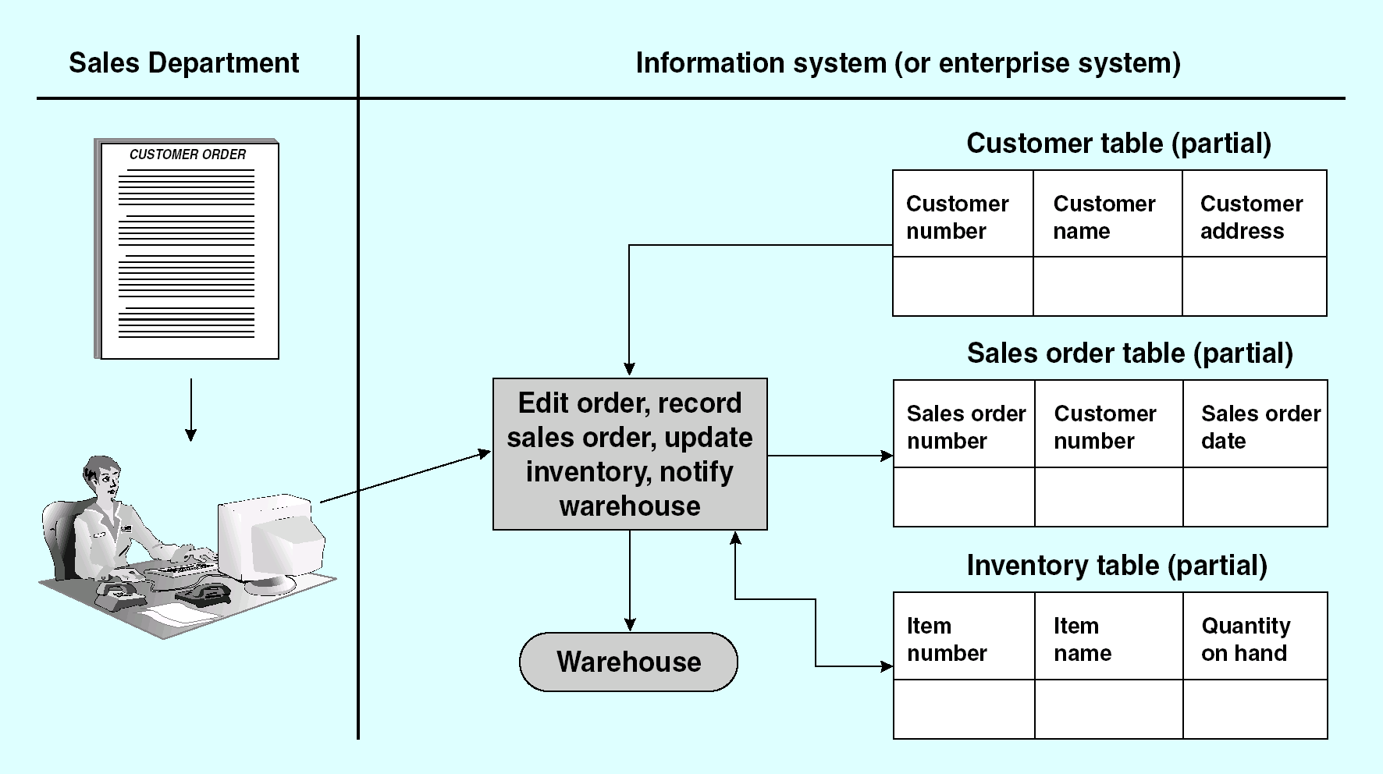
Ideal requirements to automate the purchase order process
Provide sales department with a single point of access from which they can complete the business order process
Obtain /record information (availability of items, record sales order)
Request initiation of internal processes (time to manufacture and deliver items)
Provide reliable information to the customer (delivery date, price)
This system would use one interface and one database

Slide 10
Requirements to automate the purchase order process
The main issue with the requirements is that the associated data and processes relate to different functions within the organisation, which may use different Information systems including different: databases, data models….
Potential solution to this problem:
Integration of existing function based systems
EAI is the solution but still uses multiple databases
Consolidation into a single application
ERP is the solution: a single database
In reality most enterprises will combine both approaches
Consolidate in some places
Integrate in other places
10
Notes:
10

Slide 11
Problems with integration of function based systems: EAI
Data Sharing (data transformation) between systems
Data duplication and inconsistencies
Data model inconsistencies
Partial information leads to isolated decisions lead to overall inefficiencies
Increased expenses
While EAI limits most of the above issues via its 5 step framework it is still not an ideal system as data is still duplicated and the integration is only as good as the integration design process… often this is more focused on technical issues which can be at the expense of business process.

Slide 12
Enterprise Resource Planning
ERP is
An approach to managing all resources and their use in the entire enterprise in a coordinated manner
A set of integrated business applications, or modules which carry out common business functions such as: business purchase order management ,
An approach to supporting business through optimizing, maintaining, and tracking business functions
Focused on value chains, rather than individual functions
More about business process change than technology

Slide 13
Enterprise Resource Planning
The ERP core capabilities include:
Integrated modules
Common process and data models and definitions
Common database
Update one module, automatically updates others

Slide 14
Modularisation
Most systems are modular to permit automating some functions but not others.
Some common modules, such as finance and accounting, are adopted by nearly all users; others such as human resource management are not.
For example, a service company probably has no need for a manufacturing module.
Other companies already have a system that they believe to be adequate. Generally speaking, the greater the number of modules selected, the greater the integration benefits, but also the greater the costs, risks and changes involved.

Slide 15
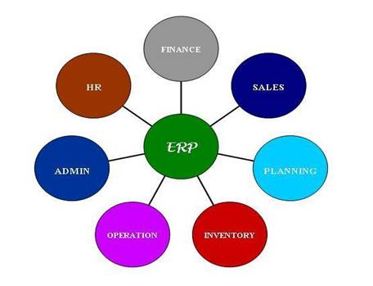
ERP modules

Slide 16
ERP: Finance modules
All kind of organizations small scale, large scale organizations benefit from the implementation of ERP financial module.
The financial module is the core of many ERP software systems.
It can gather financial data from various functional departments, and generates valuable financial reports such general ledger, trail balance, as balance sheet and quarterly financial statements

Slide 17
ERP purchasing module
Purchase module streamline procurement of required raw materials.
It automates the processes of identifying potential suppliers, negotiating price, awarding purchase order to the supplier, and billing processes.
Purchase module is tightly integrated with the inventory control and production planning modules. Purchasing module is often integrated with supply chain management software.

Slide 18
ERP sales and marketing module
Sales module implements functions of order placement, order scheduling, shipping and invoicing.
Sales module is closely integrated with organizations' ecommerce websites.
Many ERP vendors offer online store front as part of the sales module.
ERP marketing module along with CRP supports lead generation, direct mailing campaign and other marketing works. Scheduling of the promotion is possible using this.

Slide 19
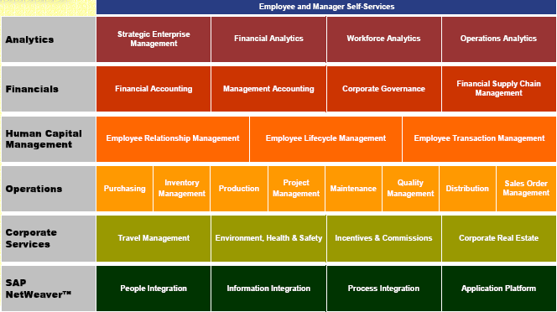
Example of an Enterprise resource planning system: mySAP

Slide 20
mySAP ERP
Traditional ERP: All the well-known value chain processes: Order to cash etc.

Slide 21
Benefits of ERP
Common set of data
Removes consistency and synchronisation issues
Inter-department integration for all departments using the ERP
Library of available standard template processes and modules make integration easier
The use of ERP I.S. systems encourages Business Process Reengineering :
is a business management strategy that focuses on analysing and designing the way business processes/workflows are performed. It does not look at business processes in isolation but in a more holistic way: like how to change the value chain to ensure/create greater core competencies; e.g. link the purchasing process to a supply chain management which in turn can communicate with customer relation management systems…
Can you think of any examples of a business process re-engineering

Slide 22
Potential Limitations of ERP
Global ERP can be a never-ending project for large organisations
No organisation exists in isolation: Value chain business processes
There are always suppliers and clients who use different data models.
This means that the need for integration cannot be removed.
Inter-department integration relies on using the global ERP
Causes problems with anomalous departments, recently required, geographically isolated or with different business processes.
Be aware: The software can drive the business rather than the other way around
Templates tend to impose the standard business process rather than your organisations business process. This is okay for commoditised processes but not for all.

Slide 23
ERP Implementation Options
Complete system.
Create IT architecture from scratch
Uncommon as there are few new companies which start off large enough to implement ERP
ERP by Process
Deploy one or a few ERP modules across all Business Units
Risk: May never extend beyond original process.
ERP by Business Unit
Deploy fully integrated ERP suite in one or more Business Units
Risk: May never extend beyond original function.
Fully Integrated ERP
Full scale deployment across the enterprise
Risk: Very expensive and could take a long time before getting a return/

Slide 24
Implementing an ERP system
ERP is always a major project
Any ERP project requires significant time and cost.
It is likely to be disruptive and result in business process changes across the organisation.
To be successful
The project must have high priority and all elements of the organisation must be aware and involved in it.
Senior management commitment with regular progress reviews at the appropriate levels of management.
Risks
Many companies are unclear on the likely total project cost or return.
As with any enterprise level project, scope creep, organisational politics and change regularly cause failure.

Slide 25
Sample Question
Describe, using a suitable example, the steps in a business process. (6 Marks)
What is enterprise resource planning (ERP) (3 marks)
Explain, using the business process example above, how an E.R.P. approach overcomes the limitations of the “island of computing”, the ad-hoc tactical approach to the automation of business process. (10 marks)
Explain two of the limitations of E.R.P (5 marks)
Compare and contrast three different ways of implementing an ERP system. (6 marks)

Slide 26
Question
Describe, using a suitable example, the steps in a business process. (6 Marks)
Explain the limitations of the “islands of computing” tactical approach and the EAI approach to implementing the above business process (6 Marks)
What is enterprise resource planning (ERP) (4 Marks)
What are the basic steps in implementing an ERP system. (6 marks)
how can a fully implemented ERP system overcome the limitations of other methods of implementing business processes. (8 Marks)
Describe the characteristics of 4 of the modules of an ERP system (8 marks)

