Slide 1
Total Quality Management: Focus on Six Sigma
Operations Management
Dr. Ron Lembke

Slide 2

What is Quality?
Dad and son cycle across US
Dad has had electro-shock therapy, and keeps recognizing things on the trip
Not supposed to remember
Realizes needs more help
Used to be philosophy prof.
Defining “quality” drove him over the edge the first time

Slide 3

What is Quality?
Quality … you know what it is, yet you don’t know what it is. But that’s self-contradictory. But some things are better than others, that is, they have more quality. But when you try to say what the quality is, apart from the things that have it, it all goes poof! There’s nothing to talk about. ...
Robert M. Pirsig, Zen and the Art of Motorcycle Maintenance, p. 163

Slide 4

What is Quality?
Obviously, some things are better than others … but what’s the “betterness”? So round and round you go, spinning mental wheels and nowhere finding anyplace to get traction. What the hell is Quality? What is it?
Robert M. Pirsig, Zen and the Art of Motorcycle Maintenance, p. 164

Slide 5

What is Quality?

Slide 6
Our Definition of Quality
“Quality is conformance to requirements”
-- Philip Crosby, “Quality is Free” 1979
The totality of features and characteristics of a product or service that bear on its ability to satisfy stated or implied needs. --ASQC

Slide 7
Total Quality Management
An emphasis on Quality that encompasses the entire company
Continuous Improvement
Employee empowerment, quality circles
Benchmarking - best at similar activities, even if in different industries
Just In Time - requires quality of suppliers
TQM Tools - allow you to measure progress

Slide 8
Importance of Quality
Lower costs (less labor, rework, scrap)
Market Share
Reputation
Product liability
International competitiveness

Slide 9
Roots of Quality
1920’s Bell Labs:
Acceptance Sampling
Want to guarantee certain % defective,
How many do we need to sample?
Supposedly 2% defective, we test 40 and 2 are bad, are more than 2% bad?

Slide 10
Inspection
Does not add value
Inspectors distrusted by workers
Increase quality and reduce need for inspectors
Poka-yoke - “mistake proof”
Have workers do own inspecting
  Before – are inputs good?
  During – process happening properly?
  After – conforms to standards?

Slide 11
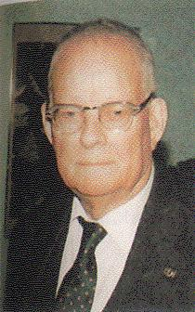
W. Edwards Deming
Statistics professor, specializing in acceptance sampling
Went to Japan after WW II
Helped Japanese focus on and improve quality
System (not employees) is cause of poor quality
Fourteen Points

Slide 12
Deming’s Paradigms
Intrinsic & extrinsic motivation
Management needs to improve and innovate processes to create results
Optimize the system toward its aim
Cooperation is better than competition

Slide 13
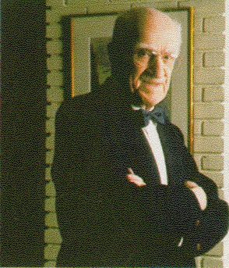
Joseph Juran
Went to Japan in 1951
Quality begins by knowing what customers want
80% of defects are controllable
  Quality Planning
  Quality control
  Quality improvement

Slide 14
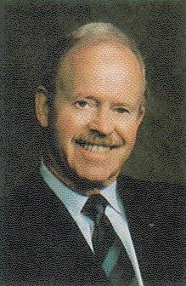
Philip B. Crosby
Martin Marietta, ITT, starting in 1960s
“Quality is Free”
Management must be firmly behind any quality plans
Do it right the first time

Slide 15
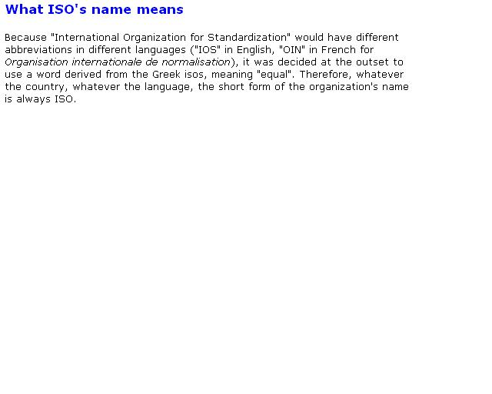

So what does it mean?
“ISO” is a word from the Greek “isos,” meaning “equal” (isoquant, isoprofit line). It’s not an abbreviation.

Slide 16

Older ISO Standards
ISO 9000:1994 Standard
  Certifies processes are standardized
  9001 for distributors
  9002 for assembly
  9003 for full-line manufacturing and retailing
ISO 9000:2000 Standard
  All replaced by ISO 9001:2000
  Conversion mandatory by Dec. 15, 2003

Slide 17
Basic Premise
A well-designed, well-implemented, and carefully managed quality system provides confidence that the outputs will meet customer expectations and requirements.

Slide 18
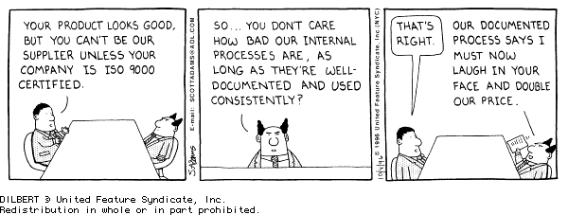

Slide 19
What is ISO certification?
Does not guarantee a quality product.
No inspection of the product is involved in certification.
To get certified:
  Have a written set of procedures for every activity
  Have your employees always follow procedures
  Pay someone to come and verify that you always follow your written procedures
If procedures are followed, your products should be consistently, uniformly good

Slide 20
So why do it?
In Europe (and elsewhere) only buy from certified companies to ensure safety
  Telecommunications equipment
  Medical devices
  Gas appliances
  Toys
  Construction products
Required for international competitiveness
Not to mention all of the other benefits of trying to improve quality

Slide 21
ISO Family of Standards
ISO 9001:2000 Basis for certification
ISO 9004:2000 to prepare for national quality award
ISO 10006 for project management
ISO 10007 for configuration management
ISO 10012 for measurement systems
ISO 10013 for quality documentation
ISO/TR 10014 managing economics of Q
ISO 10015 for training
ISO/TS 16949 for automotive suppliers
ISO 19011 for auditing

Slide 22
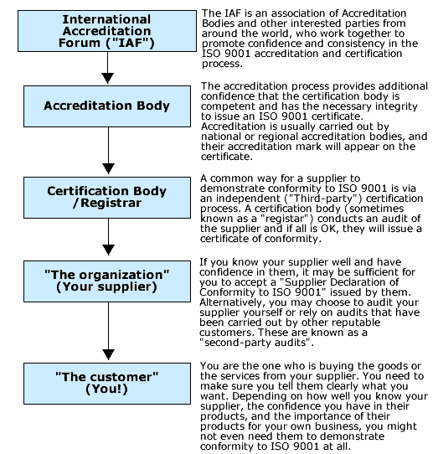
Certification Structure

Slide 23
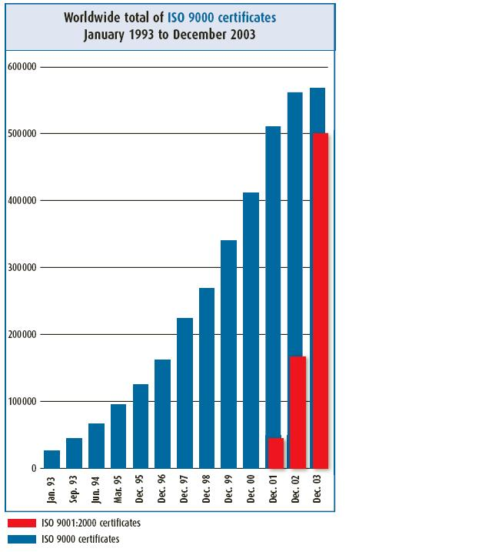
9000 Registrations
Total ISO 9000 registrations plateauing
9000:2000 growth before deadline

Slide 24
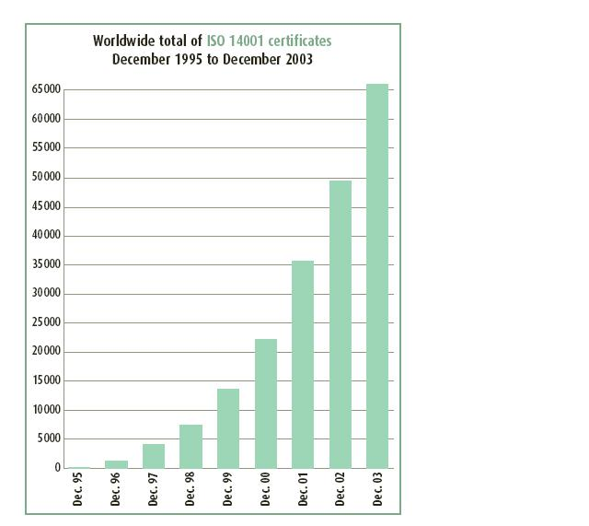
14001 certificates

Slide 25
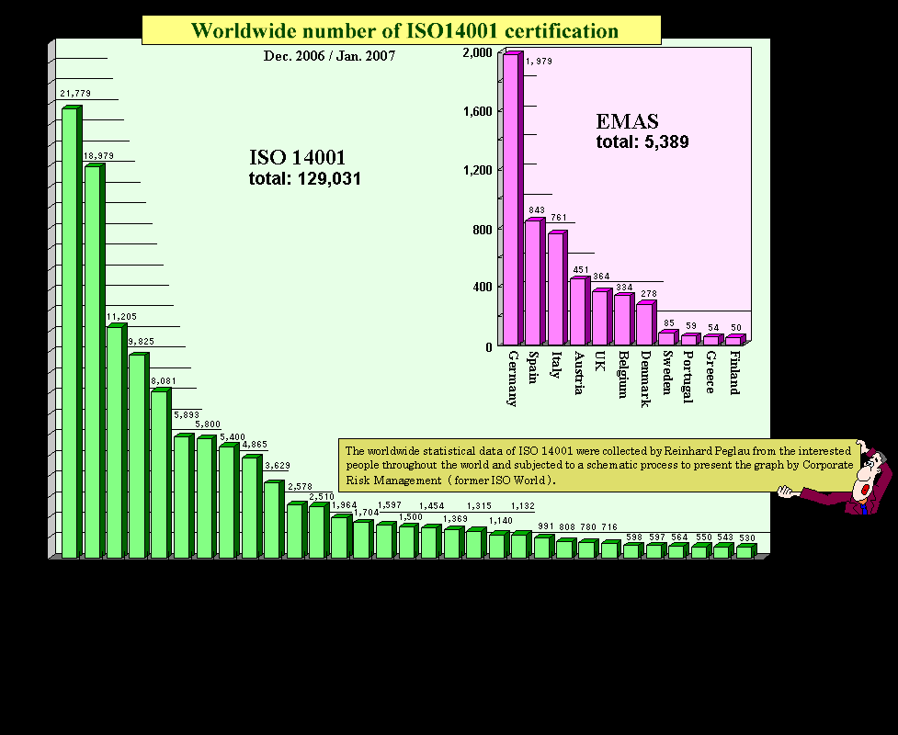

Slide 26
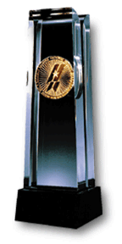
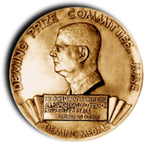
Quality Competitions
Malcolm Baldridge Quality Award (U.S.)
Awarded to 3 companies each year
Named for Secretary of Commerce killed in rodeo accident (1987)
Deming Prize (Japan)
Named after noted quality expert
Established in 1950

Slide 27
How We Got Here
National conference on Productivity, 1982
7 conferences leading up to White House Conference on Productivity
August 20, 1987 – Award created
  Stimulate companies to improve quality and productivity
  Recognize success to be example to others
  Guidelines for companies to assess progress

Slide 28
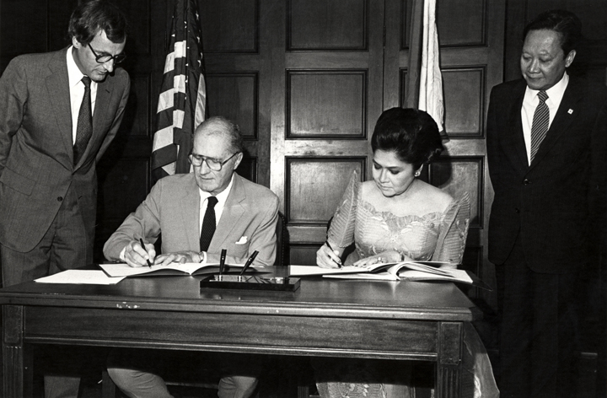
Malcolm Baldrige
1981-87 secty. of Commerce.
  Proponent of quality management as key to US economic survival
  Helped draft early version of quality act
  Resolved technology transfer differences with China and India
  First Cabinet-level meetings with Soviet Union in 7 years
    Paved way for increased access for US firms

Slide 29
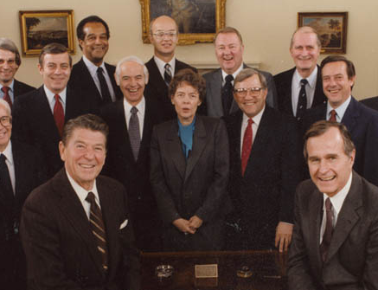

Slide 30
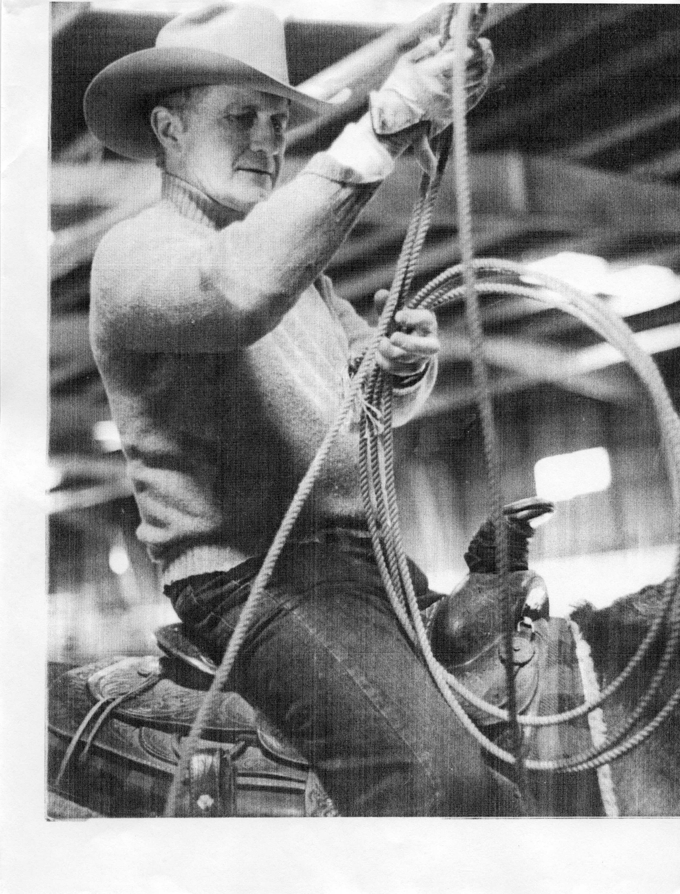
Champion Roper
National Cowboy Hall of Fame
  July 25, 1987 N. California rodeo
  Horse threw him, fell on him, and crushed him

Slide 31
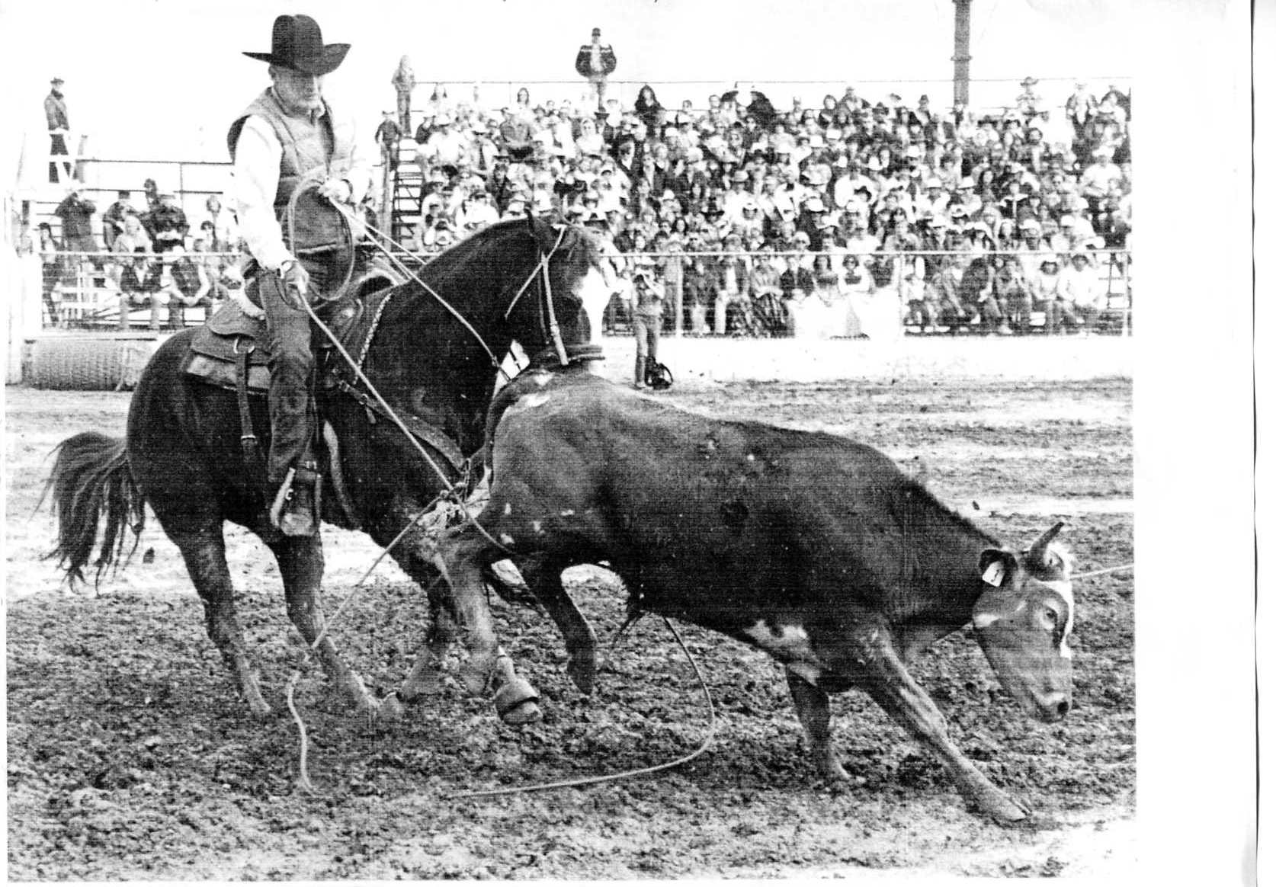

Slide 32
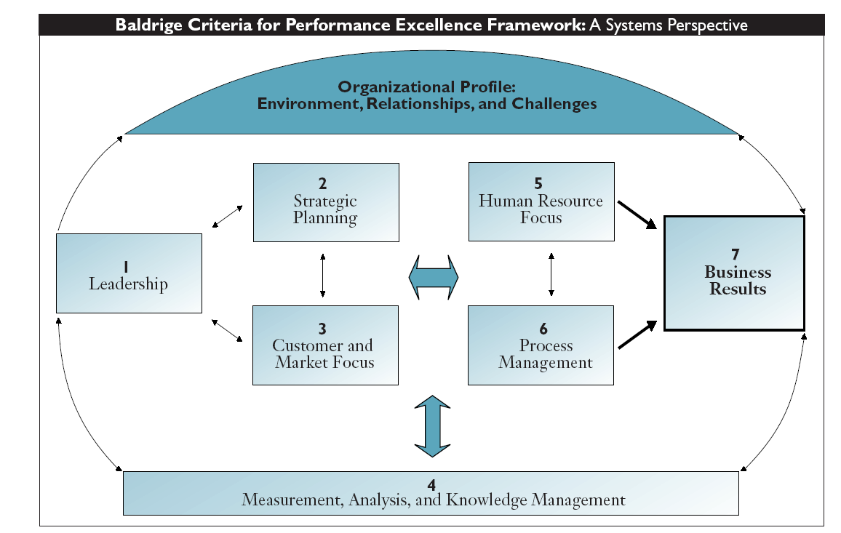

Slide 33
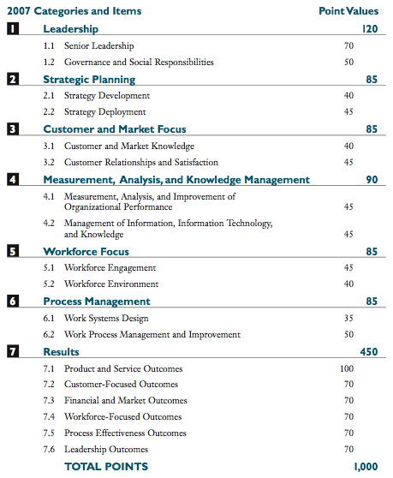
Point Values

Slide 34
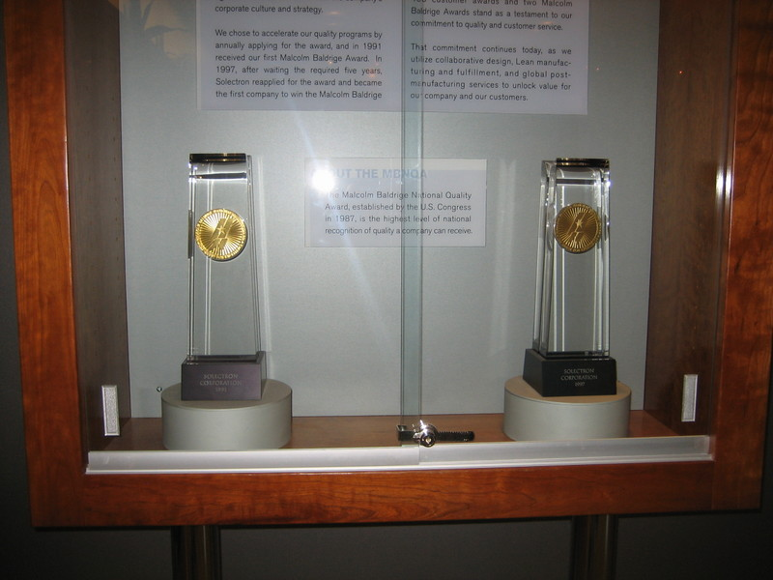
Malcolm Baldrige Double-Winner #1: Solectron
1991 1997

Slide 35
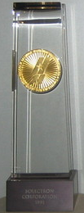

Malcolm Baldrige Double-Winner #1: Solectron
1991, 1997

Slide 36
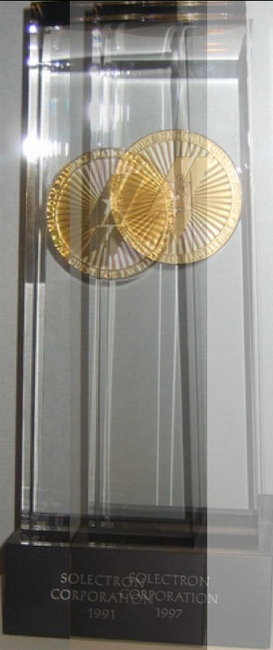
Two Great Honors
For attention to quality
What lovely trophies
Anyone notice anything?
Oopsie!
I guess somebody’s processes aren’t under control

Slide 37
Quality Competitions in Japan
Deming Prize (Japan)
Named after noted quality expert
Established in 1950
Florida Light & Power, AT&T

Slide 38
6 σ (6 sigma)
The goal is to ensure that no unacceptable parts are ever passed on to a customer.
A defect is anything that does not fall within the customer’s tolerance limits
Through continuous process improvement,
  Lower the process variability so low that the upper and lower specifications are 6 standard deviations above and below the mean

Slide 39
6 σ (6 sigma)
3σ
3 sigma:
Probability outside range = (1 – 0.99865) * 2 = 0.0027
Defect rate = 2,699 defects per million opportunities
6 sigma:
Probability part outside range = 0.00000000198024
Defect rate = 0.00197 dpm
1.97 defects per BILLION
6σ

Slide 40
Defect Rates - 1
3 sigma: 1/.0027 = 1 every 370 parts
6 sigma: 1/ 0.00000000198024
= 1 every 504.9 million parts
If we make a million parts per year, we have:
3σ: 2,699 defectives
6σ: 0.0019732 defectives

Slide 41
Defects - 2
With a 1.5σ shift, defect rates become:
3σ 66,807 dpm
6σ 3.4 dpm
The commonly accepted definition of 6σ quality is having a defect rate <= 3.4 dpm
3σ
6σ

Slide 42
6 sigma
DPMO: Defects Per Million Opportunities
DMAIC: Define, Measure, Analyze, Improve, and Control
  (Alternate meaning: Dumb Managers Always Ignore Customers)
DCDA: Plan, Do, Check, Act

Slide 43
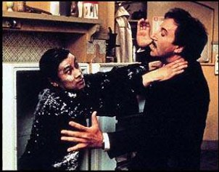
Black Belts
Green Belts: some 6 sigma training, take part in teams, small solo work
Black Belts: Coach or lead 6 sigma improvement teams
Master Black Belts: have in-depth statistical training, serve as Black Belts for more teams
Champions: Executives who will back up the proposals the black belts come up with

Slide 44
Pareto Chart - ranked histogram
Invented by Joseph Juran
Beer defects

Slide 45
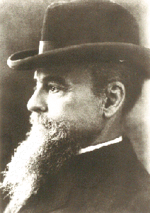
Wilfredo Pareto 1848-1923
Italian Economist
“80/20” rule: 80% of the wealth is controlled by 20% of the people Cours d'économie politique (1896-7)
80/20 rule believed to apply much more widely
1906- “Pareto Optimality” – not possible to make anyone better off (in his own estimation) without making someone else worse off

Slide 46
Cause & Effect Diagram Example
Too Many
Defects

Slide 47
Cause & Effect Diagram Example
Method
Manpower
Main Cause
Too Many
Defects
Material
Machinery
Main Cause

Slide 48
Cause & Effect Diagram Example
Method
Manpower
Drill
Tired
Too Many
Defects
Wood
Steel
Lathe
Material
Machinery

Slide 49
Cause & Effect Diagram Example
Method
Manpower
Over
Time
Drill
Slow
Tired
Too Many
Defects
Wood
Not
maintained
Not dried
Steel
Lathe
Material
Machinery

Slide 50
Control Chart Example
UCL
LCL

Slide 51
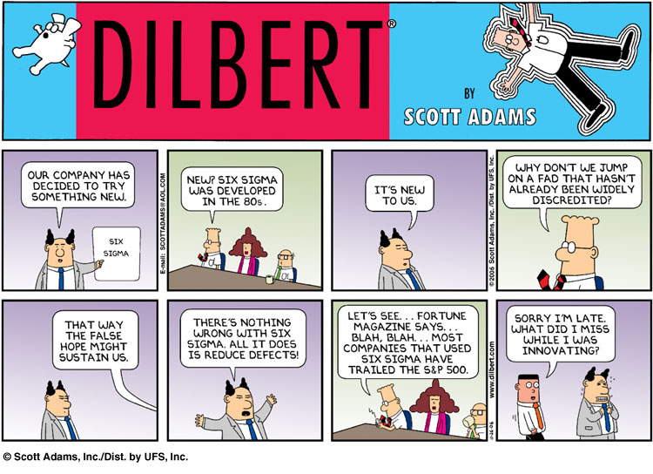
Dilbert’s View

Slide 52
Fortune Story
58 large companies have announced Six Sigma efforts
91% trailed S&P 500 since then, according to Qualpro, (which has its own competing system)
July 11, 2006

Slide 53

Qualpro’s “Six Problems with Six Sigma”
  Six sigma novices get “low hanging fruit” “Without years of experience under the guidance of an expert, they will not develop the needed competence”
  Green belts get advice from people who don’t have experience implementing it
  Loosely organized methodology doesn’t guarantee results (and they do?)
  Six Sigma uses simple math – not “Multivariable Testing” (MVT)
  Six Sigma training for all is expensive, time-consuming
  Pressure to “do something” – low value projects

Slide 54
Six Sigma
Narrow focus on improving existing processes
Best and Brightest not focused on developing new products
Fortune July 11, 2006
Can be overly bureaucratic

Slide 55
Final Thought
IBM Canada Ltd. ordered some parts from a new supplier in Japan. The acceptable quality level allowed for 1.5% defects. The Japanese firm sent the order with a few parts packaged separately, & the following letter ...
© 1995 Corel Corp.

Slide 56
Final Thought
Dear IBM:
We don’t know why you want 1.5% defective parts, but for your convenience we have packaged them separately.
Sincerely,
© 1995 Corel Corp.

