Slide 1
Building Customer Loyalty

Slide 2
Building Customer Loyalty
Julie Riecken – Training Support Manager
Rick Paulsen – Client Relations Manager

Slide 3
What is Customer Loyalty?
Attracting the right customer
Encouraging customers to buy, buy often, buy in higher quantities and bring you even more customers
Providing excellent customer service

Slide 4
Ideas for building loyalty…
You build customer loyalty by treating people how they want to be treated.
Does your customer service and marketing plan include strategies and tactics for customer loyalty & customer retention?

Slide 5
Customer loyalty programs
E-mail newsletters with specials
Buy 10, get 1 free
Discounts
Bundles
Incentive to pay on-time
Special customer contests
Special events for loyalty club members
Simple, uncomplicated
Other ideas?

Slide 6
Other ways to build loyalty…
Personal thank you cards
Personal bill messages
Taking advantage of the latest tools available to you to gather customer information.
Showing that you care and remembering what they like and don’t like.
Ask your customers how you’re doing – and take it to heart!
Treat your team well so they treat your customers well.

Slide 7
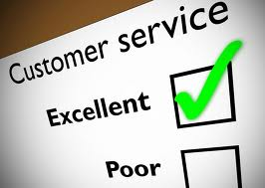
How does good customer service help build customer loyalty?

Slide 8
Lessons in Customer Service…
Customer service is the provision of service to customers before, during, and after a purchase.
The process of ensuring customer satisfaction with a product or service.
Customer service has often been done badly because it has been defined badly.
Once a customer is disappointed in your service, you may never gain loyalty

Slide 9
Experience #1 – Customer Service is TOO GOOD.
“I need to discuss disconnecting my landline phone service.”

Slide 10
Experience #2 - The unengaged Customer Service Representative.
“I have a question about my bill….”

Slide 11
Experience #3 – Customer Service is Caring & Considerate
“I need to discuss disconnecting my landline phone service.”

Slide 12
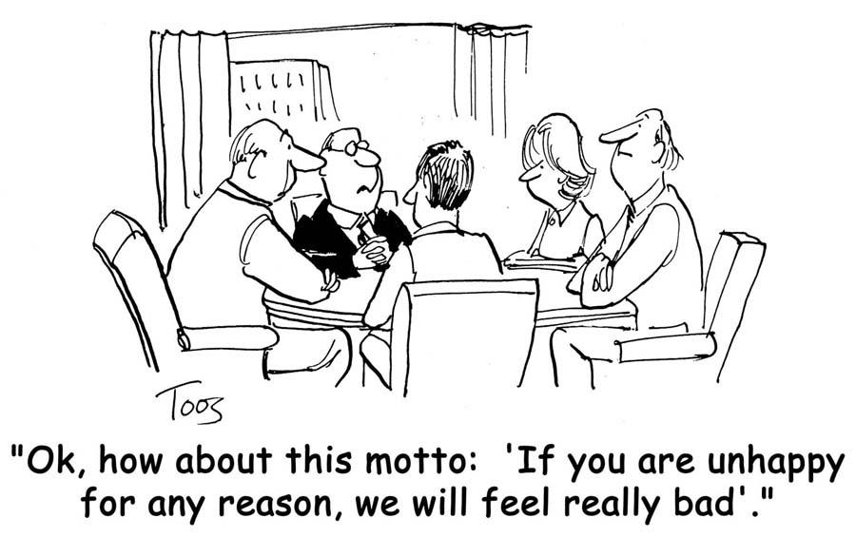
How do you feel when you get BAD customer service?
Get angry or confrontational?
Report to manager?
Be snotty back?
Offer to give person a hug?
Ruin your day?

Slide 13
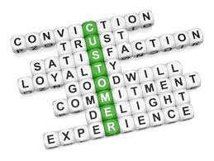
How do you feel when you get GOOD customer service?
Surprised?
Grateful?
Appreciative?
Want to hug the person?
Want to cry?
Loyal

Slide 14
LG Repairman
Rick’s phone cover
Upgrade early?
Upgraded hotel room
Proactive courtesy calls

Slide 15
Diversify to develop great service and therefore customer loyalty
Customer Support & Technology
On-line help
Chat
Connect for Support
Skype
Web Self-Care
24-hour support
Web Self-Care
Mobile Applications

Slide 16
How do you establish trust with customers over the phone?
One of the hardest parts of the job
Mostly dealing with people you might not ever meet face-to-face
Reassure them you understand their situation
Ask them what they want … simple, but effective
Avoid being argumentative
Ask them how you can make them happy, and work the compromise from there

Slide 17
Personalize your service & gain loyalty
Small enough to care, large enough to provide a quality product & service
Now is the time to focus on new products and services
Implement customer service focused procedures and processes
Pro-Active customer service
Transition NOW to becoming a Technology Company
Continue to evaluate competitive opportunities

Slide 18
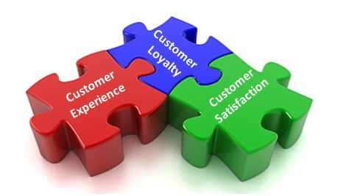
So, how do you build customer loyalty?
You build it by truly caring about the customer and figuring out how to make them more successful, happy and joyful.

Slide 19
Some Fun
Things to Try

Slide 22
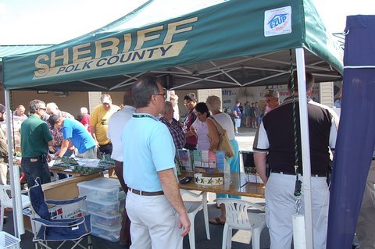
LOCAL SHERIFF DEPT.

Slide 23
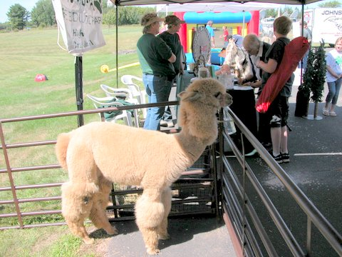
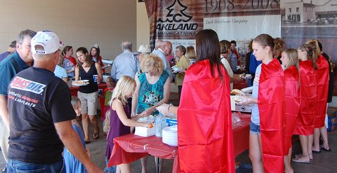
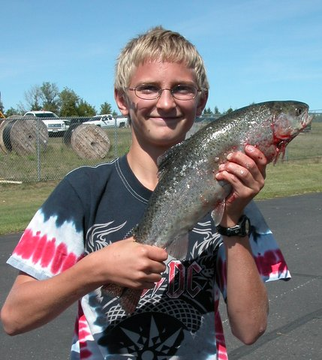
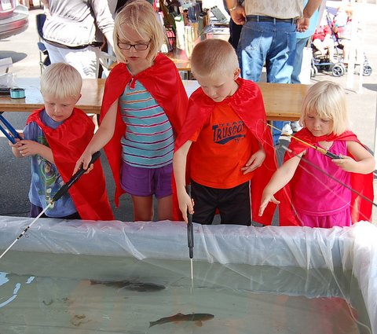
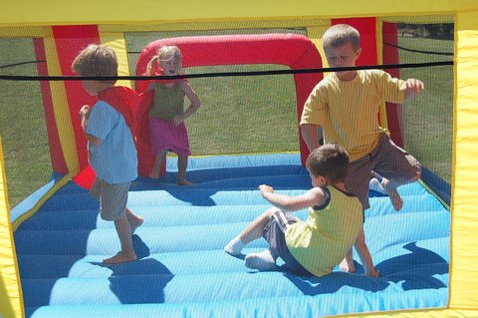
DO FUN THINGS FOR THE KIDS

Slide 24
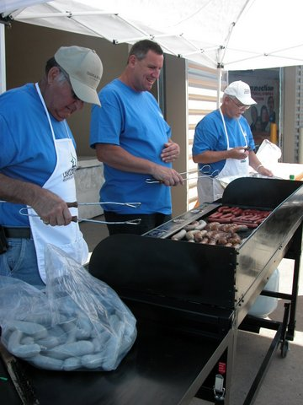
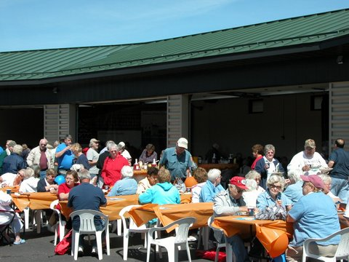
BOARD of DIRECTORS COOKING

Slide 25
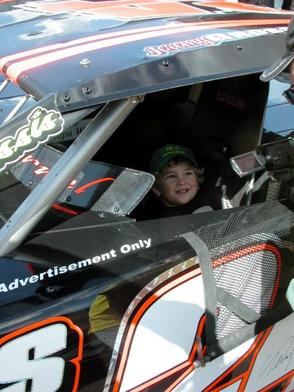
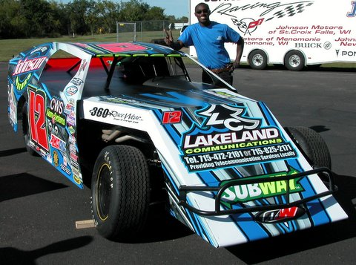
SPONSOR LOCAL RACE CARS

Slide 26
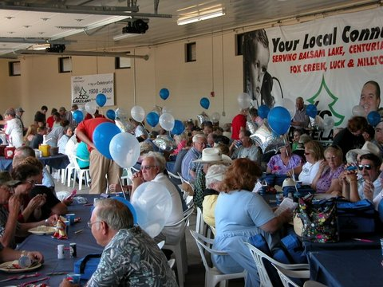
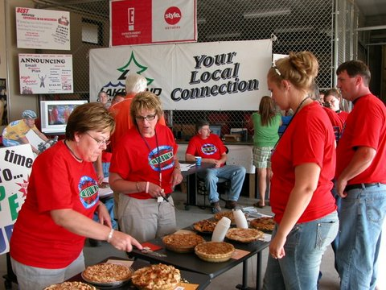
APPLE PIE
EATING CONTEST

Slide 27
Any success stories to share?
What worked?
Overall success?
Suggestions?

Slide 28
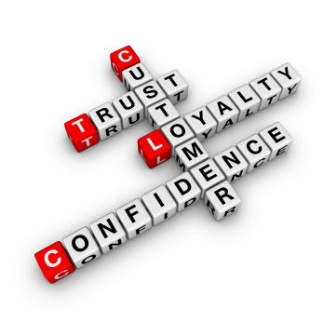
Questions?

Slide 29
Thank You!

