Slide 1
The Glass Ceiling
Marianne Bertrand
Booth School of Business, University of Chicago
14th Journées Louis-André Gérard-Varet
June 15, 2015

Slide 2
Background
Substantial gains for women over the last half century in many countries around the world:
  Education
  Labor force participation
  Earnings
Why those gains?
  Innovations in contraception
  Better regulatory controls against discrimination
  Labor demand shifts towards industries where female skills are disproportionately represented
  Technological progress in home production activities

Slide 3
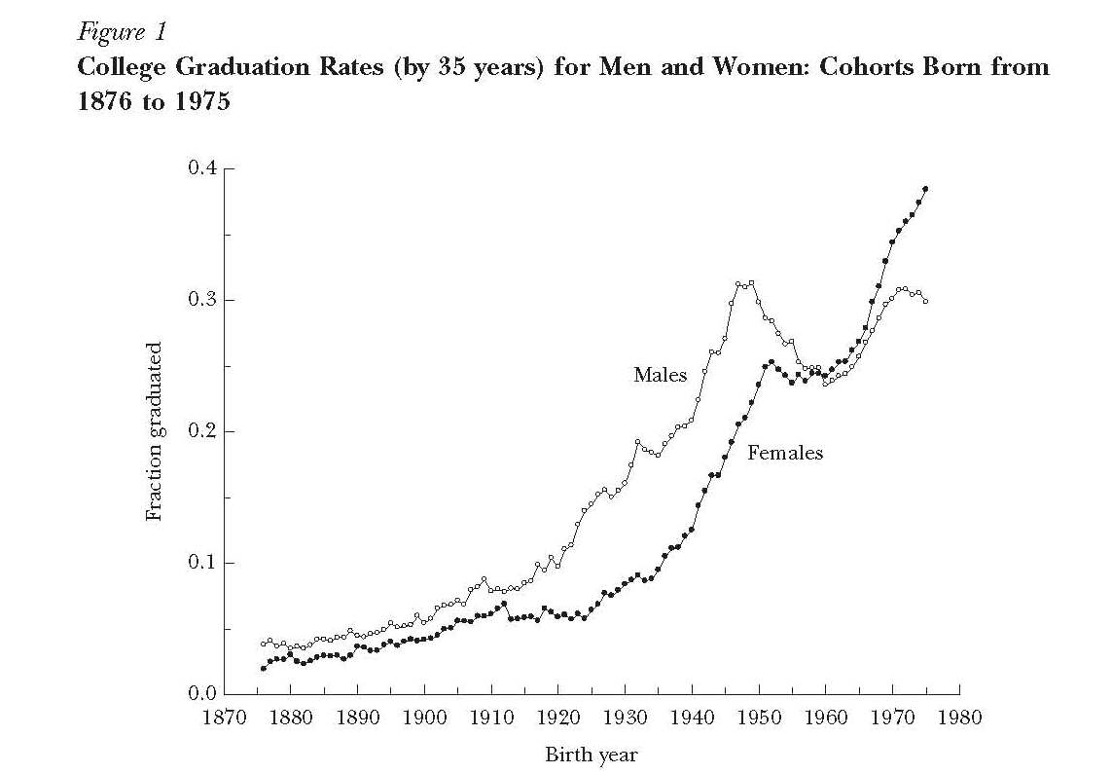
Source: Goldin, Katz and Kuziemko (2006)

Slide 4
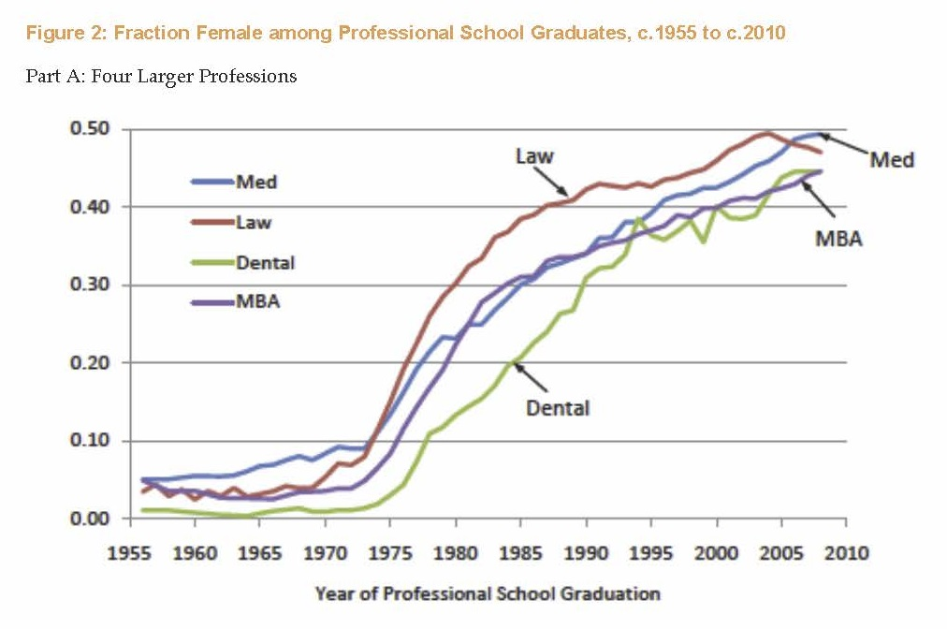
Source: Goldin and Katz (2010)

Slide 5
Yet…
Convergence appears to have slowed down since early/mid 1990s
  “Plateauing” of female labor force participation in several countries, in particular U.S.
A significant gender gap in earnings remains, even among full-time-full-year (FTFY) workers
  In U.S., FTFY female workers earn about 25 percent less than FTFY male workers
Women remain highly under-represented in high status/high income occupations
  Salient example: corporate sector

Slide 6
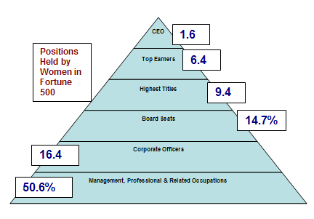

Slide 7
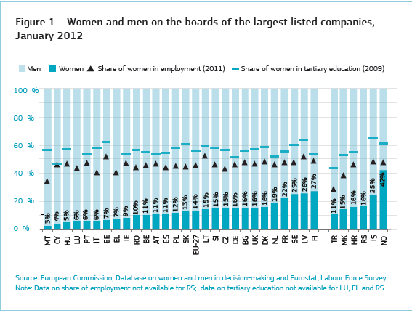
Women’s Representation on Corporate Boards

Slide 8
Outline
What explains the remaining gender gap(s)?
  A tour through the most active current areas of research in explaining the remaining gender gaps
    Gender differences in psychological attributes
    Work-family balance considerations
    Social norms: gender role attitudes and gender identity norms
More detailed look into a specific policy response that has been gaining a lot of traction in Continental Europe:
  Gender Quotas for Corporate Boards

Slide 9
What Explains the Remaining Gender Gap(s)?
Flurry of laboratory studies over the last decade or so have documented robust gender differences in a set of psychological attributes
Some of these psychological attributes may have direct relevance in explaining labor market choices and labor market outcomes
In particular:
  Women are more risk averse
  Women negotiate less/women do not ask
  Women perform more poorly in competitive environments and shy away from such competitive environments
  Women lack in self-confidence (while men tend to be overly confident)

Slide 10
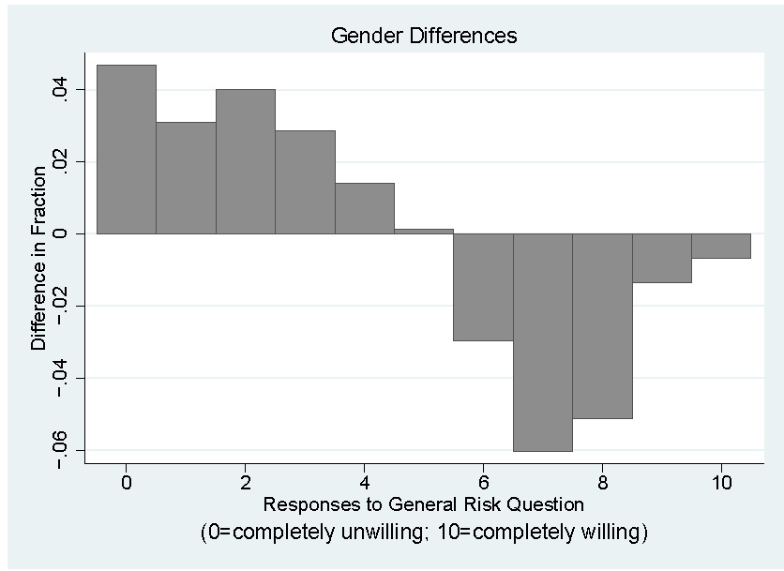
Gender and risk aversion
Source: Dohmen et al (2011)
Notes:
German Survey
Respondents asked to rate their willingness to take risk:
In general; in specific domains (health, sports, financial, etc…)
0=complete unwillingness to take risks; 10=complete willingness to take risks
Subjective measures of risk attitudes validated with lab-based measures
Similar findings in many other datasets/contexts

Slide 11
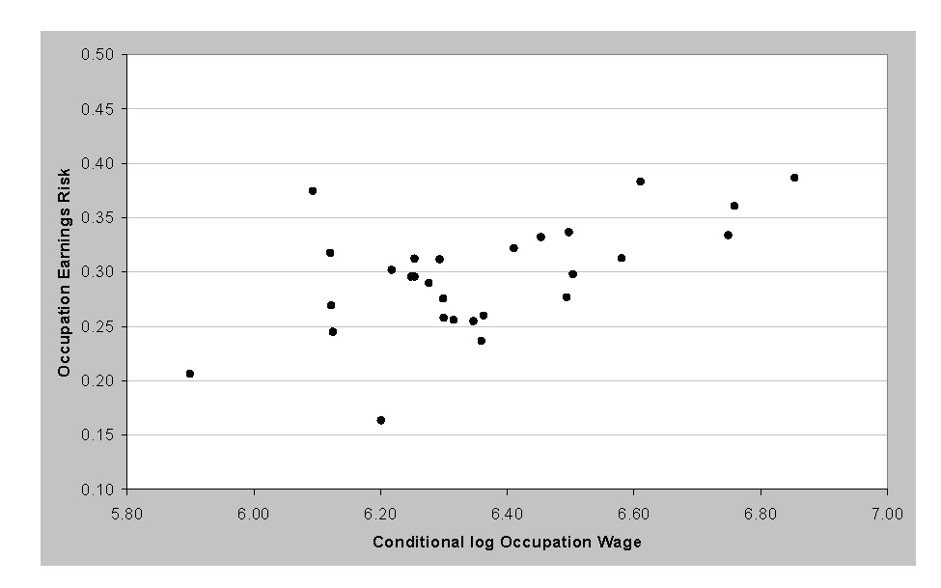
Gender and risk aversion
Source: Dohmen et al (2011)

Slide 12
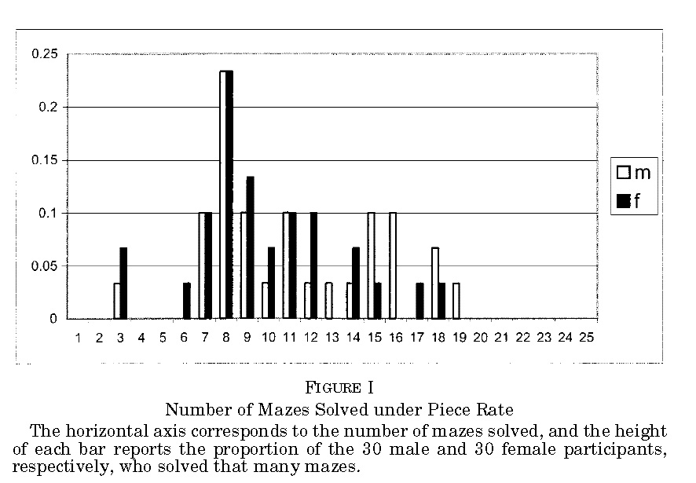
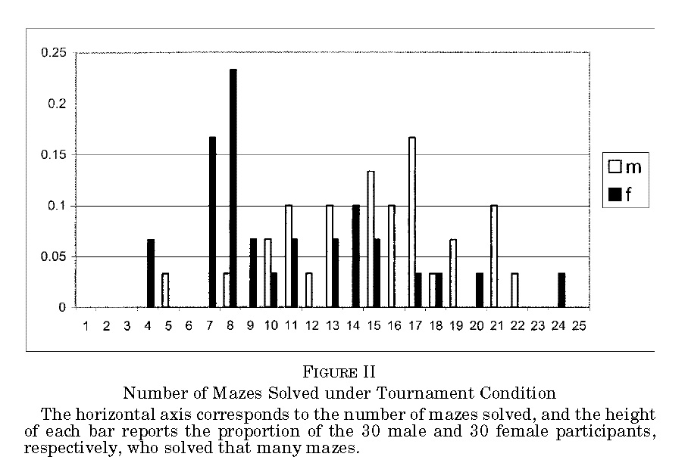
Gender and competition
Source: Gneezy et al (2003)

Slide 13
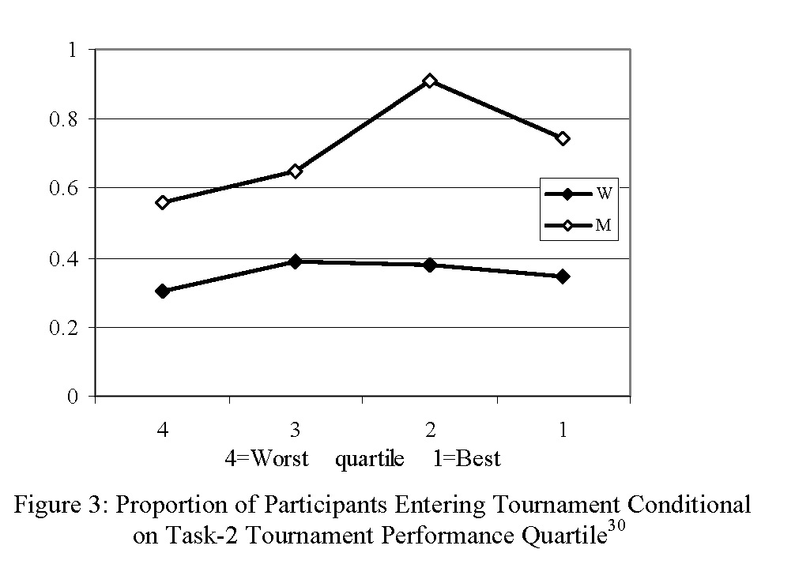
Women shy away from competition
Source: Niederle and Vesterlund (2007)
Notes:
(While Men are Drawn to It)

Slide 14
Gender differences in psychological attributes:
Next steps
Getting outside the lab
  Growing amount of work trying to quantify the impact of these gender gaps in psychological attributes for real outcomes, for example:
  Manning and Saidi (2010)
  Ors et al (2008); Buser et al (2013)
Innate or learned? nature vs. nurture? interaction?
  Important distinction when it comes to policy response
  Innate (2D:4D; left handedness; testosterone/progesterone; kids vs. adults): Hoffman and Gneezy (2010); Buser (2011); Gneezy and Rustichini (2004)
  Learned (matriarchal vs. patriarchal societies; coed vs. single-sex schools; kids vs. adults): Gneezy et al (2008); Hoffman et al (2011); Booth and Nolen (2009); Dreber et al (2011)
Notes:
Buser (2011) finds that women
are less competitive both when taking contraceptives that contain progesterone and estrogen
and during the phase of the menstrual cycle when the secretion of these hormones is
particularly high.
An alternative approach is to examine the effect of testosterone on competitiveness.
Whereas Apicella et al. (2011) find no relationship between self-selection into a
tournament and current testosterone levels, a recent study by Hoffman & Gneezy (2010)
takes advantage of the fact that left-handedness is thought to be an indicator of prenatal
testosterone and finds evidence that such exposure increases competitiveness.

Slide 15
Gender differences in psychological attributes:
Policy responses
Simple, low cost, changes in firm HR practices might prove quite effective in undoing some of these effects:
  In particular, informational policies:
    Instituting systematic feedback on relative performance
    Providing all employees with systematic information how many people have asked for a promotion in the last year, and/or the average change in compensation, by job title
Other, possibly more costly, policies:
  Affirmative action/quota targeted at high performance women within the organization
  Competition within single-sex teams
Testing the impact of such HR reforms should an important priority for further research

Slide 16
What Explains the Remaining Gender Gap(s)?
Work-family balance considerations:
  Women remain the dominant providers of child and elderly care within the household, as well as other forms of non-market work (chores, etc)
  Many of the higher-paying jobs have long hours and inflexible schedules, which makes it difficult to combine those jobs with family responsibilities
  Many of the financially more rewarding careers require continuous labor force attachment in order to stay on the “fast track,” which makes it difficult to combine those careers with job interruptions (maternity leaves, extended school breaks in summer, etc)

Slide 17
Chicago Booth MBA study
(Bertrand, Goldin and Katz 2010)
Homogenous set of men and women that have all selected into MBA education and have been admitted into the same program
  Men and women in this program likely not representative of their respective gender group in terms of psychological attributes
Main contributor to growing gender gap in earnings in this group is a growing gender gap in labor supply:
  Actual accumulated experience
  Weekly hours worked
Most of the gender gap in labor supply can be explained by the presence of children

Slide 18
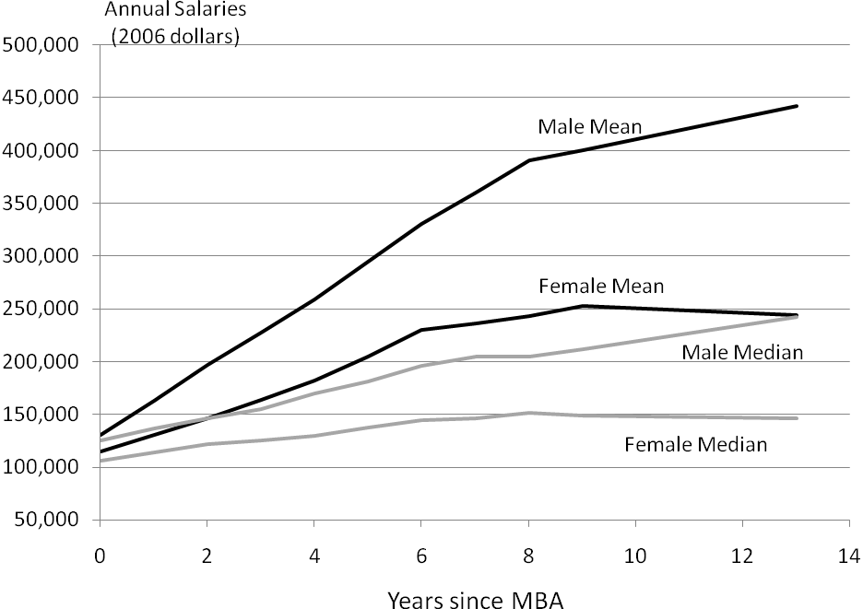
Male and female mean and median annual salaries ($2006) by years since graduation (Chicago Booth MBA data)
Source: Bertrand, Goldin and Katz (2010)

Slide 19
Labor Supply by Gender and Years since Graduation
 | Number of Years since Graduation
 | 0 | 1 | 2 | 3 | 4 | 5 | 6 | 7 | 8 | 9 | ≥ 10
 | Share not working at all in current year
Female | 0.054 | 0.012 | 0.017 | 0.027 | 0.032 | 0.050 | 0.067 | 0.084 | 0.089 | 0.129 | 0.166
Male | 0.028 | 0.005 | 0.002 | 0.003 | 0.007 | 0.004 | 0.008 | 0.008 | 0.006 | 0.011 | 0.010
 | Share with any no work spell (until given year)
Female | 0.064 | 0.088 | 0.116 | 0.143 | 0.161 | 0.193 | 0.229 | 0.259 | 0.287 | 0.319 | 0.405
Male | 0.032 | 0.040 | 0.052 | 0.064 | 0.071 | 0.077 | 0.081 | 0.082 | 0.090 | 0.095 | 0.101
 | Cumulative years not working
Female | 0 | 0.050 | 0.077 | 0.118 | 0.157 | 0.215 | 0.282 | 0.366 | 0.426 | 0.569 | 1.052
Male | 0 | 0.026 | 0.036 | 0.045 | 0.057 | 0.060 | 0.069 | 0.075 | 0.084 | 0.098 | 0.120
 | Mean Weekly hours worked for the employed
Female | 59.1 | 58.8 | 57.1 | 56.2 | 55.3 | 54.8 | 54.7 | 53.7 | 52.9 | 51.5 | 49.3
Male | 60.9 | 60.7 | 60.2 | 59.5 | 59.1 | 58.6 | 57.9 | 57.6 | 57.6 | 57.5 | 56.7

Slide 20
Gender Gap in Labor Supply: The Role of Children
(controls include Pre-MBA characteristics, MBA performance, cohort*year fixed effects)
Dependent Variable | Not working |  | Actual post-MBA experience |  | Log (weekly hours worked)
Female | 0.084 |  | -0.286 |  | -0.089
 | [0.009]* |  | [0.039]* |  | [0.013]*
Female with child |  | 0.20 |  | -0.66 |  | -0.238
 |  | [0.024]* |  | [0.094]* |  | [0.031]*
Female without child |  | 0.034 |  | -0.126 |  | -0.033
 |  | [0.007]* |  | [0.031]* |  | [0.012]*

Slide 21
Gender Wage Gap by Number of Years since MBA Graduation
 | Number of Years since MBA Receipt
 | 0 | 2 | 4 | 7 | 9 | ≥ 10
1. With no controls | -0.089 | -0.213 | -0.274 | -0.331 | -0.376 | -0.565
 | [0.020]* | [0.032]* | [0.043]* | [0.062]* | [0.079]* | [0.045]*
With controls:
2. Pre-MBA characteristics | -0.08 | -0.172 | -0.221 | -0.271 | -0.32 | -0.479
 | [0.021]* | [0.033]* | [0.044]* | [0.065]* | [0.084]* | [0.045]*
3. Add MBA performance | -0.054 | -0.129 | -0.166 | -0.2 | -0.257 | -0.446
 | [0.021]* | [0.032]* | [0.042]* | [0.063]* | [0.082]* | [0.044]*
4. Add labor market exp. | -0.053 | -0.118 | -0.147 | -0.141 | -0.181 | -0.312
 | [0.021]§ | [0.031]* | [0.042]* | [0.063]§ | [0.082]§ | [0.044]*
5. Add weekly hours worked | -0.036 | -0.069 | -0.079 | -0.054 | -0.047 | -0.098
 | [0.020] | [0.030]§ | [0.041] | [0.060] | [0.078] | [0.042]§

Slide 22
Life satisfaction Among College Educated Women
Source: Bertrand (2013)

Slide 23
Table 3: Emotional Well-Being Among College Educated Women Panel A: Career and Husband
 |  |  | (1) |  | (2) | (3) |  |  | (4)
Dependent variable: |  |  | Over the Course of the Day, Average:
 |  |  | Happiness |  | Sadness | Stress |  |  | Tiredness
Career |  | 0.088 |  |  | -0.357 | -0.052 |  |  |  | -0.21
 |  | [0.121] |  |  | [0.098]** | [0.141] |  |  |  | [0.151]
Married |  | 0.259 |  |  | -0.406 | -0.332 |  |  |  | -0.019
 |  | [0.109]* |  |  | [0.088]** | [0.127]** |  |  |  | [0.136]
Career and married |  | -0.317 |  |  | 0.567 | 0.349 |  |  |  | 0.379
 |  | [0.146]* |  |  | [0.118]** | [0.170]* |  |  |  | [0.181]*
Observations |  | 1482 |  |  | 1483 | 1483 |  |  |  | 1483
R-squared |  | 0.03 |  |  | 0.04 | 0.05 |  |  |  | 0.04

Slide 24
Work family balance considerations:
Policy responses
Firm-level HR and public policies aimed at augmenting work-family amenities within the workplace, such as:
    Parental leave
    Part time work, shorter hours
    Flexibility during the workday
    Child care services

Slide 25
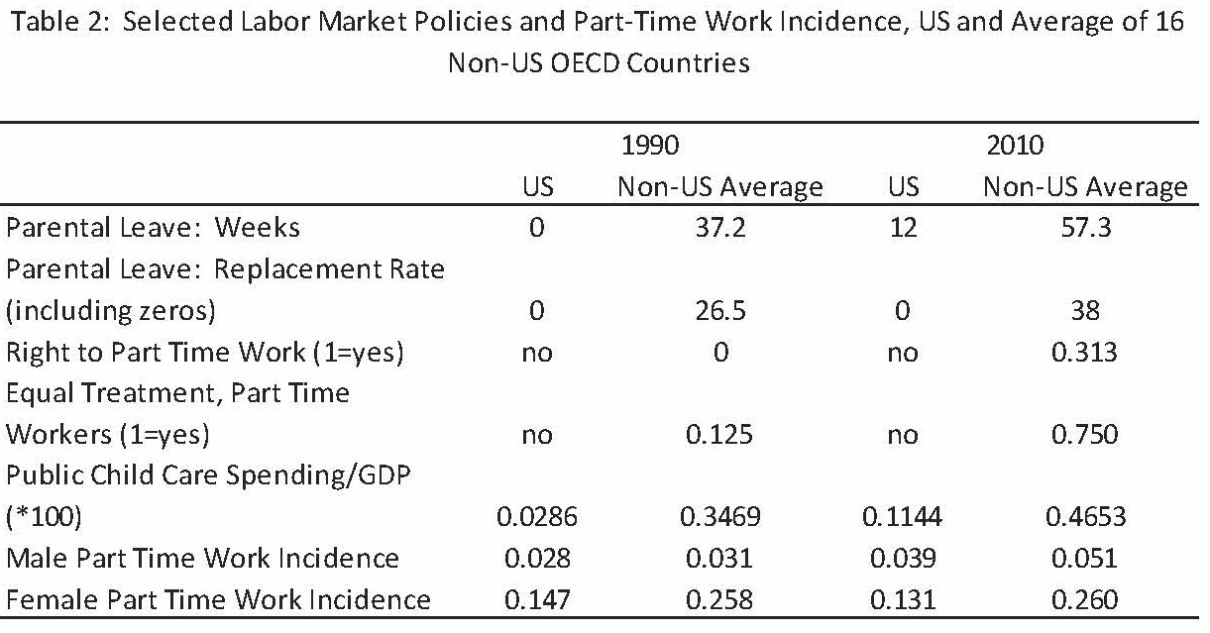
Source: Blau and Kahn (2013)

Slide 26
Work family balance considerations:
Policy responses
Theoretically ambiguous effects of some of these policies:
  For example, longer parental leave raises costs for employers of hiring women of child-bearing age; it may lead employers to not assign women to the most important jobs or clients; it may also keep women out of the workforce for “too long” to ensure a re-entry on the fast-track.
Tradeoff between reducing the gender gap in labor participation and reducing the gender gap in earnings (Blau and Kahn, 2013):
  Country-level panel evidence suggests that part (30 percent) of the US plateauing in labor force participation compared to other OECD countries can be accounted for by more aggressive work-family balance policies in non-US OECD
  But higher representation of women in high-paying managerial and professional occupations in US compared to non-US OECD

Slide 27
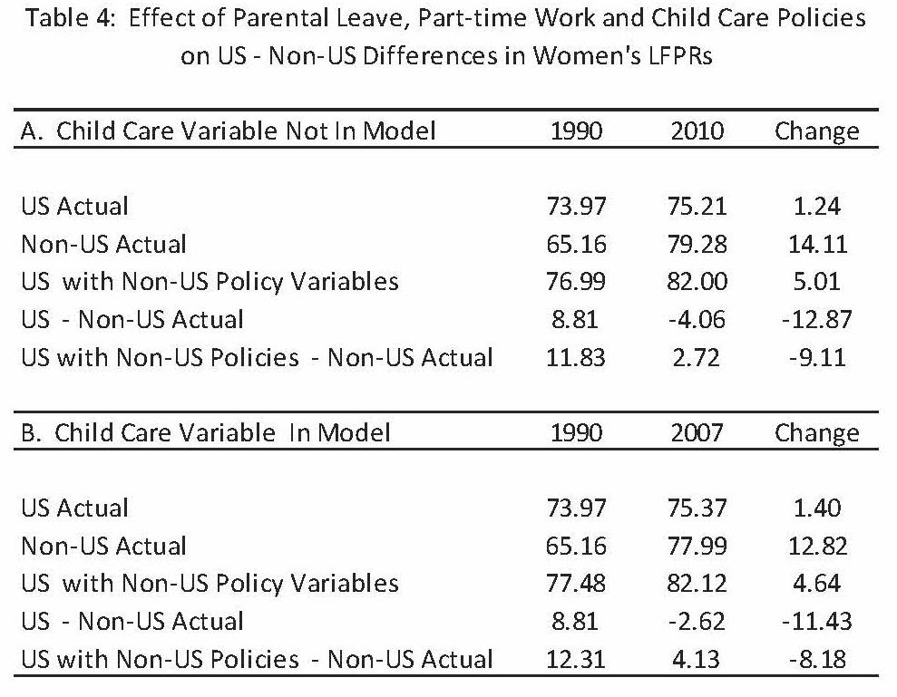
Source: Blau and Kahn (2013)

Slide 28
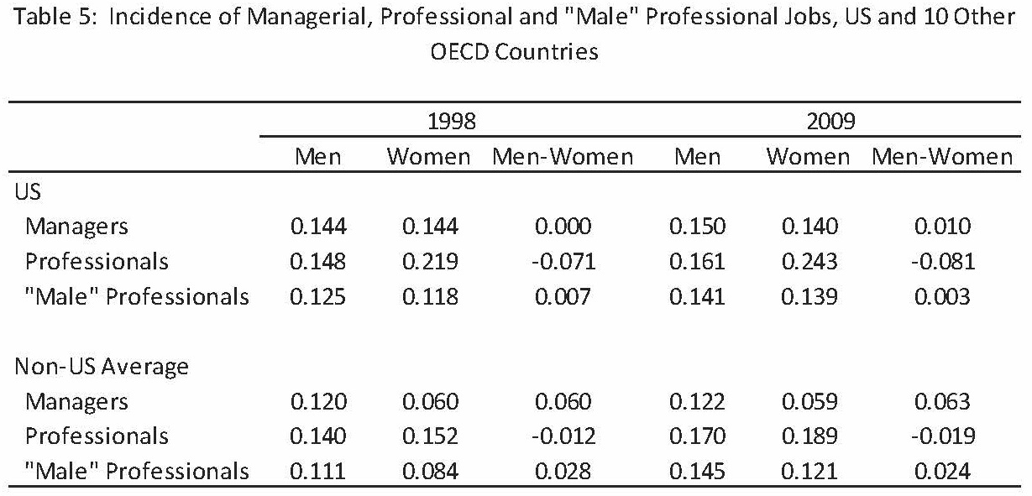
Source: Blau and Kahn (2013)

Slide 29
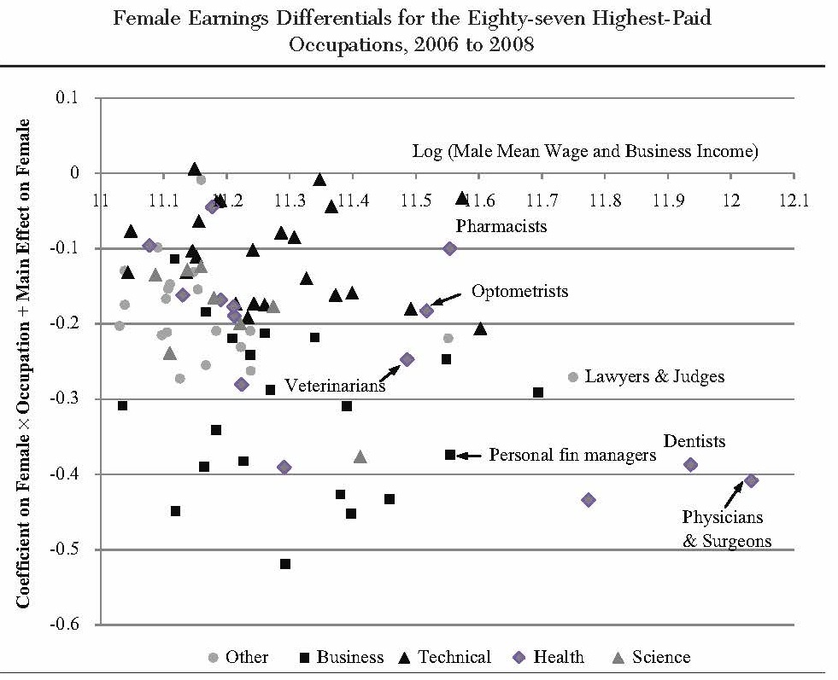
Earnings penalties for job interruptions or part-time work differ substantially across higher-powered occupations
(Source: Goldin and Katz, 2011)
Notes:
To understand earnings differences between men and women more generally
and the implicit role of workplace amenities, we examined the relative incomes
of men and women in the top eighty-seven occupations by male income.15 After
accounting for potential experience, hours worked, weeks worked, and other
observable factors, the remaining difference between men and women by occupation
is largely due to the penalties imposed on women for greater job interruptions
and their need for more flexibility. The results for 2006 to 2008 given in
Figure 4 are striking.
The Cost of Workplace Flexibility
Each dot is one of the occupations listed in the census (465 in total). The horizontal
axis gives (male) income in natural logs, and the vertical axis gives the earnings
gap in log points (approximately the percentage penalty) between the average
man and woman in an occupation, given potential job experience, hours of work,
weeks of work, region, and race.16 The occupations are divided into those that
concern business, health, science, technology, and all others.
All eighty-seven occupations are situated just at or below the horizontal axis.
That is, in all occupations, women make less than men given the somewhat rich
group of covariates included in the regression. More interesting is the manner in
which the occupations group together. The business occupations (squares) are
generally the most negative, whereas the technology occupations (dark triangles)
are the most positive. The health occupations (diamonds) are mixed, with those
having the greatest fraction self-employed being the most negative and the ones
that had decreases in self-employment being the least negative.
Business occupations, it was previously noted, place heavy penalties on employees
who deviate from the norm. But why do the technology occupations appear to
penalize women far less? One possibility is that the technology occupations are so
recent that their work organizations are structured to deal better with a labor force
that needs greater work flexibility.

Slide 30
Work family balance considerations:
Policy responses
What explains the large differences in “flexibility penalties” across occupations?
  If unalterable differences in the nature of work, little that could be changed through policy.
  If alterable differences in the organization of work (with little to no productivity costs), possible policy responses:
    Easing coordination across competing firms towards more family-friendly work organization
    Pushing more high quality women in top organizational layers (AA, quota) to accelerate redesign of work organization
Notes:
Self-regulation,

Slide 31
What Explains the Remaining Gender Gap(s)?
Gender role attitudes and gender identity norms
  Work-family balance considerations remain disproportionately a “woman’s problem” because of persistent gender role attitudes and gender identity norms
  Gender role attitudes:
    “Scarce jobs should go to men first”
    “Being a housewife is fulfilling”
    “A working mother can establish a warm relationship with her children”
  Gender identity norms:
    “Men should not do women’s work”
    “Men should earn more than their wives”
  But maybe also:
    “Women should not compete”
    “Women should not take too much risk”

Slide 32
Average gender role attitudes by birth cohorts across OECD countries

Slide 33
Source: Fortin (2005)

Slide 34
Distribution of relative earnings across couples
(Bertrand, Kamenica, Pan 2015)
US administrative data (1990 to 2004)

Slide 35
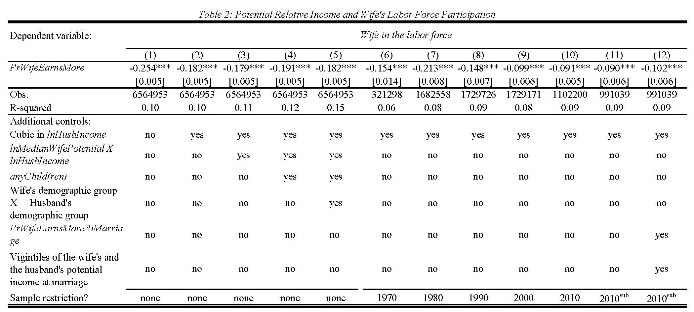
Source: Bertrand, Kamenica, Pan 2015

Slide 36
Gender role attitudes and gender identity norms:
Policy responses
How malleable are social norms? How long will it take for these norms to adjust to the gains in education and labor market opportunities for women?
  Evidence of strong persistence
    Current views about gender norms related to pre-industrial agricultural practices (Alesina et al, 2011)
  But also responsiveness to labor market changes within a generation (Fernandez et al, 2004)
Policies may help accelerate that process:
  Exposure to female leaders: Gender quotas in Indian village councils weaken men’s stereotypes about gender roles (Beaman et al, 2009)
  Schooling environment: ex: co-ed vs. single-sex schools
  Paternity leave policies (Norway and other Scandinavian countries)
Notes:
This paper seeks to better understand the historical origins of current differences in norms and beliefs about the appropriate role of women in society. We test the hypothesis that traditional agricultural practices influenced the historical gender division of labor and the evolution and persistence of gender norms. We find that, consistent with existing hypotheses, the descendants of societies that traditionally practiced plough agriculture, today have lower rates of female participation in the workplace, in politics, and in entrepreneurial activities, as well as a greater prevalence of attitudes favoring gender inequality. We identify the causal impact of traditional plough use by exploiting variation in the historical geo-climatic suitability of the environment for growing crops that differentially benefited from the adoption of the plough. Our IV estimates, based on this variation, support the findings from OLS. To isolate the importance of cultural transmission as a mechanism, we examine female labor force participation of second-generation immigrants living within the US
This paper suggests that a significant factor explaining the increase in female labor force
participation over time was the growing presence of a new type of man. This man was
brought up with a different family model—one in which his mother worked. A working
mother either influenced her son’s preferences for a working wife or directly made him a
better partner for a working woman. The increase in the proportion of these men over time
encouraged women to invest more in market skills and to participate in market work. We
develop a simple dynamic model that illustrates this idea. We present extensive crosssectional
evidence showing that men with working mothers are significantly more likely
to have wives who work, even after controlling for many features of both spouses. In
support of the dynamic implications of our theory, we present intergenerational evidence
that uses differences in mobilization rates of men across states during WWII as a source of
exogenous variation in female labor supply. We show, in particular, that higher WWII male
mobilization rates led to a higher fraction of women working not only for the generation
directly affected by the war, but also for the next generation. These women were young
enough to profit from the changed composition in the pool of men (i.e., from the fact that
WWII created more men with mothers who worked). We also show that states in which
the ratio of the average fertility of working relative to non-working women is greatest, have
higher female labor supply twenty years later.
We exploit random assignment of gender quotas across Indian village councils to investigate
whether having a female chief councillor aects public opinion towards female leaders.
Villagers who have never been required to have a female leader prefer male leaders and perceive
hypothetical female leaders as less eective than their male counterparts, when stated
performance is identical. Exposure to a female leader does not alter villagers' taste preference
for male leaders. However, it weakens stereotypes about gender roles in the public
and domestic spheres and eliminates the negative bias in how female leaders' eectiveness
is perceived among male villagers. Female villagers exhibit less prior bias, but are also less
likely to know about or participate in local politics; as a result, their attitudes are largely
unaected. Consistent with our experimental ndings, villagers rate their women leaders as
less eective when exposed to them for the rst, but not second, time. These changes in
attitude are electorally meaningful: after 10 years of the quota policy, women are more likely
to stand for and win free seats in villages that have been continuously required to have a
female chief councillor.

Slide 37
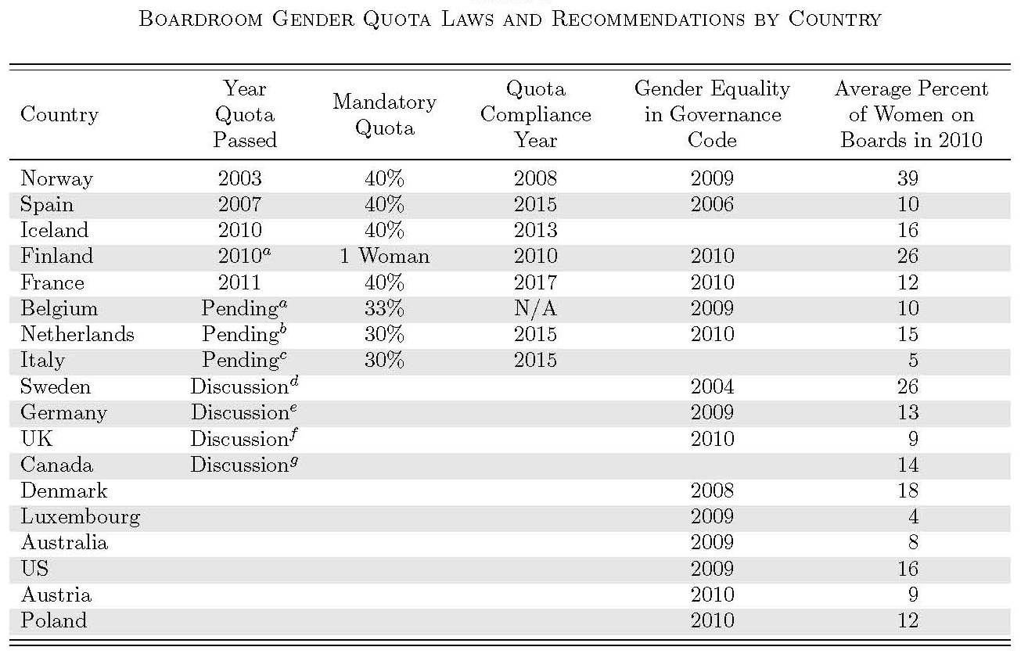
A Closer Look at Specific Policy Response:
Board Gender Quota Laws
(Bertrand, Black, Jensen and Lleras-Muney 2014)
Nov 20 2013: EU parliament voted in favor of proposed draft law that would require 40% female board members in 5.000 listed companies in the EU by 2020, and state-owned companies by 2018.
  Still would require backing from EU member states to become law
March 2015: Germany sets gender board quotas
(Source: Ahern and Dittmar 2012)
Notes:
European Union companies may soon be forced to favor women over equally-qualified men for supervisory board seats after EU lawmakers backed draft rules that would impose a 40 percent quota for female directors.
The European Parliament in Strasbourg, France, today voted with 459 votes in favor of the draft law, 148 votes against and 81 abstentions. To become law, the plans still need the backing of EU members states.
The European Commission, the EU’s executive authority, proposed the new law last year to make boards two-fifths female by 2020. EU Justice Commissioner Viviane Reding called today’s vote a “historic moment for gender equality.”
In 2013, 17.6 percent of non-executive board members of the EU’s largest companies were women, according to the commission. The European Parliament’s push for more female candidates in top posts almost scuppered the appointment of Luxembourg’s Yves Mersch to the European Central Bank’s Executive Board last year. Bundesbank President Jens Weidmann earlier this year said he won’t set a quota to promote women into management in the German central bank.
The measures would apply to about 5,000 listed companies in the EU by 2020 and state-owned companies by 2018, the commission said last year. They exclude companies with less than 250 employees or global sales below 50 million euros ($67.6 million).

Slide 38
Possible effects of gender quotas on boards
A: They might help in reducing the gender gap
  Lots of qualified women that were not being vocal enough/not competing enough for these high profiles jobs now being eased into them
  Higher representation of women in top corporate echelons fosters thinking about organizational change to increase family amenities of work (“Women watching out for other women”)
  Accelerate changes in social norms by increasing society’s exposure to high ability women in leadership position
  Incentivize more “at risk” women to stay on the fast track as likelihood of “board membership” increases; incentivize more “at risk” women to stay on the fast track as female-heavier boards expected to consider more women for other top corporate jobs
    → virtuous cycle: increase demand for organizational structures that can accommodate these women; more exposure to high ability women in leadership position (board and non-board)

Slide 39
Possible effects of gender quotas on board
B: They might do nothing, or even backfire:
  Total number of board positions is fairly limited
  40%<51%
  Power of the board may be limited (non-executive positions)
  Women may not be more “tolerant” or “accommodating” of other women
  Incentive effects, role model effects strongly dependent on the assumption that high quality women will be appointed to these boards:
    Possible issues: limited supply of qualified women; appointment of token women with limited voice
  Board position a tax on other more productive productivities?

Slide 40
Norway’s Gender Board Quota Law
2001: Proposal for gender representation in boards sent to public hearing
2002: Minister of trade submits first law proposal
January 2004: public limited liability (ASA) companies, listed and non-listed, have two years to achieve at least 40% of board directors from each gender
  Broad majority voted in favor in December 2003
Only 13% compliant in 2005
January 2006: Sanctions introduced. Non-compliant firms by 2008 faced threat of dissolution
  90% compliance by January 2008
Stated objectives of the reform:
  Accelerating gender equality in the labor market
  Performance-based arguments—“women’s leadership style” could improve productivity
Notes:
PLC (\Allmennaksjeselskap", ASA) is a separate organizational
form designed for large companies with many shareholders and liquid stock, whereas the
LTD organizational form is for small companies with few shareholder and less liquid stock
(Woxholth, 2007). For instance, PLCs can do public oering of stock and list on the Oslo
Stock Exchange, whereas a LTD can only do private placement. There are both listed and
non-listed PLCs, and the quota applies equally to both groups.

Slide 42
 | Total number of board positions at ASA firms held by:
Year | Women | Men
2002 | 185 | 2363
2003 | 216 | 2202
2004 | 301 | 2183
2005 | 444 | 1922
2006 | 591 | 1784
2007 | 821 | 1423
2008 | 801 | 1183
2009 | 683 | 1033
2010 | 586 | 881

Slide 43
Previous Work on Norway’s Reform:
  Focused on implications of reform for corporate policies and corporate performance
  Ahern and Dittmar (2012):
    Significant drop in stock prices of listed (public-limited liability) firms at the announcement of the law (Ahern and Dittmar 2012)
    Less experienced (female) board members were hired (Ahern and Dittmar 2012)
      Fewer CEOs on boards
    Likelihood of delisting higher among firms that started with fewer female board members
  Matsa and Miller (2013):
    Operating profits/assets ↓ by 4%
    Increases in employment and labor costs in listed firms
    Effects stronger at firms that appoint a new CEO post-reform
Our research:
  Did the gender board quota reform induce more gender equality in the labor market, and in particular at the top of the labor market?

Slide 44
Earnings Gender Gap in Norway, 1986-2010

Slide 46
Four Questions
  Mechanical effects of the quota reform/gender differences on corporate board
  Impact of the quota reform on women employed in ASA firms
  Impact of the quota reform on women whose qualifications mirror that of board members (e.g. “at risk” women)
  “Impact” of the quota reform on younger women considering or starting a career in business

Slide 47
1. Gender Differences on Corporate Boards
Business’ main lobbying argument against quota reform: limited pool of women qualified to serve
Moreover, reluctant firms may comply by “gaming” the system
  e.g. stuffing their boards with sub-par women
Important to consider whether these factors were relevant in practice. If relevant:
  Gender equality on the board will be limited to a count of directors
  Any possible spillover of the quota beyond the boards will be less likely:
    Limited opening of new networks (path dependence argument)
    Reinforcement of prior stereotypes (discrimination argument)
    Limited career investment incentives (“patronizing equilibrium” a la Coate and Loury 1993)
    Limited role model effects

Slide 48
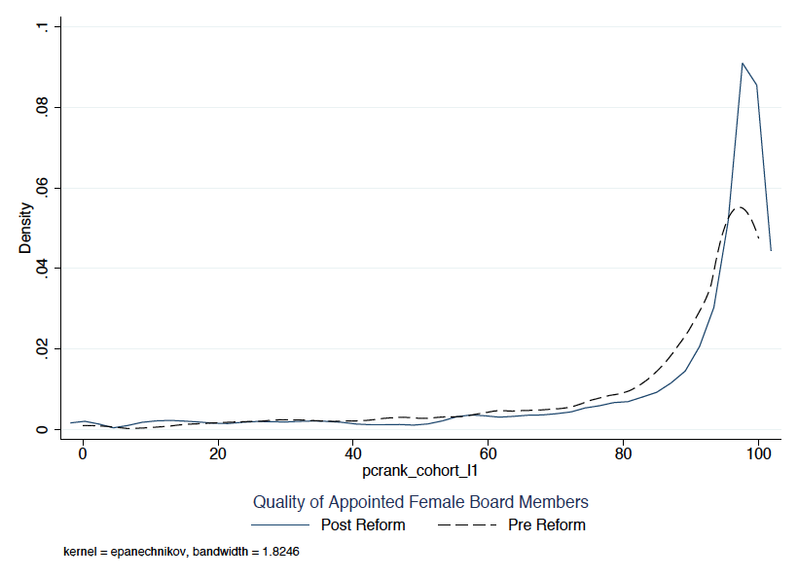
Prior percentile of earnings within cohort
(prior to board appointment)

Slide 49
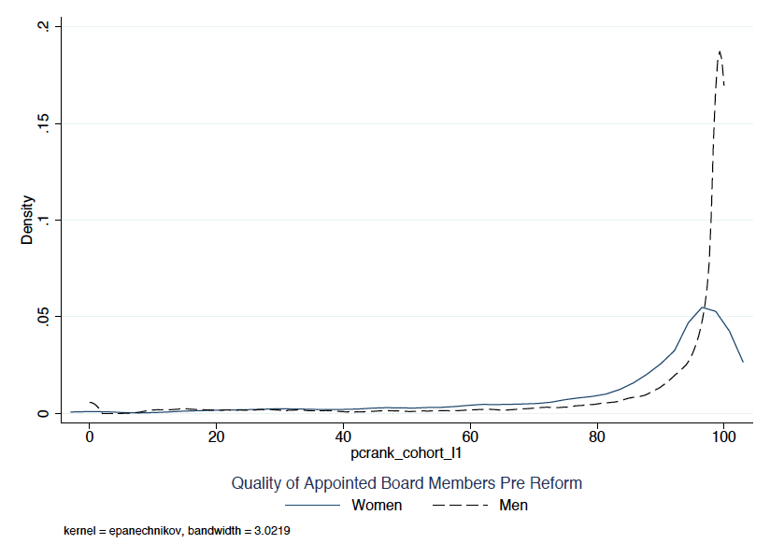
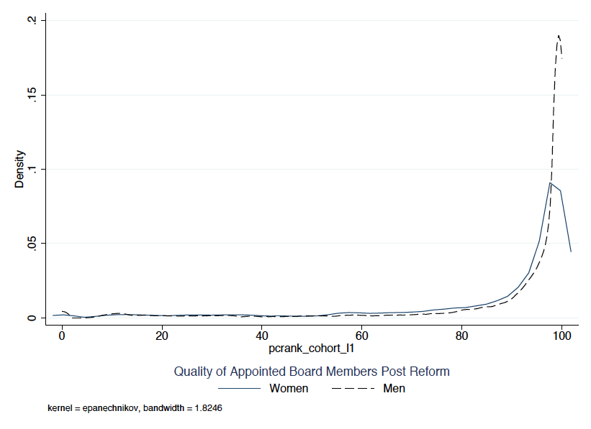
Prior percentile of earnings within cohort
(prior to board appointment)
Before Reform
After Reform

Slide 50
Table 2: Gender Gaps in Residual Earnings among ASA Board Members 1998-2010
 | By period |  |  | Pooled specification
Dependent variable: Log(earnings) | Pre-reform 1998-2003 | Post-reform 2004-2010 |  | Basic
 | 1 | 2 |  | 3
Female | -0.361*** | -0.181*** |  | -0.349***
 | [0.030] | [0.027] |  | [0.029]
Female*(2004-2010) |  |  |  | 0.169***
 |  |  |  | [0.030]
N | 32,927 | 22,073 |  | 55,000
R-squared | 0.187 | 0.147 |  | 0.197
*** p<0.01, ** p<0.05, * p<0.1. Robust standard errors in brackets. Sample includes all individuals serving on the board of an ASA firm between 1998 and 2010, Included in each regression are: a quadratic in age, education degree dummies, experience dummies, work status in prior year, marital status and number of children

Slide 51
Summary
Companies (that remain ASA) were able to recruit women to serve on reserved board seats with observable qualifications that were superior to those of the women serving pre-quota reform.
  Caveat: unobservables? multiple dimensions of quality?
As a consequence, gender gap in residual earnings fell across ASA boards post-quota.
  (A compositional effect; no evidence of larger board premia for women in the post-reform period)
Reform likely forced business to look outside the traditional networks to fill in their boards
  Government role - “Binder full of (eligible and willing to serve) women”
Results suggest existing pre-condition for potential spillovers on gender equality beyond the pure mechanical effect

Slide 52
2. Women’s Outcomes in Firms Targeted by the Quota
Heavier women representation on a firm’s corporate board may improve outcomes for other women employed by this firm:
  Women on the board more likely to recommend other women in their network for C-suite level positions; more likely to favor female candidates
    Such changes might then trickle down the corporate ladder using the same logic
  Women on the board more likely to suggest changes in human resource policies that might be particularly beneficial to female employees (“work-family” balance)

Slide 53
Table 4: Effect of Board Gender Quota on Female Representation in ASA Groups
Instrumental Variable Regressions
Panel A: Treated ASA Business Groups
 | (1) | (2) | (3) | (4) | (5) | (6) | (7) | (8)
Dependent Variable: | Employee is a…
 | woman |  | woman with an MBA |  | woman with kid |  | woman working part-time
Percent Women on Board_{t} | -0.0291 | -0.0316 | -0.0111** | -0.0106** | -0.00948 | -0.00980 | 0.00227 | -0.000399
 | [0.046] | [0.047] | [0.005] | [0.005] | [0.031] | [0.032] | [0.015] | [0.015]
Firm Fixed Effects | Yes | Yes | Yes | Yes | Yes | Yes | Yes | Yes
Year Fixed Effects | Yes | Yes | Yes | Yes | Yes | Yes | Yes | Yes
Industry Fixed Effects*Year Trend | No | Yes | No | Yes | No | Yes | No | Yes
Observations | 763,454 | 763,454 | 754,223 | 754,223 | 763,454 | 763,454 | 763,451 | 763,451
R-squared | 0.095 | 0.095 | 0.008 | 0.008 | 0.065 | 0.065 | 0.055 | 0.055
Panel B: Intent-to-Treat ASA Business Groups
 | (1) | (2) | (3) | (4) | (5) | (6) | (7) | (8)
Dependent Variable: | Employee is…
 | woman |  | woman with an MBA |  | woman with kid |  | woman working part-time
Percent Women on Board_{t} | -0.0320 | -0.0324 | -0.0117* | -0.0102 | -0.00988 | -0.0106 | 0.00405 | 0.0129
 | [0.039] | [0.040] | [0.007] | [0.007] | [0.025] | [0.026] | [0.025] | [0.025]
Firm Fixed Effects | Yes | Yes | Yes | Yes | Yes | Yes | Yes | Yes
Year Fixed Effects | Yes | Yes | Yes | Yes | Yes | Yes | Yes | Yes
Industry Fixed Effects*Year Trend | No | Yes | No | Yes | No | Yes | No | Yes
Observations | 731,696 | 731,696 | 723,067 | 723,067 | 731,696 | 731,696 | 731,693 | 731,693
R-squared | 0.112 | 0.112 | 0.010 | 0.010 | 0.067 | 0.067 | 0.095 | 0.095

Slide 54
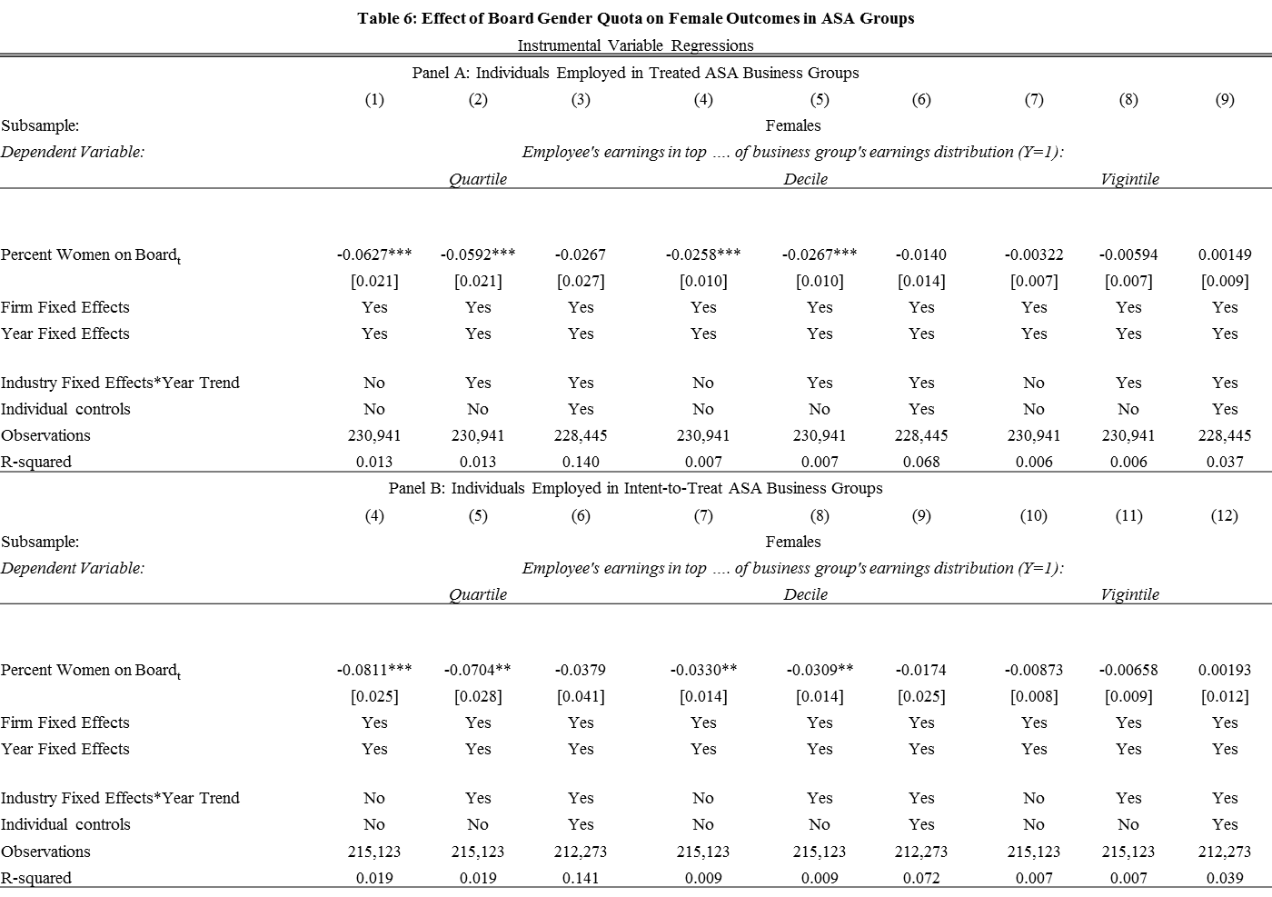

Slide 55
Summary
Any positive spillover from the board gender quota to female employment outcomes within the targeted companies had failed to materialize by the end of our sample period.
Why? Ultimately, we can only conjecture:
  Corporate boards do not matter. But see earlier work on impact of the reform on corporate policies and corporate practices.
  40% quota does not give women a majority opinion in board decisions.
    Backlash by majority of men?
  While women are presumed to recommend and favor candidates of their own gender for an appointment or a promotion, this might be not the case in practice .
    E.g. Bagues and Esteve-Volart (2010)
  Not enough time

Slide 56
3. Labor Market Outcomes of Other Women on the “Fast-Track”
The quota reform could improve outcomes for other women on the “fast-track” (e.g. those whose business qualifications mirror that of the newly appointed board members) to the extent that:
  Being offered a board position is an attractive prize (see board premium results), these women may decide to invest more in the rest of their career
  Search for female board members (and binder) may have helped bringing more of these women to the attention of the business community at large (not just ASA firms)
  Newly appointed female board members may be in a superior position to spread information about these women

Slide 57
Sample | All |  |  | Dropping Board Members
Affected group: | Pscore>99.5 | P98 & bus |  | Pscore>99.5 | P98 & bus
Panel A: Basic Specification
Female*(2004-2010) | 0.0124 | 0.0301 |  | -0.0160 | -0.0292
 | [0.035] | [0.050] |  | [0.036] | [0.055]
Female*(1992-1998) | 0.00644 | 0.0391 |  | 0.0489 | 0.0704
 | [0.052] | [0.082] |  | [0.052] | [0.090]
Female | -0.129*** | -0.132*** |  | -0.157*** | -0.134***
 | [0.032] | [0.041] |  | [0.031] | [0.044]
N | 110,375 | 44,934 |  | 97,405 | 38,153
% obs from women | 0.0729 | 0.0680 |  | 0.0680 | 0.0622

Slide 58
4. Outcomes for Younger Women in Business
Education:
  Gender gap in business degree completion (graduate and undergraduate)
Perceptions and expectations:
  Qualitative survey of current female (and male) students at Norwegian School of Business
Labor market outcomes:
  Gender gap in early career earnings across 3 cohorts of individuals that completed a business degree within 3 years of baseline year:
  1989: follow 1990 to 1996
  1996: follow 1997 to 2003
  2003: follow 2004 to 2010 (post-reform cohort)

Slide 59
Gender Gap in Graduate Degree Completion by Year (2000 normalized to 0)
Notes:
xi:reg bus female female2001-female2010 age age2 i.yr if yr>=2000 & yr==avgyr & edut00_1==6
**********************
*regression analysis
*MB notes: need to check with Sissel as to when the avgyr variable can be trusted!!!
*for now: i run these regressions starting in 2000
*for a four-year undergrad: would expect to see effects starting around 2008/2009
*for a two-year grad degree: would expect to see effects starting around 2006/2007
**********************

Slide 60
Gender Gap in Under-graduate Degree Completion by Year (2000 normalized to 0)

Slide 61
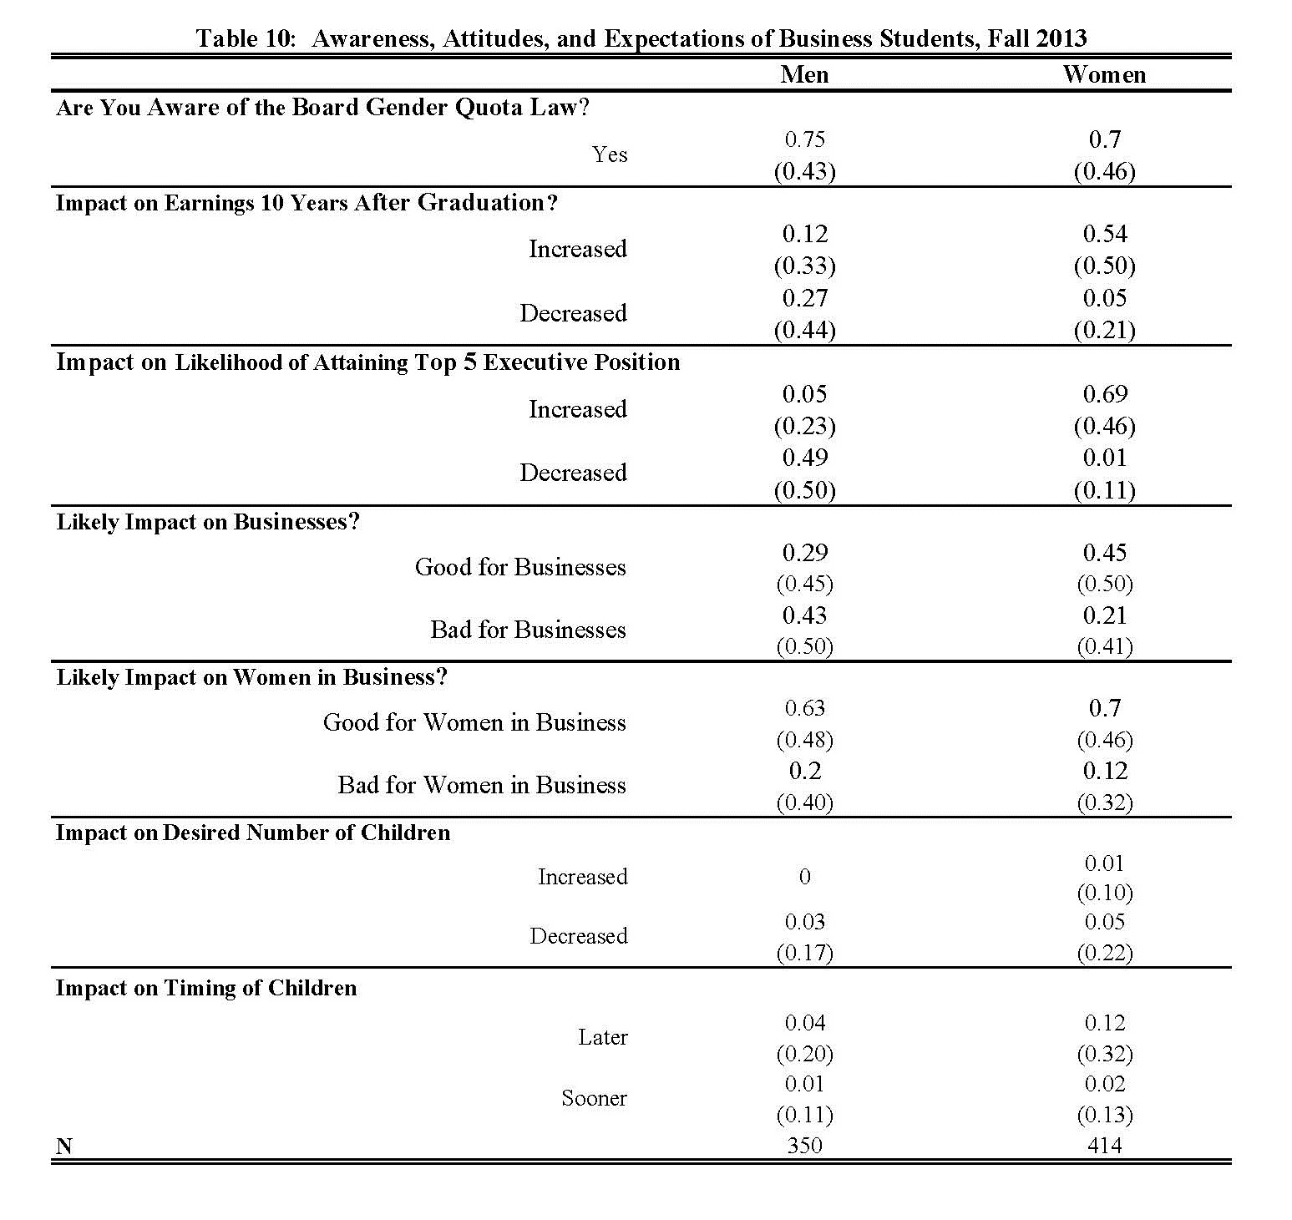

Slide 62
Table 9: Gender Gaps in Earnings Among Cohorts of Recent Graduates
Sample: | Recent Graduate Degree |  | Recent Graduate Degree--Last three years only
Treated defined as having degree in: | Business | Business, law, or social studies | Business | Business, law, or social studies
Log of Earnings
Female*(2004-2010) | -0.0135 | 0.00336 | 0.0184 | 0.0189
 | [0.019] | [0.012] | [0.023] | [0.014]
Female*(1992-1998) | 0.0825*** | 0.0588*** | 0.0782** | 0.0606***
 | [0.026] | [0.016] | [0.032] | [0.019]
Female | -0.223*** | -0.273*** | -0.307*** | -0.337***
 | [0.015] | [0.009] | [0.019] | [0.011]
N | 75,495 | 151,003 | 32,041 | 64,182
Number of kids
Female*(2004-2010) | -0.0373 | -0.0190 | -0.0573* | -0.0301
 | [0.023] | [0.017] | [0.033] | [0.023]
Female*(1992-1998) | 0.0162 | -0.0221 | 0.0233 | -0.0354
 | [0.036] | [0.023] | [0.052] | [0.031]
Female | 0.0570*** | 0.0456*** | 0.0993*** | 0.0773***
 | [0.019] | [0.013] | [0.027] | [0.017]
N | 77,666 | 154,213 | 32,820 | 65,363
Married
female*(2004-2010) | -0.0136 | -0.00103 | -0.0195 | 0.00171
 | [0.014] | [0.009] | [0.019] | [0.013]
female*(1992-1998) | -0.000839 | -0.0154 | -0.00589 | -0.0221
 | [0.023] | [0.013] | [0.030] | [0.017]
female | 0.0245** | 0.00620 | 0.0257 | 0.00224
 | [0.012] | [0.007] | [0.016] | [0.010]
N | 77,666 | 154,213 | 32,820 | 65,363

Slide 63
Summary
Norwegian reform first experiment of its kind, trying to break (or crack) the glass ceiling in the business sector by imposing corporate board gender quotas.
Experience relevant to all the countries that have lined up/are lining up to implement similar reforms.
The reform succeeded in reducing gender disparities on corporate boards of ASA firms
  Not just in terms of numbers (mechanical) but also in terms of observable qualifications
  But dwindling numbers of ASA firms.
Beyond that, we fail to see much evidence of any broader impacts of the policy.
Caveat: we are only able to look at short-run effects

Slide 64
Concluding Remarks
Significant research headways in understanding the factors explaining the remaining gender gap(s) in labor market outcomes in a world of equalized educational opportunities and reduced discrimination.
While both firm-level HR policies and public policies could be designed to address some of these factors, we know much less about what is the “right” policy mix.
Some of the identified factors might be slow to adjust, from innate differences to persistent social norms.

