Slide 1
Relationship Marketing and Customer Relationship Management (CRM)

Slide 2
Objectives
Contrast transaction-based marketing with relationship-based marketing.
Identify and explain the four basic elements of relationship marketing, as well as the importance of internal marketing.
Identify the three levels of the relationship marketing continuum.
Explain how firms can enhance customer satisfaction.

Slide 3
Objectives
Describe how companies build buyer-seller relationships.
Explain customer relationship management (CRM) and the role of technology in building customer relationships.
Describe the buyer-seller relationship in B2B marketing and identify the four types of business partnerships.

Slide 4
Objectives
Describe how B2B marketing incorporates national account selling, EDI and Web services, VMI, CPFaR, managing the supply chains, and creating alliances.
Identify and evaluate the most common measurement and evaluation techniques within a relationship marketing program.

Slide 5
Introduction
Transaction-based marketing - Buyer and seller exchanges characterized by limited communications and little or no ongoing relationship between the parties
Relationship Marketing - Development, growth, and maintenance of long-term, cost-effective relationships with individual customers, suppliers, employees, and other partners for mutual benefit

Slide 6
The Shift from Transaction-Based Marketing to Relationship Marketing
Shift away from production-oriented marketing
Emphasis on individual sales and transactions
Limited communication
No ongoing relationship
Limited in some markets, such as residential real estate

Slide 7
The Shift from Transaction-Based Marketing to Relationship Marketing
Shift toward relationship marketing
Views customers as equal partners in transactions
Encourages long-term relationships, repeat purchases, and multiple brand purchases from the firm
Leads to increased sales and low marketing costs

Slide 8
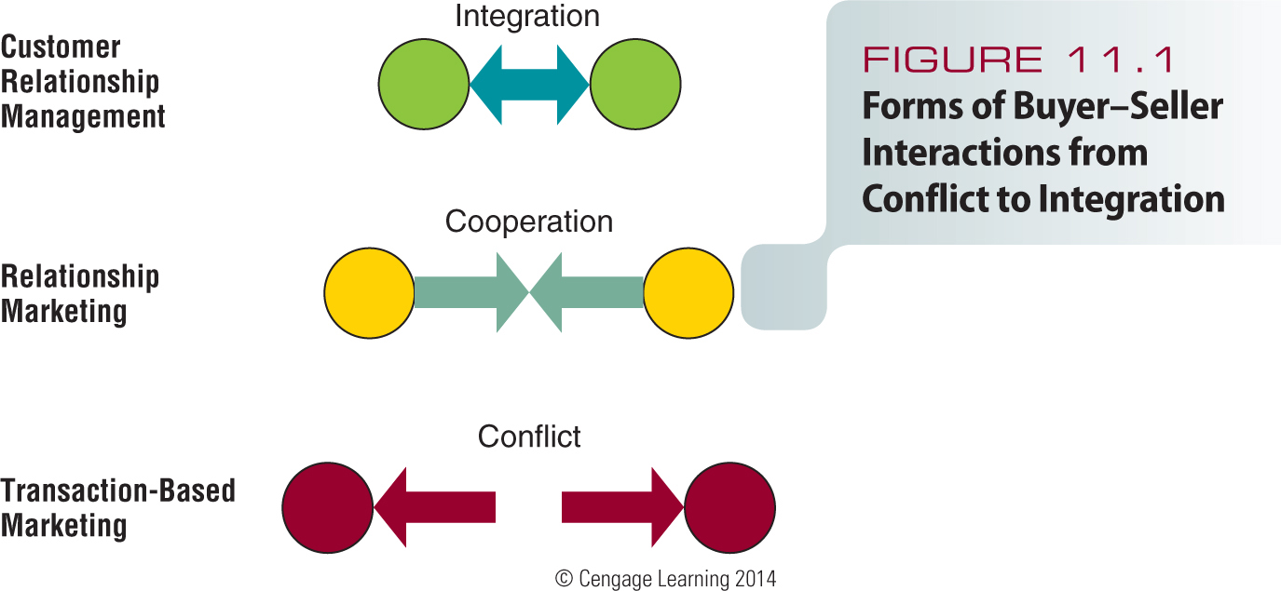
Figure 11.1 - Forms of Buyer-Seller Interactions from Conflict to Integration

Slide 9
Relationship Marketing
Focuses on long term rather than short term
Emphasizes retaining customers over making a sale
Ranks customer service as a high priority
Encourages frequent customer contact
Fosters customer commitment with the
firm
Bases customer interactions on cooperation and trust

Slide 10
Elements of Relationship Marketing
Firms build long-term relationships in four ways
Gather information about their customers
Analyze the data and use it to modify the marketing mix
Monitor interactions with customers
Use customers’ preferences and knowledge

Slide 11
Internal Marketing
External customers - People or organizations that buy or use a firm’s goods or services
Internal customers - Employees or departments within the organization whose success depends on the work of other employees or departments

Slide 12
Table 11.1 - Three Levels of Relationship Marketing

Slide 13
First Level: Focus on Price
Most superficial level, least likely to lead to long-term relationships
Marketers rely on pricing to motivate customers
Competitors can easily duplicate pricing benefits

Slide 14
Second Level: Social Interactions
Customer service and communication are key factors
Example: A wine shop holding a wine-tasting reception

Slide 15
Third Level: Interdependent Partnership
Relationship transformed into structural changes that ensure partnership and interdependence between buyer and seller
Example: Canadian software marketer Corel chose a cloud-based approach
Its tech-help agents can now answer customer queries via chat, telephone, the Web, or social media

Slide 16
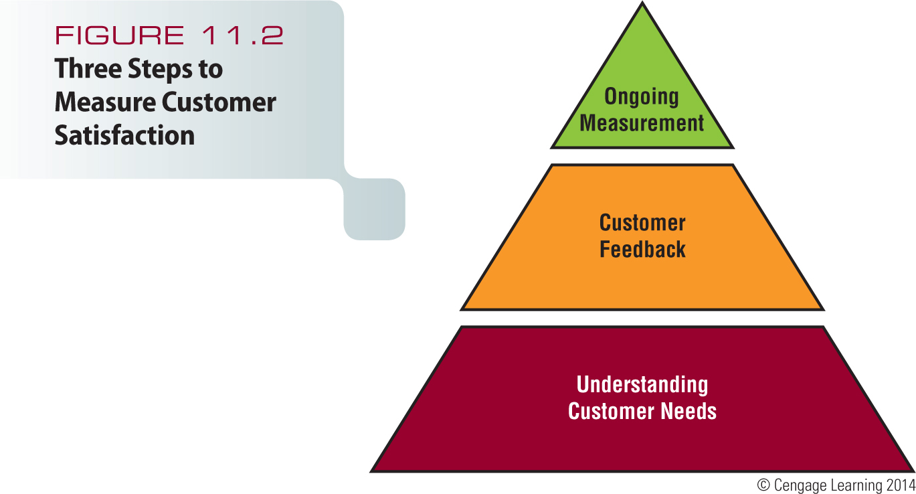
Figure 11.2 - Three Steps to Measure Consumer Satisfaction

Slide 17
Understanding Customer Needs
To build long-term relationships firms must understand what customers need, want, and expect
Must measure customer satisfaction
Marketers need to keep in touch with the needs of current and potential customers

Slide 18
Obtaining Customer Feedback and Ensuring Satisfaction
Sources of information include toll free numbers or online feedback
Some firms hire mystery shoppers posing as customers to evaluate service
Complaints help firms overcome problems and demonstrate commitment to service
Some firms conduct surveys to measure satisfaction

Slide 19
Building Buyer-Seller Relationships
Consumers form relationships to:
Reduce choices
Simplify information gathering and the entire buying process
Reduce the risk of dissatisfaction

Slide 20
Building Buyer-Seller Relationships
Perceived positive value received in a long-term buyer-seller relationships is a key benefit for customers
Customers may switch loyalties if they perceive better benefits from a competitor

Slide 21
How Marketers Keep Customers
Retaining customers is more profitable than losing them
Customer churn - Customer turnover
Is expensive for a company
Firms generate more profits with each additional year of a relationship

Slide 22
How Marketers Keep Customers
Frequency marketing - Frequent-buyer or -user marketing programs that reward customers
Affinity marketing - Solicits responses from individuals who share common interests and activities

Slide 23
Database Marketing
Use of software to analyze data about customers
Helps firms to:
Identify their most profitable customers
Calculate the lifetime value of each customer’s business
Build relationships and encourage genuine brand loyalty
Improve customer retention and referral rates

Slide 24
Database Marketing
Reduce marketing and promotion costs
Boost sales volume per customer or targeted customer group
Expand loyalty programs

Slide 25
Database Marketing
Possible sources of data
Credit card applications
Software registration
Product warranties
Point-of-sale register scanners
Customer opinion surveys
Websites
Telecom companies database

Slide 26
Database Marketing
Interactive television - Television service package that includes a return path for viewers to interact with programs or commercials by clicking their remote controls
Application service providers (ASPs) - Outside companies that specialize in providing both the computers and the application support for managing information systems of business clients

Slide 27
Customers as Advocates
Grassroots marketing - Connecting directly with existing and potential customers through nonmainstream channels
Viral marketing - Satisfied customers spread the word about products to other consumers
Buzz marketing - Gathers volunteers to try products and then relies on them to talk about their experiences

Slide 28
Customer Relationship Management
Combination of strategies and tools that drive customer relationship programs
Leverages technology to manage customer relationships
Integrates all stakeholders into a company’s product design and development

Slide 29
Benefits of CRM
Software systems can make sense of huge amounts of data
Simplifies complex business processes
CRM can be used at two different levels
On-demand
On-premises

Slide 30
Problems With CRM
Requires companywide commitment and knowledge to use the CRM system
Failure to effectively reorganize firm’s people and processes to take advantage of benefits a CRM system offers

Slide 31
Retrieving Lost Customers
Customers leave for a variety of reasons
Boredom
Move to a new location
No longer have a need for the product
Prefer competing products
Customer win-back - Process of rejuvenating lost relationships with customers

Slide 32
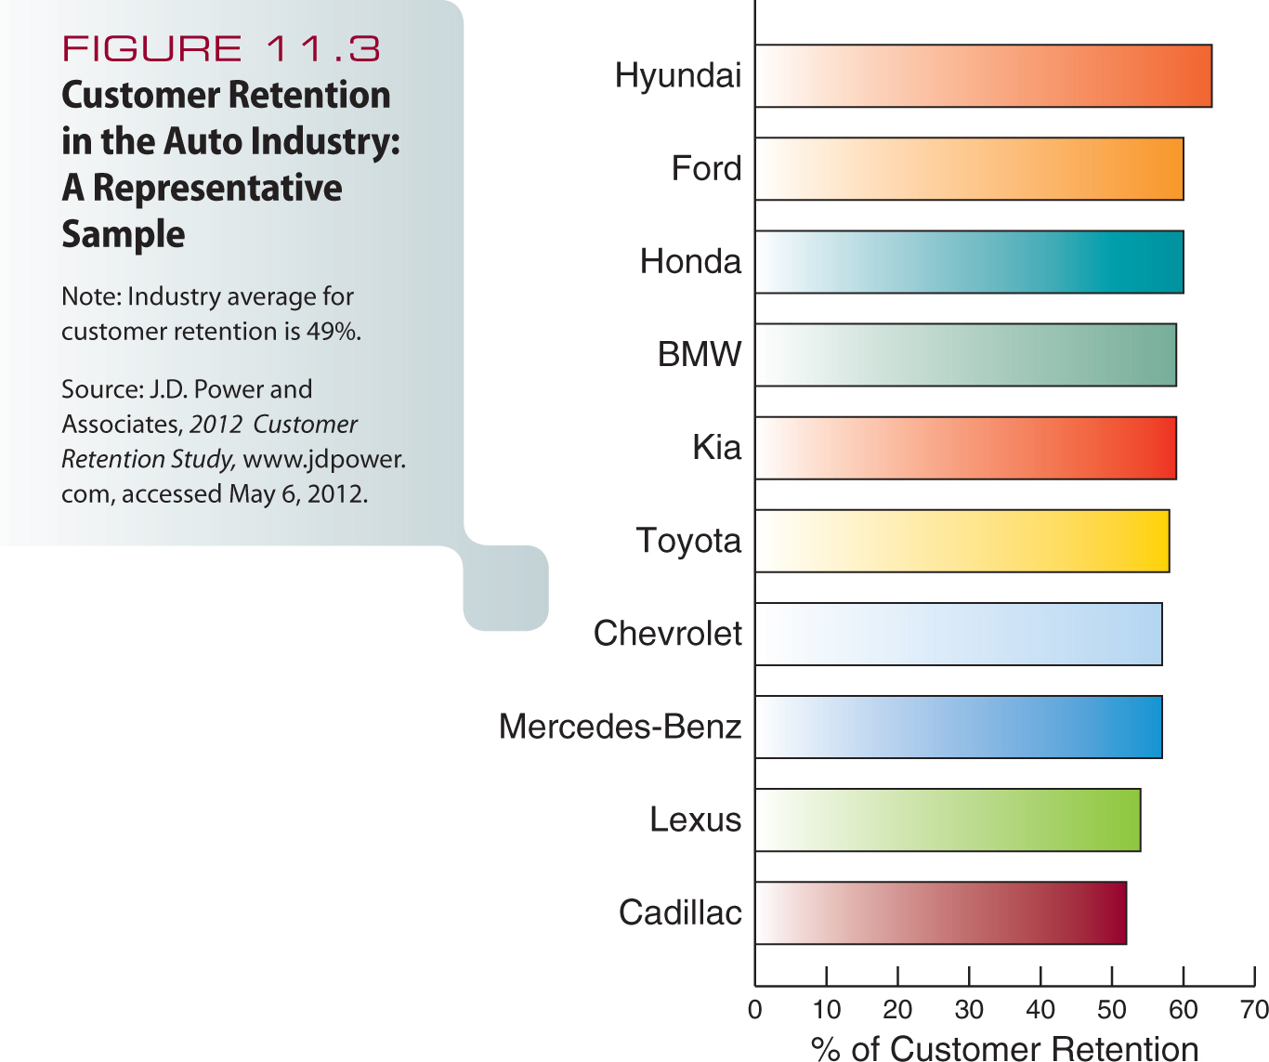
Figure 11.3 - Customer Retention in the Auto Industry: A Representative Sample

Slide 33
Retrieving Lost Customers
Rules for service providers
To anticipate where problems will arise and figure out how to prevent them
To accept that mistakes will occur in even the best systems and have a high-quality recovery effort in place that employees are empowered to enact

Slide 34
Business-to-business marketing - Organizational sales and purchases of goods and services to support production of other products

Slide 35
Buyer-Seller Relationships in Business-to-Business Markets
Advantages of buyer-seller relationships
Lower prices
Quicker delivery
Improved quality and reliability
Customized product features
Favorable financing terms

Slide 36
Buyer-Seller Relationships in Business-to-Business Markets
Partnership - Affiliation of two or more companies that help each other achieve common goals
Protect or improve position in existing markets
Gain access to new domestic or international markets
Quickly enter new markets

Slide 37
Choosing Business Partners
Partner firm must add value to the relationship
Partner firms often complement each other
Firms must share similar values and goals

Slide 38
Types of Partnerships
Buyer partnership - Firm purchases goods and services from one or more providers
Seller partnership - Long-term exchanges of goods and services in return for cash or other consideration

Slide 39
Types of Partnerships
Internal partnerships - Relationship involving customers within an organization
Foundation of an organization’s ability to meet its commitment to external entities
Lateral partnerships - Strategic relationship that extends to external entities but involves no direct buyer-seller interactions

Slide 40
Cobranding and Comarketing
Cobranding - Cooperative arrangement in which two or more businesses team up to closely link their names on a single product
Comarketing - Cooperative arrangement in which two businesses jointly market each other’s products

Slide 41
National Account Selling
Promotional effort in which a dedicated sales team is assigned to a firm’s major customers
Demonstrates depth of commitment to customers
Ability to collaborate on mutually beneficial solutions to problems
Improvements in efficiency and effectiveness for both partners

Slide 42
Business-to-Business Databases
Indispensable
Essential in building B2B relationships

Slide 43
Electronic Data Exchanges and Web Services
Electronic data interchanges (EDI) - Computer-to-computer exchanges of invoices, orders, and other business documents
Quick-response merchandising - A just-in-time strategy that reduces the time merchandise is held in inventory
Web services - Platform-independent information exchange systems that use the Internet to allow interaction between the
firms

Slide 44
Vendor-Managed Inventory
Inventory management system in which the seller determines how much of a product is needed
Collaborative planning, forecasting, and replenishment (CPFaR) - Modified VMI approach

Slide 45
Managing the Supply Chain
Supply chain - Sequence of suppliers that contribute to the creation and delivery of a product
Effective management offers several advantages
Increased innovation
Decreased costs
Improved conflict resolution within the chain
Improved communication and involvement among members of the chain

Slide 46
Business-to-Business Alliances
Strategic alliances - Partnership formed to create a competitive advantage
Improve supply chain relationships and enhance operating flexibility
Can be a new operation in which alliance partners have an ownership stake
May be less formal

Slide 47
Evaluating Customer Relationship Programs
Lifetime value of a customer - Revenues and intangible benefits a customer brings to the seller over an average lifetime
May influence the types of customers a firm tries to reach
Example: Lexus targets former owners of Mercedes and Cadillac cars

Slide 48
Pepe’s Pizzeria Video
http://www.cengage.com/marketing/book_content/boone_9781133628460/videos/ch11.html
Scripps Networks Interactive & Food Network Video
http://www.cengage.com/marketing/book_content/boone_9781133628460/videos/part3.html

