Slide 1
Theories to Understand Selling and Marketing Relationships
Dr. Denton Anthony

Slide 2
What is Relationship Marketing (RM)?
Principles and standards that:
Create stable links between exchange partners
Create effective, cost-efficient measures to engage long-term customer commitment.
Create stronger relations between a customer and the salesperson/organization.

Slide 3
Relationship Marketing Defined
There are numerous suitable definitions for RM. For our purposes, we will define RM as:
Creating, developing and sustaining exchanges of value between parties (buyers and sellers) that lead to continuous stable links.

Slide 4
Relationship Marketing,…..From 4Ps to 4Cs
A different way of looking at marketing
Price Cost to Customer
Place Convenience
Product Customers needs and wants
Promotion Communication

Slide 5
Two Viewpoints on Relationships
Customer/buyer Viewpoint
Sellers Viewpoint
Why is it important to understand both positions?

Slide 6
Customer/buyer’s Viewpoint
Why would you as a customer engage in relationships?
Benefits for engaging in relationships include:
Reduces choice and search alternatives
Initiates and builds trust
Social bonds through communication

Slide 7
Supplier/Salespersons’ Viewpoint
Benefits include:
“locking” up the customer/buyer (retention)
Positive word of mouth if positive exchanges occur
Customer commitment
Increase in purchase rates (may include secondary products and services)

Slide 8
Relationships in Marketing
Based on the principle of reciprocity
Reciprocity is a “social interaction where movement of one party evokes a compensating movement in some other party” (Houston and Gassenheimer, 1987)
In sales encounters, the balance between the disclosures of buyers and sellers may be critical in establishing buyer and seller relationships.

Slide 9
The Sales Process: Selling Foundations
In order to be successful in today’s global business environment, salespeople must have a solid relationship building foundation. They must:
Be Trustworthy
Behave Ethically
Understand Buyer Behaviour
Possess Excellent Communication Skills

Slide 10
Relationship Development
The two-way flow of information is what distinguishes personal selling from other forms of promotion (communication).
It is through the act of disclosing information to the other party that buyers and sellers seek to determine service/product- related suitability and interpersonal compatibility. What does this mean?

Slide 11
Relationship Development
The Information provided by disclosure also makes it possible for a salesperson to adapt during the sales encounter.
Disclosure is the primary means for advancing a relationship beyond a causal acquaintanceship (Altman and Taylor, 1973)
There are four interpersonal events that strongly influence relationship development:
Verbal disclosures
Non-verbal communications
The physical environment
Interpersonal perceptions

Slide 12
Understanding Sales Relationships
Two theoretical perspectives offer insight on the effects of disclosure on interpersonal interactions.
They are:
Social Penetration Theory (SPT)
Uncertainty Reduction Theory (URT)

Slide 13
Social Penetration Theory (SPT)
The Social Penetration Theory (SPT) examines the growth, development, deterioration and dissolution of interpersonal relationships
The term social penetration refers to:
Overt (open) interpersonal behaviours which take place in social interactions and,
Internal subjective processes which precede, accompany and follow overt exchanges (Altman and Taylor, 1973).

Slide 14
SPT
The SPT contends that relationships are better understood overtime as a function of dyadic factors (rewards and costs), individual personal characteristics and situational factors.
http://www.youtube.com/watch?v=VHrHUBxFcYg
SPT poses that social disclosure and its reciprocity are essential in establishing the foundation of a relationship.

Slide 15
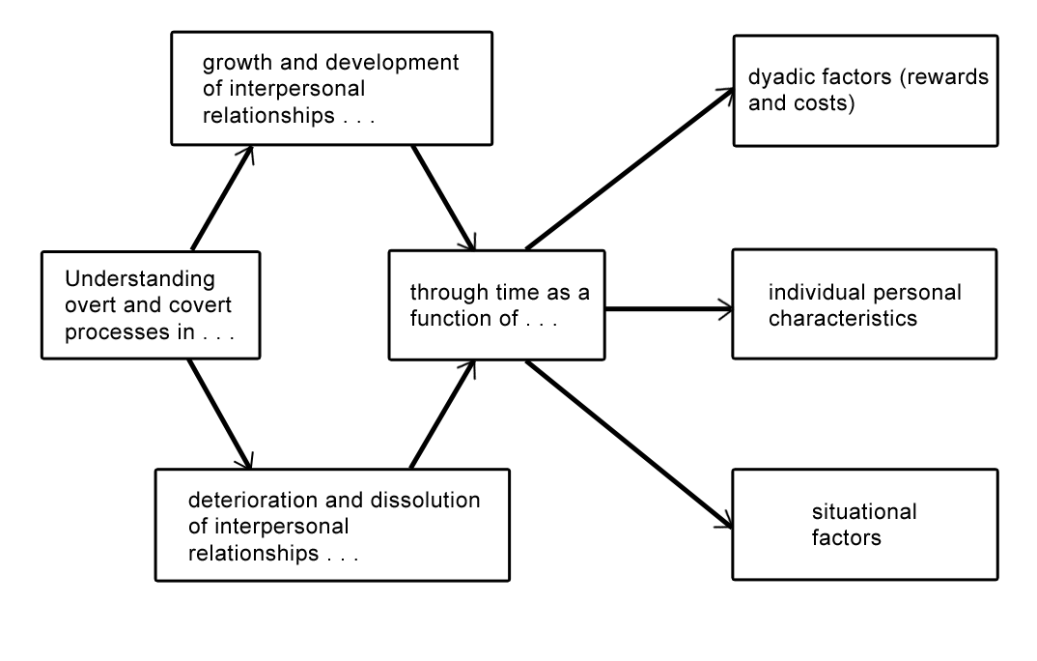
Areas of Interest for the Social Penetration Theory

Slide 16
Reward/Cost Aspects of Framework
People assess the reward/cost balance of an ongoing or next interaction.
The theory contends that people ‘forecast’ or ‘predict’ implications of future interactions at the same or deeper level of exchange.
The decision of future interactions is contingent upon levels of satisfaction/dissatisfaction at the transactional level.

Slide 17
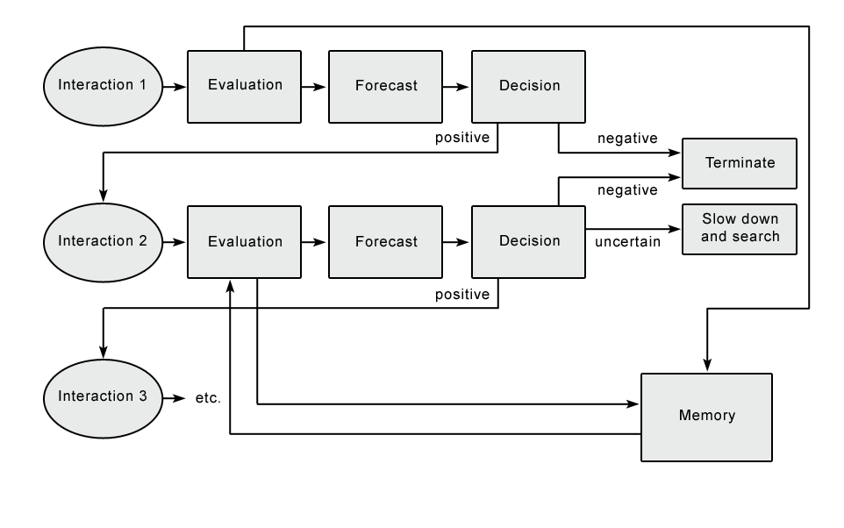
Interpersonal Reward / Cost Aspects of Social Penetration Process

Slide 18
SPT
Therefore, relationships are viewed as progressing from basic human interactions to complex interpersonal relationships, which seems to parallel sales exchanges leading to long-term relationships.
Applying the SPT to sales situations is applicable since it often takes several quality interactions that are evaluated by the buyer to often close a sale.

Slide 19
Uncertainty Reduction Theory (URT)
URT is a complementary theoretical perspective that contributes to the understanding of disclosure on the quality of interpersonal exchanges and relationship development.
URT is built on the premise that relationships will prosper when uncertainty regarding the (social) situation is reduced through disclosure.

Slide 20
URT
The assumption is that when strangers meet, there primary concern is over uncertainty reduction or increasing predictability about the behaviour of both themselves and others in the interaction.
The theory is built on a series of axioms.

Slide 21
URT
Salespeople and customers in a given situation will/should disclose personal or task-specific information to reduce uncertainty about the sale/purchase task as well as the interpersonal setting.
URT posits that communication facilitates the understanding of others in a social situation and provides procedural knowledge (what to do next) necessary to successfully conduct an interaction.

Slide 22
URT
The act of disclosing reduces uncertainty by enabling buyers and sellers to predict how an interaction partner is likely to behave.
There are many sales situations where customers experience uncertainty and rely on the credence properties (trust, integrity, etc.) of the salesperson (eg., financial services)
When a salesperson is able to reduce the customer’s uncertainty, the customer’s perception of interaction quality is increased.

Slide 23
Questions and comments?

