Slide 1
Climate Change Capacity Building, Built Environment, and Technology: Selected Issues
Track 6 Contribution

Slide 2
Structure of Presentation
Context
Challenges
Recommendations& Future direction

Slide 3
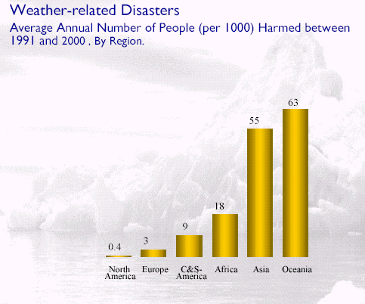
Context
Per-Capita Weather Impacts
Source: Capacity Building for Climate Change Milind Kalidikar and Ambuj Sagar
“Education, communications, training and awareness-raising on climate change are fundamental to achieving the objectives of the UNFCCC and providing people with the motivation and know-how to combat the causes and effects of climate change locally, nationally and globally”

Slide 4
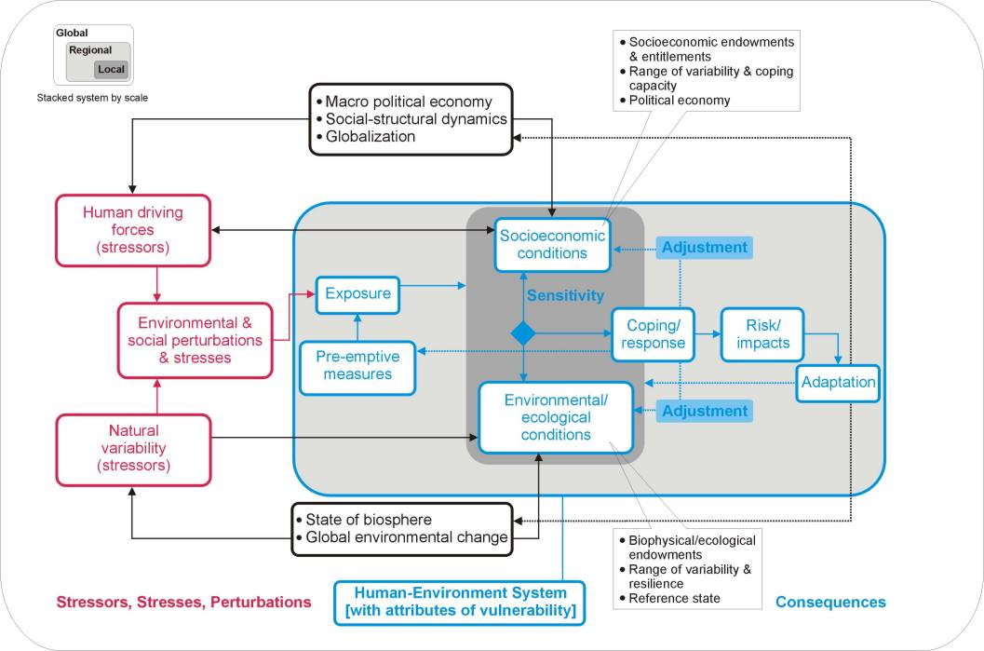
Holistic Nature of Climate Change
Source: Stockholm Environmental Institute
Notes:
Is this consistent with the Samoa pathway?

Slide 5
Challenges
The needs of only 14.5% of the population of Pacific Islands’ most vulnerable islands and atolls have been addressed ; involving only about 20% of the population (of which less than 8% have been women) (UN-Habitat, 2014; UNEP, 2015).
Of these projects that are in operation (or have “come and gone”) education, communications, training and awareness-raising tools and techniques have been developed, but adopted and practiced in only 12% of communities .
How do we meet Pacific commitments?
Commit to keeping warming below 1.5 °C by showing Pacific leadership.
Focus on climate adaptation in all the required dimensions to ensure that we have a climate resilient future.
Financing, Technology and Capacity Building requirements are cross-sectoral and critical for Tracks 1-6.

Slide 6
Challenges Cont. Built Environment & Infrastructure
Aging of existing stock
Drainage issues
Building architecture in Fiji is not climate friendly
National Building Code
Scientific data on cyclones and buildings
Need for correct certification of engineers.
Lack of insurance

Slide 7
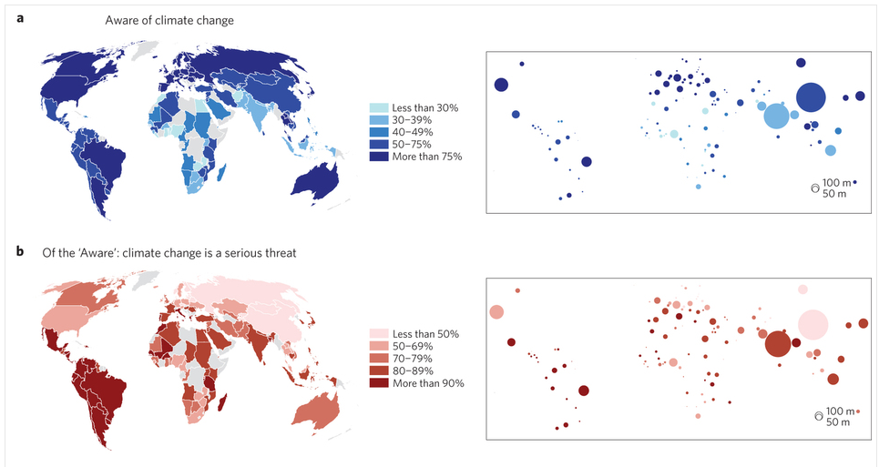
What is Needed?
Funds
Funds are needed for conducting training, education and capacity building across all sectors and at all levels and across multiple disciplines
Awareness
Stakeholders/government involvement is essential
Availability
Capacity building of education/training institutions is needed to ensure we have the expertise required

Slide 8
A Holistic Approach is Required
Capacity Building
METEOROLO-GICAL
SERVICES
LOW CARBON TRANSPORT
ECONOMIC PLANNING
& DEVELOPMENT
TECHNOLOGY &
IT
FORESTRY, RENEWABLE ENERGY,
NATURAL ENVIRONMENT
ACADEMIA
WATER RESOURCES
& IRRIGATION
BUILT ENVIRONMENT & INFRASTRUCTURE
FINANCE, ACCOUNTING, BUSINESS
PRIVATE SECTOR, GOVERNMENT
CLIMATE
CHANGE
COMMUNITIES, CIVIL SOCIETY

Slide 9
Suva Declaration: Recommendations
Leaders are requested to prioritize:
Strengthened capacity to address the multi-dimensional and multi-sectoral needs to support both climate resilience and national sustainable development plans. Including:
Increased awareness and understanding of climate change issues.
Accredited training to support the technology, building, sustainable energy and climate adaptation sector, including a focus on project management.
Strengthened capacity to identify, design and implement effective adaptation and mitigation measures that integrate economic, scientific and traditional knowledge to support transition the region to green/blue economies.
Development of Pacific based research and technological capacity is an essential foundation for innovation, and central to the foundation of PIDF focused on partnerships to create innovative solutions, including applications of negative emissions technologies.
Strengthened capacity to apply technological capacity to support private sector engagement, climate resilience research, education, and tools.

Slide 10
Suva Declaration: 2 Financing Recommendations
Developed countries should honour 2010 Copenhagen agreement to mobilize US $100 billion in adaptation funding
Still an adaptation financing gap of over $70 billion per year - about equal to global aid flows (World Bank)
Meeting $10 billion GCF pledges a good start…but only a start
New and additional adaptation funds for SIDS should be 100% grants
SIDS are at the forefront of adaptation, but insignificant contributors to climate change
Loans, even if concessional, will require SIDS to increase debt or divert resources from other priorities

Slide 11
References
Lee, Tien Ming, Ezra M. Markowitz, Peter D. Howe, Chia-Ying Ko, and Anthony A. Leiserowitz. "Predictors of public climate change awareness and risk perception around the world." Nature Climate Change (2015).
UNHabitat (2014). Climate Change Vulnerability Assessment: Lami Town, Republic of Fiji. Cities and Climate Change Initiative.
UNHabitat (2014) Cities and Climate Change Initiative Newsletter (June 2014). Cities and Climate Change Initiative Newsletter (Series title).
UNHabitat (2012). Developing Local Climate Change Plans , A Guide for Cities in Developing Countries. Cities and Climate Change Initiative , Environment and Climate Change.
UNEP (2015). Product Sustainability Information: State of Play and Way Forward United Nations Environment Programme.
UNEP (2015). Sustainable Consumption and Production: a Handbook for Policymakers. United Nations Environment Programme
UNEP (2015). Sourcebook of Opportunities for Enhancing Cooperation among the Biodiversity Related Conventions at National and Regional Levels. United Nations Environment Programme.

