Slide 1
Standardization
Control
Kaizen Facilitation

Slide 2
Objectives
Understand the need for standardization
Explore different standardization approaches

Slide 3
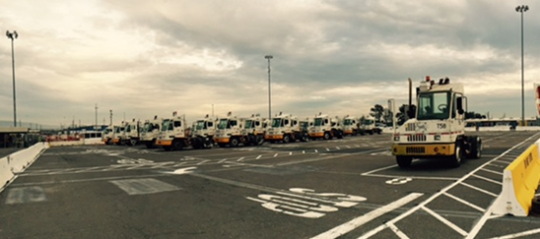
Definition
Standardization is the establishment of a uniform process to ensure consistent output

Slide 4
Example of Standardization

Slide 5
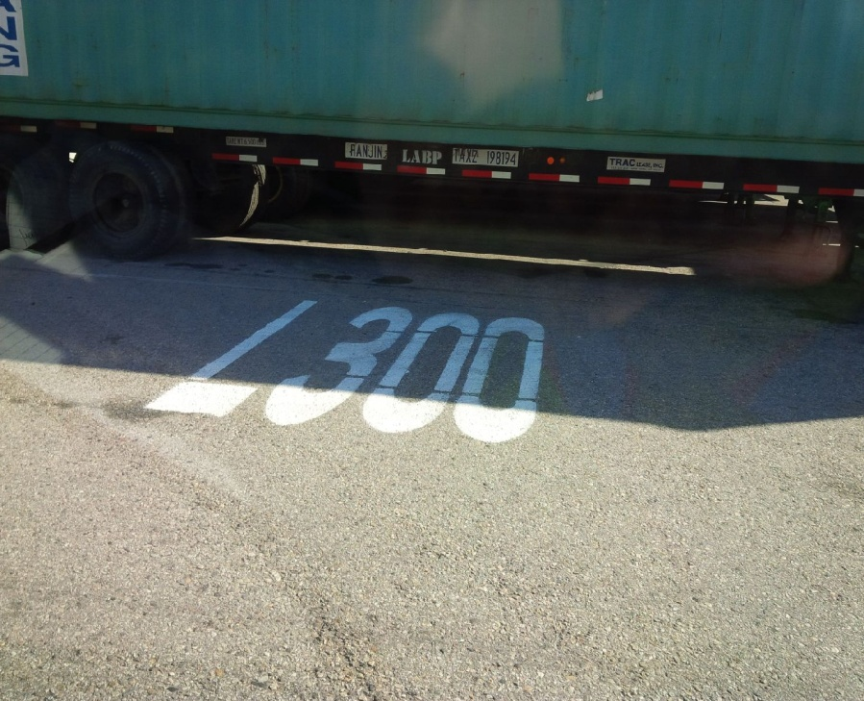
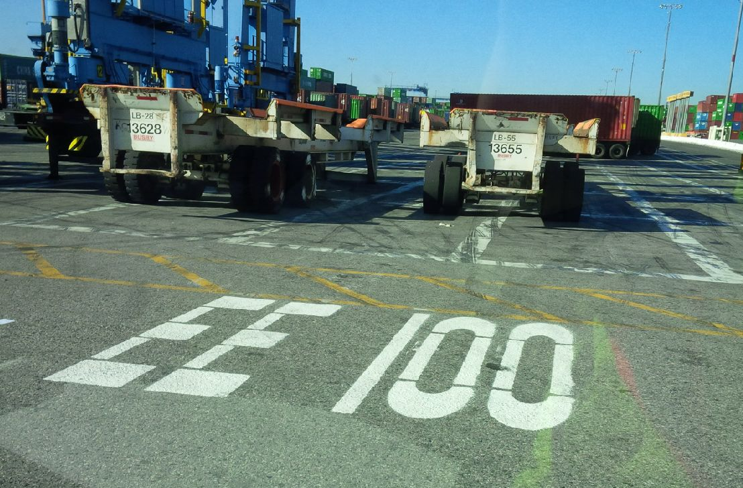
Example of Standardization

Slide 6
Why Do We Standardize?
To Get Predictable Results
To Share Best Practices
As a Basis for Improvement
Safety
Quality / Capability
Stable lead times
Pockets of excellence often scattered
Baseline for next improvement effort

Slide 7
What Are The Benefits?
Benefits of Standardization
Establishes the best way (uniform process) and locks in gains
Lets team support each other/ manage their own processes
Creates flexibility in adjusting to demand (flattens workload)
Helps improve individual performance

Slide 8
Avoiding Confusion
Standard Work
Defines what to do, when to do it, and who does it
Work Instructions
Defines how to do it (SOPs, Work Instructions, Process Manuals …)
Standards
Defines specific requirements (Laws, Regulations, Industry Standards, Quality Specs, Technical Standards, Contracts …)

Slide 9
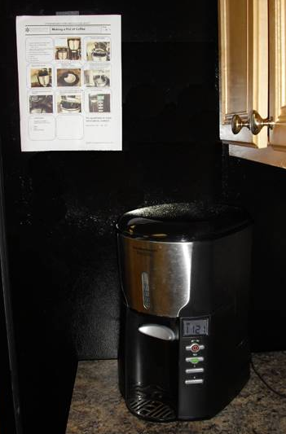
Example of Standardization
How to Make Coffee
Standard Work
Specific type of visual

Slide 10
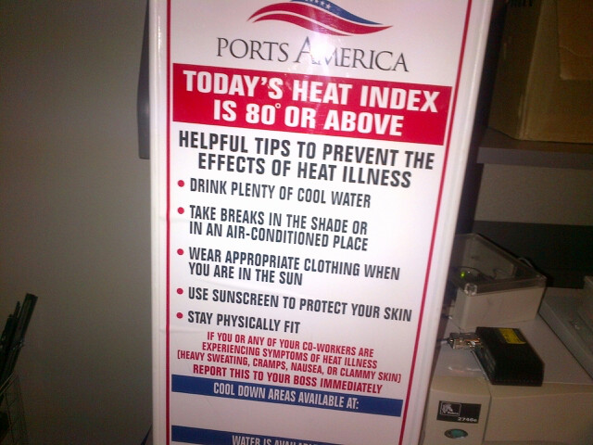
Example of Standardization
Work Instructions
Standard Operating Procedure
Written, detailed instruction

Slide 11
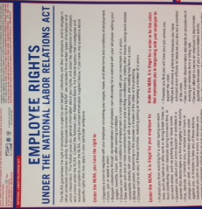
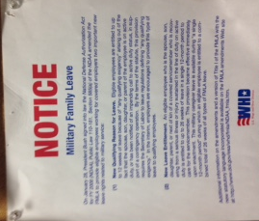
Example of Standardization
Standards
Defines specific requirements
Laws, Regulations

Slide 12
Example of Standardization
Flow Charts
Very visual method of standardization
Useful when posted in work area
Good for non-linear work
You can annotate gaps in the process; manage with a to-do list or action plan

Slide 13
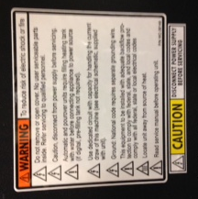
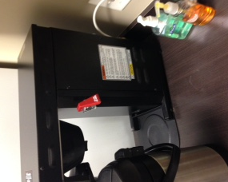
Example of Standardization
Visuals
Useful when posted in work area

Slide 14
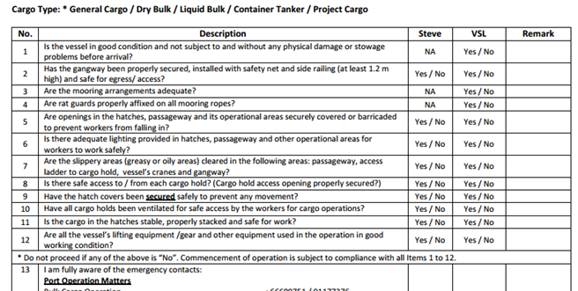
Example of Standardization
Checklists
Step-by-step process
Normally for linear work
Use for:
Critical processes
Infrequent processes
Training

Slide 15
Why Develop and Use Standardization Methods?
Consistent Output
Identical results every time
Everyone makes it the same
Easier Planning
Know meal requirements
Know time to produce
Managing Resources
Limits workspace size
Known material needs
We use Standard Work for the same reasons we use recipes

Slide 16
Other Examples of Standardization
Accounts payable
Total number of items
Cost per item
Payroll
Hours worked / not worked (vacation / holiday)
Salary
Planning
Vessel Layout
Load and discharge totals

Slide 17
Using Standard Work
Where to Post
Computer vs. Handwritten
How to Use
Handwritten forms are updated on the spot
Observing the process, training support, reminder, improvement, checking work
Post at the entrance to the work area
Computer forms are easier to share

Slide 18
Stevedoring Standard Work
Gantry around the house only during lunch
All empties go to CC300 – CC500
RORO staging has the same gang count as vehicles
The RORO driver van only carries 1 gang at a time
Deck cargo above deck, wheel cargo below deck
Dedicate equipment by area – Rail – Yard – Vessel
Plate steel on 4x4, tube and pipe on 2x4
Ship schedules on Sharepoint
On boarding new employees

Slide 19
Standardization Challenges
Limitations
Repetition can be boring if not managed
May not get to do things your way
Can’t put off the un-fun tasks
Pace is never exactly right for anyone
Hard work to get standardization established
Takes discipline to sustain

Slide 20
Review
Understand the need for standardization
Explore different approaches
Industry Standards (e.g. – Laws, OSHA, ISO 9000)
Work Instructions
Standard Operating Procedures (S.O.P.)
Checklists
Flowcharts
Visuals (e.g. – P.P.E. requirements poster)

Slide 21
Integrate Standard Work
People
Standard Work
Info
Materials
Glues together the components
Machines

Slide 22
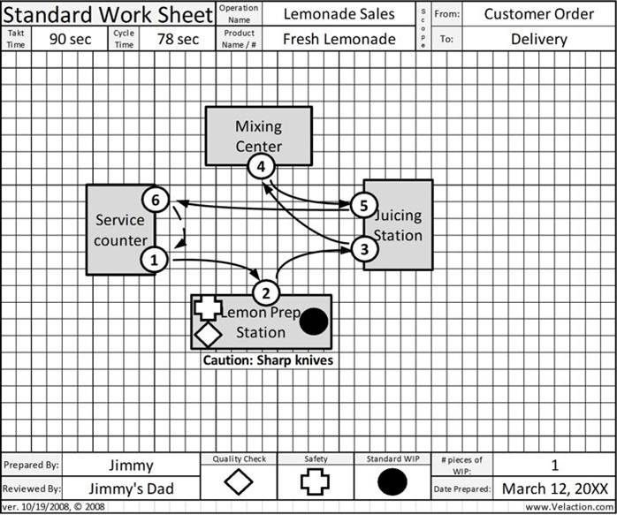
FORM – Process Flow
Process data
Layout & path (distances)
The Standard Work Sheet shows the flow of the process – Document Before and After
Standard WIP
Notes:
Convert to stevedoring

Slide 23
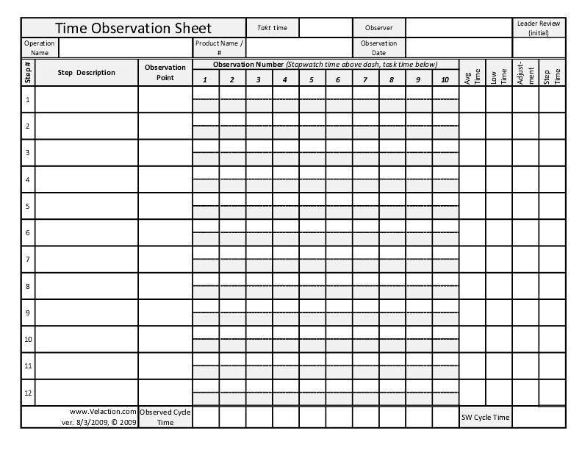
FORM - Time Observation
Running time on top
Header information
Process steps
Assess and assign step times here
Calculate step time later on bottom
Notes:
Convert to Capacity analysis

Slide 24
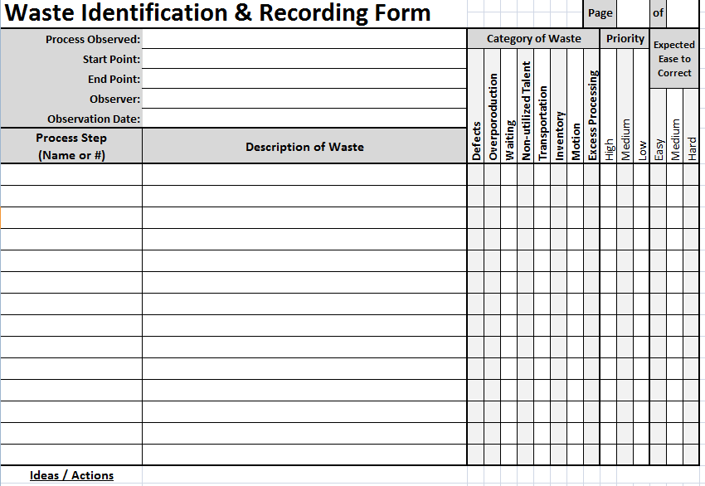
FORM – Waste Walk
Check Type of Waste
Header information
Process steps
Determine Priority and Ease to Correct
Describe Waste or Wasteful Practice
List Ideas / Solutions
Notes:
Convert to Capacity analysis

