Slide 1
Employee reactions to talent management
Loughborough University Research Seminar
Prof. Dr. Nicky Dries Faculty of Economics & Business, KU Leuven Tuesday June 16th, 2015

Slide 2
Part I: Is TM a legitimate topic of academic study?
Talent management has always seemed to me to be a tricky subject. It is at risk of becoming mere hyperbole, as in ‘the War for Talent’, or of becoming the fad of the conference circuit because the term lacks a clear definition. Proposed definitions are, at worst, a mélange of different concepts strung together without a clear statement of what is meant by talent and how we might manage it.
(Reilly, 2008, p. 381)

Slide 3
Is TM a legitimate topic of academic study?
Talent management has always seemed to me to be a tricky subject. It is at risk of becoming mere hyperbole, as in ‘the War for Talent’, or of becoming the fad of the conference circuit because the term lacks a clear definition. Proposed definitions are, at worst, a mélange of different concepts strung together without a clear statement of what is meant by talent and how we might manage it.
y
As in:
Difficult to publish; rejection based on topic alone (in non-HRM journals)
(Reilly, 2008, p. 381)

Slide 4
Is TM a legitimate topic of academic study?
Talent management has always seemed to me to be a tricky subject. It is at risk of becoming mere hyperbole, as in ‘the War for Talent’, or of becoming the fad of the conference circuit because the term lacks a clear definition. Proposed definitions are, at worst, a mélange of different concepts strung together without a clear statement of what is meant by talent and how we might manage it.
y
As in:
Consultancy speak; conjectural “knowledge”; lack of solid evidence
(Reilly, 2008, p. 381)

Slide 5
Is TM a legitimate topic of academic study?
Talent management has always seemed to me to be a tricky subject. It is at risk of becoming mere hyperbole, as in ‘the War for Talent’, or of becoming the fad of the conference circuit because the term lacks a clear definition. Proposed definitions are, at worst, a mélange of different concepts strung together without a clear statement of what is meant by talent and how we might manage it.
y
As in:
The “problem” is imaginary, or of passing nature; it is unimportant
(Reilly, 2008, p. 381)

Slide 6
Is TM a legitimate topic of academic study?
Talent management has always seemed to me to be a tricky subject. It is at risk of becoming mere hyperbole, as in ‘the War for Talent’, or of becoming the fad of the conference circuit because the term lacks a clear definition. Proposed definitions are, at worst, a mélange of different concepts strung together without a clear statement of what is meant by talent and how we might manage it.
y
As in:
Lack of theory; theory as a precondition for “real” academic value
(Reilly, 2008, p. 381)

Slide 7
Theory-driven research
Theoretical framework
Gap-spotting
Hypothesis generation
Research design
y
Data collection
Study limitations
Theory confirmation/
expansion/falsification
Gap-spotting

Slide 8
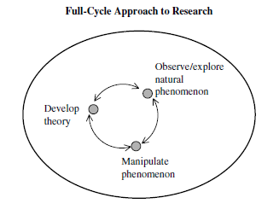
TM = phenomenon-driven field
Whereas traditional, theory-driven research follows a process whereby hypotheses are developed based on gaps detected within the current knowledge of a field—guided by established definitions, operationalizations, and measures—phenomenon-driven research takes a different route, one that “starts with the generation
of facts, most typically from large-
sample analysis, that can inform
us as to what we need a theory
for […] Then, as we get into
exploring the whys and hows, a
combination of quantitative and
qualitative studies will be fruitful”.
y
(Hambrick, 2007, p. 1349;
see also Chatman & Flynn, 2005)

Slide 9
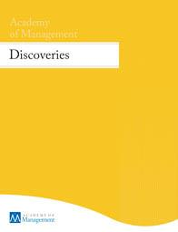
Phenomenon-driven research = “hard sell”
“After years of comparing notes with colleagues about the rejection letters we have received, it seems the most annoying passage—which I am sure editors have preprogrammed for handy one-click insertion—is this one: The reviewers all agree that your paper addresses an
important topic and is well argued; moreover, they find your empirical results convincing and interesting. At the same time, however, the reviewers believe the paper falls short in making a theoretical contribution. Therefore, I’m sorry… etc., etc., etc.”
y
(Hambrick, 2007, p. 1346)

Slide 10
Stages in the evolution of a phenomenon
First, in an embryonic state, a novel phenomenon can hardly be singled out against a background of other known phenomena and states of the world;
Second, in a growing state, discrepancy between the phenomenon and scientific knowledge prompts the interest of a growing number of scholars (an informal scientific community);
Third, in a mature state, classes of regularities emerge, as being distinct from each other (< designs, methods, explanations);
Fourth, in a declining state, the phenomenon gradually merges with the background of other known, scientific phenomena (due to competing regularities, or self-evidency).
WE ARE HERE
y
(von Krogh, Lamastra, & Haefliger, 2009)

Slide 11
Results of 2015 bibliometric analysis
TM can be classified as an “embryonic” field from 1998-2011, and a “growing” field from 2011-today—we are seeing more consensus about definitions and frameworks, and research methods are (slowly) improving.
Dominant theoretical frameworks | Alternative theoretical frameworks
Resource-based view (RBV) International HRM Employee assessment Institutionalism | Knowledge management Career management Strength-based approach Social exchange theory
y
(Gallardo-Gallardo, Nijs, Dries, & Gallo, 2015)

Slide 12
35% of articles use this definition:
“[TM refers to] activities and processes that involve the systematic identification of key positions which differentially contribute to the organization’s sustainable competitive advantage, the development of a talent pool of high potential and high performing incumbents to fill these roles, and the development of a differentiated human resource architecture to facilitate filling these positions with competent incumbents and to ensure their continued commitment to the organization.”
y
(Collings & Mellahi, 2009, p. 305)

Slide 13
The “talent” construct itself…

Slide 14
In HR practice: the 9-box
Society for Human Resource Management
70-20-10 rule
(so-called “vitality curve”)
(Silzer & Church, 2010)

Slide 15
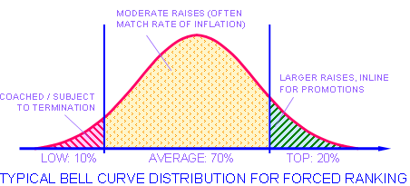
“Talent pools”/forced comparison
y
(Jack Welch, former CEO of GE)

Slide 16
“HR architecture”: Pivotal positions
y
(Adapted from Lepak & Snell, 1999)

Slide 17
Critique: “rank & yank”
y
So… how do employees react to all of this?

Slide 18
Part II: Data collected 2004 - 2014
Comparative analysis of +20 cases (large multinationals) based on HR policy documents;
Semi-structured interviews with +100 people who played an active role in the TM policies of their organizations (i.e., HR directors, HR managers, CEO’s, union representatives, people identified as ‘talented’);
Survey data of +700 organizations about their TM strategies & practices;
Survey data of +2,000 people identified as ‘talented’ (+ control groups) asking for their TM experiences;
A list of +5,000 spontaneous associations with ‘talent’ held by HR managers from all over the world.
Team-level data of 44 work teams of 6 people each.

Slide 19
1| Outcome = career type
Dries, N. & Pepermans, R. (2008). ‘Real’ high potential careers: An empirical study into the perspectives of organisations and high potentials. Personnel Review, 37 (1), pp. 85-108.

Slide 20
1| Outcome = career type
Problem setting: TM literature is normative and non-empirical; experiences of the actual people in TM programs hardly ever examined.
Research question: If the organizational career is “dead” and careers are now “boundaryless”, why have TM programs at all?
Methods: Qualitative, inductive study interviewing 14 “hipos” and their organizations’ HR managers.
Key findings: Rather than the organizational career being “dead”, TM creates workforce differentiation in the type of careers (un)available to subsets of employees.

Slide 21
2| Outcome = career satisfaction
Dries, N., Van Acker, F., & Verbruggen, M. (2012). How ‘boundaryless’ are the careers of high potentials, key experts and average performers? Journal of Vocational Behavior, 81 (2), pp. 271-279.

Slide 22
2| Outcome = career satisfaction
Methods: Case-control [+ double-blind] survey study in 12 large organizations (N=250 “hipos”; 230 “key experts; 461 “average performer” controls).
Key findings: Those who organizations consider their “best” people are more often found in traditional-organizational careers—both in terms of employer inducements [job security, POS, promotions, salary] and employee attitudes [loyalty preference, commitment]. Organizational careers coincide with more career satisfaction than careers displaying more “boundaryless” features. Individuals' career types are mostly determined by supervisor-rated performance, much more so than by individual career orientation.

Slide 23
3| Outcome = perceived PC obligations
Dries, N., Forrier, A., De Vos, A., & Pepermans, R. (2014). Self-perceived employability, organization-rated potential and the psychological contract. Journal of Managerial Psychology, 29 (5), pp. 565-581.

Slide 24
3| Outcome = perceived PC obligations
Problem setting: The “employability paradox”.
Research question: Can the “hipo” label create stronger ties between high-performing employees and their organizations (i.e., relational self-perceived PC obligations: time frame/performance), thus buffering their high employability [hipo label = moderator]?
Methods: Case-control study in 5 organizations (N=103).
Key findings: Employability does not create more transactional perceived employee obligations, but being labeled hipo does increase relational perceived employer obligations (with no perceived obligation to reciprocate)! [no correlation/interaction between hipo & employability]

Slide 25
4| Outcome = PC breach
Dries, N. & De Gieter, S. (2014). Information asymmetry in high potential programs a potential risk for psychological contract breach. Personnel Review, 43 (1), pp. 136-162.

Slide 26
4| Outcome = PC breach
Methods: Qualitative study interviewing 20 “hipos” and their organizations’ HR directors.
Key findings: Information asymmetry in TM programs poses a potential risk for PC breach. Although strategic ambiguity can be an effective communication strategy in that it creates a power imbalance in favor of the organization, at all times a delicate balance must be maintained between leaving leeway for decision making, and creating perceived promises in high potential employees that are subsequently broken. In fact, through information asymmetry organizations run the risk of achieving the exact opposite of the goals they had for their TM programs in the first place.

Slide 27
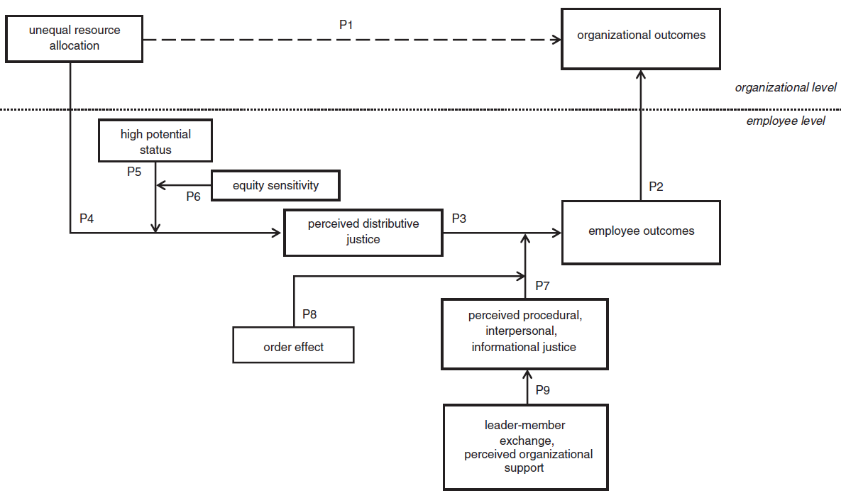
5| Perceived justice as a key mediator
(Propositions
paper)
Gelens, J., Dries, N., Hofmans, J., & Pepermans, R. (2013). The role of perceived organizational justice in shaping the outcomes of talent management: A research agenda. Human Resource Management Review, 23 (4), pp. 341-353.

Slide 28
6| Outcome = Work satisfaction/effort
Gelens, J., Hofmans, J., Dries, N., & Pepermans, R. (2014). Talent management and organizational justice: Employee reactions to high potential identification. Human Resource Management Journal, 24 (2), pp. 159-175.

Slide 29
6| Outcome = Work satisfaction/effort
Problem setting: Most of organizations’ assumptions about employee reactions to TM implicitly or explicitly revolve around perceived fairness of these programs.
Methods: Case-control study in 1 organization (N=203).
Key findings: Perceived distributive justice was significantly higher for employees identified as a high potentials, and fully mediated their more positive relationship to job satisfaction. High perceived distributive justice was only associated with more work effort when procedural justice was also high [moderated mediation]; in fact, when procedural justice is low, higher distributive justice could even lead to lower work effort.

Slide 30
7| Outcome = Employee morale
Study 8a: Contrastive vignette study
Gelens, J., Dries, N., Hofmans, J., & Pepermans, R. (working paper). Star and non-star performer reactions to workforce differentiation: Perceived justice as a boundary condition.
Notes:
The more an employee believes his or her supervisor sees them as a high performer; the more they find the exclusive TM scenario more fair than the inclusive one. [Self-serving bias?]

Slide 31
7| Outcome = Employee morale
Study 8b: Experiment
Gelens, J., Dries, N., Hofmans, J., & Pepermans, R. (working paper). Star and non-star performer reactions to workforce differentiation: Perceived justice as a boundary condition.
Notes:
When no procedural information is provided, both groups find the allocation equally fair whether they themselves are considered a hipo or not. However, procedural information, when provided, has a positive effect on those who did receive the status but a negative effect on those who did not. Results combined with the previous study (“6” in this presentation) may indicate that providing transparent procedural information creates more positive employee reactions in hipos, but not in non-hipos. Possibly not giving information creates a smaller risk of self-threat for those not selected and more leeway for self-serving interpretations of the allocation decision. + More explicit criteria to self-assess against.
HOWEVER in study 6 we measured perceived procedural justice, which isn’t entirely the same as amount of procedural information provided [informational justice]. People who are not identified as hipos may even believe procedures are more fair when they receive less explicit information… (we can’t show that with these data, though).

Slide 32
7| Outcome = Employee morale
Study 8c: (Single-case) survey study
“Strong context” case organization (i.e., claim TM transparency)
However, 75 out of 306 (1 in 4) respondents still misclassified themselves (actual >< self-perceived)
Different results when looking at self-perceived vs. actual TM status (cf. work of Mariëlle Sonnenberg on “talent-perception incongruence”)
Important finding: perceived distributive justice buffers “actual” high performers’ (higher) turnover intentions → transparency = key to retention?
Gelens, J., Dries, N., Hofmans, J., & Pepermans, R. (working paper). Star and non-star performer reactions to workforce differentiation: Perceived justice as a boundary condition.
Notes:
All these results taken together:
Talented status leads to better employee outcomes (satisfaction, commitment, intention to stay), partly because of higher distributive justice.
Procedural justice is not just important for non-selected, but also for the hipos (especially for their work effort and for buffering turnover intentions).
Strategic ambiguity in communicating about procedures may be better for non-hipos (self-serving), but not for hipos. Strategic ambiguity in hipos creates risk of PC breach.
Hipos expect more from their organizations after identification, but do not necessarily reciprocate this “relational PC” loyalty.
PC fulfilment and justice seem important mediators in retaining hipos.
External employability and room for self-serving attributions may be useful to maintain non-hipo morale.

Slide 33
Next steps: Going full-cycle
Some important questions remain:
Why do organizational decision makers insist on differentiating on a matter (i.e., talent) they believe to be so sensitive (i.e., in that it determines people’s internal career opportunities greatly), they could not possibly communicate it to their employees?
What about the ethics of it all?
And what are the implications for differentiation in organizational practice if the “secrecy” phenomenon implies that the jobs/careers of the “talented” vs. “less talented” cannot be visibly different? [Prelim analyses on “secrecy” data imply a positive main effect of transparency!]

Slide 34
Going full-cycle
One of our interests is to examine “net effects” of differentiation taking a “weighted” approach where organizations assign a higher value to the reactions of talent-status employees. [e.g., we are looking at the possibility of a simulation study, with which we have no experience however]
In order to demonstrate causality, experimental research is needed (e.g. intra-group/team processes and effects of differentiation).
Possibly also multilevel research (individuals nested in work groups nested in organizations).

Slide 35
Questions? Contact me: nicky.dries@kuleuven.be +32.16/37.37.19.

