Slide 1
Talent management
Khamis 2 hb Jun 2011
1-2 petang

Slide 2
TALENT MANAGEMENT(TM)
NEED FOR EFFECTIVE TM PROCESS:
Provide a focus for investment
Place subject of talent high in the corporate agenda
Desirable objective for HR professionals
It contributed to other strategic objectives such as:
Building a high-performance workplace or a learning organisation
Adding value to the employer of choice and branding agenda
Contributing to diversity management

Slide 3
TM: WHY HRD ONLY IS NOT ENOUGH
CHALLENGING WORKFORCE ISSUES:
Heightened competition for skilled workforce
Impending retirement of the baby boomers
Low levels of employee engagement
Acknowledgement of the high cost of turnover
Ardours demands of managing global workforce
Importance of succession planning
Offshore and outsourcing trend.

Slide 4
DEFINITION OF TALENT
It is the identifying of potential and consists of those individuals who can make a difference to the organisational performance, either to their immediate contribution or in the longer term by demonstrating the highest levels of potential.
B. Definition as suggested by CIPD:
“It is a systematic attraction, identification, development, engagement/retention and deployment of those individuals with high potential who are of particular value to an organisation.”

Slide 5
TM: VARIOUS APPROCHES
Must have an agreed organisation wide definition of talent and TM
Use a language for TM activities that is understood by all the parties
A proactive, strategic approach to TM,
Engage line managers from an early stage,
TM can be used to:
Enhance organisation’s image
Support employer branding
Provide a means of enhancing employee engagement to improve retention,

Slide 6
TM: VARIOUS APPROCHES (contd):
TM activities should be developed with other HR policies and practice
Developing talent may be based on a blend of formal and informal methods
HR specialists play important role in support, guidance to design and develop TM
Process need to be in place to track, the performance and progress of those identified as talent
TM is a dynamic process and need to be reviewed continuously to meet the changing trend and making the organisation a success ultimately.

Slide 7
TM: RELATED HRD RESPONSIBILITY
Identify investments,
Design developments required to its role in TM,
Calculate ROI to the organisation.
Identify talent gaps
Identify actions to different performance segments.
Understand the CAN DO/WILL DO Matrix

Slide 8
TM: HRD TO HAVE INITIATIVES ON:
ORGANISATIONAL INTELLIGENCE:
retention strategy,
succession planning
knowledge transfer
internally driven performers
high performance teams
self organising success
leadership investments, on-boarding and transition support.

Slide 9
TM: HRD CAN HELP WITH SCENARIO BUILDING
HR LEADERSHIP ACCOUNTABLE FOR HELPING ORGANISATION INTERPRET LONG TERM NEEDS THROUGH SCENARIO BUILDING:
WHAT IF WE DO NOTHING?
WHAT IF WE WERE ABLE TO EXCEED OUR GREATER EXPECTATION?
WHAT IS REALISTIC?

Slide 10
TM: CREATING AND EVALUATING PRIORITIES
PLAN
SET GOALS
INVEST
PERFORM
MEASURE

Slide 11
TM : THE STRATEGY:
Clear sense of direction and purpose
Caring management
Flexible benefits and schedules
Open communication
Changed work environment: people want an enjoyable work environment
Performance management
Reward and recognition
Training and development

Slide 12
TM: ABILITY AND WILLING MATRIX
EMPLOYEE RETENTION IS A CRITICAL COMPONENT OF TM

Slide 13
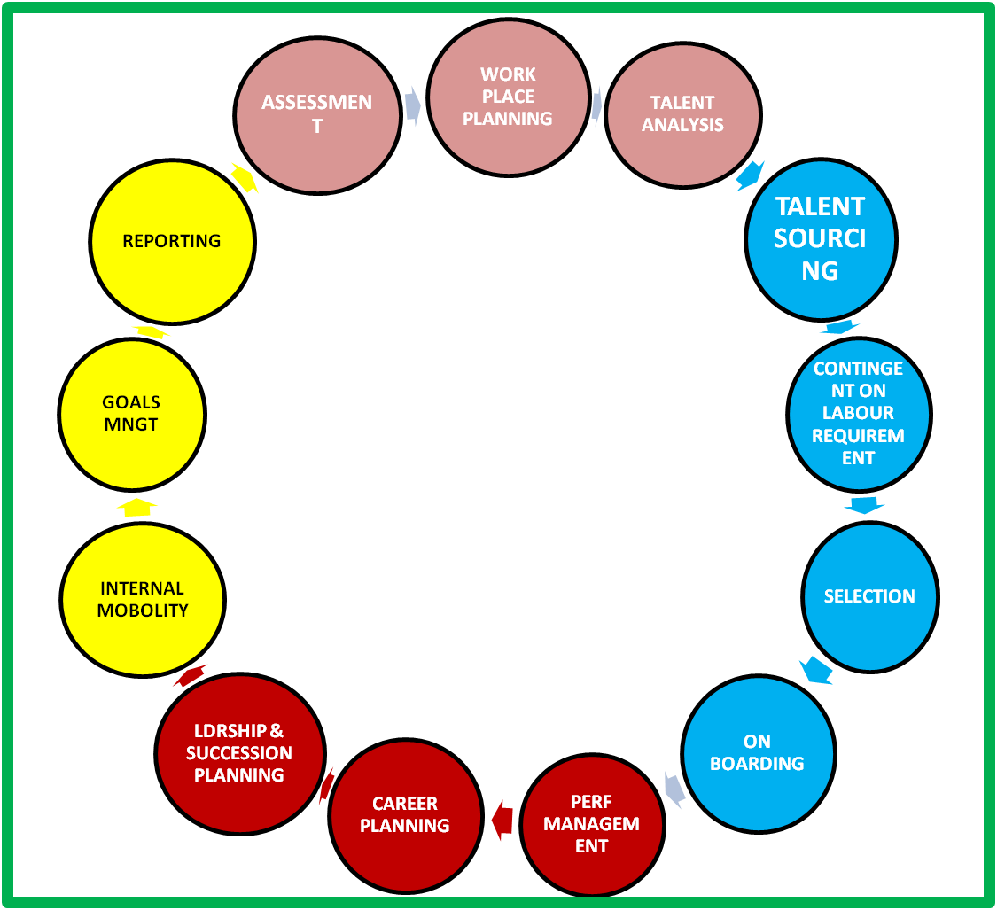
TM: THE PROCESS CYCLE
ORGANISATIONAL GOALS
ORGANISATIONAL GOALS
ORGANISATIONAL PERFORMANCE
ASSESS
ACQUIRE
ALIGN
DEVELOP
RETAIN TALENTED INDIVIDUALS

