Slide 1
Designing Talent Management Practices That Work: Secrecy or Transparency?
Prof. Dr. Nicky Dries Faculty of Economics & Business KU Leuven EAWOP—Thursday May 21st, 2015

Slide 2
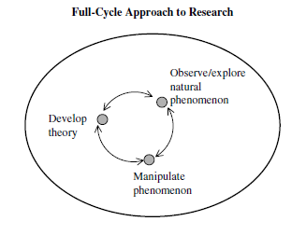
TM = phenomenon-, not theory-driven field
Whereas traditional, theory-driven research follows a process whereby hypotheses are developed based on gaps detected within the current knowledge of a field—guided by established definitions, operationalizations, and measures—phenomenon-driven research takes a different route, one that “starts with the generation
of facts, most typically from large-
sample analysis, that can inform
us as to what we need a theory
for […] Then, as we get into
exploring the whys and hows, a
combination of quantitative and
qualitative studies will be fruitful”.
y
(Hambrick, 2007, p. 1349)

Slide 3
Phenomenon-driven research = “hard sell”
“Talent management has always seemed to me to be a tricky subject. It is at risk of becoming mere hyperbole, as in ‘the War for Talent’, or of becoming the fad of the
conference circuit because the term lacks a clear definition. Proposed definitions are, at worst, a mélange of different concepts strung together without a clear statement of what is meant by talent and how we might manage it”.
y
(Reilly, 2008, p. 381)

Slide 4
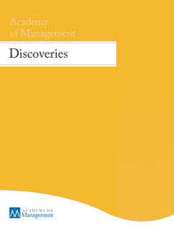
Phenomenon-driven research = “hard sell”
“After years of comparing notes with colleagues about the rejection letters we have received, it seems the most annoying passage—which I am sure editors have preprogrammed for handy one-click insertion—is this one: The reviewers all agree that your paper addresses an
important topic and is well argued; moreover, they find your empirical results convincing and interesting. At the same time, however, the reviewers believe the paper falls short in making a theoretical contribution. Therefore, I’m sorry… etc., etc., etc.”
y
(Hambrick, 2007, p. 1346)

Slide 5
Results of 2015 bibliometric analysis
TM can be classified as an “embryonic” field from 1998-2011, and a “growing” field from 2011-today (next stages phenomenon-driven cycle = “mature” and “declining”)—we are seeing more consensus about definitions and frameworks, and research methods are improving.
Dominant theoretical frameworks | Alternative theoretical frameworks
Resource-based view (RBV) International HRM Employee assessment Institutionalism | Knowledge management Career management Strength-based approach Social exchange theory
y
(Gallardo-Gallardo, Nijs, Dries, & Gallo, 2015)

Slide 6
35% of articles now use this definition:
“[TM refers to] activities and processes that involve the systematic identification of key positions which differentially contribute to the organization’s sustainable competitive advantage, the development of a talent pool of high potential and high performing incumbents to fill these roles, and the development of a differentiated human resource architecture to facilitate filling these positions with competent incumbents and to ensure their continued commitment to the organization.”
y
(Collings & Mellahi, 2009, p. 305)

Slide 7
A-players in A-positions
Top-down: Directing best people to best (pivotal) jobs
Bottom-up: Designing job (trajectories) around best people (+ job crafting & i-deals by ‘hipos’ themselves)
y
(Adapted from Lepak & Snell, 1999)

Slide 8
Critique: ‘rank & yank’
y

Slide 9
Talent management secrecy
Talent management secrecy—the organizational practice of not communicating (the presence of) TM practices and procedures openly to employees—emerged spontaneously as a recurring theme (cf. phenomenon) through 8 TM studies (2008-2014):
Study 1: Multilevel case-control employee survey (hipos vs. non-hipos)
Study 2: HR survey on TM policies
Study 3: HR survey on TM philosophies
Study 4: Interview study with hipos & HR managers
Study 5: Global HR survey on TM philosophies
Study 6,7,8: HR survey on perceived justice of TM procedures
We are now examining if we can transform this into a full-cycle research program with these as “observational” data.

Slide 10
Study 1: Case-control study
y
In stark contrast to HR discourse (which would predict a large divide between hipos and non-hipos and a resultant negative net effect of non-secrecy), we found a positive main effect of open communication.
Notes:
10
In this study, we aimed to test these often-heard but never tested assumptions about the effects of openly communicating to employees whether they are considered high potentials or not (so about performance, success and commitment/turnover intentions).
We hypothesized that:
- High potentials are better performers than non-high potentials;
- High potentials are more successful than non-high potentials;
- High potentials are more committed to their organizations than non-high potentials;
- MODERATION: And that these effects are reinforced under conditions of open communication;
>> i.e. under conditions of open communication, the positive effects for high potentials increase, but also the negative effects for non-high potentials.
Only organizations who could produce explicit lists of high potentials and non-high potentials and used the same definition of talent management as we do were allowed to participate.
Respondents were anonymous to us, and they in turn were not informed of the high potential/non-high potential variable.

Slide 11
Study 4: Interview study
y
(Dries & De Gieter, 2014)

Slide 12
Study 6, 7, 8: Perceived justice of TM
Study 6: Contrastive vignette study
Study 7: Experiment
y
Study 8: (Case) survey study
“Strong context” case organization (i.e., claim TM transparency)
However, 75 out of 306 respondents still misclassified themselves
Different results when looking at self-perceived vs. actual TM status
(cf. work of Mariëlle Sonnenberg on “talent-perception incongruence”)
Important finding: perceived distributive justice buffers “actual” high performers’ (higher) turnover intentions → transparency = key to retention!

Slide 13
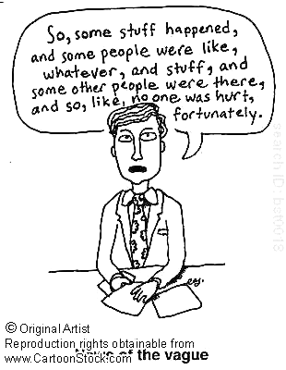
Next steps: Going full-cycle
Based on our (mostly inductive) data, we have identified 2-3 literature streams as being of specific interest to develop more deductive research designs (preferably experiments → causality) in a next step:
1. Pay secrecy (e.g. Colella et al., 2007, AMR)
2. Strategic ambiguity (e.g. Eisenberg, 1984)
3. Social identity/status theory
(e.g. Bunderson & Barton, 2011)

Slide 14
Next steps: Going full-cycle
Overall question remains—why differentiate on a matter (i.e., talent) that you believe to be so sensitive (i.e., in that it determines career outcomes/access to “A positions” greatly), you could not possibly communicate it to employees? What about the ethics of it all? And what are the implications for job design in TM if the secrecy phenomenon/trend implies that the jobs of the “talented” vs. “less talented” cannot be visibly different? [+ One of our interests is to examine “net effects” of differentiation taking a “weighted” approach where organizations assign a higher value to the reactions of “talent” vs. “non-talent”-status employees]

Slide 15
Questions? Contact me: nicky.dries@kuleuven.be +32.16/37.37.19.

