Slide 1
Staff Performance Evaluation & Merit Based Compensation for Staff Employees Lewis Benavides, SHRM – SCP, SPHR Senior Associate Vice President for Human Resources and CHRO Tony Yardley, SHRM – SCP, SPHR Manager, Institutional Equity
October 2016

Slide 2
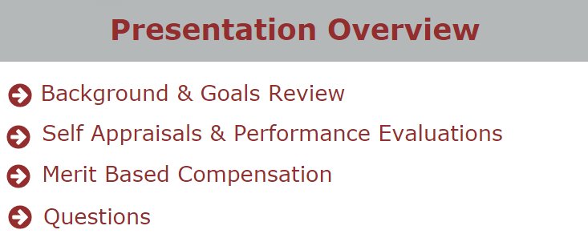

Slide 3
Background
TWU determined that the current performance evaluation process should undergo a committee review to evaluate if the performance management plans are consistent and could be effectively and equitably linked to compensation.
Two committees were formed in July 2015 to review and recommend changes to the performance evaluation system. Employee surveys were conducted, employee town hall meetings were held by the committees, performance evaluation forms were developed and finalized.
In January 2016, phase 1 training meetings were held for supervisors and employees to review the committees’ work, review the goals portion of the employee performance evaluation process, and introduce the pay for performance concept now named merit based compensation.

Slide 4
Goals
Mutually agreed upon goals are an essential element of the performance evaluation process and allow employees to demonstrate clear achievements throughout the review period.
Goals should be completed in the SharePoint system at this time.
However, for those that have not finalized their goals, please do so. Let’s do a quick review:

Slide 5
Completing the Goals
The Performance Evaluation tab on the HR website contains links to the employee and supervisor recorded sessions in January regarding goals and the SharePoint system for entering the Performance Development Goals.
www.twu.edu/humanresources/

Slide 6
Self Appraisals
The Self Appraisals, designed by the committees to be concise and user friendly, are an opportunity for employees’ to document and communicate their own work performance to their supervisors for the period being reviewed.
Self Appraisals are initiated by the employee and are a required step in the performance evaluation process. However, they do not require supervisor approval.
Similar to the process developed in SharePoint for Goals, Self Appraisals will be entered by the employee in SharePoint. (Employees with no access to computers will be allowed to complete a paper Self-Appraisal form. Supervisors of these employees will scan and upload the paper form when completing the Performance Evaluations).
Employees will click on a link provided by HR by email and made available on the HR website. www.twu.edu/humanresources/

Slide 7
Self Appraisal Preparation
Consider the Self Appraisal as an opportunity for you to share your perception of your performance to your supervisor prior to the performance evaluation
PREPARE
Review job description
Review goals
Detail your accomplishments
Gather any letters, emails, certificates of recognition
Note training and development activities

Slide 8
Self Appraisal Preparation
PREPARE
Think through and note any obstacles in your position
Consider the entire review period
Document changes in assignments and special assignments
TWU community involvement – committees, volunteer
Provide detailed and accurate answers

Slide 9
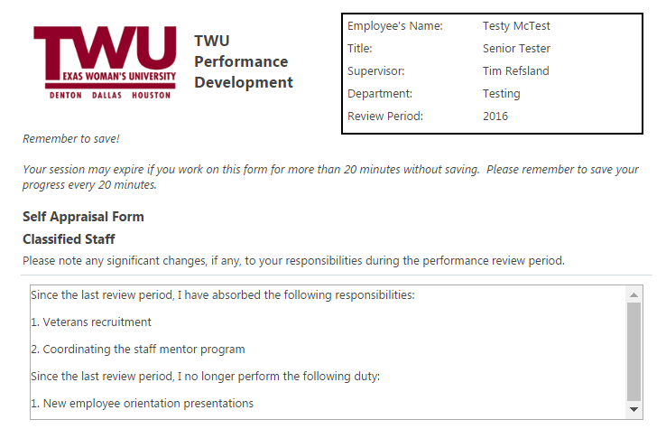
Automatically Populates
Save every
20 minutes

Slide 10
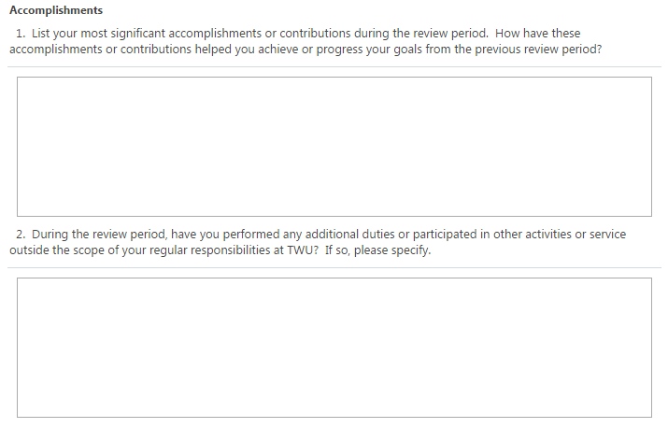
Self Appraisals
Significant accomplishments
Additional duties & activities

Slide 11
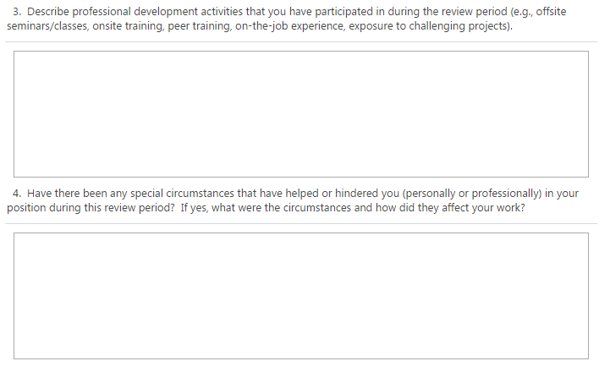
Self Appraisals
Professional development activities
Special circumstances

Slide 12
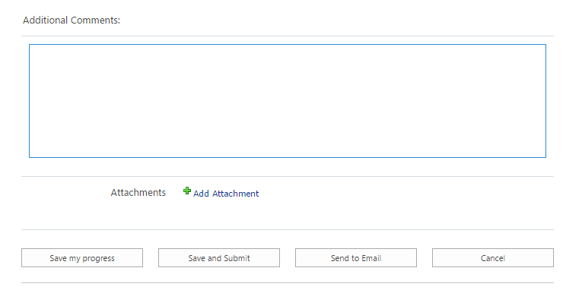
Self Appraisals
Additional comments
Add attachment
Save my progress
Save and Submit
Send to Email
Cancel

Slide 13
Performance Evaluations
Performance Evaluations, also designed to be concise and user friendly, are a necessary tool to provide feedback and assessment of the employee’s work performance and contribution during the review period.
Performance Evaluation ratings in the form of an overall score will be used to evaluate an employee’s contribution for merit based compensation.
After the Self Appraisal has been submitted by the employee, Supervisors will be notified by email when the Self-Appraisal is complete. Supervisors will review the Self-Appraisal and begin the Performance Evaluation.

Slide 14
Performance Evaluations
Classified Staff: Performance Competencies
11 Questions
3 Additional Questions for Police Officers
3 Additional Questions for Custodians, Groundskeepers and Maintenance Staff
5 Additional Questions for Supervisors

Slide 15
Performance Evaluations
Professional & Administrative Staff: Performance Competencies
12 Questions
6 Additional Questions for Supervisors

Slide 16
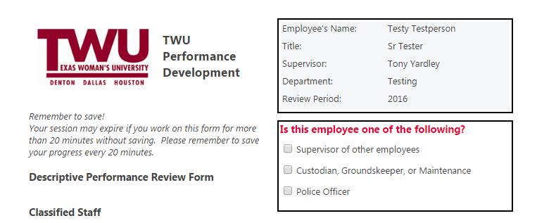
Performance Evaluations
Automatically Populates
Save every
20 minutes
Determines relevant additional questions

Slide 17
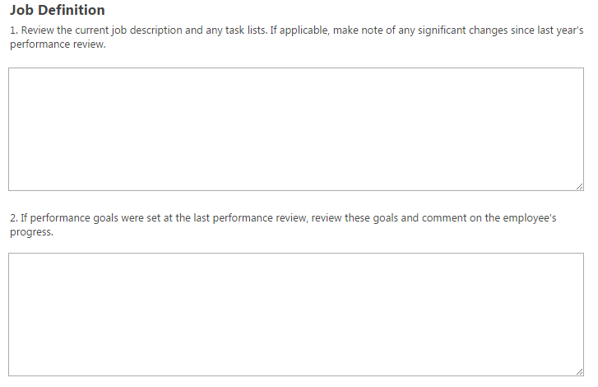
Performance Evaluations
Note significant changes to duties
Comment on employee goals

Slide 18
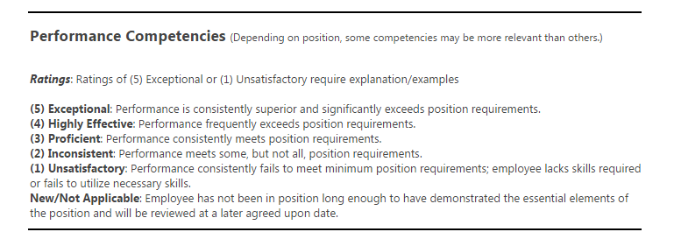
Performance Evaluations - Ratings

Slide 19
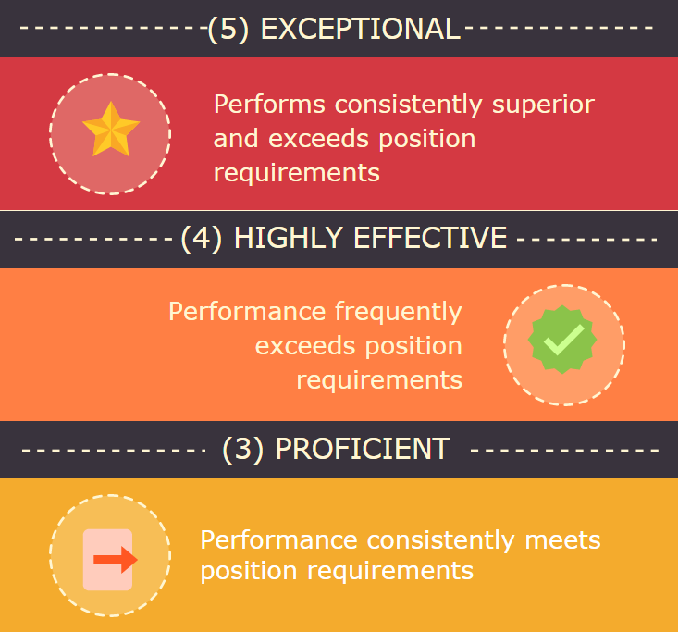

Slide 20
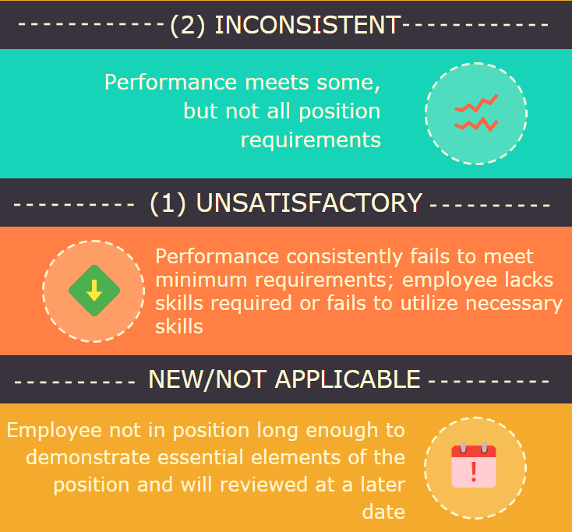

Slide 21
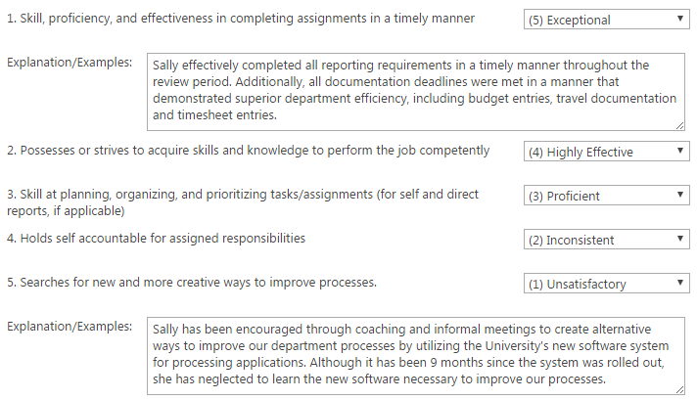
Performance Evaluations
(5) Exceptional Requires
Explanation or Example
(1) Unsatisfactory Requires
Explanation or Example

Slide 22
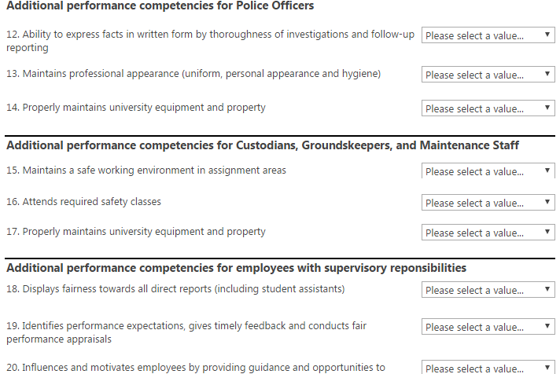
Performance Evaluations
Police Officers
Custodians, Groundskeepers & Maintenance
Supervisors

Slide 23
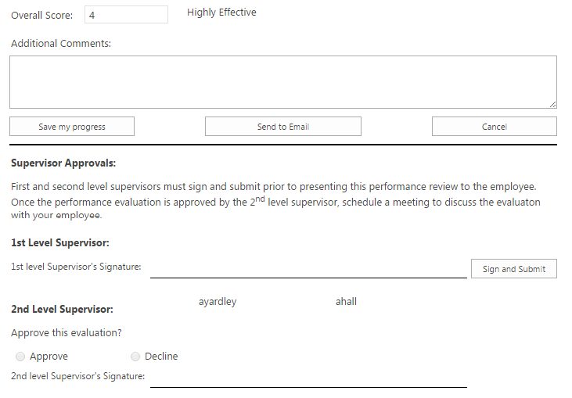
Overall Rating
Overall
Score
Additional Comments
Save my
progress
Cancel
Send to Email
Requires 1st and 2nd Level Supervisor Approvals

Slide 24
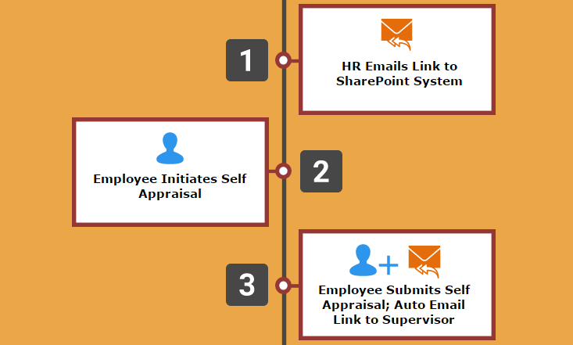
Performance Evaluations
Self Appraisal & Performance Evaluation Process

Slide 25
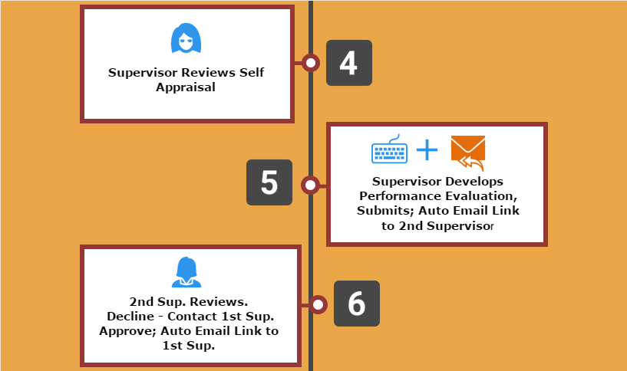
Self Appraisal & Performance Evaluation Process

Slide 26
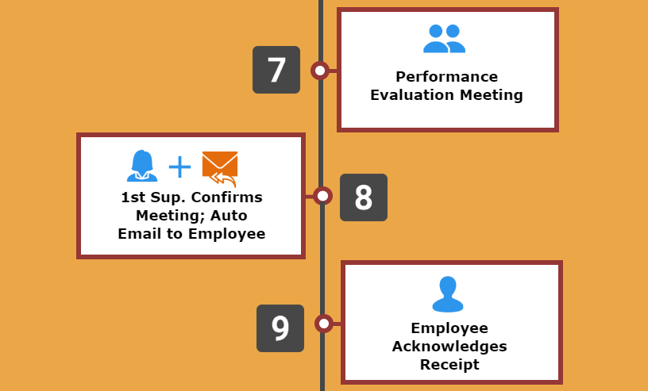
Self Appraisal & Performance Evaluation Process

Slide 27
Facilities Staff without Computer Access
Employee completes paper Self Appraisal
Supervisor completes Performance Evaluation in SharePoint
Supervisor emails copy of Performance Evaluation to him/herself and prints a copy
Supervisor conductions Performance Evaluation Meeting, asks employee to sign as acknowledgement
Checkbox for Supervisor, “I have met with my employee and he/she has acknowledged receipt.”
Upload scanned copies of Self Appraisal and signed Performance Evaluation

Slide 28
Performance Evaluations – Common Ratings Errors
Contrast Error – tendency to compare performance to other employees
First-impression Error - tendency to initially judge “favorable” or “unfavorable,” serving as basis for evaluating performance
Recency Effect – tendency to give extra weight to recent performance and diminish performance through the review period

Slide 29
Performance Evaluations – Common Ratings Errors
Central Tendency Effect- consistently rating at or near the average or midpoint regardless of performance. Damages high performers
Negative or Positive Leniency- rating too hard or too lenient
Halo Effect– generalizing positively from one aspect of performance to all aspects of performance

Slide 30
Performance Evaluations – Common Ratings Errors
Devil Effect – generalizing from one or two negative aspects of performance and becoming blind to the positive aspects
Personal Bias– tendency to rate based on how the supervisor feels about the employee. Personal bias can stem from various sources such as colleagues, considerations of race, gender, faith, social and family background, etc.

Slide 31
Performance Evaluations – Performance Review Meeting
The Performance Evaluation Meeting is an opportunity for the supervisor and employee to review and discuss the employee’s performance over the previous review period.
The supervisor will communicate his/her decisions regarding the performance competency ratings, review accomplishments, assist with any work related problems and suggest ideas for improvement.
The employee should feel free to point out accomplishments, discuss obstacles to performance and offer ideas for improvement. The employee should also be given the opportunity to ask questions and clarify expectations for the future.

Slide 33
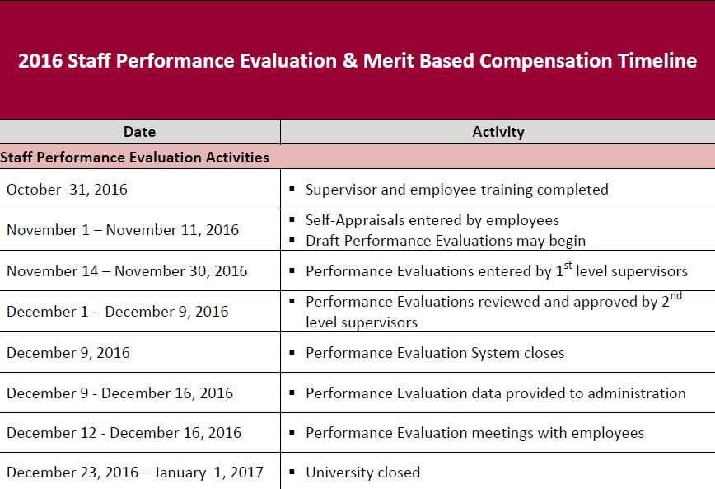

Slide 34
Transition to Merit Based Compensation
In some years the University has relied on annual one time lump sum payments to reward employees.
From the University’s perspective this can be financially beneficial because these increases are not included in base salaries and have not been carried forward in the budget in future years.
However, from the employee’s perspective the base salary does not increase, the merit increase is not eligible for retirement and the employee loses the benefit of the compounding effect of merit increases over multiple years.

Slide 35
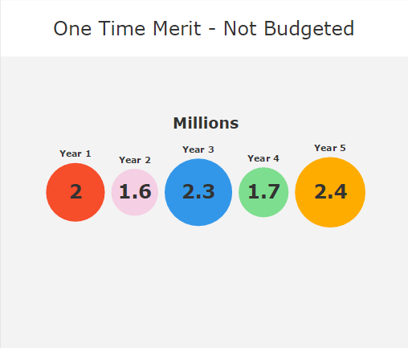
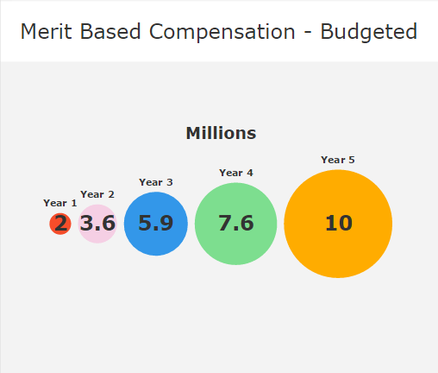
Transition to Merit Based Compensation

Slide 36
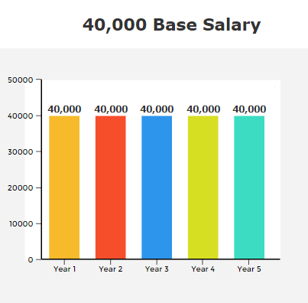
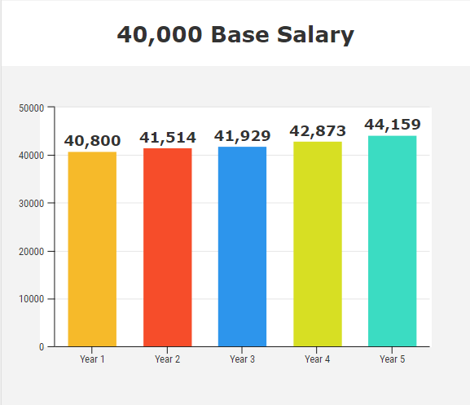
Transition to Merit Based Compensation
2%
1.75%
1%
2.25%
3%
2%
1.75%
1%
2.25%
3%
$0.00
+ $4,159
One Time Merit
Merit Based Compensation

Slide 37
Benefits to Employees
Results in a sustainable increase that is ongoing over a long period of time
Compounding affect of increases over multiple years
Retirement Eligible
For the TRS Retirement Plan, calculation at retirement is based on a higher annual salary resulting in a higher monthly annuity
For the ORP Retirement Plan, more money is contributed and matched in your retirement account

Slide 38
Merit-Based Compensation
The FY 2017 budget includes ~$2 million (2% of the total salary budget) for sustainable merit increases.
Merit is intended to reward performance and should not be allocated across the board.
A merit increase is an increase to recognize meritorious job performance but is not associated with a promotion or a change in job title resulting from a significant change in job duties.

Slide 39
After completion of performance evaluations, all non-exempt employees receiving a “proficient”, “highly effective”, and “exceptional” rating will receive a 2% or $500 merit increase (whichever is higher).

Slide 40
Non- Exempt Staff
Total Non-exempt employees: 412
Top 10 Non-exempt positions:
(50) Custodian I
(35) Administrative Assistants
(32) Sr. Secretary
(23) Secretary
(16) Library Assistants II, III
(15) Guards II
(15) Coordinators
(14) Police Officers, Police, Police Corporals
(13) Asst. to (AVP, Deans, Sr. Provost, Sr. Assoc. VP, VP)
(12) Custodian II
(11) Power Plant Operators

Slide 41
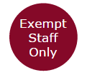
After completion of performance evaluations, all exempt staff employees receiving “proficient”, “highly effective”, and “exceptional” ratings will receive a 0.75% or $500 merit increase (whichever is higher).

Slide 42
Phase III Merit Awards
After Phase I and Phase II merit awards are applied to base salaries:
Vice Presidents will be provided with the remaining available merit allocations (2% less the amounts awarded in Phase I and Phase II) to be awarded to exempt employees.
Vice Presidents will be responsible for providing allocations to their department heads/unit leaders.

Slide 43
Vice President Review
Merit increases awarded will be aggregated at the Vice President level and will be reviewed to ensure total merit awards are within authorized limits and that merit was not allocated across the board

Slide 44
Merit Eligibility
To be eligible for a merit increase*, an employee:
Must have been employed before Feb. 1, 2016
Must not have been awarded a merit increase after Feb. 1, 2016
Must not have received a promotion or re-classification (if either resulted in a salary increase) after Feb. 1, 2016
*Employees serving in an “interim” capacity are eligible for a merit increase based on their salary prior to their “interim” appointment.

Slide 45
Merit Eligibility
Staff: Must have demonstrated meritorious performance as documented on a current year performance evaluation with a “Proficient” or higher overall rating that has been conducted in accordance with university policies. There are five levels on the staff Performance evaluation:
Rating | Scale | Eligibility
Unsatisfactory | 1 - 1.49 | Ineligible
Inconsistent | 1.5 - 2.49 | Ineligible
Proficient | 2.5 - 3.49 | Eligible
Highly Effective | 3.5 - 4.49 | Eligible
Exceptional | 4.5 - 5 | Eligible

Slide 46
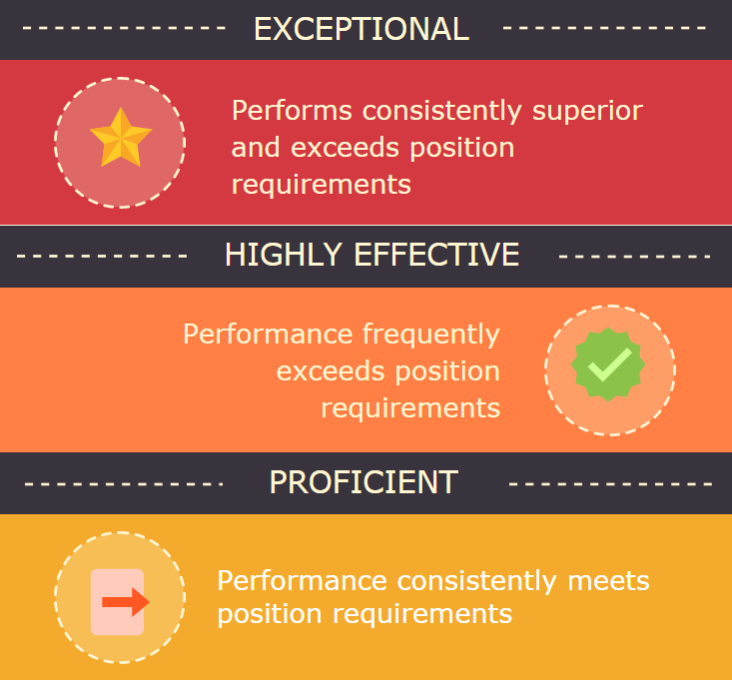
Merit Eligible

Slide 47
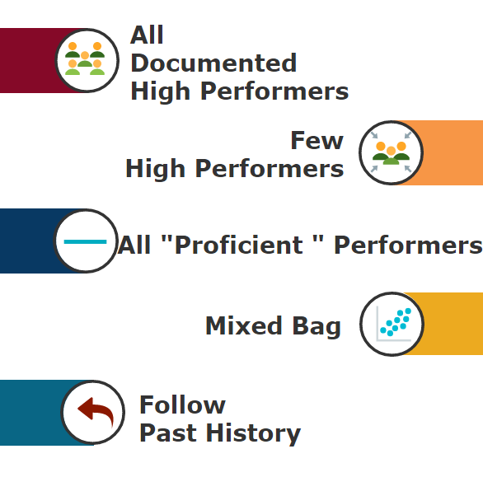
Merit
Distribution
Scenarios

Slide 48
Past History – Ratings Distributions
 | 2015 | 2014 | 2013 | 2012
Rating | Percentage | Percentage | Percentage | Percentage
Outstanding | 23.78% | 28.79% | 23.49% | 24.81%
Exceeds Expectations | 54.97% | 50.84% | 56.51% | 53.49%
Meets Expectations | 19.56% | 19.91% | 19.45% | 20.74%
Improvement Needed | 1.69% | .46% | .55% | .97%
Unsatisfactory | 0.00% | 0.00% | 0.00% | 0.00%

Slide 49
Merit Distribution- Suggested Factors to Consider
Supervisors may rely on any of the following factors when making merit pay recommendations:
Suggested Factors
Student/customer service
Knowledge of the requirements of the position
Quality of work
Ability to handle responsibility
Work productivity

Slide 50
Merit Distribution- Suggested Factors to Consider
Suggested Factors
Demonstrated initiative
Attendance record
Mentor and leadership qualities
Job related education and certifications
Competencies and skills
Teamwork, collaboration and cooperation
TWU community involvement
Driving the strategic initiatives of the dept./university

Slide 51
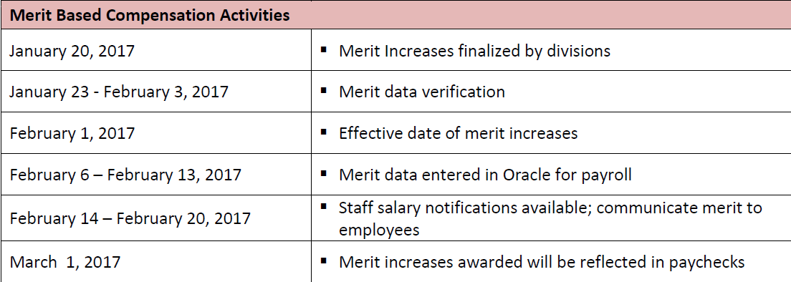

Slide 52
FAQs
Q1. What employee status qualifies for performance evaluations and merit?
A1. Regular full-time and regular part-time staff employees.
Q2. Will new regular full-time and regular part-time new hires receive a performance evaluation?
A2. All regular full-time and regular part-time employees hired prior to September 1, 2016 should receive a performance evaluation.
Q3. What is the process for faculty merit awards?
A3. There will be a separate process facilitated by Dr. Martin for faculty merit awards.
Q4. What do I do if I haven’t completed my goals?
A4. Go to the Performance Evaluation page of the HR website, click on the Performance Development Goals link and complete them now in the SharePoint system.
Q3

Slide 53
FAQs
Q5. Why did the cabinet decide on 2% or $500 for Non-exempt staff and .75% or $500 for Exempt staff? Why is there a difference?
A5. Rising healthcare and retirement costs as well as the introduction of a new merit based compensation program present some challenges to employees. Based on these challenges, an attempt was made to reduce the burden on supervisors by phasing-in the merit compensation by providing non-exempt employees who receive one of the top 3 meritorious rankings with a merit award of 2% or $500 (whichever is greater). This provides some financial protection while also allocating salary increases on a meritorious basis. Exempt employees will also receive some financial protection (a lesser amount) but, by using the lesser amount, supervisors will retain some flexibility to award merit increases from the funds remaining in the merit pool.

Slide 54
FAQs
Q6. Will the remaining merit award allocations to exempt employees (2% less the amounts awarded in Phase 1 and Phase 2) be added to base salaries?
A6. Yes. Any potential merit awards will be added to the base salary.
Q7. Why are employees hired on or after February 1, 2016 ineligible for merit? Why are employees promoted or re-classified with a salary increase after February 1, 2016 ineligible for merit?
A7. All new programs, even at other higher education institutions have necessary cut – off dates. This date was chosen because it is one year from the effective date of the merit increases.
Q6

Slide 55
FAQs
Q8. Will the University be raising salaries to market in the future, similar to the market base increases in 2014?
A8. The University is committed to transitioning to a Merit Based Compensation model. However, we will continue to track and maintain market data for positions.
Q9. Are we getting a lump sum payment this year?
A9. No. The University is moving away from lump sum payments and transitioning to Merit-Based Compensation. Any potential merit awards will be added to base salaries.
Q9

Slide 56
FAQs
Q10. If my FLSA status changes due to the new updated FLSA regulations how will that affect my merit award?
A10. A limited number of positions will be affected by the updated FLSA regulations to be effective December 1, 2016. However, if the FLSA status of your position changes and there is no salary change it will have no effect on a potential merit award. Any potential merit award will be based on the FLSA status of your position as of November 1, 2016. However, if the FLSA status change results in a salary increase that is higher than the merit you would have received, you will receive the greater of the merit increase or the salary increase, but not both.

Slide 57
FAQs
Q11. What if my supervisor wants to award an across the board merit increase?
A11. Due to the transition away from across the board increases, merit awards resembling an across the board merit distribution will not be approved. For example, if merit awards in your department result in 2%, 2.01%, 2.05%, it is likely these awards will not be approved. Vice President’s will provide direction as to their expectations of the merit distribution parameters.
Q12. What is the effective date of the increase and when will I see it on my paycheck?
A12.The effective date is February 1, 2017 to be reflected on your March 1, 2017 paycheck.
Q12

Slide 58
FAQs
Q13. Why are employees ineligible for merit, yet hired before September 1, 2016 required to complete a performance evaluation ?
A13.The Performance Evaluation process and Merit Based Compensation are two distinct programs of the University. Although you may not be eligible for merit this year, performance evaluations are a necessary tool to measure employee performance.
Q14. What kind of discretion will the supervisors be given when awarding the remaining merit to exempt employees after Phase II?
A14. In general, the discretion is designed to be flexible. However, supervisors will be given directed guidance by their division Vice President or equivalent.
Q13

Slide 59
FAQs
Q15. What if I want to appeal my performance evaluation or merit increase?
A15. The content of the performance evaluations may be appealed through your chain of command. All appeals must be resolved by December 16, 2016. Merit increases are not subject to appeal. As always, Human Resources reserves the right to review any action that violates relevant state and federal law.

Slide 60
QUESTIONS?

