Slide 1
Bankruptcy
Procedures and Outcomes
by
Nick Sushkov

Slide 2
Questions to Generate Discussion
What is bankruptcy?
Bankruptcy is a federal court process that can help one eliminate legal responsibility for many of one’s debts or repay them over time under the protection of the bankruptcy court.
Why does the law allow people/corporations to file bankruptcy?
Bankruptcy laws offer people and corporations in serious debt a way to make a financial fresh start.
How can filing bankruptcy limit your life?
Consider bankruptcy only as a last resort as it can have a long-term negative impact on your ability to obtain credit, find a job, get insurance or rent a place to live.

Slide 3
Questions to Generate Discussion cont.
Why do you think that U.S. laws allow people to file bankruptcy?
Bankruptcy is a constitutional right in the U.S. because the founding fathers who drafted the Constitution believed that people experiencing financial distress should be able to have a fresh start.
Article One, Section Eight of the U.S. Constitution authorizes Congress to enact bankruptcy laws.
In other countries, people can be put in prison for not paying their debts, but in the U.S. there is no debtors’ prison.

Slide 4

“With apologies to Apple Pie, bankruptcy is as American as it gets. From the earliest days of the Republic to General Motors' June 1 filing for Chapter 11, debt relief has been at the center of a tug-of-war between competing Yankee principles: reinvention and responsibility.”
http://www.time.com/time/magazine/article/0,9171,1902827,00.html#ixzz1KlJPZHmL

Slide 5
Brief History
Colonial America
  Defaulting on your debts was considered a moral failing
Revolutionary War
  The first federal bankruptcy law, which drew on English statutes, was signed in 1800
  The Bankruptcy Act of 1898 expanded debt protection
Late 1970
  Congress simplified filing for both personal and corporate bankruptcy
2005
  A stricter law

Slide 6
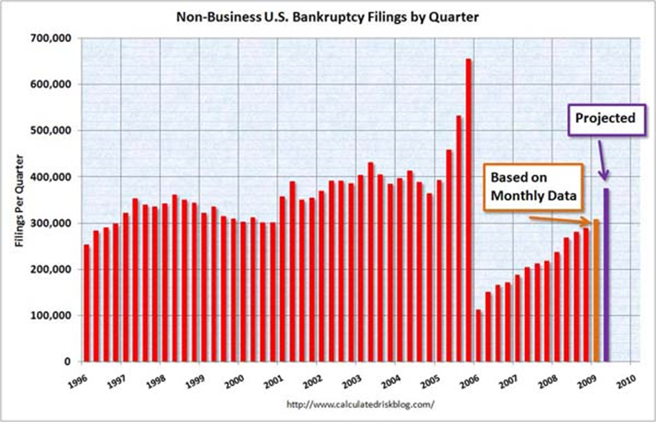
Bankruptcy Abuse Prevention and Consumer Protection Act of 2005

Slide 7




Who Can File for Bankruptcy?
Businesses
  Corporations, Limited Liability Companies, Partnerships
Individuals

Slide 8
How a Corporation Files for Bankruptcy
Voluntary
Managers realize the firm is insolvent
Must file in district in which the majority of the firm’s assets reside
Involuntary
Holders, or other creditors file to force the debtor into bankruptcy
Just another lawsuit…debtor has the right to defend itself

Slide 9

Types of Bankruptcy
Forms of Bankruptcy Relief
  Liquidation
  Reorganization
Six types of bankruptcy:
Chapter 7
  Basic liquidation for individuals and businesses
  Straight bankruptcy
Chapter 9
  Municipal bankruptcy

Slide 10
Types of Bankruptcy cont.
Chapter 11
  Rehabilitation or reorganization
  Used primarily by business
Chapter 12
  Rehabilitation for family farmers and fishermen
Chapter 13
  Rehabilitation with a payment plan for individuals with a regular source of income
Chapter 15
  Ancillary and other international cases

Slide 11
Chapter 7
Debt liquidation plan which results in the discharge of most of a debtor’s unsecured debts
Debtor typically receives a discharge about three months from the date his bankruptcy petition is filed
As much as 65% of all U.S. consumer bankruptcy filings are Chapter 7 cases

Slide 12
Chapter 11
Available to every business
Debtor remains in control of its business operations as a debtor in possession
Results in reorganization of the debtor's business or personal assets and debts
  Court may convert the case to a Chapter 7 for liquidation
  May be dismissed
Stock may be delisted from its primary stock exchange

Slide 13
Chapter 13
Also called “reorganization” or “repayment”
  Is an option if one has a source of dependable income but is unable to pay her debts
Allows a debtor to consolidate or restructure her debts and pay them out over a three to five year period
Debtor will not receive a discharge until she completes her Chapter 13 plan, usually in three to five years

Slide 14
Bankruptcy Law-Corporation
Objective of Bankruptcy Law
Primary goal is to maximize the value of the distressed firm’s assets
  Liquidation
  Reorganization
Maximizing asset value also maximizes total value available to be distributed to stakeholders
  Suppliers
  Employees
  Creditors
  Shareholders
Cost of bankruptcy, and length of bankruptcy cases, are driven by disagreements among stakeholders

Slide 15

Primary Players
Judge
Debtor
Creditors
Bankruptcy Trustee
United States Trustee
Creditors Committee
Debtor in Possession

Slide 16
Asset Allocation in Bankruptcy
(Absolute Priority Rule)
Assets and new securities are allocated according to the Absolute Priority Rule:
Secured claims
Debtor-in-possession claims
Priority claims (legal fees, wages,…)
General unsecured claims
Preferred stock
Common stock

Slide 17
Debtor Benefits in Chapter 11
Creditors cannot seek enforcement of liens
Creditors cannot seize collateral
Existing management team retains control of operations
Interest ceases to accrue on the filing date

Slide 18
“Fresh Start” Accounting
Fresh Start Rule allows a firm that emerges from Chapter 11 to “write-up” asset values to current market value rather than historical cost
  Requires the firm to distribute at least 50% of common stock to creditors
  Market values assigned by estimating future cash flows
  Results in immediately positive book equity and improved financial ratios

Slide 19
Debtor Benefits in Chapter 13
For any qualified debtor who wishes to save property from foreclosure or repossession
Allows a debtor to pay a mortgage delinquency over time rather than in a lump sum
Allows a homeowner who is with a second mortgage to treat that mortgage as an unsecured debt

Slide 20
Debtor Benefits in Chapter 7
Best for any debtor with little or no assets
For a homeowner who wishes to surrender real property
Eliminates the possibility of a deficiency judgment

Slide 21
What It Means To Get a Discharge
A discharge wipes a debt clean such that the debtor is no longer liable
  Discharge allows the debtor to obtain its fresh start
Individuals
Through reorganization or liquidation
Corporations
Through reorganization, not liquidation

Slide 22
Fraud
Bankruptcy fraud is a white-collar crime
Multiple filings are not in and of themselves criminal, but they may violate provisions of bankruptcy law
Common criminal acts:
  Concealment of assets
  Concealment or destruction of documents
  Conflicts of interest
  Fraudulent claims
  False statements or declarations
  Fee fixing or redistribution arrangements

Slide 23
Chrysler LLC
Chrysler LLC and twenty-four of its affiliated subsidiaries filed for chapter 11 bankruptcy on April 30, 2009
Failure of the company to come to agreement with its creditors for an outside-of-bankruptcy restructuring plan
Chrysler Turns First Profit Since Bankruptcy
  The company reported first-quarter net income of $116 million and revenue of $13.1 billion on Monday
  Why?

Slide 24
Key Points
Two Forms of Bankruptcy Relief:
Liquidation
Reorganization
Chapters:
Chapter 7 – Liquidation (Personal or Business)
Chapter 11 – Reorganization (Personal or Business)
Chapter 13 – Reorganization (Personal)

Slide 25
Questions to generate discussion
Why do you think the law does not allow you to erase loans, credit card purchases of luxury items or cash advances within 60 days of your bankruptcy?
- Taking loans, cash advances or buying luxury goods on credit in the weeks before you file bankruptcy is seen as a sign of bad faith. The court assumes that you are filing bankruptcy just to get out of paying for these obligations.
Can you stop paying your student loans if you file for bankruptcy?
- Student loans made, insured, guaranteed or funded by the government are not dischargeable in bankruptcy.

Slide 26

Questions

