Slide 1
Credit Risk and Trade Finance Management Part I: Central & Eastern Europe Experiences Part II: Working as a Finance Business Partner and Future Opportunities
Allen Holland
Financial, Risk & Change Management Consultant

Slide 2
Key Learning
Be Humble.

Slide 3
Key Learning
Keep Expectations Low.
Also Known as, “Under-promise & Over-deliver.“

Slide 4
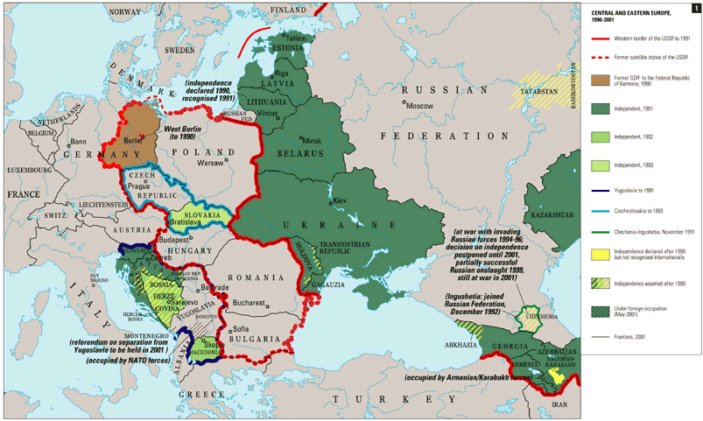
Central & Eastern Europe

Slide 5
KEEP
CALM
AND
DO NOT
PREJUDGE

Slide 6
CEE

Slide 7
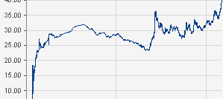
USD / RUB
11.02.1998 12.10.2005 12.06.2013

Slide 8
CEE
Short-term: “Trust, but verify.“
“Measure 7 times before you cut once.“
“Trust in God, all others pay cash.“
Medium to Long-term: “Fortes, inquit, fortuna juvat.“ (Fortune favors the brave!)

Slide 9
CEE Annual Growth Rate

Slide 10
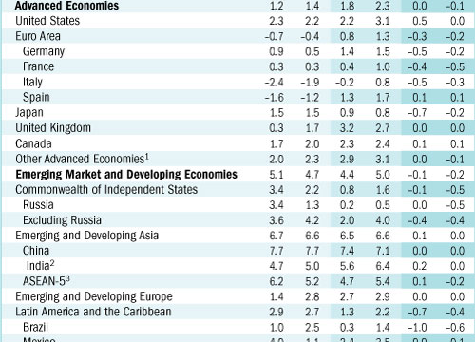

Slide 11
Foreign Direct Investment

Slide 12
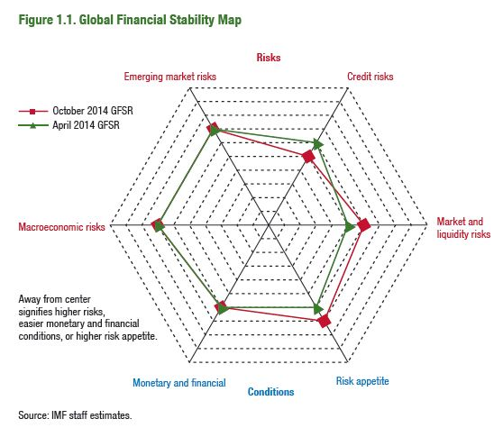
Global Risk Map

Slide 13
Bullish on CEE in the Medium & Longterm
Well-educated, Hard-working & Multilingual Citizens
EU, EURO, NATO
High Tech Industry
Natural Resources
Outsourcing
FDI
BRICS form their own World Bank - $50 Bio Dev. Bank & $100 Bio Currency Exchange Reserve

Slide 14
Key Learning
Understand Your Company‘s Business Strategy and Risk Appetite.

Slide 15
Key Learning
Communication & Relationship Building.
Finding good local partners: Business Manager, Lawyer, Tax Expert, Accountant

Slide 16
The 4 Agreements by Don Miguel Ruiz

Slide 17
1. Be Impeccable with your Word: Speak with integrity. Say only what you mean. Avoid using the Word to speak against yourself or others. Use the power of your Word in the direction of truth.
2. Don’t Take Anything Personally: Nothing others do is because of you. What others say and do is a projection of their own reality, their own dream. When you are immune to the opinions and actions of others, you won’t be the victim of needless suffering.
3. Don’t Make Assumptions: Find the courage to ask questions and to express what you really want. Communicate with others as clearly as you can to avoid misunderstandings.
4. Always Do Your Best: Under any circumstance, simply do your best, and you will avoid self-judgment, self-abuse, and regret.

Slide 18
Key Learning
Financial Analysis
Reliable Numbers? Audits? Credit Reports? Depends on Country, Industry and Size of Company.
EU Countries – Online Info on Bankruptcy, Legal Cases, Bad Debts, Tax Returns? Insolvency Registers interconnected EU-wide
Qualitative Factors: Office, Employees, Reputation, History, Intuition, Customer‘s Connection with your Product or Service.
Personal Pledges from Owners/Pledges of Land, Commodities, etc.
BE WARY OF TRADERS!!!
80/20 Rule

Slide 19
The Future?

Slide 20
Finance Business Partner
Counterparty Risk / Country Risk / WC Holistic Management
Trade Finance
Risk Management / ERM / ISO 31000
Supply Chain Risks & Credit Risks
Compliance / GRC
Controlling / Reporting
Financial IT
Training
Strategy

Slide 21
Growth & Prosperity Needs World Trade
Supply Chain Finance
BPO
Receivables Securitization
Factoring
Mobile Payments / Digital Currencies
Data Analytics / Real-time Data / Predictive Analytics / Data Discovery Tools
Social Media
Barter
Flexibility / Freelancing

