Slide 1
ARCH/GARCH Models

Slide 2
Risk Management
Risk: the quantifiable likelihood of loss or less-than-expected returns.
In recent decades the field of financial risk management has undergone explosive development.
Risk management has been described as “one of the most important innovations of the 20th century”.
But risk management is not something new.

Slide 3
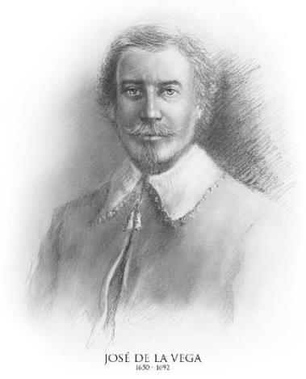
Risk Management
José (Joseph) De La Vega was a Jewish merchant and poet residing in 17th century Amsterdam.
There was a discussion between a lawyer, a trader and a philosopher in his book Confusion of Confusions.
Their discussion contains what we now recognize as European options and a description of their use for risk management.

Slide 4
Risk Management
There are three major risk types:
market risk: the risk of a change in the value of a financial position due to changes in the value of the underlying assets.
credit risk: the risk of not receiving promised repayments on outstanding investments.
operational risk: the risk of losses resulting from inadequate or failed internal processes, people and systems, or from external events.

Slide 5
Risk Management
VaR (Value at Risk), introduced by JPMorgan in the 1980s, is probably the most widely used risk measure in financial institutions.

Slide 6
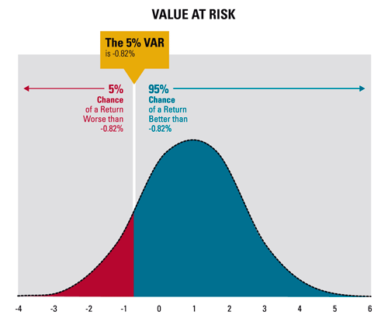
Risk Management
Given some confidence level $α∈\left(0,1\right)$. The VaR of our portfolio at the confidence level α is given by the smallest value $l$ such that the probability that the loss $L$ exceeds $l$ is no larger than$α$.

Slide 7
The steps to calculate VaR
σ
t
days to be forecasted
market position
Volatility measure
VAR
Level of confidence
Report of potential loss
Notes:
The process to compute VaR is the following:
Estimate the value of the portfolio with several assets
2)Forecast the volatility for each asset
3)Establish the maximum amount ofdays to estimate the value VaR´s
4)Determine the level of confidence or the probability of the worst loss
5)Make the report of the potential loss by each asset

Slide 8
The success of VaR
Is a result of the method used to estimate the risk
The certainty of the report depends upon the type of model used to compute the volatility on which these forecast is based
Notes:
No comments

Slide 9
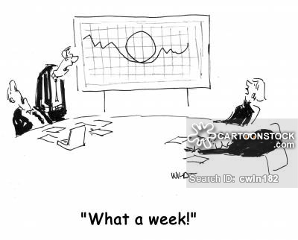
Volatility

Slide 10
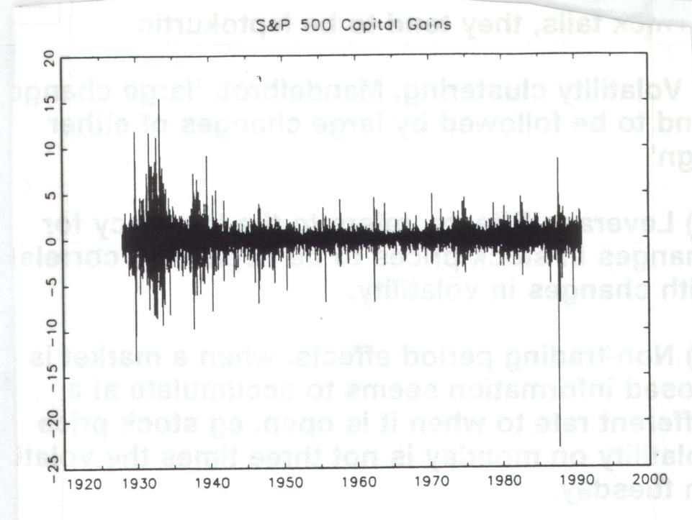
Volatility

Slide 11
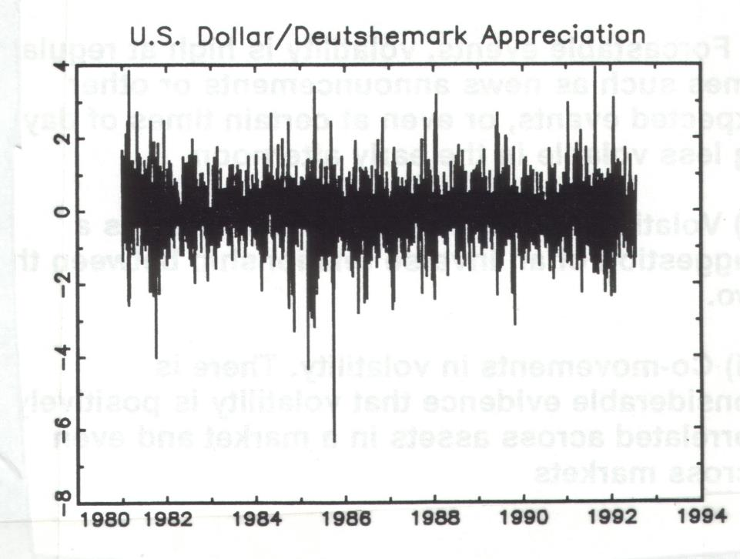

Slide 12
Modeling Volatility with ARCH & GARCH
In 1982, Robert Engle developed the autoregressive conditional heteroskedasticity (ARCH) models to model the time-varying volatility often observed in economical time series data. For this contribution, he won the 2003 Nobel Prize in Economics (*Clive Granger shared the prize for co-integration http://www.nobelprize.org/nobel_prizes/economic-sciences/laureates/2003/press.html).
ARCH models assume the variance of the current error term or innovation to be a function of the actual sizes of the previous time periods' error terms: often the variance is related to the squares of the previous innovations.
In 1986, his doctoral student Tim Bollerslev developed the generalized ARCH models abbreviated as GARCH.

Slide 13
Notes:
Using all the data of the decade I model the volatility with a Garch (1,1)
As we can observe the white line is a Garch (1,1) model which follows the real volatility

Slide 14
Time series
Robert F. Engle (1942 -) currently teaches at NYU, won Nobel Memorial Prize in Economic Sciences in 2003 for developing ARCH.
Tim Bollerslev (1958 -), currently teaches at Duke University, invented GARCH model, was a student of Robert at UCSD.

Slide 15
Time series-ARCH (*Note, Zt can be other white noise, no need to be Gaussian)
Let $Z_{t}$ be N(0,1). The process$X_{t}$ is an ARCH(q) process if it is stationary and if it satisfies, for all $t$ and some strictly positive-valued process $σ_{t}$, the equations
$$X_{t}=σ_{t}Z_{t}$$
$$σ_{t}^{2}=α_{0}+\sum_{i=1}^{q}{α_{i}X_{t−i}^{2}}$$
Where $α_{0}>0$ and $α_{i}≥0$, $i=1, . . . , q$.
Note: $X_{t}$ is usually the error term in a time series regression model!

Slide 16
Time series-ARCH
ARCH(q) has some useful properties. For simplicity, we will show them in ARCH(1).
Without loss of generality, let a ARCH(1) process be represented by $X_{t}=Z_{t}\sqrt{α_{0}+α_{1}X_{t−1}^{2}}$
Conditional Mean
$$E\left(X_{t} | I_{t−1}\right)=E\left(Z_{t}\sqrt{α_{0}+α_{1}X_{t−1}^{2}} | I_{t−1}\right)=E\left(Z_{t} | I_{t−1}\right)\sqrt{α_{0}+α_{1}X_{t−1}^{2}}=0$$
Unconditional Mean
$$E\left(X_{t}\right)=E\left(Z_{t}\sqrt{α_{0}+α_{1}X_{t−1}^{2}}\right)=E\left(Z_{t}\right)E\left(\sqrt{α_{0}+α_{1}X_{t−1}^{2}}\right)=0$$
So $X_{t}$ have mean zero

Slide 17
Time series-ARCH

Slide 18
Time series-ARCH
$X_{t}$ have unconditional variance given by $Var\left(X_{t}\right)=\frac{α_{0}}{1−α_{1}}$
Proof 1 (use the law of total variance):
$$Var\left(X_{t}\right)=E\left(Var\left(X_{t} | I_{t−1}\right)\right)+Var\left(E\left(X_{t} | I_{t−1}\right)\right)$$
$$=E\left(α_{0}+α_{1}X_{t−1}^{2}\right)+Var\left(0\right)$$
$$=α_{0}+α_{1}E\left(X_{t−1}^{2}\right)$$
$$=α_{0}+α_{1}Var(X_{t−1})$$
Because it is stationary, $Var\left(X_{t}\right)= Var(X_{t−1})$.
So $Var\left(X_{t}\right)=\frac{α_{0}}{1−α_{1}}$.

Slide 19
Time series-ARCH
Proof 2:
Lemma: Law of Iterated Expectations
Let $Ω_{1}$ and $Ω_{2}$ be two sets of random variables such that $Ω_{1}⊆Ω_{2}$. Let $Y$ be a scalar random variable. Then
$$E\left(Y | Ω_{1}\right)=E\left[E\left[Y | Ω_{2}\right] | Ω_{1}\right]$$
$Var\left(X_{t} | I_{t−2}\right)=E\left(X_{t}^{2} | I_{t−2}\right)=E\left[E\left(X_{t}^{2} | I_{t−1}\right)\right]\left|I_{t−2}\right]$ $=α_{0}+α_{1}E\left(X_{t−1}^{2} | I_{t−2}\right)=α_{0}+{α_{0}α}_{1}+α_{1}^{2}X_{t−2}^{2}$
$$Var\left(X_{t} | I_{t−3}\right)=α_{0}+{α_{0}α}_{1}+α_{0}α_{1}^{2}+α_{1}^{3}X_{t−3}^{2}$$
$$…$$
$$Var\left(X_{t}\right)=E\left(X_{t}^{2}\right)=E\left(E…E\left(X_{t}^{2} | I_{t−1}\right)… | I_{1}\right)=α_{0}\left(1+…+α_{1}^{t−1}\right)+α_{1}^{t}X_{0}^{2}$$
Since$α_{1}<1$, as $t→∞$, $Var\left(X_{t}\right)=\frac{α_{0}}{1−α_{1}}$

Slide 20
Time series-ARCH
fatter tails
The unconditional distribution of X_{t} is leptokurtic, it is easy to show.
$$Kurt\left(X_{t}\right)=\frac{E(X_{t}^{4})}{{[E(X_{t}^{2})]}^{2}}=3\frac{1−α_{1}^{2}}{1−3α_{1}^{2}}>3$$
Proof:
$$E\left(X_{t}^{4}\right)=E\left(E\left(X_{t}^{4} | I_{t−1}\right)\right)=E\left(σ_{t}^{4}E\left(Z_{t}^{4} | I_{t−1}\right)\right)=E\left(Z_{t}^{4}\right){E\left(α_{0}+α_{1}X_{t−1}^{2}\right)}^{2}=3(α_{0}^{2}+2α_{0}α_{1}E\left(X_{t−1}^{2}\right)+α_{1}^{2}E(X_{t−1}^{4}))$$
So $E\left(X_{t}^{4}\right)=3\frac{α_{0}^{2}}{1−α_{1}}\frac{1+α_{1}}{1−3α_{1}^{2}}$. Also, $E\left(X_{t}^{2}\right)=\frac{α_{0}}{1−α_{1}}$
$$Kurt\left(X_{t}\right)=\frac{E(X_{t}^{4})}{{[E(X_{t}^{2})]}^{2}}=3\frac{1−α_{1}^{2}}{1−3α_{1}^{2}}$$

Slide 21
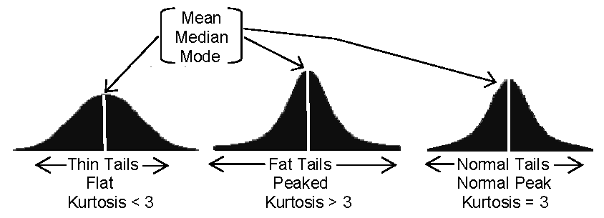
Time series-ARCH
The unconditional distribution of $X_{t}$ is leptokurtic,
$$Kurt\left(X_{t}\right)=\frac{E(X_{t}^{4})}{{[E(X_{t}^{2})]}^{2}}=3\frac{1−α_{1}^{2}}{1−3α_{1}^{2}}>3$$
The curvature is high in the middle of the distribution and tails are fatter than those of a normal distribution, which is frequently observed in financial markets.

Slide 22
Time series-ARCH
For ARCH(1), we can rewrite it as
$$X_{t}^{2}=σ_{t}^{2}Z_{t}^{2}=α_{0}+α_{1}X_{t−1}^{2}+V_{t}$$
where
$$V_{t}=σ_{t}^{2}\left(Z_{t}^{2}−1\right)$$
$E(X_{t}^{4})$ is finite, then it is an AR(1) process for $X_{t}^{2}$.
Another perspective: ${E(X}_{t}^{2}\left|I_{t−1}\right)=α_{0}+α_{1}X_{t−1}^{2}$
The above is simply the optimal forecast of $X_{t}^{2}$if it follows an AR(1) process

Slide 23
Time series-EWMA
Before introducing GARCH, we discuss the EWMA (exponentially weighted moving average) model
$$σ_{t}^{2}=λσ_{t−1}^{2}+\left(1−λ\right)X_{t−1}^{2}$$
where $λ$is a constant between 0 and 1.
The EWMA approach has the attractive feature that relatively little data need to be stored.

Slide 24
Time series-EWMA
We substitute for $σ_{t−1}^{2}$,and then keep doing it for $m$ steps
$$σ_{t}^{2}=\left(1−λ\right)\sum_{i=1}^{m}{λ^{i−1}}X_{t−i}^{2}+λ^{m}σ_{t−m}^{2}$$
For large $m$, the term $λ^{m}σ_{t−m}^{2}$is sufficiently small to be ignored, so it decreases exponentially.

Slide 25
Time series-EWMA
The EWMA approach is designed to track changes in the volatility.
The value of $λ$ governs how responsive the estimate of the daily volatility is to the most recent daily percentage change.
For example, the RiskMetrics database, which was invented and then published by JPMorgan in 1994, uses the EWMA model with $λ=0.94$ for updating daily volatility estimates.

Slide 26
Time series-GARCH
The GARCH processes are generalized ARCH processes in the sense that the squared volatility $σ_{t}^{2}$ is allowed to depend on previous squared volatilities, as well as previous squared values of the process.

Slide 27
Time series-GARCH (*Note, Zt can be other white noise, no need to be Gaussian)
Let $Z_{t}$ be N(0,1). The process$X_{t}$ is a GARCH(p, q) process if it is stationary and if it satisfies, for all $t$ and some strictly positive-valued process $σ_{t}$, the equations
$$X_{t}=σ_{t}Z_{t}$$
$$σ_{t}^{2}=α_{0}+\sum_{i=1}^{q}{α_{i}X_{t−i}^{2}}+\sum_{j=1}^{p}{β_{j}σ_{t−j}^{2}}$$
Where $α_{0}>0$ and $α_{i}≥0$, $i=1, . . . , q$, $β_{j}≥0, j=1, . . . , p$.
Note: $X_{t}$ is usually the error term in a time series regression model!

Slide 28
Time series-GARCH
GARCH models also have some important properties. Like ARCH, we show them in GARCH(1,1).
The GARCH(1, 1) process is a covariance-stationary white noise process if and only if $α1+β < 1$. The variance of the covariance-stationary process is given by $α0/(1 − α1 − β)$.
In GARCH(1,1), the distribution of $X_{t}$ is also mostly leptokurtic – but can be normal.
$$Kurt\left(X_{t}\right)=3\frac{1−{\left(α1+β\right)}^{2}}{1−{\left(α1+β\right)}^{2}−2α_{1}^{2}}≥3$$

Slide 29
Time series-GARCH
We can rewrite the GARCH(1,1) as
$$X_{t}^{2}=σ_{t}^{2}Z_{t}^{2}=α_{0}+\left(α1+β\right)X_{t−1}^{2}−βV_{t−1}+V_{t}$$
where
$$V_{t}=σ_{t}^{2}\left(Z_{t}^{2}−1\right)$$
$E(X_{t}^{4})$ is finite, then it is an ARMA(1,1) process for X_{t}².

Slide 30
Time series-GARCH
The equation for GARCH(1,1) can be rewritten as
$$σ_{t}^{2}=γV_{L}+α_{0}+{α1X}_{t−1}^{2}+βσ_{t−1}^{2}$$
where $γ+α1+β=1$.
The EWMA model is a special case of GARCH(1,1) where $γ=0,α1=1−λ,β=λ$

Slide 31
Time series-GARCH
The GARCH (1,1) model recognizes that over time the variance tends to get pulled back to a long-run average level of $V_{L}$ .
Assume we have known $σ_{t}^{2}=V$, if $V>V_{L}$, then this expectation is negative

Slide 32
Time series-GARCH
If $V<V_{L}$, then this expectation is positive
This is called mean reversion.

Slide 33
Time series-(ARMA-GARCH)
In the real world, the return processes maybe stationary, so we combine the ARMA model and the GARCH model, where we use ARMA to fit the mean and GARCH to fit the variance.
For example, ARMA(1,1)-GARCH(1,1)

Slide 34
Time Series in R
Data from Starbucks Corporation (SBUX)

Slide 35
Program Preparation
Packages:
>require(quantmod): specify, build, trade and analyze quantitative financial trading strategies
>require(forecast): methods and tools for displaying and analyzing univariate time series forecasts
>require(urca): unit root and cointegration tests encountered in applied econometric analysis are implemented
>require(tseries): package for time series analysis and computational finance
>require(fGarch): environment for teaching ‘Financial Engineering and Computational Finance’

Slide 36
Introduction
>getSymbols('SBUX')
>chartSeries(SBUX,subset='2009::2013')

Slide 37
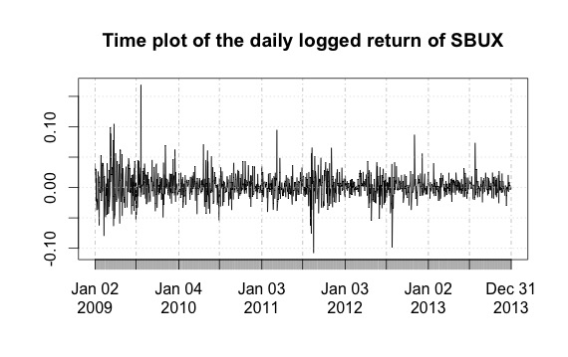
Method of Modeling
>ret=na.omit(diff(log(SBUX$SBUX.Close)))
>plot(r, main='Time plot of the daily logged return of SBUX')

Slide 38
KPSS test
KPSS tests are used for testing a null hypothesis that an observable time series is stationary around a deterministic trend.
The series is expressed as the sum of deterministic trend, random walk, and stationary error, and the test is the Lagrange multiplier test of the hypothesis that the random walk has zero variance.
KPSS tests are intended to complement unit root tests

Slide 39
KPSS test
$$x_{t}=D_{t}β+u_{t}+ω_{t}$$
$$ω_{t}=ω_{t−1}+ε_{t}$$
$$ε_{t}\sim WN(0,σ^{2})$$
where $D_{t}$: contains deterministic components
$u_{t}$: stationary time series
$ω_{t}$: pure random walk with innovation variance

Slide 40
Trend Check
KPSS test: null hypothesis:
>summary(ur.kpss(r,type='mu',lags='short'))
Return is a stationary around a constant, has no linear trend

Slide 41
ADF test
ADF test is a test for a unit root in a time series sample.
ADF test:
$$∆X_{t}=α+βt+γX_{t−1}+δ_{1}∆X_{t−1}+…+δ_{p}∆X_{t−p−1}+ε_{t}$$
null hypothesis: $γ=0⇒X_{t}$has unit root
It is an augmented version of the Dickey-Fuller test for a larger and more complicated set of time series models.
ADF used in the test, is a negative number. The more negative it is, the stronger the rejection of the hypothesis that there is a unit root at some level of confidence.

Slide 42
Trend Check
ADF Test: null hypothesis: X_{t} has AR unit root (nonstationary)
>summary(ur.df(r,type='trend',lags=20,selectlags='BIC'))
Return is a stationary time series with a drift

Slide 43
Check Seasonality
>par(mfrow=c(3,1))
>acf(r)
>pacf(r)
>spec.pgram(r)

Slide 44
Random Component
Demean data >r1=r-mean(r)
>acf(r1); pacf(r1);

Slide 45
Random Component
>fit=arima(r,order=c(1,0,0))
>tsdiag(fit) AR(1)

Slide 46
Random Component
First difference > diffr=na.omit(diff(r))
> plot(diffr); acf(diffr); pacf(diffr);

Slide 47
Random Component
>fit1=arima(r,order=c(0,1,1)); tsdiag(fit1);

Slide 48
Random Component
>fit2=arima(r,order=c(1,1,1)); tsdiag(fit2); ARIMA(1,1,1)

Slide 49
Model Selection
$$AIC=2k−2ln⁡(L)$$
where $k$ is the number of parameters, $L$ is likelihood
Final model:
$$X_{t}=0.0017−0.0724X_{t−1}+ε_{t}$$

Slide 50
Shapiro-Wilk normality test
The Shapiro- Wilk test, proposed in 1965, calculates a W statistic that tests whether a random sample comes from a normal distribution.
Small values of W are evidence of departure from normality and percentage points for the W statistic, obtained via Monte Carlo simulations.

Slide 51
Residual Test
>res=residuals(fit)
>shapiro.test(res) not normally distributed

Slide 52
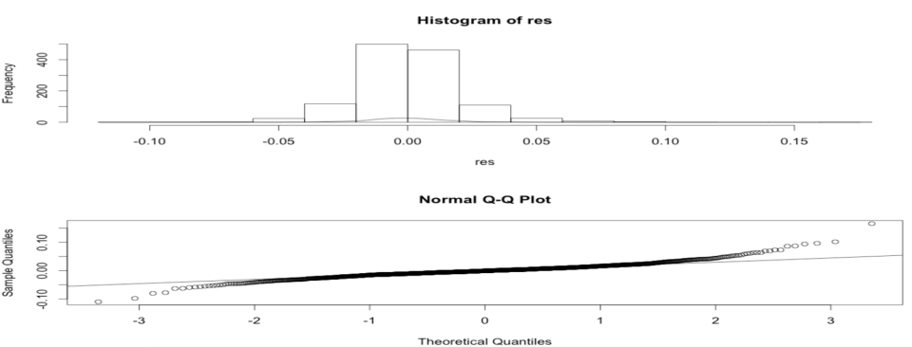
Residual Test
>par(mfrow=c(2,1))
>hist(res); lines(density(res))
>qqnorm(res); qqline(res)

Slide 53
ARMA+GARCH
ARMA(1,0)+GARCH(1,1)
>summary(garchFit(~arma(1,0)+garch(1,1),r,trace=F))
ARIMA(1,1,1)+GARCH(1,1)
>summary(garchFit(~arma(1,1)+garch(1,1),data=diffr,trace=F))

Slide 54
Model Comparison

Slide 55
Forecasting

Slide 56
Time Series in SAS
Data from Starbucks Corporation (SBUX)

Slide 57
SAS Procedures for Time Series
PROC ARIMA
This procedure do model identification, parameter estimation and forecasting for model ARIMA(p,d,q)
$${(1−B)}^{d}X_{t}=μ+\frac{1−θ_{1}B−…−θ_{q}B^{q}}{1−φ_{1}B−…−φ_{p}B^{p}}Z_{t}$$
where $μ$ is ground mean of $X_{t}$ and
$$μ\left(1−φ_{1}B−…−φ_{p}B^{p}\right)=μ\left(1−φ_{1}−…−φ_{p}\right)$$
is the usually intercept (drift).
does NOT do ARCH/GARCH

Slide 58
SAS Procedures for Time Series
PROC AUTOREG
This procedure estimate and forecast the linear regression model for time series data with an autocorrelated error or a heterosedastic error
$$Y_{t}=X_{t}β+υ_{t}$$
$$υ_{t}=−φ_{1}υ_{t−1}−…−φ_{p}υ_{t−p}+ε_{t}$$
$$ε_{t}=σ_{t}Z_{t}$$
$$σ_{t}^{2}=α_{0}+\sum_{i=1}^{Q}{α_{i}ε_{t−i}^{2}}+\sum_{j=1}^{P}{γ_{j}σ_{t−j}^{2}}$$
Independent assumption invalid Autocorrelated error
Homosedasity assumption invalid Heterosedastic error
Linear regression model
Autocorrelated error
Heterosedastic error

Slide 59
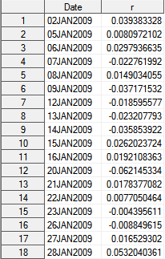
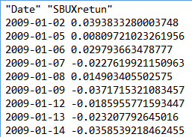
Import Data
DATA st.return;
INFILE "\SBUXreturn.txt"
firstobs=2;
INPUT Date YYMMDD10. r;
FORMAT Date Date9.;
RUN;
st.return
SBUXreturn.txt

Slide 60
PROC SGPLOT DATA=st.return;
SERIES X=Date Y=r;
RUN;

Slide 61
Testing for Autocorrelation
The following statements perform the Durbin-Watson test for autocorrelation in the returns for orders 1 through 3. The DWPROB option prints the marginal significance levels (p-values) for the Durbin-Watson statistics.
PROC AUTOREG DATA=st.return;
TITLE2 "AUTOREG AR Test";
MODEL r = / METHOD=ML DW=3 DWPROB;
RUN;

Slide 62
Durbin-Watson test
If $e_{t}$ is the residual associated with the observation at time $t$, then the test statistic is
$$d=\frac{\sum_{t=2}^{T}{{\left(e_{t}−e_{t−1}\right)}^{2}}}{\sum_{t=1}^{T}{e_{t}^{2}}}$$
where $T$ is the number of observations.
Since
$$d=\frac{\sum_{t=1}^{T}{e_{t}^{2}}+\sum_{t=1}^{T}{e_{t−1}^{2}}−2\sum_{t=1}^{T}{e_{t}e_{t−1}}}{\sum_{t=1}^{T}{e_{t}^{2}}}$$
$$≈2−2\frac{\sum_{t=1}^{T}{e_{t}e_{t−1}}}{\sum_{t=1}^{T}{e_{t}^{2}}}≈2−2r=2(1−r)$$
where $r$ is the sample autocorrelation of the residuals.

Slide 63
Durbin-Watson test
Since $d≈2\left(1−r\right)$
Positive serial correlation $0<r<1$ $0<d<2$
Negative serial correlation $−1<r<0$ $2<d<4$
To test for positive autocorrelation at significance α :
If $d< dL,α$, the error terms are positively autocorrelated
If $d> dU,α$, there is no statistical evidence
To test for negative autocorrelation at significance α :
If $(4−d)< dL,α$, the error terms are negatively autocorrelated
If $(4−d)> dU,α$, there is no statistical evidence
($dL,α$ and $dU,α$ are lower and upper critical values)

Slide 64
Testing for Autocorrelation
Durbin-Watson Statistics
Order | DW | Pr < DW | Pr > DW
1 | 2.1419 | 0.9941 | 0.0059
2 | 1.9685 | 0.2979 | 0.7021
3 | 2.0859 | 0.9429 | 0.0571
Note: | Pr<DW is the p-value for testing positive autocorrelation, and Pr>DW is the p-value for testing negative autocorrelation.
Autocorrelation correction is needed.
Generalized Durbin-Watson tests should not be used to decide on the autoregressive order.

Slide 65
Stepwise Autoregression
Once you determine that autocorrelation correction is needed, you must select the order of the autoregressive error model to use. One way to select the order of the autoregressive error model is Stepwise Autoregression.
The following statements show the stepwise feature, using an initial order of 5:
PROC AUTOREG DATA=st.return;
TITLE2 "AUTOREG (fit P) for log returns";
MODEL r = / METHOD=ML
NLAG=5 BACKSTEP;
RUN;

Slide 66
Stepwise Autoregression
Estimates of Autocorrelations
Lag | Covariance | Correlation | -1 9 8 7 6 5 4 3 2 1 0 1 2 3 4 5 6 7 8 9 1
0 | 0.000430 | 1.000000 | | |********************|
1 | -0.00003 | -0.065364 | | *| |
2 | 8.91E-6 | 0.020711 | | | |
3 | -0.00002 | -0.038408 | | *| |
4 | 0.000018 | 0.040727 | | |* |
5 | 3.925E-6 | 0.009124 | | | |
Backward Elimination of Autoregressive Terms
Lag | Estimate | t Value | Pr > |t|
2 | -0.014197 | -0.50 | 0.6158
5 | -0.014863 | -0.53 | 0.5985
3 | 0.034743 | 1.23 | 0.2181
4 | -0.038273 | -1.36 | 0.1743
Estimates of Autoregressive Parameters
Lag | Coefficient | Standard Error | t Value
1 | 0.065364 | 0.028145 | 2.32

Slide 67
Testing for Heteroscedasticity
One of the key assumptions of the ordinary regression model is that the errors have the same variance throughout the sample. This is also called the homoscedasticity model. If the error variance is not constant, the data are said to be Heteroscedastic
The following statements use the ARCHTEST= option to test for heteroscedasticity
PROC AUTOREG DATA=st.return;
TITLE2 "AUTOREG arch Test";
MODEL r = / METHOD=ML ARCHTEST;
RUN;

Slide 68
Testing for Heteroscedasticity
Portmanteau Q Test
For nonlinear time series models, the portmanteau test statistic based on squared residuals is used to test for independence of the series
$$Q\left(q\right)=T\left(T+2\right)\sum_{i=1}^{q}{\frac{r\left(i;{\hat{e}}_{t}^{2}\right)}{N−i}}$$
where
$$r\left(i;{\hat{e}}_{t}^{2}\right)=\frac{\sum_{t=i+1}^{T}{\left({\hat{e}}_{t}^{2}−{\hat{σ}}^{2}\right)\left({\hat{e}}_{t−i}^{2}−{\hat{σ}}^{2}\right)}}{\sum_{t=1}^{T}{{\left({\hat{e}}_{t}^{2}−{\hat{σ}}^{2}\right)}^{2}}}$$
$${\hat{σ}}^{2}=\frac{1}{T}\sum_{t=1}^{T}{{\hat{e}}_{t}^{2}}$$

Slide 69
Testing for Heteroscedasticity
Lagrange Multiplier Test for ARCH Disturbances
Engle (1982) proposed a Lagrange multiplier test for ARCH disturbances. Engle’s Lagrange multiplier test for the qth order ARCH process is written
$$LM\left(q\right)=\frac{TW^{′}Z{\left(Z^{′}Z\right)}^{−1}Z^{′}W}{W^{′}W}$$
where
$$W={\left(\frac{{\hat{e}}_{1}^{2}}{{\hat{σ}}^{2}},…,\frac{{\hat{e}}_{T}^{2}}{{\hat{σ}}^{2}}\right)}^{′}, Z=\left[\begin{matrix}1 & {\hat{e}}_{0}^{2} & … & {\hat{e}}_{−q+1}^{2} \\ ⋮ & ⋮ & ⋮ & ⋮ \\ ⋮ & ⋮ & ⋮ & ⋮ \\ 1 & {\hat{e}}_{N−1}^{2} & … & {\hat{e}}_{N−q}^{2}\end{matrix}\right]$$
The presample values $\left({\hat{e}}_{0}^{2},…,{\hat{e}}_{−q+1}^{2}\right)$ have been set to 0

Slide 70
Testing for Heteroscedasticity
Tests for ARCH Disturbances Based on OLS Residuals
Order | Q | Pr > Q | LM | Pr > LM
1 | 3.3583 | 0.0669 | 3.3218 | 0.0684
2 | 20.6045 | <.0001 | 19.7499 | <.0001
3 | 30.4729 | <.0001 | 27.3240 | <.0001
4 | 32.0168 | <.0001 | 27.5946 | <.0001
5 | 40.3500 | <.0001 | 32.2671 | <.0001
6 | 45.0011 | <.0001 | 34.6383 | <.0001
7 | 53.2330 | <.0001 | 38.9149 | <.0001
8 | 74.7145 | <.0001 | 52.6820 | <.0001
The p-values for the test statistics strongly indicate heteroscedasticity

Slide 71
Fitting AR(p)-GARCH(P,Q)
The following statements fit an AR(1)-GARCH model for the return r. The GARCH=(P=1,Q=1) option specifies the GARCH conditional variance model. The NLAG=1 option specifies the AR(1) error process.
PROC AUTOREG DATA=st.return;
TITLE2 "AR=1 GARCH(1,1)";
MODEL r = / METHOD=ML NLAG=1 GARCH=(p=1,q=1);
OUTPUT OUT=st.rout HT=variance P=yhat
LCL=low95 UCL=high95;
RUN;

Slide 72
Fitting AR(1)-GARCH(1,1)
Parameter Estimates
Variable | DF | Estimate | Standard Error | t Value | Approx Pr > |t|
Intercept | 1 | 0.001778 | 0.000476 | 3.74 | 0.0002
AR1 | 1 | 0.0512 | 0.0330 | 1.55 | 0.1203
ARCH0 | 1 | 7.8944E-6 | 1.6468E-6 | 4.79 | <.0001
ARCH1 | 1 | 0.0804 | 0.009955 | 8.08 | <.0001
GARCH1 | 1 | 0.9041 | 0.0110 | 81.91 | <.0001
$$r_{t}=\text{0.001778}+υ_{t}$$
$$υ_{t} \text{= −}\text{0.0512}υ_{t−1}+ε_{t},$$
$$ε_{t}=σ_{t}Z_{t},$$
$$σ_{t}^{2}=7.89×{10}^{6}+0.0804ε_{t−1}^{2}+0.9041σ_{t−1}^{2}$$

Slide 73
Fitting GARCH(1,1)
Parameter Estimates
Variable | DF | Estimate | Standard Error | t Value | Approx Pr > |t|
Intercept | 1 | 0.001789 | 0.000500 | 3.58 | 0.0003
ARCH0 | 1 | 8.2257E-6 | 1.7139E-6 | 4.80 | <.0001
ARCH1 | 1 | 0.0824 | 0.0103 | 8.04 | <.0001
GARCH1 | 1 | 0.9014 | 0.0114 | 78.91 | <.0001
$$r_{t}=\text{0.00178}\text{9}+ε_{t},$$
$$ε_{t}=σ_{t}Z_{t},$$
$$σ_{t}^{2}=8.23×{10}^{6}+0.0824ε_{t−1}^{2}+0.9014σ_{t−1}^{2}$$

Slide 74
Model Comparison
AR(1)-GARCH(1,1) GARCH(1,1)
GARCH Estimates
SSE | 0.53505391 | Observations | 1258
MSE | 0.0004253 | Uncond Var | 0.00050829
Log Likelihood | 3208.05084 | Total R-Square | 0.0048
SBC | -6380.4153 | AIC | -6406.1017
MAE | 0.01438744 | AICC | -6406.0538
MAPE | 115.691692 | HQC | -6396.4484
 |  | Normality Test | 1079.9508
 |  | Pr > ChiSq | <.0001
GARCH Estimates
SSE | 0.53762652 | Observations | 1258
MSE | 0.0004274 | Uncond Var | 0.00050837
Log Likelihood | 3206.71256 | Total R-Square | .
SBC | -6384.876 | AIC | -6405.4251
MAE | 0.01440745 | AICC | -6405.3932
MAPE | 113.751489 | HQC | -6397.7025
 |  | Normality Test | 1054.2731
 |  | Pr > ChiSq | <.0001

Slide 75
Prediction

Slide 76
VaR (Value at Risk)

Slide 77
Summary
Models for conditional variance (risk)
ARCH
EWMA
GARCH
Numerical experiment
ARIMA+GARCH in R
AR+GARCH in SAS
VaR in SAS

Slide 78
This presentation was
revised from my
students’ presentation.

