Slide 1
Risk Management Fundamentals
Terri-Anne Wallen, Executive Director Internal Audit

Slide 2
Introduction
Terri-Anne Wallen
Executive Director Internal Audit

Slide 3
Risk Management Fundamentals
Implementing and facilitating a risk management program is much more than a theoretical exercise of measuring risk significance and likelihood.
Learning Objectives
Provide a baseline understanding of risk and risk management.
Identify how you can further your risk management program involvement as Internal Audit to assist your company and their management in seeing the strategic value of a risk management program.
Participating or coordinating your company’s risk management program with focus on those risks most critical to a company’s strategy, business model and viability.
Understanding the importance of evaluating critical risks, catastrophic risks and reputational risks and the related risk acceptance or mitigation – especially for IT-related risks.

Slide 4
Risk Management Fundamentals
Risk Management definition
Risk Management objectives
Risk Management participants
Risk Management at CSG
Use of Risk Management program as a strategic tool
Importance of assessing significance and likelihood
Understand Risk tolerances and appetite with inter-relation to mitigation efforts
Example Risk assessment, mitigation and escalation criteria
Performing catastrophic risk assessment
Performing reputational risk assessment

Slide 5


Risk Exists in Business….Everyday
Company Management
You

Slide 6
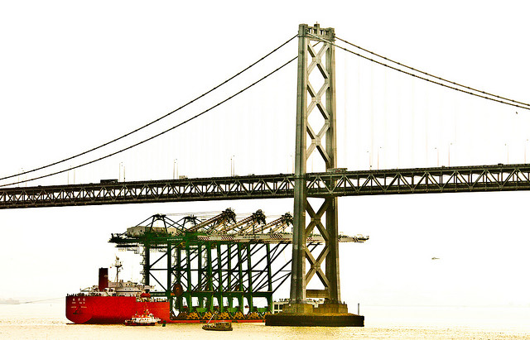

Risk Management Reflection
A ship is safe in harbor, but that’s not what ships are for.

Slide 7
What is Risk Management?
What is risk – the potential for anything to go wrong or a missed opportunity.
Companies take risk because it is exciting, fun, full of thrills, makes money and/or increases reputation/image; Risk versus reward is central to risk management.
An essential business process for all companies undergo to protect their assets from threats and identifies opportunities to grow.
Risk Management is an important tool to recognize and address problems in an organization.

Slide 8

Participant Survey
Poll / Show of hands
  Coordinates Risk Management program
  Maintains relationship with owner of Risk Management
  Regularly audits Risk Management program
  No involvement or interaction with Risk Management

Slide 9
Discussion
What Risk Management activities do you perform? What is your level of involvement?
Does your company maintain a risk committee? An IT Risk Committee?
What value does your company derive from Risk Management?

Slide 10



Risk Management Objectives
Aligning risk appetite and strategy
Enhancing risk response decisions
Reducing operational surprises and losses
Identifying and managing multiple and cross-enterprise risks
Seizing opportunities
Improving deployment of capital
Enterprise Risk Management

Slide 11
Risk Management Participants
Board Oversight
Monitors management’s risk appetite
Provides feedback and/or points of shareholder value
Executives & Senior Leaders
CEO ultimately responsible
Member of risk committee with charter
Risk Management and/or Internal Audit
Performed by Risk Management and/or Internal Audit
Candid Involvement by Sr. Leadership
Responsible to mitigate, accept or transfer risk (including IT Risk)

Slide 12
Risk Management at High Level
Define Risk Management Ownership
Risk Assessment
Risk Register
Risk Charter
Risk Monitoring
Risk Reporting
Executive Sponsor and Senior Leadership Participation
Board and/or Audit Committee Oversight

Slide 13
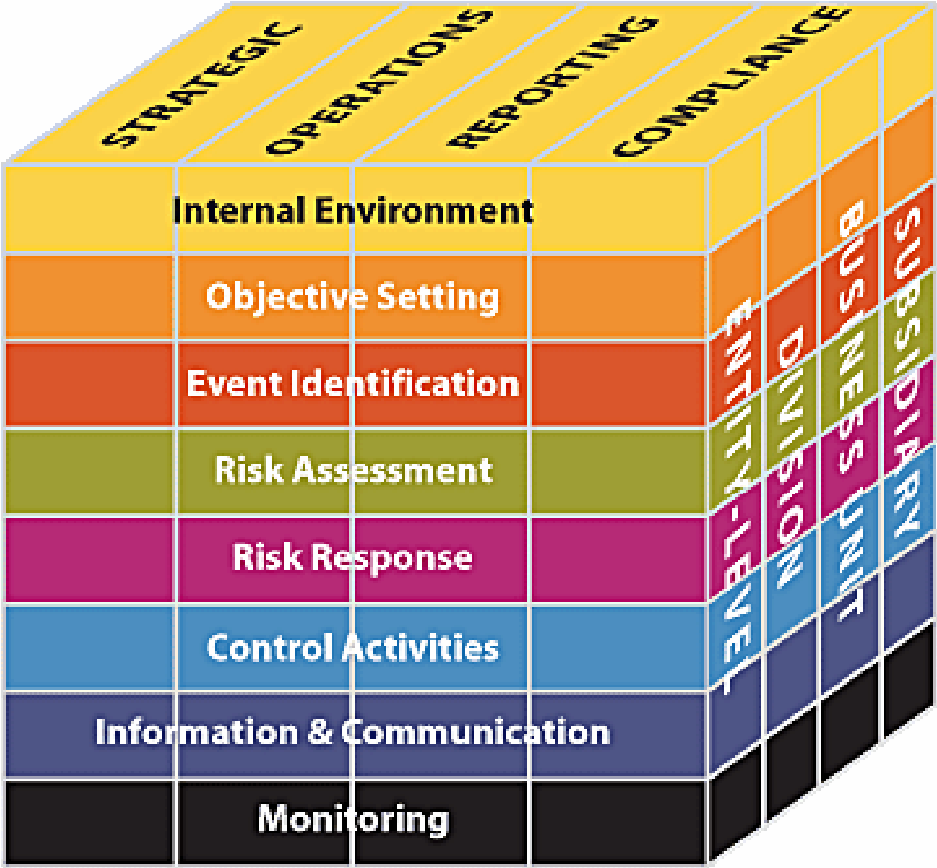
Risk Management Framework - COSO
Adoption of Risk Management framework provides the foundation for your
Risk Management program

Slide 14
Risk Management at CSG
Declaration of Risk Management framework
  COSO Integrated framework
Established Charter, Policy and Procedures
  Charter established and reviewed annually
  Policy provides the requirements for risk assessment, mitigation, escalation and documentation
    Includes risk terminology / definitions
  Procedures provide the tactical process for use by “the business”
    Includes a risk assessment and mitigation form (to standardize)
  Defines the roles and responsibilities for the Board, Audit Committee, Management, various committees and Internal Audit

Slide 15
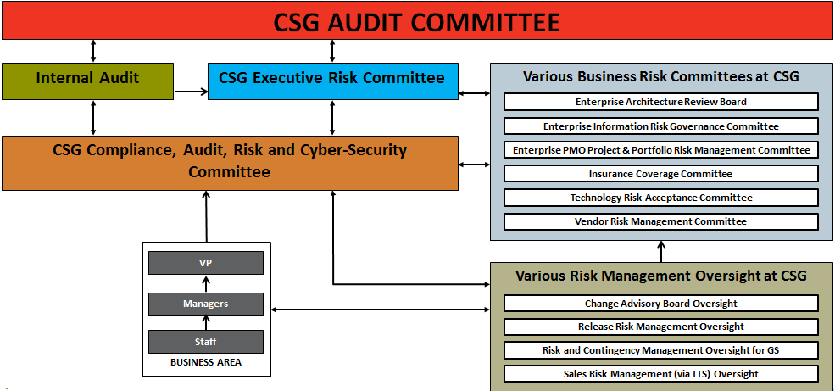
Risk Committees and Oversight

Slide 16
Risk Management at CSG
Understand strategy and key initiatives
  Provides alignment across Board and Management
  Assignment of strategy and key initiatives to Executive and Senior Management
  Links to critical risk (in the risk register)
Maintain a risk register
  Catalog of any risks that potentially could occur
    Define risks that are catastrophic and reputational
  Significant focus on those risks considered critical
  Assignment of risks to Executive and Senior Management
  Reviewed quarterly
  Maps to strategy and key initiatives
  Links to Internal Audit’s annual plan

Slide 17
Risk Management at CSG
Perform risk assessment
  Occurs quarterly with Executives and Senior leadership
  Coordinated by Internal Audit
  Evaluation of the Significance and Likelihood of any risk
  Bi-annual survey with all VPs, Executives, Senior leadership and the Board
  New or emerging risks evaluated
  Documents mitigation efforts in place to reduce, transfer or eliminate the risk (collaboration between Internal Audit Management)
Periodic discussions / check points between Management and Internal Audit
  Occurs quarterly with Management owners of risks that align to strategy and key initiatives.
  Includes discussion of existing mitigation efforts, new mitigation efforts and new or emerging risks

Slide 18
Risk Management at CSG
Quarterly Risk Management presentation
  Internal Audit provides a report of quarterly risk assessment
  Executive Risk Committee review and discussion of report
  Evaluation of risk mitigation efforts, including assessment of additional mitigation efforts
  Includes assessment of reputational and catastrophic risks
  Provides Internal Audit’s opinion of the sufficiency of risk mitigation efforts for existing, new and emerging risks
  Provided to the Audit Committee and Board

Slide 19
Risk Management as a Strategic Tool
Use of Risk Management program by Management as a strategic tool
  True value of risk management received when “the business” uses the quarterly risk management materials to manage
  Integration of quarterly risk assessment into monthly business reviews
  Integrally used to manage and monitor the business and execution of strategy
  Clear understanding of risk escalation for existing, new or emerging risks

Slide 20
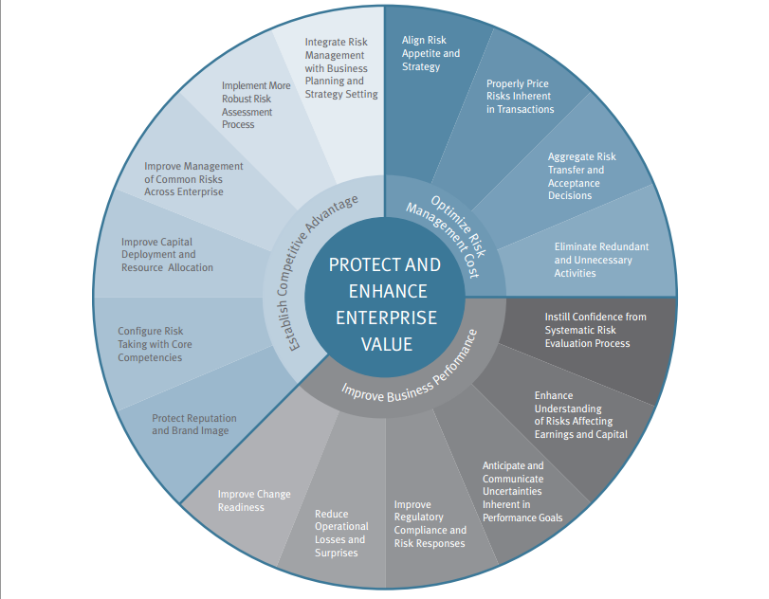
Risk Management Value Proposition
Establishing oversight of business objectives
Aligns risk appetite and strategy
Proactive vs. reactive
Enhanced corporate governance
Focus on strategy vs. protection of tangible assets
Aims to increase enterprise value
Ability to capitalize on emerging opportunities
Instill greater confidence with the Board, CEO and Executives
Source: Protiviti

Slide 21
Risk Tolerances and Appetite
Risk tolerances and appetite options (i.e., mitigation efforts)
  Avoidance: exiting the activities giving rise to risk
  Reduction: taking action to reduce the likelihood or impact related to the risk
  Alternative Actions: deciding and considering other feasible steps to minimize risks.
  Share or Insure: transferring or sharing a portion of the risk, to finance it
  Accept: no action is taken, due to a cost/benefit decision
Mitigation efforts are defined based upon the Significance and the Likelihood of the risk

Slide 22
Risk Management – Risk Assessment
Organization, Topic and Risk(s) |  | Significance | Likelihood | CSG Owner | Mitigation Efforts
Organizations:
Risk Topic:
1
2
3
4
Escalation path based on the highest rating of Significance and Likelihood: ___________________

Slide 23
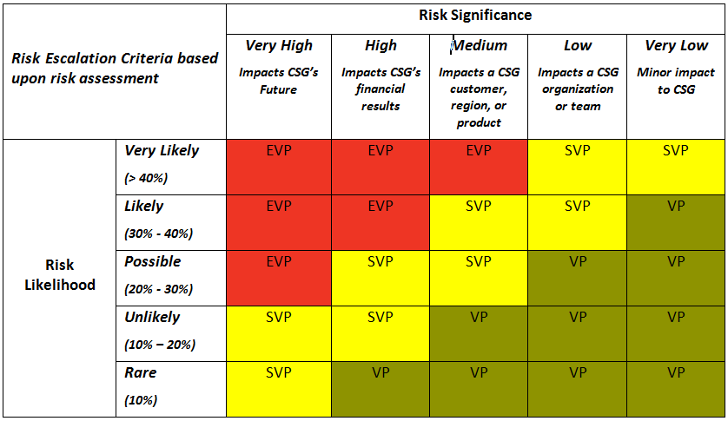
Risk Escalation Criteria

Slide 24
Risk Assessment and Mitigation - Example
Organization, Topic and Risk(s) |  | Significance | Likelihood | CSG Owner | Mitigation Efforts
Organizations: Global Infrastructure, Operations, Legal and Product Management
Risk Topic: Waiver requested to allow continue use of Windows 2003 when support has ended for Product XYZ.
1 | There is a security risk / vulnerability for utilizing a platform that is no longer supported. | Very High | Possible | Global Infrastructure – Bret Justus | Installation of CSP on machines with Windows 2003. Validation that anti-virus is still compatible and operating with Windows 2003 machines. Isolation of machines/products from other products.
2 | CSG is not in compliance with customer contracts. | Medium | Rare | Legal – David Johnson | Review of client contracts by Legal to ensure contracts do not have specific requirements for using unsupported software / operating system.
3 | There is operational performance issues with using unsupported software / operating systems. | Medium | Unlikely | Global Operations – Bob Rion | Operational review completed to consider compatibility of other 3rd party software implications.
4 | CSG’s product is not maintained to current standards that is not acceptable to clients. | Medium | Unlikely | Product Management – Product Manager | Product end of life determined for 2016 and no further new sales of product is occurring.
EXAMPLE ONLY
Escalation path based on the highest rating of Significance and Likelihood: EVP (for this example)

Slide 25
Catastrophic Risk Assessment
Potentially Catastrophic Risks
  A risk that can cause sudden, great damage and/or threaten a Company’s viability
  The significance and likelihood of the catastrophic risk is assessed
  These are tracked and reported quarterly
  For CSG, these are a subset of Critical Risks
  Constant evaluation of company’s ability to react and manage a catastrophic event
  Documentation, testing and evaluation of crisis management plans
    Disaster Recovery
    Security Breach / Incident

Slide 26
Catastrophic Risk Assessment - Example
Tie to Strategic Initiative | Potential Catastrophic Risk | Potential Risk Events/ Potentially Catastrophic Consequences | Mitigation efforts
1a & 2c | Information privacy and security Access and security to programs and data privacy is not appropriately safeguarded from threats. | We experience a security incident or breach that involves our clients’ and/or subscribers’ confidential data. Inability to timely and effectively respond to security incident (i.e., effective crisis management). Consequences (1) Subjects us to material amounts of expense to remediate the incident, (2) Loss of client confidence, and/or (3) Severe and irreparable damage to our reputation. This could lead to a significant negative financial impact to us in the near-term, and/or possibly jeopardize our strong position in the North American cable market (both near-term and long-term). | Continually evaluate Cyber risk management processes to keep pace with market trends, to include evaluation of commercial insurance needs. Ongoing monitoring /testing of cyber security controls and processes (i.e., penetration, scanning, vulnerability testing, incident response, etc.).

Slide 27
Reputational Risk Assessment
Reputational Risks
A risk that can cause a company’s reputation severe and sometimes irreparable damage (e.g., events that undermine public trust in our products or brand).
Why is reputation risk important?
  A large percentage of our market value is attributed to reputation (e.g., the trust our clients put in us to operate their business-critical applications).
  Typically, reputational risks are inextricably linked to other business risks being monitored, so the potential event that could result in reputational risks is being managed.
CSG’s reputational risk assessment assumed any event/scenario would be considered significant and we assessed the likelihood (after consideration of mitigation efforts).
  The other aspect of reputational risk relates to the crisis management/ communication plans after the occurrence of the event that gave rise to the reputational risk.

Slide 28
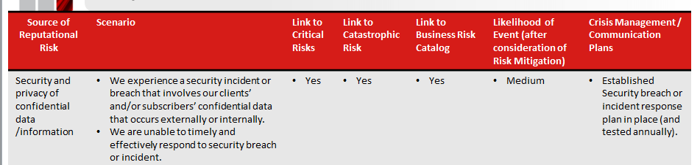
Reputational Risk Assessment - Example

Slide 29
Questions / Discussions before wrapping up?

