Slide 1

October 2013
Grant Group Meeting
Presented by:
Lori and Nancy
Office of Research &
Sponsored Programs

Slide 2
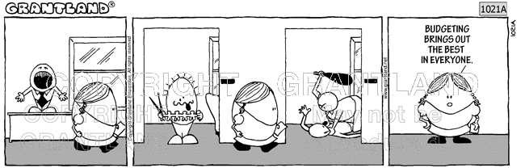
Budgeting for better or worse…

Slide 3
In a perfect world…
Your PI/PD shares project budgets with you prior to submission…
Accounts are established and budgets are spent to the penny…
Nothing ever gets posted to the wrong account…
Your PI/PD never purchases anything without telling you first…
Notes:
We know this doesn’t always happen

Slide 4
Budget Basics – major line items
  Personnel
  Fringe Benefits
  Travel
  Equipment
  Materials and Supplies
  Contractual
  Construction
  Participant Costs
  F&A (Indirect Costs)
Notes:
Accounting principles always apply. Some times something is inadvertently left in a budget and its not an allowable expense. Chances are it won’t become an allowable expense just because it was budgeted.

Slide 5
Line Item vs. Detailed
Travel…..$11,180.00
TRAVEL
 | Airfare |  | From : Waterloo To: DC ; 1 of people * 1 trips |  |  |  |  |  | $700
 | Waterloo to Tallahassee 1 person 2 trips |  |  |  |  |  |  |  | $1,600
 | Waterloo to TBD domestic conference locations 1 person 3 trips |  |  |  |  |  |  |  | $2,400
 | Lodging | 1 of people * 5 nights 2 trips to Tallahassee |  |  |  |  |  |  | $1,500
 | 1 person 4 conferences (DC+3) 4 nights each |  |  |  |  |  |  |  | $2,200
 | . Meals | 1 of people * 32 of days |  |  |  |  |  |  | $1,280
 | Mileage | From: To: ; # trips * # Roundtrip Miles |  |  |  |  |  |  | $0
 | Registration (estimates SRSM 400, ARA 200, Campbell 300) |  |  |  |  |  |  |  | $900
 | local transportation (taxis to and from airports @$100 per trip) |  |  |  |  |  |  |  | $600
 |  | SUBTOTAL - DOMESTIC TRAVEL |  |  |  |  |  |  | $11,180

Slide 6
Line Item vs Detailed
Other Direct Costs…$53,200
OTHER DIRECT COSTS
 | Materials and Supplies
 | Laptop, software, hard drives, back up drives |  |  |  | 2,500
 |  | Items |  |  | 0
 | Publication/Documentation/Dissemination |  |  |  | 500
 | Consultants (External to UNI) |  |  |  | 50,000
 | Computer Services |  |  |  | 0
 | Subawards
 | Grad. Assist. Tuition |  |  |  | 0
 | Postage, Telephone, Gen. Services |  |  |  | 200
 | Other - list |  |  |  | 0
 |  | SUBTOTAL |  |  | $53,200

Slide 7
Budget Justification
Narrative for the numbers…
This is important when clarification is needed.

Slide 9
These are the budgets of our lives…
Internal budget
Proposal budget (sponsor format/categories)
Contract budget (might incorporate proposal budget)
NSPA
GCAFS
Invoice
Shadow
Notes:
Explain each one and show on-line examples

Slide 13

Notes:
PI/PD do not have access to on-line reports; stumbling blocks to reconciling?

Slide 14
Reports and Reconciliation
GCAFS
On-line reports
Do you use a shadow system???
Notes:
Handout

Slide 15
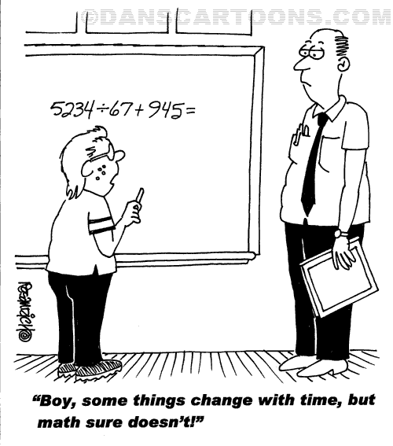

Slide 16
Re-Budgeting
Sometimes prior permission is needed when re-budgeting. Sometimes permission is not needed.
Certain costs such as participant and F&A need prior approval.
Amount being re-budgeted might need prior approval.

Slide 17
Resources
NSPA
Contract
RSP Staff
Sponsor RFP
Website
A-21
UNI Office of Business Operations
Notes:
Explain each one

Slide 18
THANK YOU

