Slide 1
Decision Tree
In the Name of God
Machine Learning
Mohammad Ali Keyvanrad
Thanks to:
Tom Mitchell (Carnegie Mellon University )
Rich Caruana (Cornell University)
1393-1394 (Spring)

Slide 2
Outline
Decision tree representation
ID3 learning algorithm
Entropy, Information gain
Issues in decision tree learning

Slide 3
Outline
Decision tree representation
ID3 learning algorithm
Entropy, Information gain
Issues in decision tree learning

Slide 4
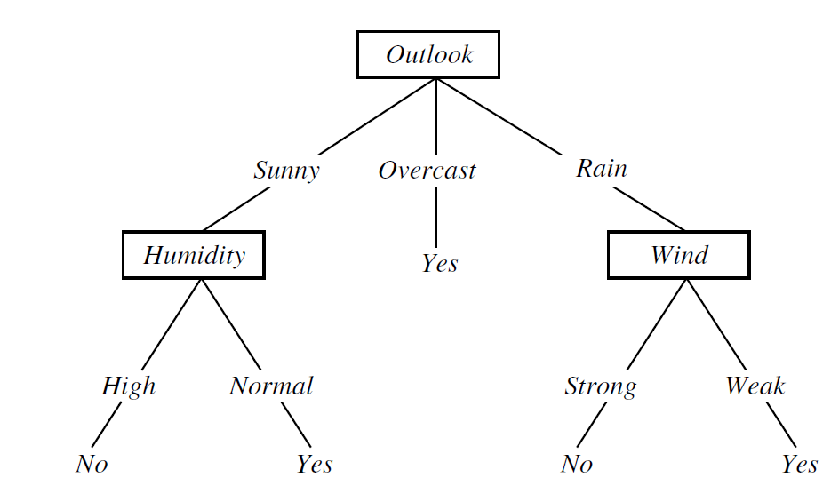
Decision Tree for Play Tennis

Slide 5
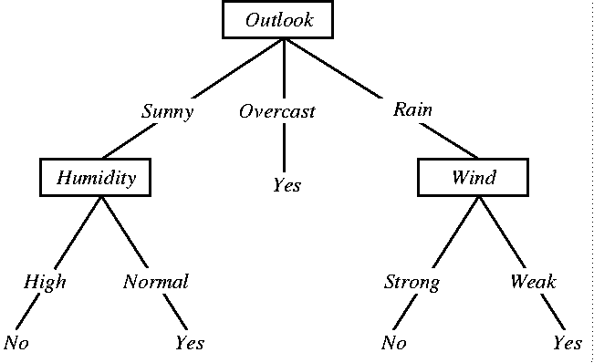
Decision Trees
internal node = attribute test
branch = attribute value
leaf node = classification

Slide 6
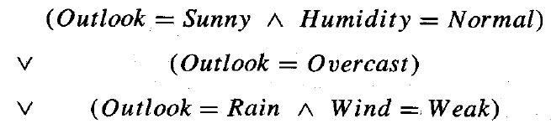
Decision tree representation
In general, decision trees represent a disjunction of conjunctions of constraints on the attribute values of instances.
  Disjunction: or
  Conjunctions: and

Slide 7
Appropriate Problems For
Decision Tree Learning
Instances are represented by attribute-value pairs
The target function has discrete output values
Disjunctive descriptions may be required
The training data may contain errors
The training data may contain missing attribute values
Examples
  Medical diagnosis

Slide 8
Outline
Decision tree representation
ID3 learning algorithm
Entropy, Information gain
Issues in decision tree learning

Slide 9
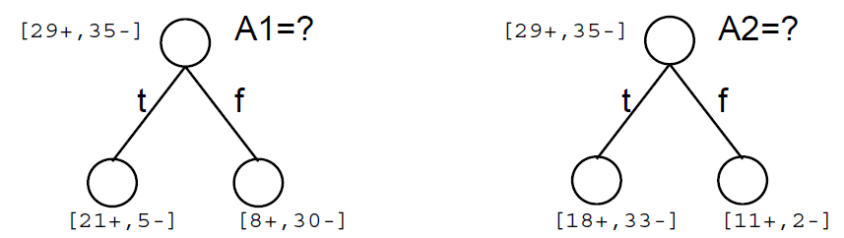
Top-Down Induction of Decision Trees
Main loop
  find “best” attribute test to install at root
  split data on root test
  find “best” attribute tests to install at each new node
  split data on new tests
  repeat until training examples perfectly classified
Which attribute is best?

Slide 10
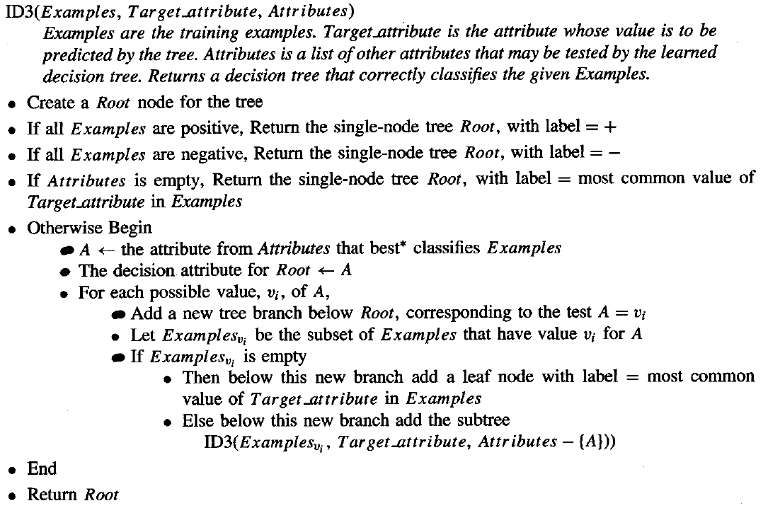
ID3

Slide 11
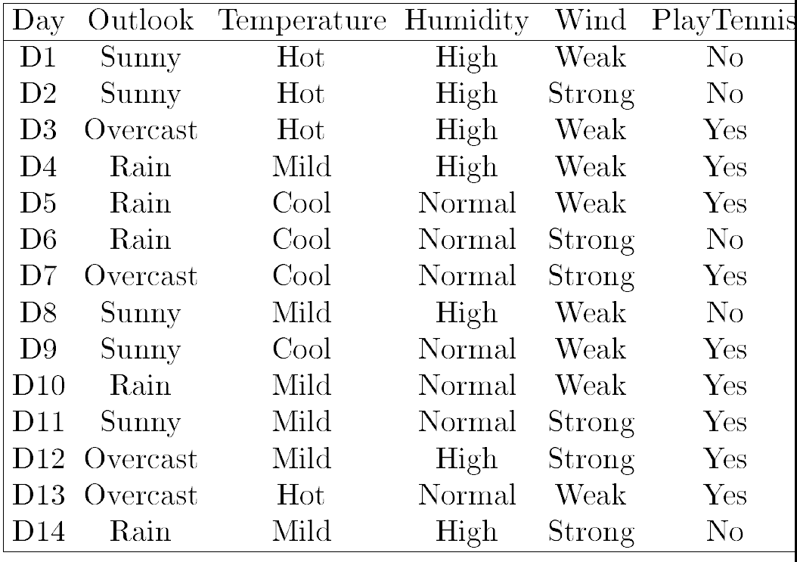
ID3

Slide 12
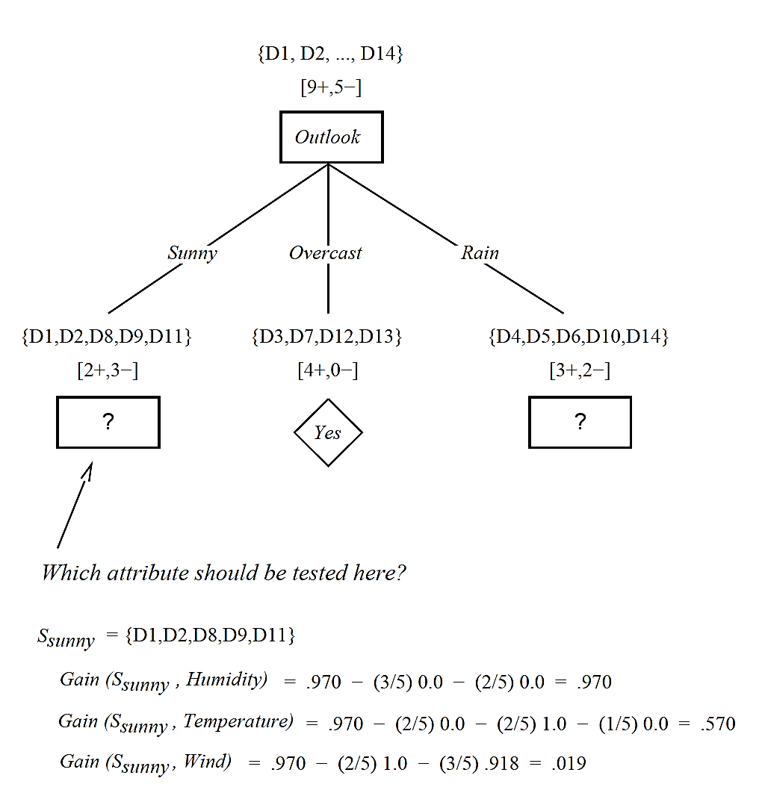
ID3

Slide 13
Outline
Decision tree representation
ID3 learning algorithm
Entropy, Information gain
Issues in decision tree learning

Slide 14

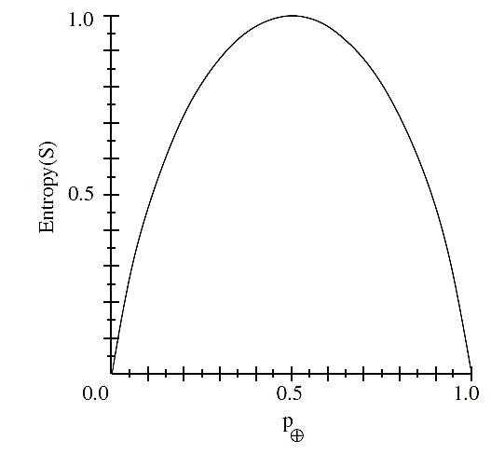

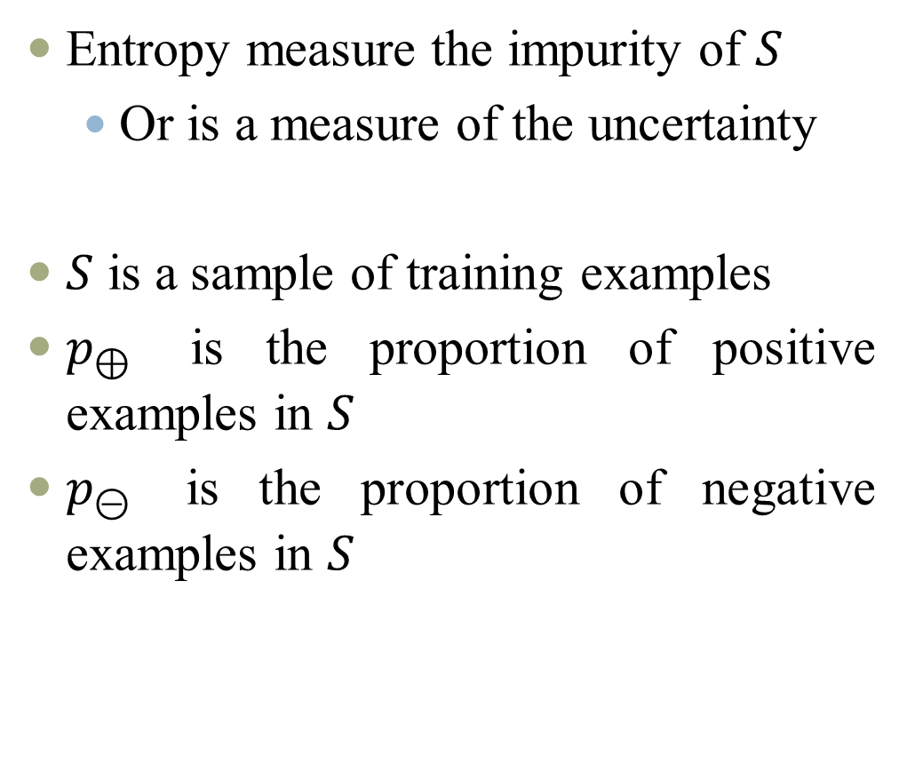
Entropy
Entropy measure the impurity of $S$
  Or is a measure of the uncertainty
$S$ is a sample of training examples
$p_{⊕}$ is the proportion of positive examples in $S$
$p_{⊝}$ is the proportion of negative examples in $S$

Slide 15
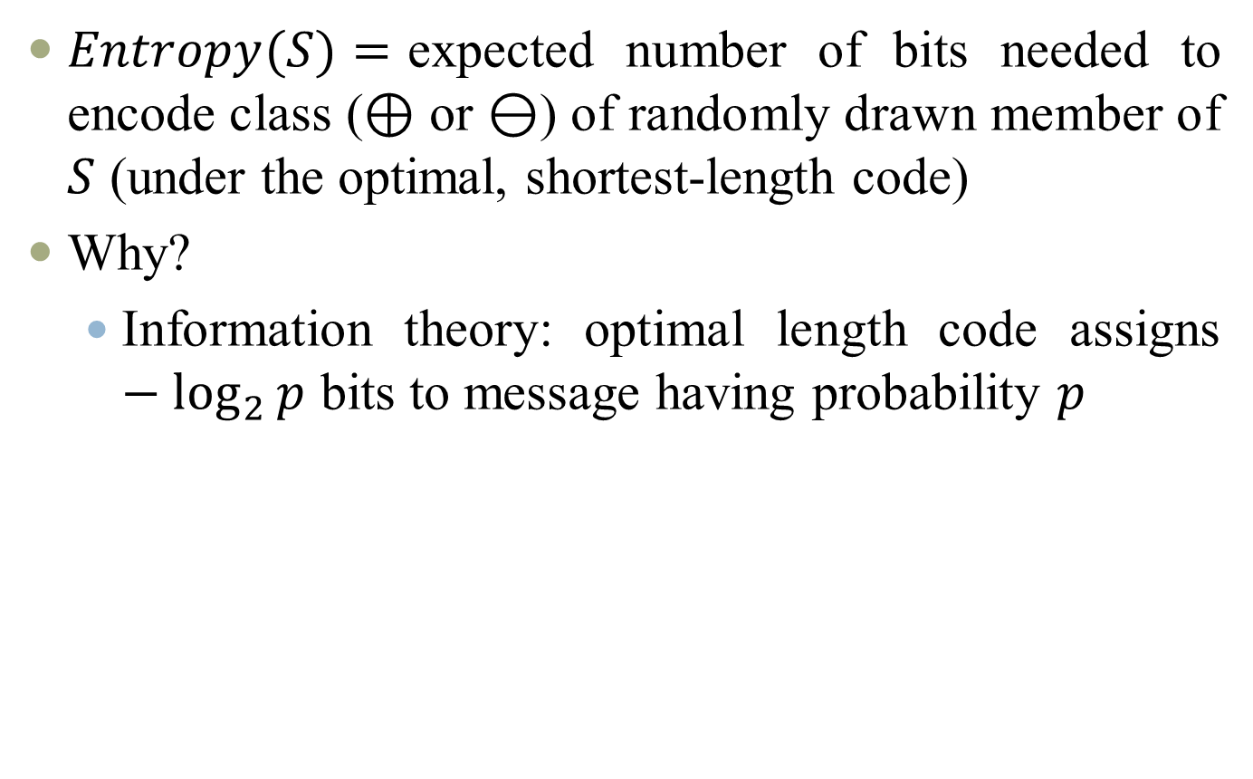


Entropy
$Entropy(S)=$expected number of bits needed to encode class ($⊕$ or $⊖$) of randomly drawn member of $S$ (under the optimal, shortest-length code)
Why?
  Information theory: optimal length code assigns $−\log_{2}{p}$ bits to message having probability $p$
$${String: α}_{0}α_{0}α_{1}α_{0}α_{0}α_{1}α_{2}α_{3}$$
$$Entropy \left(S\right)=1.75$$

Slide 16
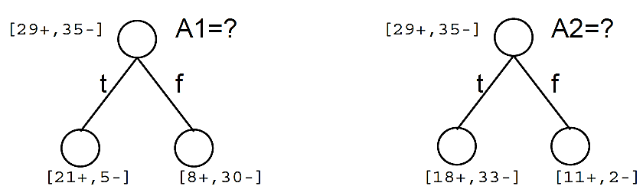

Information Gain
Expected reduction in entropy due to splitting on an attribute
    $Values(A)$ is the set of all possible values for attribute $A$
    $S_{v}$ is the subset of $S$ for which attribute $A$ has value $v$

Slide 17
Training Examples

Slide 18
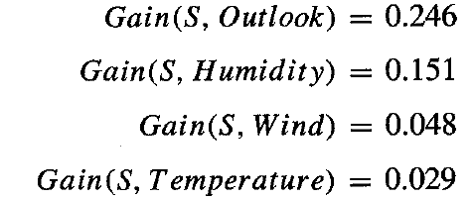
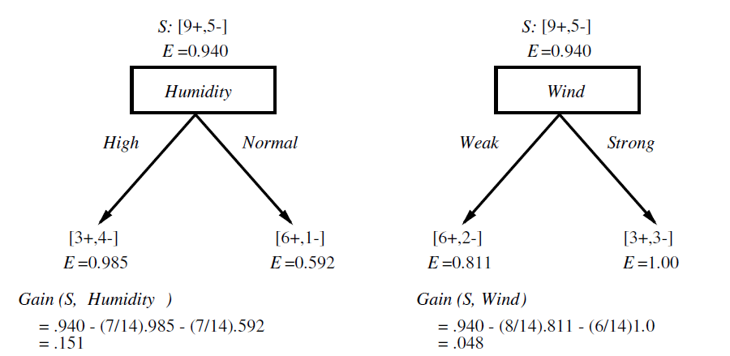
Selecting the Next Attribute
Which Attribute is the best classifier?

Slide 20
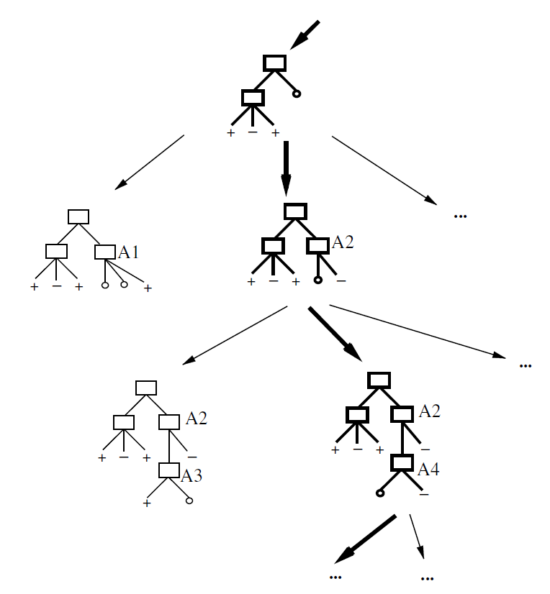
Hypothesis Space Search by ID3
The hypothesis space searched by ID3 is the set of possible decision trees.
ID3 performs a simple-to complex, hill-climbing search through this hypothesis space.

Slide 21
Outline
Decision tree representation
ID3 learning algorithm
Entropy, Information gain
Issues in decision tree learning

Slide 22
Overfitting
ID3 grows each branch of the tree just deeply enough to perfectly classify the training examples.
  Difficulties
    Noise in the data
    Small data
Consider adding noisy training example #15
  Sunny, Hot, Normal, Strong, PlayTennis=No
  Effect?
    Construct a more complex tree

Slide 23


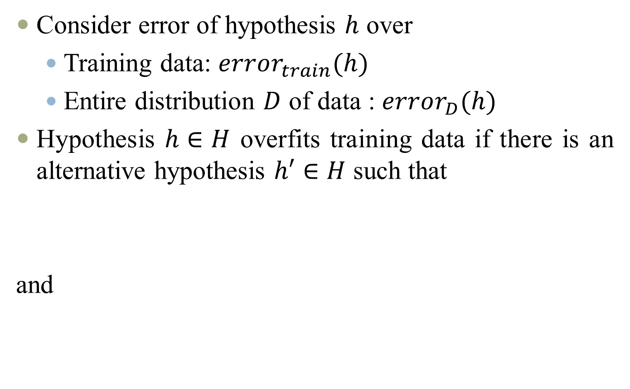
Overfitting
Consider error of hypothesis $h$ over
  Training data: $error_{train}(h)$
  Entire distribution $D$ of data : $error_{D}(h)$
Hypothesis $h∈H$ overfits training data if there is an alternative hypothesis $h′∈H$ such that
and

Slide 24
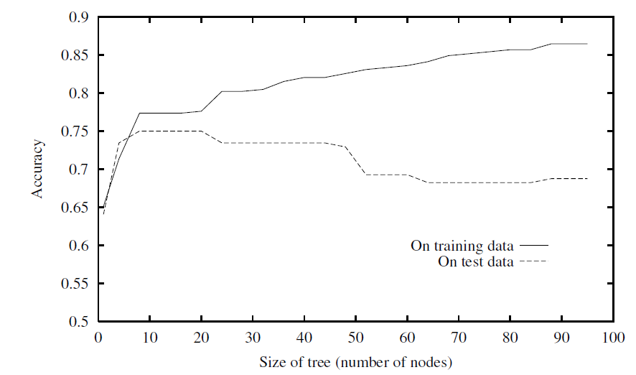
Overfitting in Decision Tree Learning

Slide 25
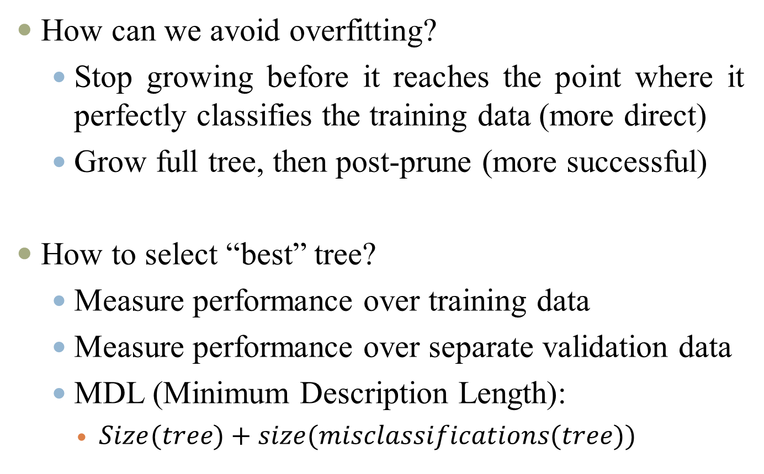
Avoiding overfitiing
How can we avoid overfitting?
  Stop growing before it reaches the point where it perfectly classifies the training data (more direct)
  Grow full tree, then post-prune (more successful)
How to select “best” tree?
  Measure performance over training data
  Measure performance over separate validation data
  MDL (Minimum Description Length):
    $Size(tree)+size(misclassifications(tree))$

Slide 26
Reduced-Error Pruning
Split data into training and validation set
Do until further pruning is harmful (decreases accuracy of the tree over the validation set)
  Evaluate impact on validation set of pruning each possible node (plus those below it)
  Greedily remove the one that most improves validation set accuracy

Slide 27
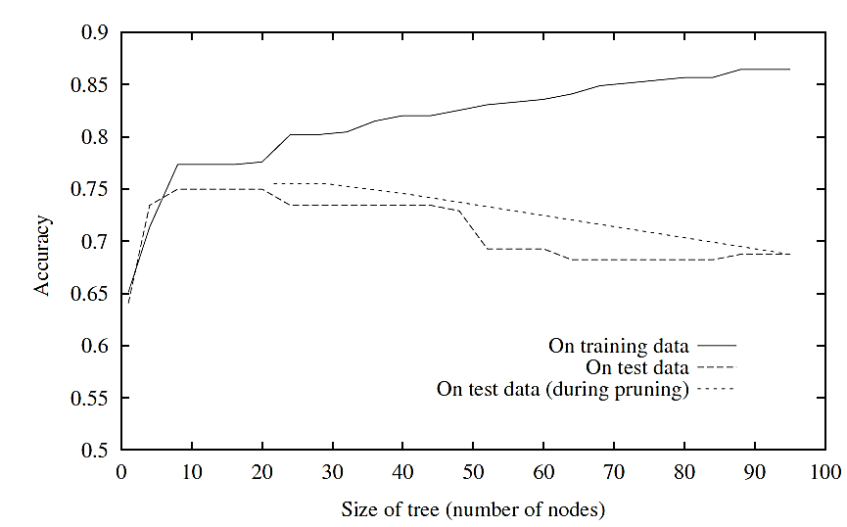
Effect of Reduced-Error Pruning

Slide 28
Rule Post-Pruning
Each attribute test along the path from the root to the leaf becomes a rule antecedent (precondition)
Method
  Convert tree to equivalent set of rules
  Prune each rule independently of others
    each such rule is pruned by removing any antecedent, whose removal does not worsen its estimated accuracy
  Sort final rules into desired sequence for use
Perhaps most frequently used method (e.g., C4.5)

Slide 29
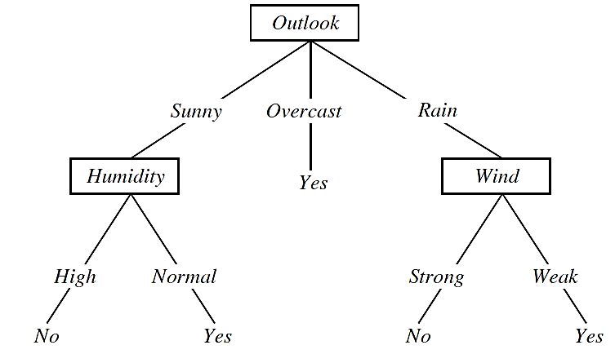
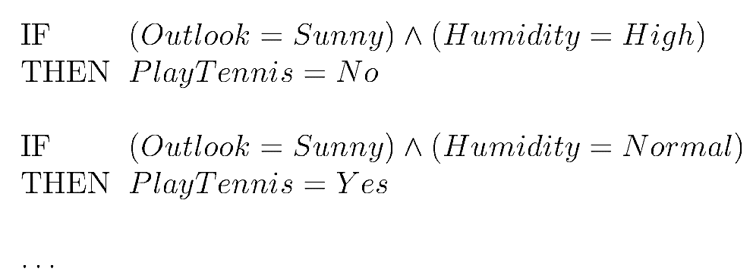
Converting A Tree to Rules

Slide 30
Rule Post-Pruning
Main advantages of convert the decision tree to rules
  The pruning decision regarding an attribute test can be made differently for each path.
    If the tree itself were pruned, the only two choices would be to remove the decision node completely, or to retain it in its original form.
  Converting to rules removes the distinction between attribute tests that occur near the root of the tree and those that occur near the leaves.
  Converting to rules improves readability. Rules are often easier for to understand.

Slide 31
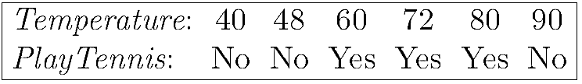
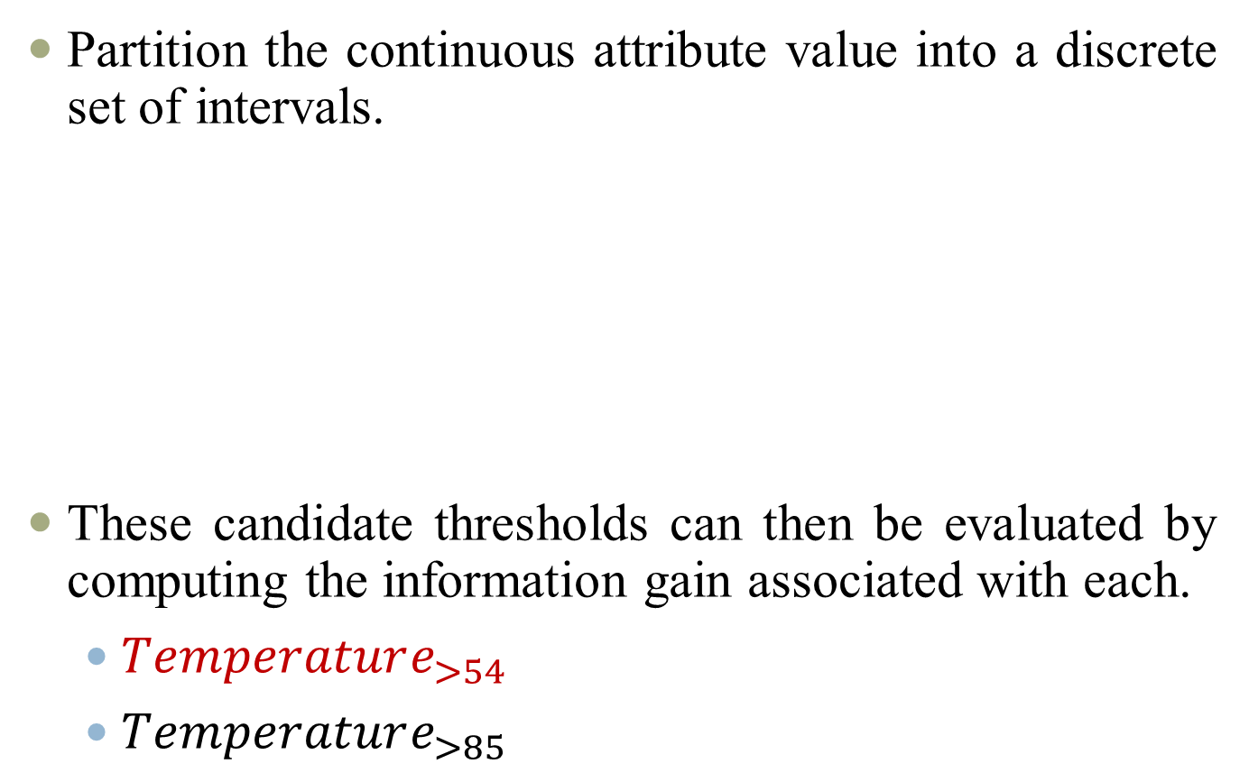


Continuous-Valued Attributes
Partition the continuous attribute value into a discrete set of intervals.
These candidate thresholds can then be evaluated by computing the information gain associated with each.
  $Temperature_{>54}$
  $Temperature_{>85}$
$$\frac{48+60}{2}=54$$
$$\frac{80+90}{2}=85$$

Slide 32

Unknown Attribute Values
What if some examples missing values of A?
  Use training example anyway, sort through tree
    If node $n$ tests $A$, assign most common value of $A$ among other examples sorted to node $n$.
    Assign most common value of A among other examples sorted to node $n$ with same target value.
Humidity
Wind

Slide 33

Unknown Attribute Values
    Assign probability $p_{i}$ to each possible value $v_{i}$ of $A$
      Assign fraction $p_{i}$ of example to each descendant in tree
      fractional examples are used for the purpose of computing information Gain
      Classify new examples in same fashion(summing the weights of the instance fragments classified in different ways at the leaf nodes)
Humidity
Wind

Slide 34
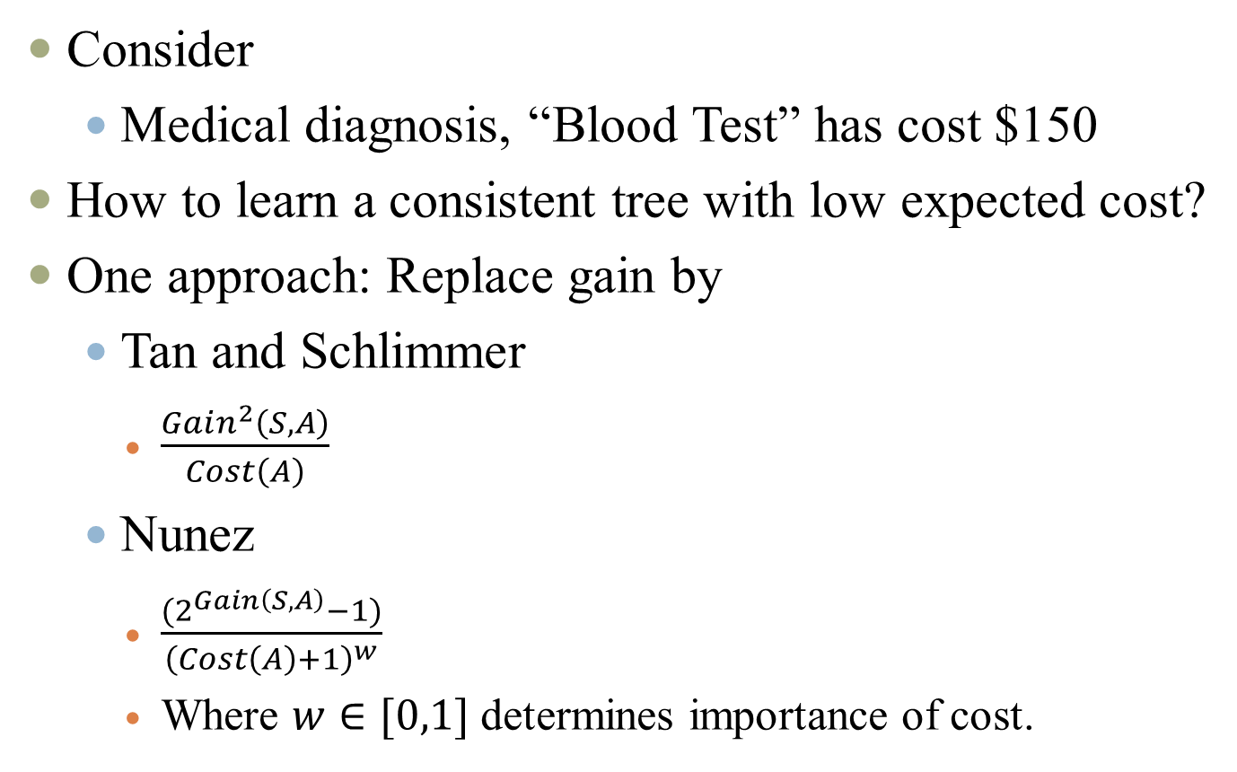
Attribute with Costs
Consider
  Medical diagnosis, “Blood Test” has cost $150
How to learn a consistent tree with low expected cost?
One approach: Replace gain by
  Tan and Schlimmer
    $\frac{Gain^{2}\left(S,A\right)}{Cost\left(A\right)}$
  Nunez
    $\frac{{(2}^{Gain\left(S,A\right)}−1)}{{\left(Cost\left(A\right)+1\right)}^{w}}$
    Where $w∈[0,1]$ determines importance of cost.

Slide 35


