Slide 1
Information Systems and Business Strategy
Chapter 1
Opening Case: Information Technology Helps LCBO Transform Itself

Slide 2
Chapter 1 Overview
SECTION 1.1 – INFORMATION SYSTEMS IN BUSINESS
  Information Systems’ Role in Business
  Information Systems Basics
  Roles and Responsibilities in Information Systems
SECTION 1.2 – BUSINESS STRATEGY
  Identifying Competitive Advantages
  The Five Forces Model – Evaluating Business Segments
  The Three Generic Strategies-Creating A Business Focus
  Value Chain Analysis – Targeting Business Processes
  Business-Driven Information Systems and Business Strategy
Notes:
Information is everywhere. Information is a strategic asset. Without information, an organization simply could not operate. This chapter introduces students to several core business strategies that focus on using information to gain a competitive advantage.
This chapter also gives students an overview of the opportunities in MIS over the next number of years in the Canadian marketplace.

Slide 3
Learning Outcomes
Explain the role information systems have in business.
Explain information systems basics and the responsibilities of senior IS personnel.
Describe the job market in Canada over the next five years for MIS and ICT professionals and identify the opportunities.
Describe how business-driven information systems can increase competitive business strategy.
Explain the various ways organizations can assess their competitive advantages.
Notes:
A detailed review of the learning outcomes can be found at the end of the chapter in the textbook.

Slide 4
SECTION 1.1
INFORMATION SYSTEM’S ROLE IN BUSINESS
Notes:
CLASSROOM OPENER
GREAT BUSINESS DECISIONS – Netflix Transforms Video Rentals
Even five years ago, it was typical for people to drop by their corner video rental store and stock up with DVDs for the weekend or the trip to the cottage. Today, few people would think about moving further than their computer, TV or phone to enjoy the latest in electronic entertainment.
In 1999, Reed Hastings and Marc Randolph, took advantage of the dramatic adoption of the Internet by consumers and advances in video streaming technology to transform Netflix into an online movie rental service and changed forever the way we rent movies.
Beginning with less than 200,000 subscribers in 2000, Netflix today, according to the Forbes business magazine, boasts over 50 million users. While the business has not been without its management crises, its rapid growth over the years has been a steady penetration into the mass electronic entertainment market. In September 2010, Blockbuster, the largest chain of video rental stores across North America, that had been late to launch their own SVOD (streaming video on demand), lost the race for the video rental customer and declared bankruptcy.
Reed Hastings, Netflix CEO, attributes the initial success of Netflix as much to their decision to use their unique subscription business model, as to their ability to harness leading edge technology to emerging changes in consumer behaviour. Netflix was founded in 1997 as a mail order movie rental business. Unlike a video store that charged a fee per rental and locked the consumer into a due date for the return of the DVD, Netflix charged a monthly flat rate to subscribers and allowed unlimited use of the DVDs that were mailed to them. In interviews with Inc. Magazine and other media, Hastings has stated his belief that the subscription model for its online video streaming service, with its flat rate and no deadlines, set Netflix apart from its rivals.
Netflix’s combination of business strategy with technical savvy makes them a leader today.
Check out Netflix year over year growth on their Web Site: https://pr.netflix.com/WebClient/loginPageSalesNetWorksAction.do?contentGroupId=10477

Slide 5
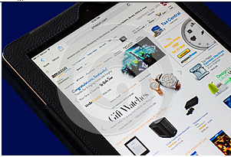
Competing in the Information Age
Learning
Outcome
Business ideas integrated with technology. . .
Amazon.com first created by Jeff Bezos to offer customized, lower cost books.
Netflix wanted to offer unlimited viewing of rented movies.
Better use of time for young professionals was the goal that inspired Grocery Gateway.
1.1
Amazon.com
FIGURE 1.1
Notes:
Why do you think you need to study management information systems?
Technology is everywhere in business.
Canadian Business, Maclean’s magazine, Fortune, Forbes, BloombergBusinessweek are business journals, not technology magazines, and yet they are filled with technology.
CLASSROOM EXERCISE
Understanding the Relevance of Technology In Business
This exercise clearly demonstrates why anyone involved in business must understand technology. It can be a real revelation for students who otherwise are not interested in IT.
Bring in several copies of Canadian Business, Maclean’s, BloombergBusinessweek, Fortune, Fast Company, or any popular business magazine. The magazines do not have to be current. Provide a marking tool such as a small set of Post-It Notes. Ask for a few volunteers and have the students review the magazine and stick a Post-It Note on each technology-related article, advertisement, etc. When the student has completed this task, the magazine will be covered in Post-it Notes, clearly demonstrating that technology is everywhere in business, even in the popular business magazines such as BusinessWeek.
If your class is in a computer lab or if students bring laptops into class, assign magazine websites to different students. Add an element of competition by rewarding the first few students who find 5 business articles that include technology (or even 5 headlines). Get students to talk about how the key business message in the article and how technology is an essential feature in it.
Be sure to reinforce that these are business magazines, not technology magazines. Yet they are completely filled with technology – which is clearly demonstrated by the Post-It Notes. How can any business student today possibly argue that they do not need to know or understand technology when faced with a magazine, such as BusinessWeek, that is filled with technology? Read a few of the articles or advertisements. Ask how many of your students are familiar with Siebel, Oracle, or PeopleSoft and can articulate what they can do for a company?
The goal of this course is to help your students understand the business side of technology. Being able to understand all of the technology articles in BusinessWeek is one of the benefits your students will receive upon completion of the course.

Slide 6
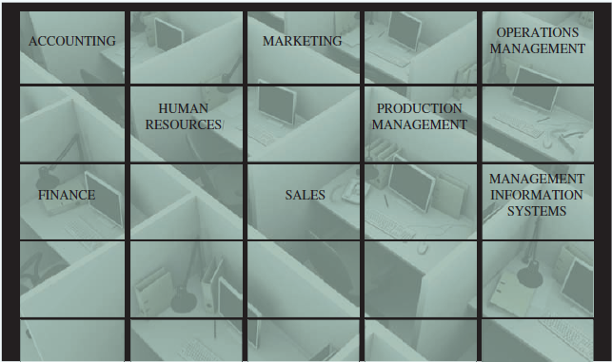
Information Systems’ Impact on Business Operations
Business undertake enterprise-wide IT initiatives to:
  Lower Costs
  Improve Productivity
  Generate Growth
IT provides:
  Communication
  Data and Information
  Analysis
1.1
Departmental Structure of a Typical Organization
FIGURE 1.2
Notes:
This is an excellent opportunity to discuss each business area and ensure your students have a solid understanding of business in general:
Accounting provides quantitative information about the finances of the business including recording, measuring, and describing financial information
Finance deals with the strategic financial issues associated with increasing the value of the business, while observing applicable laws and social responsibilities
Human resources includes the policies, plans, and procedures for the effective management of employees (human resources)
Sales is the function of selling a good or service and focuses on increasing customer sales, which increases company revenues
Marketing is the process associated with promoting the sale of goods or services. The marketing department supports the sales department by creating promotions that help sell the company’s products
Operations management (also called production management ) includes the methods, tasks, and techniques organizations use to produce goods and services. Transportation (also called logistics) is part of operations management.
Management information systems (MIS) is the function that plans for, develops, implements, and maintains IS hardware, software, and the portfolio of applications that people use to support the goals of an organization

Slide 7
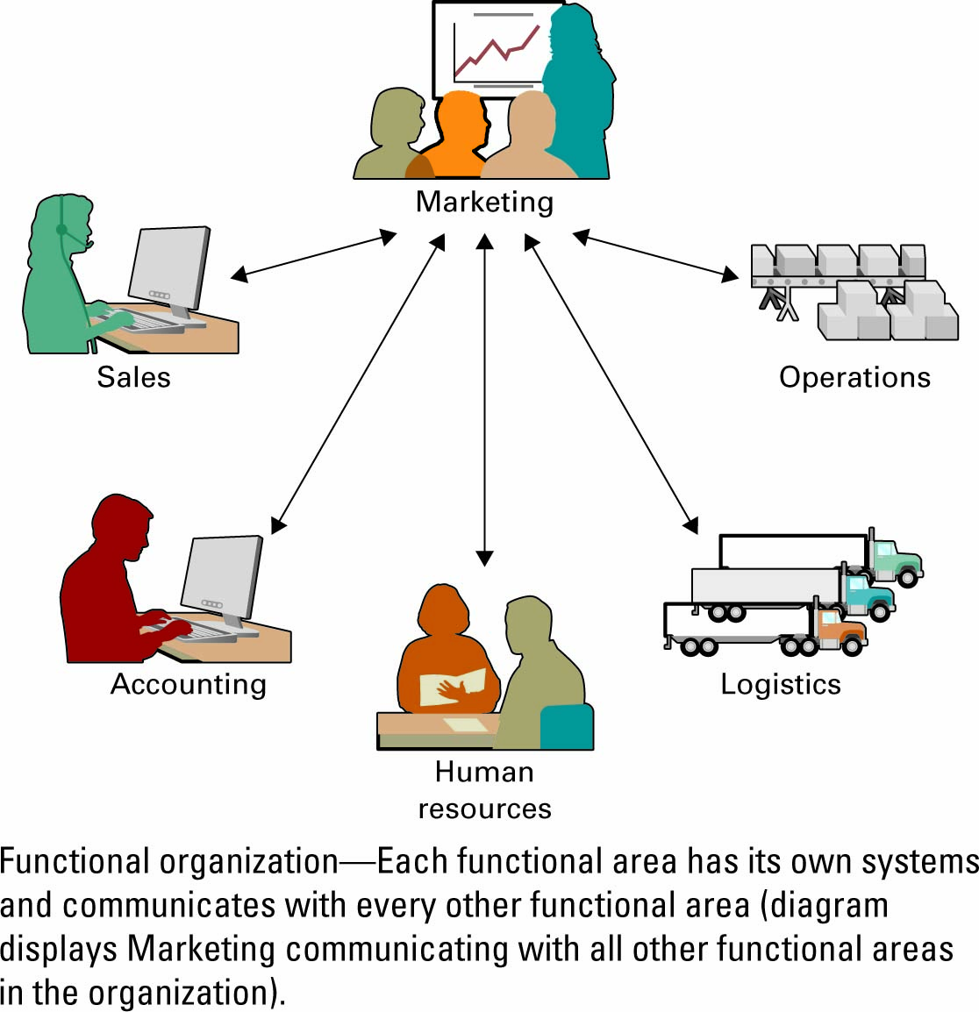
Information Systems’ Impact on Business Operations
Learning
Outcome
Marketing Working with Other Organizational Departments
1.1
Organizations typically operate by functional areas or “silos”.
Departments must function interdependently to share common information.
Figure 1.3
Notes:
Each functional area undertakes a specific core business function
Sales and Marketing – forecasting, segmentation, advertising, promotions
Operations and Logistics – purchasing, supplying, receiving, transportation
Accounting and finance – accounting, planning, budgeting, tax, costs
Human resources – hiring, training, benefits, and payroll
Functional areas are interdependent
Why are functional areas interdependent?
Departments cannot operate in isolation; they require information from around the organization to operate
Ask students what information is being exchanged by marketing with each of the other functional areas pictured above.

Slide 8

Information Systems Basics
Learning
Outcome
Information systems (IS)
  Computer-based tools that used to work with information and support the information and information-processing needs of an organization
  Include: Hardware, Software, Trained personnel, Policies & Procedures & Security measures
IS is an enabler of business success and innovation
1.2
Notes:
IS does not represent business success and innovation, it is an enabler of business success and innovation
PeopleSoft and SAP are large integrated information systems. Have students go to the web sites of these companies and access business cases. Have the students identify what the goal was of each of the projects PeopleSoft or SAP have described in the case. It will be a business goal. What efficiency did the IS system provide? What was the competitive result?
Will spending large amounts of money on IS guarantee automatic success?
Spending large amounts of money on IS will not guarantee an organization automatic success
To be successful, organizations need to allocate resources on the right types of IS that correctly support their business operations

Slide 9

Information Technology
Information technology (IT)
  The acquisition, processing, storage, and distribution of voice, graphics, text, and numbers and other information by a combination of computers and telecommunications networks.
1.2
Notes:
Ask students to consider what is the relationship between IT spending and business success. Will spending large amounts of money on IT guarantee automatic success?
Will avoiding spending money on IT improve the company’s bottom line?
What are some factors that impact on IT spending?
Answers may include:
Cost versus benefit.
Are company objects consistent with large investment in IT? For example, Ford Motor company has a heavy investment in IT but a day care center might have less.
Amount competitors are investing.

Slide 10

Information Systems Basics
Learning
Outcome
Management information systems (MIS)
  The function that plans for, develops, implements, and maintains IS hardware, software, and applications that people use to support the goals of an organization
  MIS is a business function, similar to Accounting, Finance, Operations, and Human Resources
1.2
Notes:
MIS is not technology
MIS is a business function
Most organizations have an IS department that is responsible for performing the MIS function
This is similar to an organization having an Accounting department that is responsible for performing the accounts payable and accounts receivable functions

Slide 11
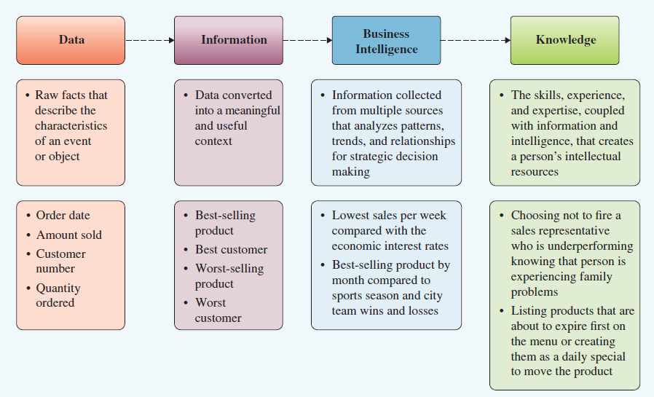
Data, Information, BI & Knowledge
Data, Information, Business Intelligence (BI) and Knowledge
1.2
Figure 1.4
Notes:
It is important to distinguish data, information, business intelligence (generally referred to as BI) and Knowledge as each has a unique role in an information system.
Data, not information, is stored in a database management system. A wide range of data is stored, more that is needed for any single purpose. However, by selecting subsets of the raw data available to businesses, cross-referencing and analyzing it, valuable information is created for specific purposes. Data (and information) can be used over and over again in different ways to satisfy different organizational information needs. Knowledge is expertise coupled with experience and expertise. It provides greater insight for more complex situations. BI is the analysis that produces Knowledge.
Have students provide examples of how a piece of data (such as the outdoor temperature in Madrid, Spain) can be information (if you were going there tomorrow), used in Business Intelligence (determining what kind of clothing to export to that city) and be part of knowledge (residents of Madrid could tell you whether the data you have is reliable enough to use as a basis for your business decision). Try a student’s grade in a course or the price of a dozen eggs.
Another exercise might be to ask your students to look around the classroom and identify 3 pieces of data and 3 pieces of information
This is a bit of a trick question, unless you know the system you are building or the problem you are trying to solve it is impossible to know what is data and what is information
For example, if you were building a system to track students:
Data might include height, name, and hair colour
Information might include student to professor ratio, percentage of marketing majors who are female, number of students who pass the course.
Knowledge might include using the number of students who pass the course and the student to professor ratio to determine if changes should be made to course structures to create smaller or larger class sizes (i.e. knowledge-based judgments are made on the basis of information)
If you were building a system to track inventory:
Data might include chair manufacturer, chair colour, and chair size
Information might include number of chairs required for students in each class, average number of chairs needed to be replaced each semester.
Knowledge might include a judgment about how often chairs should be replaced in a typical year

Slide 12
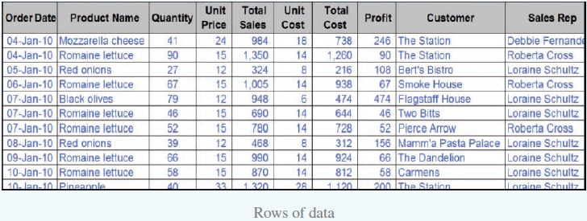
Data
Raw facts that describe the characteristics of an event or object.
1.2
Rows of data
Figure 1.5
Notes:
The rows in an Excel spreadsheet demonstrate data contain raw facts that describe the characteristics of an event or object. Data are recorded facts.
Data can be turned into information to answer a question or support a decision.
For example, for which order did the company make the most profit?
You might see if your students can think of three or four other business questions this data can answer.

Slide 13
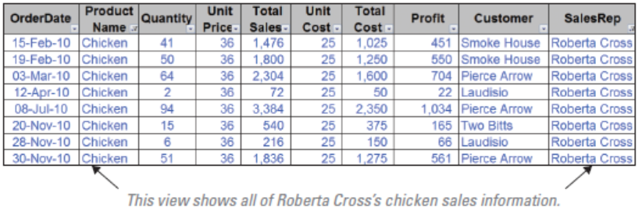
Information
Data converted into a meaningful and useful context.
1.2
Figure 1.6
Notes:
A fundamental role of all business managers is to be able to take the data and analyze it to find information to make great business decisions.
Ask your student how a business might use this data to improve decision making?
They might consider….
What represents data in Figure 1.6?
What information is being provided about what is represented in Figure 1.6?
What could a business do now that it has that information?
You might also have your students consider what is the difference between price and cost?
And,what would happen to a manager that only focuses on total sales, not total profit?

Slide 14
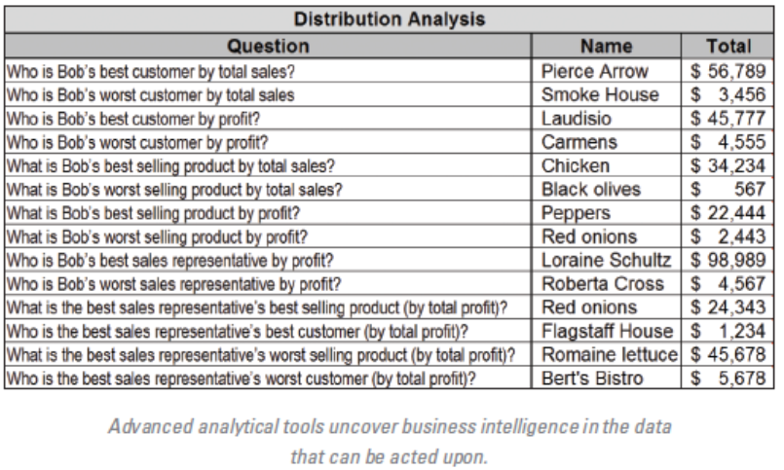
Business Intelligence & Knowledge
1.2
Figure 1.7
Notes:
This chart is a result of Business Intelligence. It shows that Bob’s weakest sales representative for this period is Roberta Cross. If Bob considered only this information, he might conclude that firing Roberta was a good business decision. However, because Bob has knowledge about how the company operates, he knows that Roberta has been out on medical leave for several weeks; hence, her sales numbers are low. Without this additional knowledge, Bob might have executed a bad business decision, delivered a negative message to the other employees, and sent his best sales representatives out to look for other jobs.
The key point in this scenario is that it is simply impossible to collect all the information about every situation, and yet without that, it can be easy to misunderstand the problem. Using data, information, business intelligence, and knowledge to make decisions and solve problems is therefore the key to finding success in business. These core drivers of the information age are the building blocks of business systems.

Slide 15
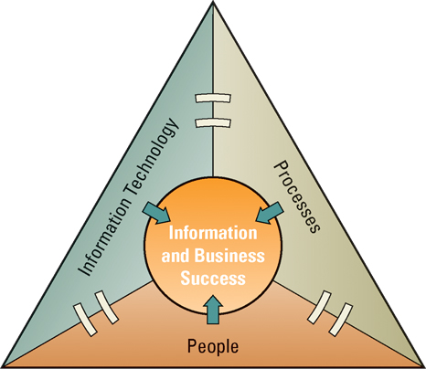
Relationship among People, Processes, Information Technology and Information
1.2
People use processes to work with Information Systems to produce Information.
Figure 1.8
Notes:
IS in and of itself is not useful unless the right people know how to use and manage it efficiently and effectively.
Have students consider information systems as any system that facilitate the acquiring, process and distribution of information.
Have students make a list of all they information systems students use in their daily lives. This may include any electronic devices , apps and any academic related processes they use.
Have students break these down into their component IT (hardware, software), processes (how they use it) and people involved. Ask them what would happen if one of the components was not integrated and working effectively with the others.
What would they do if they didn’t have these information systems?
People, information, and information systems (in that order of priority) are inextricably linked
If one fails, they all fail.
All three, people, information and information systems are considered valuable company assets.
Information is one of the most important assets in an organization, and the primary way that people get information is through information systems
Without databases and spreadsheets how would managers gather, correlate, and analyze information?

Slide 16
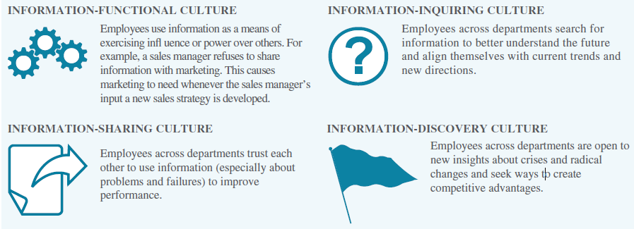
Information Cultures
Different Information Cultures Found in Organizations
1.2
Figure 1.9
Notes:
Culture is a term that refers to the attitudes, beliefs and expectations people have about a specific community of which they are a part. The “community” can be their family, their place of work, their country etc. Much has been written about business culture. In banks, for example, people are formal and there are many rigid processes. At a barber shop or hair dressing salon, there is much more informal culture in terms of dress, processes and interactions.
A culture often develops around a specific reason people interact. Communication among people within an organization is so extensive and important that attitudes, beliefs and expectations have grown up as to how it is done in that particular work community.
Have students provide examples of each of the types of cultures listed above. Have them describe and identify the kind of information culture they face at home, at work and at school. Have students assess the benefits and weaknesses of each. Which would they prefer to be a part of and why?

Slide 17
Information System Roles and Responsibilities
Learning
Outcome
Chief information officer (CIO)
  Oversees all uses of IT and ensures the strategic alignment of IT with business goals and objectives
Chief knowledge officer (CKO)
  Responsible for collecting, maintaining, and distributing the organization’s knowledge
Chief privacy officer (CPO)
  Responsible for ensuring the ethical and legal use of information
1.3
Notes:
Excellent resource on how people are Microsoft’s greatest assets
http://http://www.microsoft.com/enterprise/newsletters/bi-newsletter/june2013.aspx#fbid=0MBcysqowrB
The CKO is quickly becoming a visible career target. The Institute for Intellectual Capital Research in Hamilton, ON interviewed 53 executive search firms and concluded that the CKO position will become commonplace.

Slide 18


Information Systems Roles and Responsibilities
Learning
Outcome
Chief security officer (CSO)
  Responsible for ensuring the safety of IT resources including data, hardware, software, and people
Chief technology officer (CTO)
  Responsible for ensuring the throughput, speed, accuracy, availability, and reliability of IT
1.3
Notes:
While many companies may not have a different individual for each of these positions, they must have top managers who take responsibility for all of these areas. Often who reports to whom is an organizational structure challenge. In many organizations, the CISO, Chief Information Security Officer, used to report to the CIO (Chief Information Officer). Now, more frequently, the CIO reports directly to the CEO (Chief Executive Officer). This reduces the opportunity for the CIO to use his/her position to defraud the company by manipulating the company’s information system.

Slide 19
CIO’s Top Priorities
1.3
Results of CIO Magazine’s Top 3 Activities of CIOs
Game Changing Activities | Service / Cost Centre Activities
Driving business innovation | Improving IT operations
Cultivating IT-business relationship | Developing new systems
Developing business strategy | Controlling IT costs
Figure 1.10
Notes:
Meet JP Rangaswami who over the years, has been named CIO Innovator and CIO of the Year and One of the 50 Most Influential Technology People, by a wide range of respected technology journals and forums in Europe and North America. Follow the link, http://www.ted.com/talks/jp_rangaswami_information_is_food
to hear this Ted Talk, where he draws a insightful comparison between his two passions, food and information.

Slide 20

Skills Gap in Canada
Report from Information & Communication Technology Council
  Over 100,000 MIS/ICT jobs to be filled, 2011 - 2016
  Priority given to individuals with a combination of business and ICT skills
  Priority to those who have experience with enterprise information systems such as PeopleSoft and SAP
Median salaries (2014) with 2-4 years experience:
  Business Analyst - $63,303
  Web Designer - $81,369
  IS Auditor - $94,261
1.3
Notes:
ITC– Information and Communications Technology
Have students review job opportunities on Monster.com or other employment website. How many business positions state some type of ICT skill requirement in their descriptions?

Slide 21
Opening Case Questions:
Information Technology Helps LCBO Transform
What might have happened to the LCBO if its top executives had not supported the investment needed in IT?
Evaluate the effects on the LCBO if its inventory control and warehouse management systems fail.
Notes:
As with the principles of project management, support from top executives is a requirement for all projects to succeed. Thus, if this support did not exist at the LCBO, the project would in all likelihood have failed.
These systems are essential to the success of the LCBO, especially with the addition of new channels like Vintages.com. Failure of these systems would result in difficulties in servicing their customers. What effect this would have on its revenues is questionable because the LCBO has almost a monopoly position in Ontario. The government has not privatized the industry, though there is the privately owned Beer Store and some small specialty wine stores that are privately run, in addition to special rules for wineries. System failure could lead to demands for complete privatization as has been done in Alberta.

Slide 22
Opening Case Questions: Information Technology Helps LCBO Transform
Is it unethical for the LCBO to share its customer information from Vintages.com with other government agencies or departments? Explain your answer.
Is Mr. Kelly fulfilling his role as a senior vice president of information (CIO) correctly?
Notes:
The quick answer here is yes and it in addition to being unethical, this would also be illegal as this activity is regulated by FOIP and PIPEDA in Canada.
4. Yes Mr. Kelly is fulfilling his role as senior vice president of information correctly. Students will have different justifications for their answers.

Slide 23
SECTION 1.2
BUSINESS STRATEGY
Notes:
CLASSROOM OPENER
GREAT BUSINESS DECISIONS – Beyoncé levers social media
Music consumers shifted their behaviour from album buyers to track buyers around the turn of the millennium and it has made the profitable distribution of albums a challenge for record labels and artists. Contemporary popular music icon, Beyoncé Knowles-Carter, employed an infrequently used strategy to successfully promote her release of “Beyoncé”, her most recent collection, December 2013.
Instead of the usual pre-release hype, Beyoncé banked on the power of social media to spread the word of her new album. Ignoring traditional vehicles including radio stations, music writers and retails, unannounced, Beyoncé gave iTunes a week-long exclusive on sales. Initial purchasers spread the word on Twitter, Facebook and other sites and social media came alive at the release. With word-of-mouth within the social community, being the most powerful of promotional tools, “Beyoncé” soared up the charts to become one of the biggest releases of the year.
Analysts believe that few recording artists can play the same game. They point to Beyoncé’s enormous brand equity and the market power of iTunes that made her strategy successful. However, it can be argued that social media has been a force of change in music distribution since its inception. More emerging music and artists have been able to get exposure through social media than before its existence.
Have students read Billboard’s commentary about Beyoncé’s decision for promoting her album release at http://www.billboard.com/biz/articles/news/digital-and-mobile/5847787/business-matters-how-beyonces-album-roll-out-was-less and ask students if they think traditional music distribution’s time has past, why or why not.

Slide 24
Competitive Advantage
Learning
Outcome
1.4
Key to survival and growth
  Competitive advantage
    A product or service that an organization’s customers place a greater value on than similar offerings from a competitor
  First-mover advantage
    Occurs when an organization can significantly impact its market share by being first to market with a competitive advantage
  Always temporary as it is quickly copied
Notes:
Ask your students….what were the features that gave Apple a competitive advantage with iPhone? How long did the advantage last? Who are its chief competitors? How quickly does Apple have to release better features to stay ahead of the game?
Have student groups search on iPhone and iPhone competitors and compare latest iPhone features with one other competitor.

Slide 25

Identifying Competitive Advantage
Learning
Outcome
1.4
Environmental scanning
  The acquisition and analysis of events and trends in the environment external to an organization
Three common tools used in developing competitive advantages:
  Porter’s Five Forces Model
  Porter’s three generic strategies
  Value chains
Notes:
Environmental Scanning revolves around learning as much as possible about the trends that can impact the company but that the company has no ability to control.
Ask students if they have taken a marketing course or general business course that dealt with the Macro-environmental factors (PEST is a popular anogram for these). Get students to search and create a list of the factors. One site is http://www.wisegeek.org/what-are-macro-environment-factors.htm
Divide the factors among student groups and have them come up with factors to consider for a specific business or industry such as the automotive, cell phone or education industry.

Slide 26
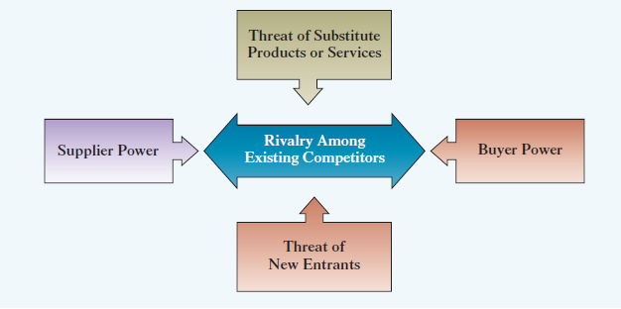
Michael Porter’s Five Forces Model
Porter’s Five Forces Model
1.5
Figure 1.13
Notes:
Attractiveness of an industry is the measure of how likely a business within that industry will succeed.
Buyer power is high when buyers from the business have many choices of whom to buy from and low when their choices are few. Does a business within a specific industry want the industry to be characterized by high buyer power or low?
Supplier power is high when buyers have few choices of whom to buy from and low when their choices are many. Does a business within a specific industry want the industry to be characterized by high supplier power or low?
Threat of substitute products or services is high when there are many alternatives to a product or service and low when there are few alternatives from which to choose. Does a business within a specific industry want the industry to be characterized by high threat of substitution or low?
Threat of new entrants is high when it is easy for new competitors to enter a market and low when there are significant entry barriers to entering a market. Does a business within a specific industry want the industry to be characterized by high threat of new entrants or low?
Rivalry among existing competitors is high when competition is fierce in a market and low when competition is more complacent. Does a business within a specific industry want the industry to be characterized by high rivalry or low?

Slide 27

Buyer Power
Learning
Outcome
Buyer power
  The ability of buyers to affect the price of an item
  Generated for the buyer when it accounts for the largest percentage of a business’s profit
  Switching cost
    The amount of benefits (monetary or non-monetary) a consumer must give up to go to another buyer.
  Loyalty program
    Rewards customers based on the amount of business they do with a particular organization
    Increase the switching costs for buyers.
1.5
Buyer
Notes:
Buyer power is the customer’s power over the business. This typically occurs when a single buyer provides the largest demand for an organization’s offering. Consider this fictional example. What would happy if Tim Horton’s accounted for more than 50% of Mocha Coffee Ltd.’s coffee bean sales. If Mocha Coffee’s costs went up, would it be able to raise its prices? Could it risk Tim Horton’s looking for a cheaper coffee bean and lose more than half its business?
Ask students to name a favorite business or brand. Why is this business or brand better for them than a competitor? What switching costs would they incur to use a different business or brand?
One of the best IT-based examples of strategically reducing buying power is the loyalty programs that many organizations offer.
Which kinds of loyalty programs are students currently using?
Frequent-flyer miles
Restaurant discounts such as Subway’s get your 12th sandwich free
Coffee clubs where you get your 10th cup of coffee free

Slide 28
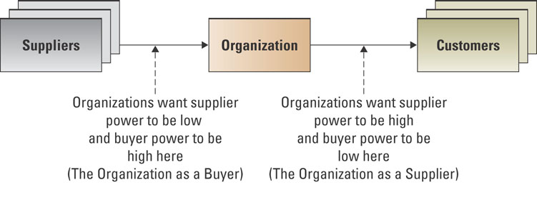
Supplier Power
Learning
Outcome
Supplier power
  The ability of suppliers to set prices and terms.
1.5
Figure 1.14
Notes:
Ask students under what circumstances would a supplier be able to dictate prices and terms to businesses in the industry?
A Private exchange where business post contracts for materials and services to attract bids using a reverse auction, lowest price for comparative quality wins, is an information systems strategy to reduce supplier power. It opens up the supply contracts to global markets.
What is an example of an organization facing “high” supplier power?
How did information systems change the balance of supplier power that the Canadian Postal System had?
How an organization can be both a supplier and a buyer in a supply chain? Can an organization have both supplier power as a supplier and as a customer?

Slide 29



Substitute Product or Service
Learning
Outcome
Substitute products or services
  Alternatives to a product or service
Loyalty programs increase Switching Costs and reduce this threat.
1.5
Notes:
Ideally, an organization wants to be in a market in which there are few substitutes for its products or services. Organizations face three levels of substitutes: Direct or brand substitution, near substitution and abandonment. For example, coffee prices go up at Starbucks, consumer moves to Timothy’s. Coffee prices go up both at Starbucks and Timothy’s, consumer gets their caffeine hit from a cola. Cola price goes up, too, and consumer kicks the caffeine habit. Have students discuss levels of substitution for jeans, types of cars or other products.
Creating high Switching costs is the key to countering threat of substitution. For example, customers of cell phone companies have to pay a penalty to break a contract to move to another cell phone provider. Formerly, they would lose their cell phone number. Now, with LNP, customers can change companies and keep their number, and government regulation is reducing the length of contracts and cost to break them, thus, reducing switching costs. What do students think can cell phone companies do against the threat of substitution?

Slide 30

New Entrants
Learning
Outcome
New entrants
  The ease of which new competitors can enter a market
  Entry barrier
    A feature of a product or service that customers have come to expect and entering competitors must offer the same for survival
1.5
Notes:
What is an industry that has a high entry barrier?
Energy or Telecommunications – the high cost of equipment to provide the services
Banking – Banking is based on trust earned over hundreds of years and billions of safe, secure financial transactions.
What is a commercial activity that has a low entry barrier?
Restaurants – simply lease a space, obtain a license, and you can sell food
Clothing store—lease a space and buy stock on line

Slide 31

Rivalry Among Competitors
Learning
Outcome
Rivalry among existing competitors
  The amount of direct conflict between businesses in a specific industry
  Product differentiation
    Unique differences in the features of products or services that influence demand
1.5
Notes:
Ask your students to provide a few examples of where strong rivalry has lead to product differentiation and what does that differentiation look like?
You might have them consider cell phones, fashions, news magazines and automobiles. They might consider differentiation along price, feature, distribution, branding or other lines.

Slide 32
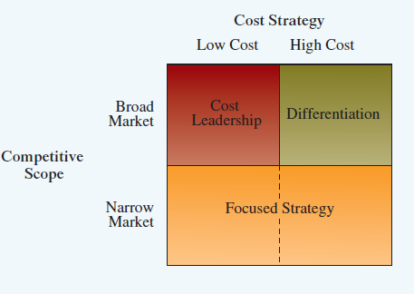
Three Generic Strategies
Learning
Outcome
Using a single generic strategy makes efficient use of resources
First Selection is Broad or Narrow focus
Within Broad Focus choose
  Cost Leadership, or
  Differentiation
Narrow Focus is a single generic strategy
Porter’s Three Generic Strategies
1.5
Figure 1.15
Notes:
Broad Focus refers to targeting a mass market. Ask students to consider the differences between a Cost leadership strategy versus a differentiation strategy for a generic mass market product such as sugar. What are the advantages and disadvantages of each strategy. Ask student to analyze the fast food market. Do any companies use a cost leadership strategy? Of companies that differentiate, what is the basis of their differentiation?
Narrow Focus refers to targeting a small, well-defined market or niche. Ask students if a Focused strategy is, by definition, a strategy of differentiation. If so, on what basis? If not, why not? Are their any fast food companies that have a focused strategy? Have them explain.

Slide 33

Value Creation
Business process
  A standardized set of activities that accomplish a specific task or objective.
Value chain
  A series of business processes, each adding value to the final product or service
1.5
Notes:
The Value Chain describes the organization as a chain of value-adding processes. Consider each value-added process as a distinct function that furthers the goals of the organization. Value Chain analysis is used to look at optimizing each function so that the organization’s overall goal is maximized.
You might ask if any students are training for an athletic event or team sports or even working with a trainer to improve a recreational activity. Then, you might ask these students if their coaches view their performance as a series of actions where the each contributes a specific aspect to the overall performance. Can they describe a situation where their coaches broke down component motions to identify which needed improvement and to suggest changes to maximize overall performance?

Slide 34
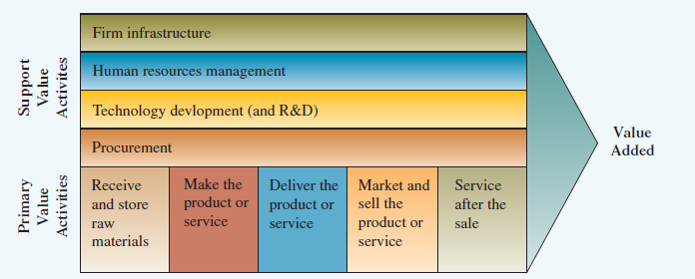
Value Creation
Learning
Outcome
The Value Chain
1.5
Figure 1.18
Notes:
Direct students to the overall shape of the Value Chain figure which is an arrow at whose point is the amount of value created for the customer. Beginning at the left, each Primary Value Activity adds value at each stage for the ultimate customer, and for which the organization can make a profit. For example, if the company was making jeans, at the first stage of receiving and storing raw materials, the benefit to the customer is the collection of all the inputs needed for jeans. If the process stopped there, the customer would be that much closer to a pair of jeans. Support value activities add indirect value. Research and Development and HR do not directly improve the customer’s acquisition of the pair of jeans they want. They are necessary functions so that the primary value activities can be undertaken. Have students identify the value chain for a product of their choice and then, for a service of their choice. Have them identify the value added at each point.
Porter’s Value Chain has direct implications for Information Systems as it identifies functional areas that need to have their information systems integrated so each activity moves seamlessly to the other in that “chain” of value to the customer.
You might demonstrate the importance of information integration. Ask your students to pull out their cell phones and count how many people they have in their contacts list and can call at a tap on the pad. These are the people that their information systems allows them to be integrated with. Ask them how they feel if their cell phone isn’t charged and they can’t be connected. Then, ask students to trace the information needed from one function to the next to move a product from raw materials to the customer and imagine if the functions were not linked by an IS that provided real time updates.

Slide 35
Value Creation
The Value Chain and Porter’s Five Forces
1.5
Figure 1.19
Notes:
The diagram above details the specific areas in the value chain that are vulnerable to Porter’s 5 forces. Have students review the implications of the five forces and the strategies that help mitigate them.

Slide 36
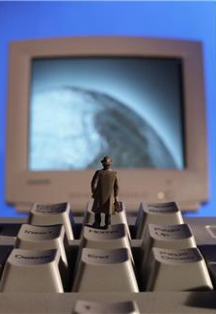
Business-Driven Information Systems
Learning
Outcome
Porter’s Five Forces Model
  An external analysis of industry forces impacting on the organization
  IS collects, process and reports Environmental Scan information
  IS provides the technology to support strategies to limit the threat of the forces
Three Generic Strategies
  The strategic decision a company can make in about its business focus
  IS can run simulations and models of possible alternatives updated in real time
1.5
Notes:
Ask students to consider what activities they did before coming to class and create a list of about 6. Ask them what they used to complete the activities. For the technology tools ask what information the technology provided and what they would have done without that information. For example, many people wake with the radio turning on and listen to the weather so that they know what to wear.

Slide 37

Business-Driven Information Systems
Learning
Outcome
The Value Chain
  An internal analysis that helps a business optimize the value from its functions
  IS integrates the functions by enabling critical data/information sharing
Business-Driven Information Systems
  Information Systems developed to support a business’s competitive strategy
  Business strategy drives information systems design and choices
1.5
Notes:
Ask students if any of them felt pressured to buy the latest in cell phones but with features they never use. How do they feel about having to pay for technology that doesn’t support their needs? How would shareholders feel if companies they invested in spent their money purchasing expensive IT equipment to make them appear up-to-date but didn’t need. More and more shareholders are demanding IS audits to ensure that business strategy is driving technology, not the other way around.

Slide 38
Opening Case Questions: Information Technology Helps LCBO Transform
Which of Porter’s Five Forces is the LCBO trying to use to establish and maintain its competitive advantage?
What does the LCBO’s primary value chain look like, using specific examples of its value chain to describe it?
Which of the three generic strategies is the LCBO using?
How does the fact that the LCBO is a monopoly affect its use of Porter’s Five Forces? Its use of the Three Generic Strategies?
Notes:
5. Which of Porter’s Five Forces is the LCBO trying to use to establish and maintain its competitive advantage?
The answers will be interesting depending on whether the students understand that the LCBO is a government organization with a near monopoly on liquor sales in Ontario. It does have some private competition in wine sales, which sees it dealing with the bargaining power of buyers with the creation of vintages.com. Even as a near monopoly it must also consider the threat of substitutes.
6. What does the LCBO’s primary value chain look like, using specific examples of its value chain to describe it?
Liquor Distributors >> Warehousing >> Business Channels >> Ontario Bars, Hotels and Resellers
>> Retail Channels>>Consumers
7. Which of the three generic strategies is the LCBO using?
The LCBO is using a focused strategy with it wines sales as it has the most competition in the wine market but it is a narrow market. In the hard liquor the LCBO has an monopoly.
8. How does the fact that the LCBO is a monopoly affect its use of Porter’s Five Forces? Its use of the Three Generic Strategies?
The LCBO no longer is not a full monopoly. It does have a monopoly with hard liquor sales but not so with wine and beer. The new processes and channels being offered by the LCBO means that the LCBO is looking at Porter’s Five Forces and his generic strategies in developing its new marketing strategies.

Slide 39
Closing Case One:
Say “Charge It” with Your Mobile Device
Using Porter’s Five Forces describe the barriers to entry for this new technology.
Which of Porter’s three generic strategies is this new technology following?
Describe the value chain of using mobile devices as a payment method.
What types of regulatory issues might occur due to this type of technology?
Notes:
1. Using Porter’s Five Forces describe the barriers to entry for this new technology.
The barriers to entry include the new technology (special chip for the phone) required to support associating a cell phone with a credit card, creating partnerships between the credit card company and the cell phone company, minimizing security issues associated with the technology, and gaining consumer trust. One of the biggest barriers to entry will be convincing cell phone users that the technology is secure. How will lost and stolen cell phone and credit card bills be handled? A person with a stolen cell phone could now purchase all kinds of goods on the credit card. Will this be the consumer’s responsibility? Would you be willing to associate your credit card with your cell phone?
2. Which of Porter’s three generic strategies is this new technology following?
This technology is following a differentiation strategy for a broad market.
3. Describe the value chain of using mobile devices as a payment method.
The value chain approach views an organization as a series of processes, each of which adds value to the product or service for each customer. Using a mobile device as a payment method would add value to the primary value activities because it would become easier for customers to purchase products. When customers simply swipe their phone to pay for a product they are receiving a value-added benefit from this technology.
4. What types of regulatory issues might occur due to this type of technology?
Typical credit card regulatory issues would most likely be enforced to cell phone spending such as not being allowed to purchase illegal goods such as gambling (lottery tickets) on credit, cigarettes under the age of 18, or alcohol under the age of 21. Punishment for using a stolen cell phone to purchase goods would be enforced by law. There might even be spending limits on cell phone purchases similar to the limit on ATM cards to only $400 a day withdrawals.

Slide 40
CLOSING CASE TWO
Innovative Business Managers
Choose one of the companies listed above and explain how it could use a CIO, CTO, and CPO to improve business.
Why is it important for all of G Adventures’ functional business areas to work together? Provide an example of what might happen if the G Adventures’ marketing department failed to work with its sales department.
Why are information systems important to an organization like G Adventures?
Notes:
1. Choose one of the companies listed above and explain how it could use a CIO, CTO, and CPO to improve business.
Chief Information Officer (CIO) oversees all uses of IS and ensures the strategic alignment of IS with business goals and objectives.
Chief Technology Officer (CTO) is responsible for ensuring the throughput, speed, accuracy, availability, and reliability of IS.
Chief Security Officer (CSO) is responsible for ensuring the security of IS system.
Chief Privacy Officer (CPO) is responsible for ensuring the ethical and legal use of information.
Chief Knowledge Office (CKO) is responsible for collecting, maintaining, and distributing the organization’s knowledge.
Answers to this question will vary. The important part of the answer is the student’s justification as to why the company will achieve business success through the use of a CIO, CTO, or CPO.
2. Why is it important for all of G Adventures’ functional business areas to work together? Provide an example of what might happen if the G Adventures marketing department failed to work with its sales department.
If the functional business areas of an organization do not work together the business will remain as siloes and gaining an enterprise-wide view of the organization would be impossible. Sales must work with marketing to determine which incentives and discounts should be offered. Accounting must work with finance to make solid strategic decisions. MIS must work to support all of the departments across the organization.
Sales is the function of selling a good or service and focuses on increasing customer sales, which increases company revenues. A salesperson has the main activity of selling a product or service. Many industries require a license before a salesperson can sell the products, such as real estate, insurance, and securities.
Marketing is the process associated with promoting the sale of goods or services. The marketing department supports the sales department by creating promotions that help sell the company’s products. Marketing communications seek to build product or service awareness and to educate potential consumers on the product or service.
If sales and marketing failed to communicate and work together the marketing department might develop products and discounts that did not correlate to what was occurring in the field and what the salespersons were actually selling. Sales might sell products that are not developed or offer discounts that are too low causing the firm to lose money. At G Adventure, the marketing department could market an adventure trip that the sales department had not heard about and was unprepared to sell. This could include marketing a tour in a remote destination without having negotiated the aspects of the tour with local providers like hotels and local guides or even the local government.
3. Why are information systems important to an organization like G Adventures?
Every organization needs information to remain successful. Without information the company would have a difficult time understanding its clients, competitors, and business success and failures. G Adventures is a business and just like any other business it requires information to keep it running. As more and more tour operators offer customers a new experience, such as locations and activities, market share is maturing and possibly beginning to decline. It must find new ways of attracting and keeping customers. Updating customers through MP3 files on various locations or activities is one way it could use a new type of technology to help grow its business.

Slide 41
Closing Case Two
Innovative Business Managers
Which of Porter’s Five Forces is most important to Nike’s business?
Which of the three generic strategies is PepsiCo following? Which strategy is TransForce following?
Explain the value chain and how a company like GE can use it to improve operations.
Notes:
4. Which of Porter’s Five Forces is most important to Nike’s business?
All of Porter’s Five Forces are important to Nike’s business so answers to this question will vary. The important part of the answer is the student’s justification as to why the force is important to Nike’s business.
5. Which of the three generic strategies is PepsiCo following?
PepsiCo is following a broad differentiation strategy.
6. Explain the value chain and how a company like GE can use it to improve operations.
A business process is a standardized set of activities that accomplish a specific task, such as processing a customer’s order. To evaluate the effectiveness of its business processes, an organization can use Michael Porter’s value chain approach. An organization creates value by performing a series of activities that Porter identified as the value chain. The value chain approach views an organization as a series of processes, each of which adds value to the product or service for each customer. To create a competitive advantage, the value chain must enable the organization to provide unique value to its customers. In addition to the firm’s own value-creating activities, the firm operates in a value system of vertical activities including those of upstream suppliers and downstream channel members. To achieve a competitive advantage, the firm must perform one or more value-creating activities in a way that creates more overall value than do competitors. Added value is created through lower costs or superior benefits to the consumer (differentiation). GE can use the value chain to create best-in-class processes giving it a competitive advantage over its competition.

Slide 42
Closing Case Three
Capitalizing on the iPod
Do you agree or disagree that Apple’s iTunes, iPhone apps, and iPad apps give the company a competitive advantage? Be sure to justify your answer.
Why are data, information, business intelligence, and knowledge important to Apple? Give an example of each type in relation to the iPad.
Analyze Apple using Porter’s Five Forces Model.
Notes:
1. Do you agree or disagree that Apple’s iTunes, iPhone apps, and iPad apps give the company a competitive advantage. Be sure to justify your answer.
One of the main factors that brought Apple back from near oblivion was its ability to produce, market, and sell IT products such as the iPod, iPhone, and customer developed applications. If Apple’s top executives did not have the foresight to view the MP3 players as a competitive advantage, then chances are the company would not have made a strong comeback in the highly competitive electronics market.
2. Why are data, information, business intelligence, and knowledge important to Apple? Give an example of each type in relation to the iPad.
Data are raw facts that describe the characteristics of an event or object. Before the information age, managers manually collected and analyzed data, a time-consuming and complicated task without which they would have little insight into how to run their business. Lacking data, managers often found themselves making business decisions about how many products to make, how much material to order, or how many employees to hire based on intuition or gut feelings. In the information age, successful managers compile, analyze, and comprehend massive amounts of data daily, which helps them make more successful business decisions.
Examples include: Sales date, Quantity sold, Cost, Sales price, Total profit, Shipping address, Customer address, Wireless type, Memory amount, Color.
Information is data converted into a meaningful and useful context. Having the right information at the right moment in time can be worth a fortune. Having the wrong information at the right moment; or the right information at the wrong moment can be disastrous. The truth about information is that its value is only as good as the people who use it. People using the same information can make different decisions depending on how they interpret or analyze the information. Thus information has value only insofar as the people using it do as well. Information would include:
How many iPads did the average customer purchase?
What day of the week are the most iPads sold?
What part of the country were the most iPads sold?
What was the best selling store?
How many applications did the average iPad customer purchase?
Business intelligence (BI) is information collected from multiple sources such as suppliers, customers, competitors, partners, and industries that analyzes patterns, trends, and relationships for strategic decision making. BI manipulates multiple variables and in some cases even hundreds of variables including such items as interest rates, weather conditions, and even gas prices. For instance, BI can predict inventory requirements for a business for the week before the Super Bowl if, say, the home team is playing, average temperature is above 80 degrees, and the stock market is performing well. This is BI at its finest, incorporating all types of internal and external variables to anticipate business performance. BI would include:
What impact does the stock market have on iPad sales?
What impact does the business quarter have on iPad sales?
What industries are purchasing the most iPads?
What industries are purchasing the least iPads?
Knowledge includes the skills, experience, and expertise, coupled with information and intelligence that creates a person’s intellectual resources. Knowledge workers are individuals valued for their ability to interpret and analyze information. Today’s workers are commonly referred to as knowledge workers and they use BI along with personal experience to make decisions based on both information and intuition, a valuable resource for any company. Examples of knowledge would include:
Who is the best analyst to fix iPad issues concerning calendar functions?
Who is the best analyst to fix iPad issues concerning email issues?
Which resources are the main points of contact for customer developed application issues?
3. Analyze Apple using Porter’s Five Forces Model.
Apple’s buyer power was low when it first introduced the iPod since it was first to market with the product. Now, there are many competitors to Apple’s iPod and its buyer power is increasing since customers can choose from many different manufacturers of MP3 players. Apple’s supplier power was high and now it is decreasing since buyers have many choices of whom to buy from. Apple can use environmental scanning, or the acquisition and analysis of events and trends in the environment external to an organization, to analyze rivalry. Apple can use environmental scanning to analyze everything from competitor strategies to understanding new and shifting market trends to determining the strategic placement of Apple stores. Without watching its environment and understanding what its competitors are doing and where the market is headed, Apple will have a difficult time setting its strategic direction, as Steve Jobs determined when he thought he had missed the MP3 bandwagon.

Slide 43
Closing Case Three
Capitalizing on the iPod
Which of the three generic strategies is Apple following?
Which of Porter’s five forces did Apple address through its introduction of the iPhone?
Notes:
4. Which of the three generic strategies is Apple following?
Apple has a focused strategy.
5. Which of Porter’s five forces did Apple address through its introduction of the iPhone?
Apple decreased the power of its buyers and increased its own supplier power by introducing the iPhone. Since the iPhone was the first to market with an internet access, data storage, MP3 player, etc., its buyers had no power and no choice but to purchase the product from Apple. Unfortunately, Apple could not create an entry barrier and soon many other companies began offering integrated cell phones, which increased buyer power and reduced supplier power.

