Slide 1
Social Marketing & Tailoring (p.197-208)
Darcie Hill
Notes:
Health Communication

Slide 2
Taking Health Communication to the Next Level
Upstream:
environment level,
policy makers,
social & physical determinants
Definition: Social Marketing is a process that uses marketing principles and techniques to influence target audience behaviors that will benefit society and the individual.
Midstream:
family, friends, influential others
Downstream:
primary audience aka individuals
Notes:
Social marketing’s role does not stop with the individual whose health behavior it the focus; it can and should target the social and physical determinants of those behaviors

Slide 3
Strengths of Social Marketing Interventions
Cost-effective
Audience-driven (consumer-oriented)
Utilizes communication channels
Promote an environment of change
Empowerment of communities
Based on extensive formative research
Notes:
- Ability to change social norms, health behaviors & promote an environment of change
- Formative Research- learning the customer’s current behavior, what enables it and what reinforces it

Slide 4
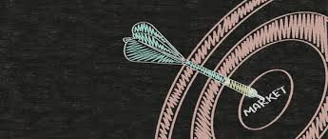
Debunk Misconceptions of Social Marketing
Social marketing relies on advertising
Truth: Social marketers use an integrated marketing mix
Social marketing “blames the victim”
Truth: Target the environment and policy makers
Social marketing is manipulative
Truth: Develop affordable and accessible products so people can take control; create a supportive environment for change
Truth: Enable the audience to become partners
(Grier & Bryant, 2005)
Notes:
Truth or Myth?

Slide 5
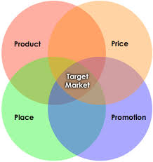
What exactly is social marketing?
The Marketing Mix
Social Marketing involves a mix of elements that must integrate and work together toward achieving the desired outcome– influencing behavior.
Notes:
These element should include the Marketing Mix
The 4 P’s: Product, Price, Place, Promotion

Slide 6
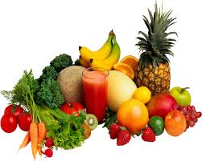
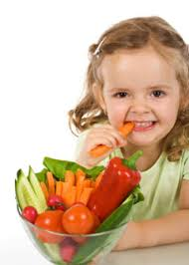
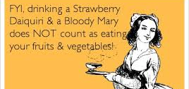
Product
Tangible: actual product, program, or service
Intangible: behavioral practices, change in attitudes, beliefs, or ideas
When designing a product: know perceptions of the target audience
Product Design Theories: Diffusion Theory (trialability, compatibility, relative advantage), Stages of Change (TTM), Value- Expectancy (TRA)
Notes:
Tangible: actual product (e.g. fruits and vegetables), program (e.g. interactive app), or service (e.g. meeting with a dietician)
Intangible: behavioral practices (e.g. eating 5 servings of fruit & veg a day), or a change in attitudes, beliefs, or ideas
When designing a product: know perceptions of the target audience regarding the problem being addressed & whether the product may be an adequate solution
- Diffusion Theory- marketer should consider:
Trialability- minimal cost/commitment to try it
Compatibility- suitable for cultural values & norms
Relative advantage- overall improvement
Stages of Change (TTM)- matching product characteristics to the different stages of the target audience.
Value-Expectancy (TRA)- consider pros and cons underlying attitude toward the behavior

Slide 7
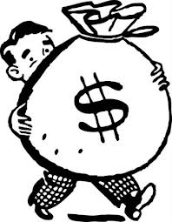
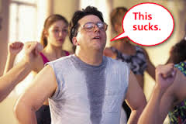
Price
Monetary costs: $
Psychological/Social costs:
Examples: loss of time, fear, embarrassment, physical exertion, being ostracized
Goal for marketers:
minimize cost, maximize value
Use SCT to inform price: cost/benefit, small goals, self-efficacy, expectancies (value)

Slide 8
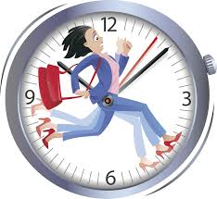
Place- the where & when
Definition: the different channels used to get the product to the audience
Physical location
Media channel
Marketer needs to consider accessibility
Activities & habits of the target audience
Notes:
Physical location → EX: health clinic, retail store, school, mall
Media channel → EX: TV, radio ad, internet, app
Marketer needs to consider accessibility—the function of the product
Research: activities & habits of the target audience, their experience & satisfaction with current delivery system

Slide 9
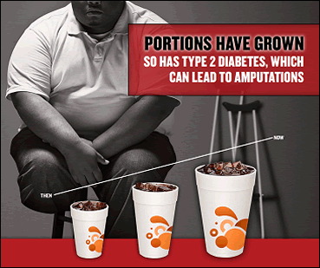
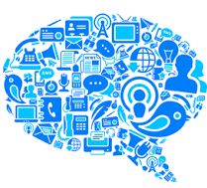
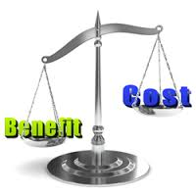
Promotion
Integrated use of different channels to inform, persuade, and influence beliefs and behaviors relevant to the product.
Goal: to create demand for the product
Theories that inform this step: value-expectancy theories (TRA), SCT, Protection Motivation Theory
Benefits > Costs
Reason to pay attention
EX: “doctors recommend”
“people like you do it”
Perceived threat
Notes:
- Integrated use of different channels to get the word out and promote the product
- EX: media events, PSA, DVDs, swag, advertising, public relations, direct mail campaigns, editorials, point-of-purchase programs

Slide 10
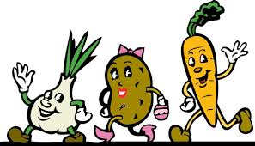
Applied Example of Marketing Mix Strategy
“We want adolescence aged 13-18 to see that eating five servings of fruits and vegetables a day is healthy and more beneficial than eating ‘junk food’.”
Behaviors such as eating 5 servings of fruits and veggies a day, or choosing an apple instead of a snickers as a snack, creating an interactive app with incentives for teens to play
Costs- cost of healthy food, loss of pleasure from ‘junk food’, cost of an app. Benefits- feel better, healthy food actually taste good, app: coupons, push-notifications, recipes
Websites, billboards at school, posters at grocery store locations, anywhere with wifi or mobile data access
Media channels, community outreach, collaborating with grocery stores to provide coupons/specials at their store, posters, logo/slogan
Product:
Price:
Place:
Promotion:
Notes:
- I’m going to need all of your help on this one. We are working as a team here to promote our goal
- We can think of this goal in general and in terms of using an interactive app that teens can download and play: creating their own avatar, recording food intake and playing games/specific tasks, motivation of reaching new levels to unlock recipes, congratulatory push-notifications, etc.

Slide 11
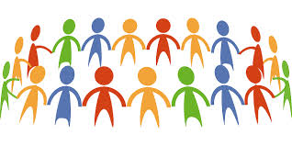
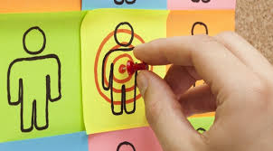
Message Targeting vs. Tailored Communications
Message Targeting: group level
Tailored Communications: individual level
Targeting & tailoring can be thought of on a continuum: mass audience ←→ targeting ←→ tailoring
Notes:
When to use tailoring over targeting?
- If the extra burden of assessing individuals is worth the payoff in terms of program impact (i.e. attitude/behavior change)
- If NOT targeting practices are easier to implement and more cost effective

Slide 12
Tailoring Communications
Message tailoring recognizes the mismatch between a message designed for an entire group and some members of that group.
Informed by individualized messages from stage-based theories (TTM)
Tailoring put into Practice:
Step 1: Assessment- general information, stage of change, attitude toward the behavior, self-efficacy to quit
Step 2: Feedback- computerized messages that are most appropriate for an individual based on assessment
Notes:
Most advertising utilizes group-targeting, but some have recognized this mismatch and begun using individualized communication
- Stage based theories- Transtheoretical Model of Change, Health Belief Model, SCT
They are sensitive to where individuals are on those theoretical constructs, and this responsive feedback adds to the efficiency of the intervention.
Dual advantage of tailoring combined with easy dissemination, thereby magnifying the effect size
- Example: Intervention for heterosexually active African Americans by Noar et al. (2011)- Tailored Information Program for Safer Sex (TIPSS)
Above cutoff- individuals scored adequately on the construct
Below cutoff- individuals have a deficit on that construct

Slide 13
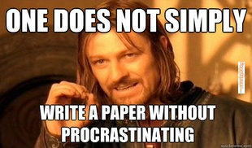
EX: Precontemplation for Writing Flayper #3
Theoretical Concept | Messages
Stage of Change | You told us that you don’t start writing your paper until the day before it is due.
Attitudes (pros): above cutoff | You told us that you recognize some benefit to starting your paper a week before it’s due. That’s great! For a minute think about the benefits of the early start: No all-nighters, less stress, & a better grade.
Attitudes (pros): below cutoff | You told us that there is no way you are starting your paper a week before it’s due. For a minute, think about the benefits of getting an early start. Click on the items below to learn more: 1. You won’t have to pull an all-nighter 2. Your stress level will be reduced 3. You will get a better grade
Notes:
You can think of this example of tailoring communication to an overall behavior: studying/writing papers/success in school/etc. However, since it is all relevant to us this term, let’s look at an example of a student who is in the precontemplation stage for writing Flayper #3.

Slide 14
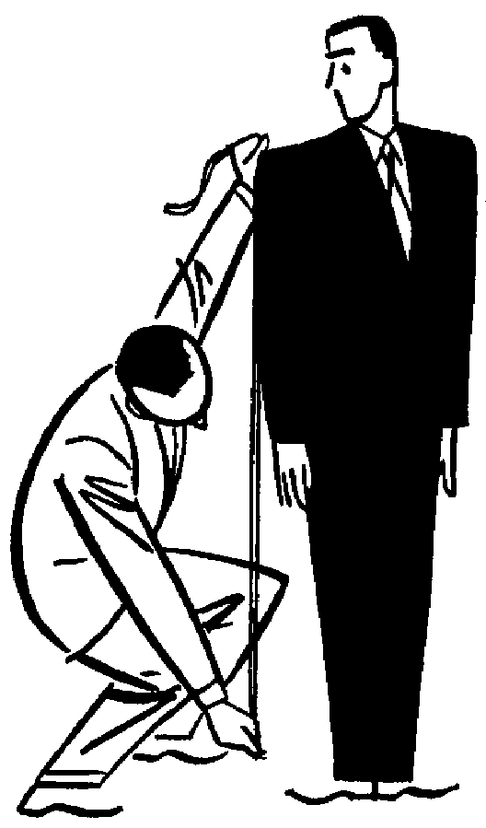
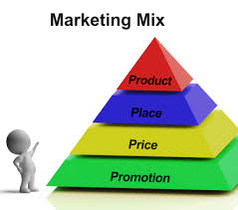
Questions?
Just the right fit!
Notes:
Any questions about the 4P’s or Tailoring Communications?

