Slide 1
The Social Media Piece of the Social Marketing Pie
2016 Office of Special Education Programs Project Directors’ Conference
August 2016
Alicia Eberl-Lefko, M.H.S., CHES
Principal Communications Specialist
Practice Area Director for Public Health

Slide 2
Defining Social Marketing Versus Integrated Marketing Versus Social Media
Social Marketing
Using commercial marketing techniques for behavior and/or social change (e.g., a stop smoking campaign).
Integrated Marketing
Employing a variety of coordinated marketing strategies in concert with each other (e.g., paid advertising, earned media, promotional materials, social media).
Social Media
Promoting online social interactions using tools such as Facebook, Twitter, Instagram, Pinterest, Snapchat, and other platforms.
Usually an element of a broader social marketing and/or integrated marketing strategy—a “piece of the pie.”

Slide 3
Why Does the Terminology Matter?
Your broader social marketing strategy is everything.
What is the larger goal or behavior change you are trying to achieve?
Who are your audiences? Where do they live, work, and play?
What are all the marketing and outreach strategies you are planning on using?
Now, how does social media fit?
How does social media relate to the other strategies? What does social media get you that is different or complementary?
Who are you trying to reach? What platforms are they on? How do they use social media?
How does social media enhance or tie into other marketing strategies?

Slide 4
Start With the Goals
What is the goal of your social media effort?
Grow your following and awareness (e.g., increase the number of people “liking” your Facebook page or following you on Twitter).
Increase engagement with your audience (e.g., replies to posts, reposts, or Tweets).
Get people to take an action (e.g., get an HIV test).
Drive people to other resources (e.g., webpages).
Analytics measure your progress toward goals and help refine your tactics for maximum impact.

Slide 5
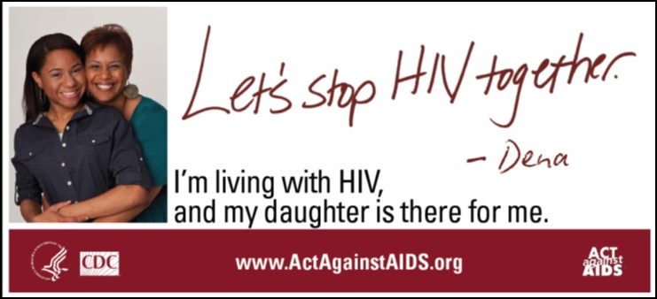
Act Against AIDS: A Case Study
Lead federal HIV social marketing initiative
Launched by Centers for Disease Control and Prevention and the White House in 2009
Objectives include increasing awareness of all Americans about HIV prevention, encouraging HIV testing and treatment, and decreasing stigma.
Audience-specific campaigns (e.g., general public, Hispanics/Latinos, gay and bisexual men)
Full-spectrum, research-based intervention
Integrated marketing (e.g., website, ads, public service announcements, earned media, social media)
Partnership development
Community outreach and events

Slide 6
Act Against AIDS Social Media: The Facts
Facebook—159,000+ followers
Twitter—27,000+ followers
Instagram—2,000+ followers
Other Social Media Efforts
Pinterest
Blogger Outreach
Mobile Units
Make Your Own App
Thunderclap
E-Newsletter
YouTube

Slide 7
Act Against AIDS: Using Metrics to Refine Your Tactics
Goal: Raise HIV awareness and knowledge by increasing audience engagement.
Tactic: Use quizzes to engage audiences in content.
Challenge: Open-ended Facebook quizzes received few (if any) comments.
Solution: Test posting quizzes using a multiple-choice format and platform polling features.

Slide 8
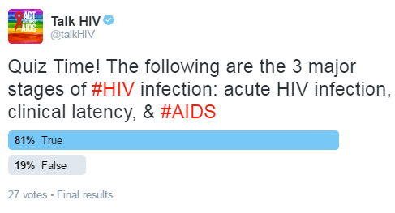
Act Against AIDS: Using Metrics to Refine Your Tactics (cont.)
Month 1 Result: Posting a quiz on Twitter using its multiple-choice polling feature = 27 responses.
Month 2 Results:
Two Facebook polls in multiple-choice format = 30 responses
Those posts received the second- and third-most comments of all posts that month.
The page earned 30% more comments that month than average.

Slide 9
Act Against AIDS: Trends in Metrics Matter
Analytics tools offer real-time feedback on how your content is performing with your audience.
Dashboards help visualize how your content is performing.
Looking at the “big picture” can help you understand the highs and lows in your content performance.
Social media metrics can provide clues to the performance of other marketing channels and even behavior change.

Slide 10
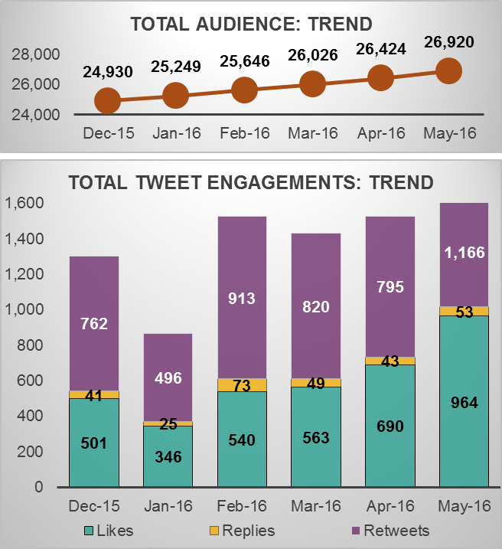
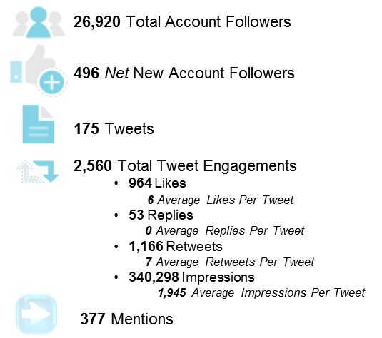
Act Against AIDS: Sample Analytics Report
Key Findings: Twitter
Total tweet engagements increased for @talkHIV, driven by a 102% increase in total likes, a 65% increase in total retweets, and a 9% increase in total replies, compared with the historical averages. The tweets that received the most likes and retweets focused on HIV Vaccine Awareness Day (May 18), testing for individuals aged 13 to 64, and Harvey Milk Day (May 22).
May 2016 Social Media Report | Act Against AIDS

Slide 11
Alicia Eberl-Lefko, M.H.S., CHES
301-592-2175
aeberl-lefko@air.org
6003 Executive Blvd., Suite 3000
Rockville, MD 20852-3880
General Information: 301-592-8600
www.air.org

