Slide 1
Community Based Social Marketing
Shannon Judd
Greening Tribal Facilities Training
Tulsa, OK October 20-22, 2015

Slide 2
What are your barriers?
Think about something you know or believe you should do, but you don’t at this time?
What is preventing you from doing it?

Slide 3
Overview
What is Community Based Social Marketing?
Information vs. Action
Steps in conducting a Community Based Social Marketing Project
Fond du Lac Tribal College Example

Slide 4
What is Community Based Social Marketing??
Approaching projects based on barriers and motivations of individuals to doing a behavior
Founded by Doug MacKenzie-Moore
Acknowledges the concept that one’s attitude or belief are not always reflected in their actual behavior
Encompasses a variety of methods to address one’s barriers and motivations in order to change behavior

Slide 5
“Behavior change is the cornerstone of sustainability.”
Significant challenges exist to making a community sustainable.
Technologies and other options only work if people use them.
Only providing information on an issue is rarely successful.
People do change their behaviors when the benefit to them outweighs the barrier.
(Doug McKenzie-Mohr, www.cbsm.com, 2014)

Slide 6
Examples of Information-Intensive Outreach
Radio
Television
Internet
Newsprint
Flyers
Brochures
Notes:
Environmental psychologists refer to conventional programs as “information intensive”. These information intensive programs rely solely on the distribution of information through radio, television, the internet, or newsprint as their way of promoting changes in behaviour.

Slide 7
Information-Intensive Outreach
Based on following ideas:
People’s attitudes will be reflected in their behavior
People will act on something based on Economic Self-Interest
Notes:
Information intensive programs tend to be based on one of two models of behaviour change: The attitude-behaviour change approach or the economic self-interest approach.

Slide 8
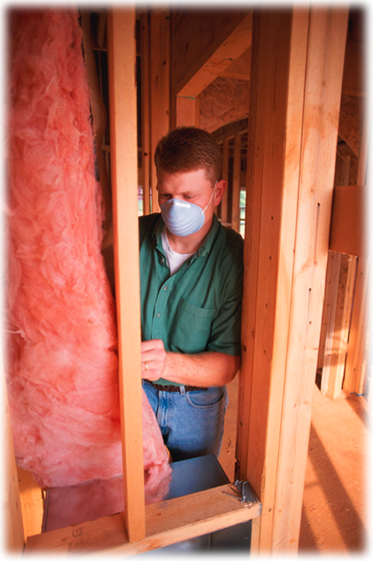
Attitude-Behavior Example
Energy Efficiency Workshop
Attitudes and Knowledge
Evaluation
  1 of 40 Lowered HHW
  2 of 40 Installed Wrap
  8 of 40 Installed Showerhead
(Doug McKenzie-Mohr, www.cbsm.com, 2014)
Notes:
This is a great case study for showing the inadequacies of information-intensive programs that are based upon the attitude-behaviour change model. Scott Geller organized a three-hour energy-efficiency workshop in which the attendees responded to an advertisement in the local newspaper. Stress that the workshop was three hours in length, which is far longer than we normally get to spend with our target audience, and that they were highly motivated to make their homes energy efficient. Note that Geller measured their energy efficiency attitudes and knowledge before the workshop and afterward. The attendees attitudes and knowledge had shifted substantially as a result of participating in the workshop. As a consequence, the attitude-behaviour change model would predict that their behaviour should as well (make sure that you stress this point as it is the principal point that you are making with this slide). However, when an evaluation was done, only one person had lowered their temperature on their hot water heater, two had put blankets around their hot water heaters (but they had done this before the workshop!), and eight had installed low flow showerheads. I usually stress that number of households who had installed low-flow showerheads is more impressive as it is nearly 25% of participants. I wait till this point has been digested and then let the audience know that everyone was given low-flow showerheads, but only eight installed them.
I would encourage you to build this slide bullet by bullet so that your audience does not see the results until you are ready to show them to them. I would also encourage you to stress that this study sets the “outside boundary” conditions of what we could most hope for -- that is, you are able to spend three hours with the target audience and they are highly motivated.

Slide 9
The Alternative:
Community-Based Social Marketing (CBSM)
Step 1: Selecting the behaviors to be promoted.
Step 2: Identifying the barriers and benefits to an activity.
Step 3: Developing a strategy that utilizes CBSM tools that have been shown to be effective in changing behavior.
Step 4: Piloting the strategy.
Step 5: Evaluating the strategy once it has been
            implemented across a community.
(Doug McKenzie-Mohr, www.cbsm.com, 2014)

Slide 10
Step 1: Selecting Behaviors and Audience
Audience:
Is there a particular group in the population that should be targeted?
Behaviors:
Non-Divisible~ They can’t be divided into further behaviors.
End-State~ Behavior selected should reflect the specific thing you are trying to get them to do.
Notes:
Example of divisible behavior – reduce waste. Need to divide it further…recycle, compost, use reusable items

Slide 11
Rank | Behaviour | GHG (kg/ph/y) | Probability (0 - 4) | Penetration (0 -100%) | Weight
1 | Purchase Green Power | 8700 | 2.15 | 3% | 18143
3 | Cold Water Wash | 450 | 3.09 | 38% | 862
4 | Increase Use of Clothes Line | 200 | 3.07 | 8% | 564
2 | Install 10 CFLs | 700 | 3.03 | 23% | 1633
5 | Install LF Showerhead | 215 | 2.5 | 61% | 209
Notes:
This table makes use of estimations of household reductions in CO2 emissions that are associated with homes in Queensland, Australia engaging in the five behaviors (GHG is being measured in kilograms per household per year). The probability figures come from a random sample of Queensland homes that were surveyed regarding the likelihood of engaging in these and other behaviours. The penetration values are largely made up.
Institute for Sustainable Futures (ISF): University of Technology: Sydney (2008)
Paper: ClimateSmart Home Energy Analysis

Slide 12

Step 2: Identifying Barriers and Benefits
Review relevant articles and studies.
Observe people engaging in both the behavior to be promoted and the behavior to be discouraged.
Use focus groups to get detailed input on key benefits and barriers.
Implement a questionnaire to target audience and
analyze the data.

Slide 13
Identifying Barriers and Benefits
If limited time and money, consider using intercept questionnaires instead of focus groups and full questionnaires.
    Ask specifically about the barriers and benefits of the behavior.
Identify the most important barriers and benefits to focus resources on.
Barriers are behavior-specific and may vary for different individuals.
Notes:
Make sure you call it a questionnaire!

Slide 14
Step 3: Developing Strategies
Use the information gather in Steps 1 and 2 to develop the pilot project strategy.
Choose CBSM tools based on the identified barriers and benefits.
  Commitment
  Social Norm
  Social Diffusion
  Prompts
  Communication and Messaging
  Incentives
  Convenience

Slide 15
Develop Strategy
Specific Behavior | Barriers | Benefits
Encourage
Discourage
Notes:
See page 42 of FSB

Slide 16
Strategies
Commitments
Prompts
Norms
Social Diffusion
Services or Products
Communication
Incentives/Disincentives
Convenience

Slide 17
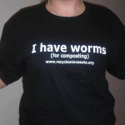
Strategies: Commitments
Can you get people to formally commit to an action? Wear a button? Post a sticker on their car, bins, house, office? Sign a poster or wall?
Public vs. Written Commitments
Group Commitments
Involvement
Must be voluntary!
Tshirt: Recycling Association of Minnesota Store

Slide 18
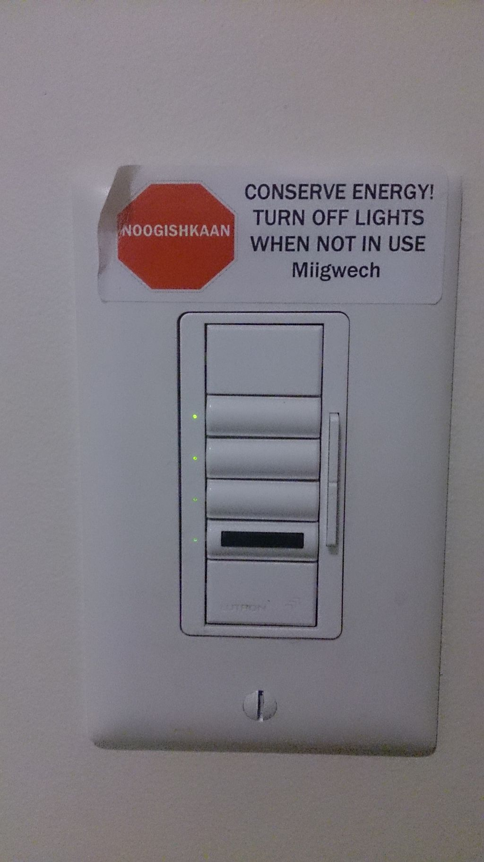
Strategies: Prompts
Some People Just Need Reminders!
Opportunities for prompts:
  Signage, stickers
  Reminders sent via text, social media, etc.
  Announcements over loudspeaker at appropriate facilities
Focus on what should be done rather than what should not.

Slide 19
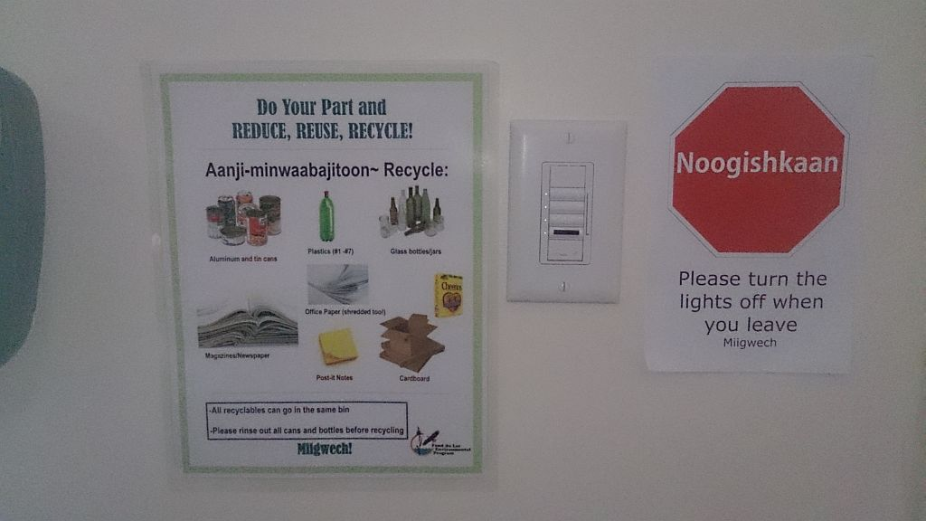
Prompts
Make it noticeable!
Make it self-explanatory
Present prompt close to where they need it!
Again, focus on the positive! What should you do versus what shouldn’t you do.

Slide 20
Social Norms
Develop your project so that the behavior you are targeting can become a social norm
Facilitate community visibility
  Publicize activities and feedback on results of activities
  Some activities are already visible: renewable energy system, curbside recycling or compost bins.
Once a ‘norm’ is established, keep it going
  If you develop a collection program for items, keep it going
Personal contact: Keep in contact with those exhibiting these norms to reinforce them! Talk with those that are not as well!

Slide 21
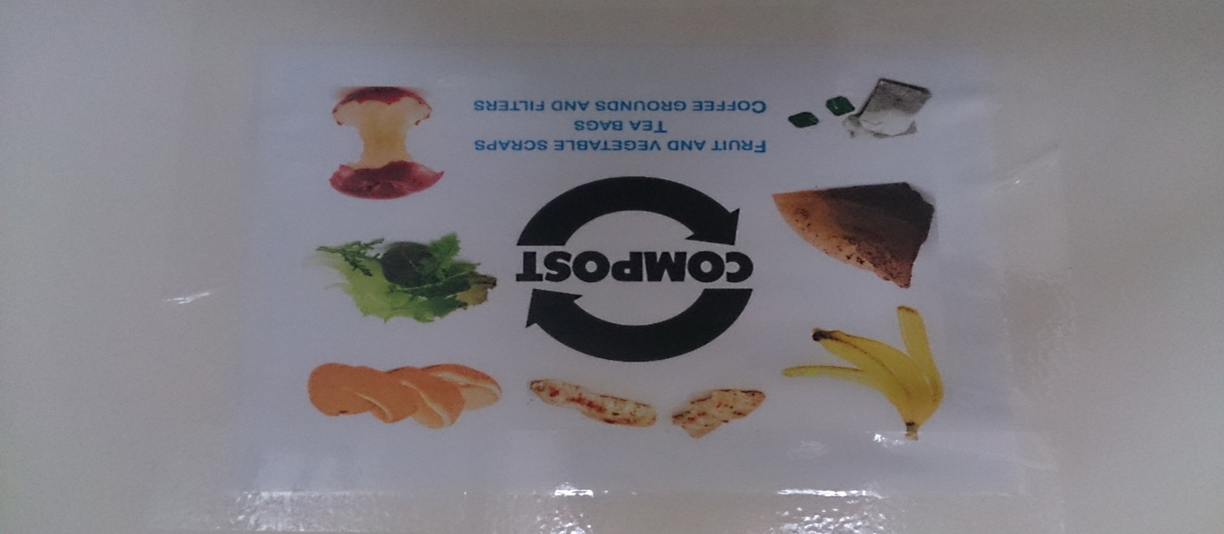
Social Norm Example
Keep momentum going: Once people establish a habit, do not ask them to stop!

Slide 22
Social Diffusion
This strategy is based upon the evidence that people will frequently adopt the same behaviors as others close to them.
Make commitments or actions publicly visible!
If there is no easy way to display one’s actions or commitments, post them on something else!
  Ie…post all commitments or actions on curbside recycling bins.
  Feature the households in a widely-publicized media outlet

Slide 23
Services or Products
Offering new services or products can have a great affect on the public’s willingness to change their behaviors.
Consider maintaining services or products:
  Do you have the resources to continue providing these services or products?
  If services and products are limited to a certain time period or financial threshold, make that known!

Slide 24
Communication and Messaging
Go positive instead of negative…avoid threatening if possible…
Make it memorable!
Provide Targets
Facilitate communication between individuals
Provide Results Feedback

Slide 25
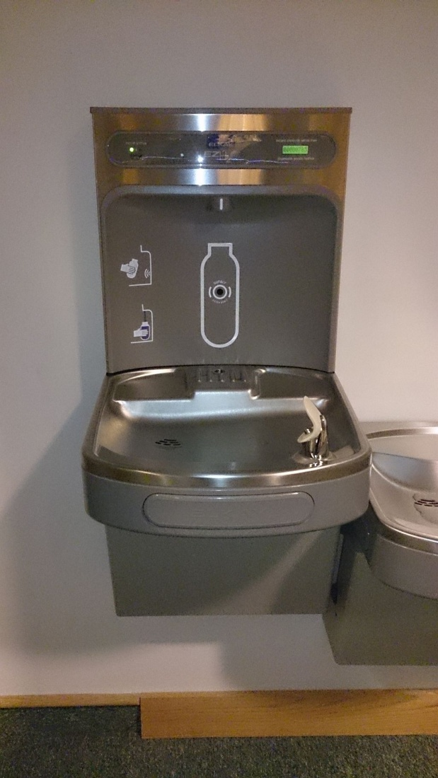
Communication: Removing Barriers and Giving Perspective
Bottle filling stations make it easy to fill water bottles.
Bottle filling stations have a tally at the upper right that counts the number of bottles filled.

Slide 26
Incentives/Disincentives
Can have a high impact on individual or group actions
Pair the incentive with the action!
Devise an incentive that is visible
Be careful!
  How might people try to avoid the incentive?
  Is the incentive temporary?
Notes:
Avoiding incentive – basically not follow through with what they need to do to get the incentive.

Slide 27
Convenience
Besides overcoming individual’s internal barriers, address external barriers.
Using CBSM tools will be less effective if the behavior is inconvenient.
Guidelines:
    Identify, isolate, and address what can be done.
    Study other similar programs to determine the cost-effectiveness of removing the barrier.
    People will see a behavior as more convenient as they gain more experience with it.

Slide 28
Messaging and Communication
Keep it positive, mostly….

Slide 29


Notes:
See pages 50-51 of FSB

Slide 30
Example message: Turn it positive
No
Smoking

Slide 31
Example Message: Turn it positive
Miigwech for
Not
Smoking

Slide 32
Example Message: Turn it Positive
No Dumping
No Littering

Slide 33
Example Messaging: Turn it positive
Ganawenim Gidaakiminaan
Take Care of the Earth
Please do not litter

Slide 34
Example messaging: Turn it positive
Miigwech for Not Littering

Slide 35
Example Messaging
Miigwech to the Community for Cleaning up this site

Slide 36
Example Messaging: Turn it positive
It is illegal not to recycle!

Slide 37
Example Messaging: Turn it positive
Do your part to protect resources for future generations: recycle.

Slide 38
Exception to “Positive Messaging”
Financial Gain vs. Loss
  According to studies referenced by Doug McKenzie Moore, a study was conducted that showed it was more effective to tell people how much they would lose by not doing energy improvement project vs. telling them how much they could save.

Slide 39
Strategy Table from “Fostering Sustainable Behavior, p. 132
Barriers | Strategies
Lack of Motivation | Commitment, Norms, Incentives
Forget | Prompts
Lack of Social Pressure | Norms
Lack of Knowledge | Communication, Social Diffusion
Inconvenient | Change program structure

Slide 40
Step 4: Piloting the Strategy
Pilot the strategy in a small portion of the community.
    Troubleshoot any issues before broad implementation.
    If necessary, test out different methods and refine the program until effective.
Use random and independent sampling with both a control and a test group.
Focus on measuring behavior changes.

Slide 41
Step 5: Implementing and Evaluating
Collect baseline info on current level of behavior before implementing the strategy.
Implement the strategy and collect data.
  Use different time intervals to track long-term impact on behavior and provide ongoing evaluation.
Guidelines:
  Use advertising and media to increase awareness of the program.
  Provide feedback on the program’s success to reinforce the behavioral changes made.
  Compile and share your findings.

Slide 42
Fond du Lac Tribal & Community College Community Based Social Market Project
Steps:
  Focus Group held to select priorities and targeted behavior
  Researched projects
  Conducted a waste characterization pre-project
  Developed pre-questionnaire
  Analyzed results and develop pilot project
  Implemented Pilot Project
  Post-Questionnaire
  Targeted Behavior
  Recyling on campus and in dorms
Target Audience
  Students

Slide 43
Pre-Questionnaire Results
Not enough bins around campus and none in dorm
People just do not think to recycle
Too busy to find a recycling bin
Bin openings make it difficult
Preferred signage and bins were identified

Slide 44
Pilot Project
Expanded outreach at staff and student orientation
Ordered bilingual signage and bins based on preferences expressed in the pre-survey and established recycling and trash stations throughout campus
Student workers in charge of collecting recyclables

Slide 45
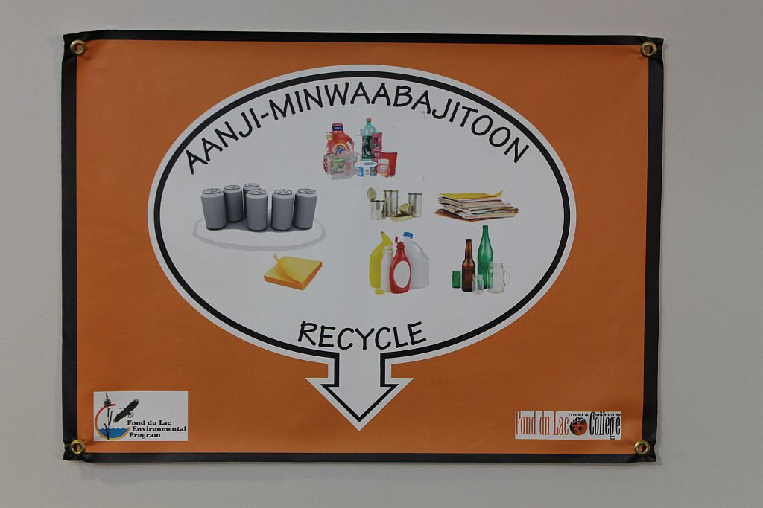
Recycling Sign
Notes:
We tried to include ‘questionable items’

Slide 46
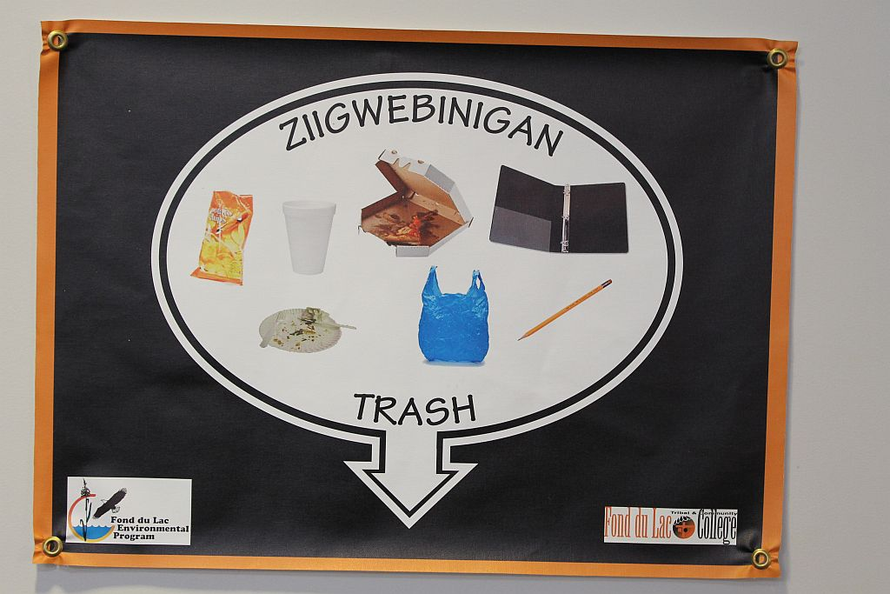
Trash Sign
Notes:
Again, we tried to include questionable items

Slide 47
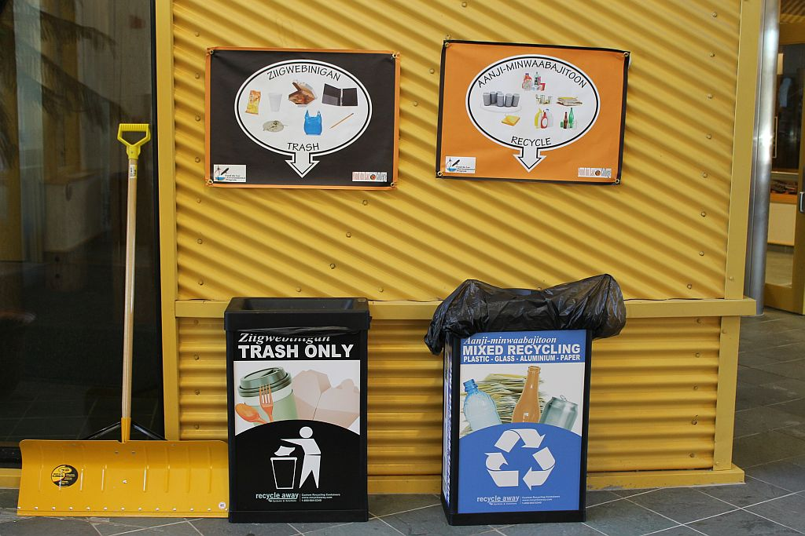
Recycling Station

Slide 48
Comments from post survey
The bilingual signage was appreciated
It’s hard to get into a new habit when you are busy (dorms and campus)
Having more recycling bins than trash cans helped
Pictures on the signs helped decipher what was recyclable and not
Survey:
https://www.surveymonkey.com/results/SM-F8KPDL5L/

Slide 49
Results from Final Waste Sort
Final waste sort was completed approximately two months after the pilot project was started.
Amount of recycling in trash pre-project and post-project was used to gauge project success.
Results were posted during sustainability week in late October.

Slide 50
Improvement in Recycling at FDLTCC
A look into the effects of the new recycling program
Face the Facts:
Recycling one aluminum can saves enough energy to run your television for three hours.
Tossing away an aluminum can wastes as much energy as pouring out half of that can’s volume of gasoline.
Recycling one glass bottle saves enough energy to light a 100-watt light bulb for four hours.
In 2010, $2.8 billion worth of paper was thrown away, enough to cover 26,700 football fields 3 feet deep.
If you laid all the aluminum cans that were recycled in 2010 end to end, they would circle the earth 169 times.
Overview:
A new recycling program has been in effect at FDLTCC since August. New recycling bins with big, straightforward signs were set up to implement better recycling habits from students and faculty. After only 2 months of the program, there was a significant decrease in the amount of recyclables found in the colleges' garbage. Keep up the good work and keep recycling!
% recycling in trash before
% recycling in trash after
Next Steps:
It is important to continue to increase recycling awareness throughout the college, especially in dorms, food service areas, and classrooms where there are a lot recyclables such as plastic bottles and paper.
Commons Conference rooms Offices
The bar graph above displays the comparison of data collected from waste sorts done at FDLTCC in mid May and mid October, 2014. This graph focuses on three main areas the waste came from: the commons, conference rooms, and offices.

Slide 51
Additional Methods for community buy-in
Appeal to the interests and cares of the community
Weave your message into activities that focus on other related interests of the community
  Thirteen Moons Gichi Manidoo Giizis Powwow and Producers Workshop
  Homemade products workshops
Take advantage of regular community gathering locations to engage people.
  Elderly Nutrition Program, Director’s meetings, Schools, Elder’s Advisory Groups, Committees

Slide 53
Resources
Community Based Social Marketing
http://www.cbsm.com
Tools of Change
http://www.toolsofchange.com
Pacific University CBSM Campaign
http://www.aashe.org/files/resources/student-research/2009/Cole2007.pdf
Keep America Beautiful Webinars: www.kab.org
Under Events – Recycling Behavior series.

Slide 54

Personal Action Commitment
What is one thing you will commit to doing in your own life when you leave here?
Notes:
54

Slide 55
Group Activity
Based on a goal identified in Tuesday’s group activity, select an audience and behavior related to that goal.
How would you approach that audience?
Brainstorm potential barriers and motivations that audience may have related to that behavior.
Identify one or two strategies to address those barriers and benefits.
Strategies
  Commitments
  Prompts
  Social Norms
  Social Diffusion
  Services or Products
  Communication
  Incentives/Disincentives
  Convenience

