Slide 1
Competing for
Advantage
CREATING COMPETITIVE ADVANTAGE

Slide 2
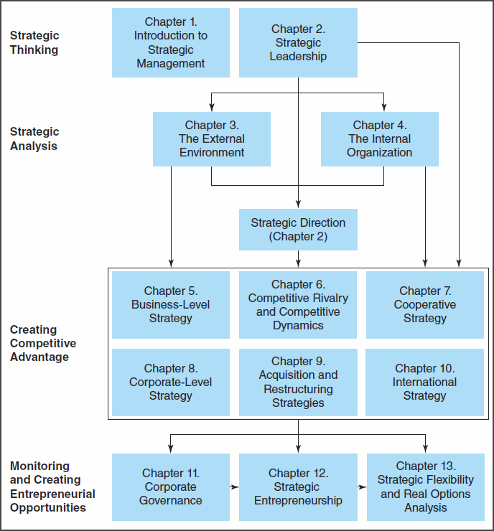
The Strategic Management Process
Notes:
Figure 1.6: The Strategic Management Process – A logical approach for responding to 21st century competitive challenges. Provides an outline of the content of the textbook by each chapter.
Creating Competitive Advantage
Business-level strategy – competitive advantages the firm will use to effectively compete in specific product markets
Competitive rivalry and dynamics – analysis of competitor actions and responses is relevant input for selecting and using specific strategies
Cooperative strategy – an important trend of forming partnerships to share and develop competitive resources
Corporate-level strategy – concerns the businesses in which the company intends to compete and the allocation of resources in diversified organizations
Acquisition and restructuring strategies – primary means used by diversified firms to create corporate-level competitive advantages
International strategy – significant sources of value creation and above-average returns
Strategy is concerned with making choices. The main point of strategy is to help decision makers choose among competing priorities and alternatives facing their firms. The fundamental objective of all strategies is to create value for stakeholders.
Each strategy should specify desired outcomes and how they are to be achieved. Strategies are purposeful, precede action, and demonstrate a shared understanding of the firm’s strategic intent and strategic mission.

Slide 3
Business-Level Strategy
Key Terms
  Business-level strategy
    Integrated and coordinated set of commitments and actions the firm uses to gain a competitive advantage by exploiting core competencies in specific product markets
Notes:
Business-Level Strategy – Five basic approaches combine the scope of an organization's activities in the market (broad or narrow) with the primary source of its competitive advantage (low cost or uniqueness).
In this chapter, the analysis of each of the five basic business-level strategies describes how the effective use of each strategy allows the firm to favorably position itself relative to the five competitive forces in the industry.

Slide 4
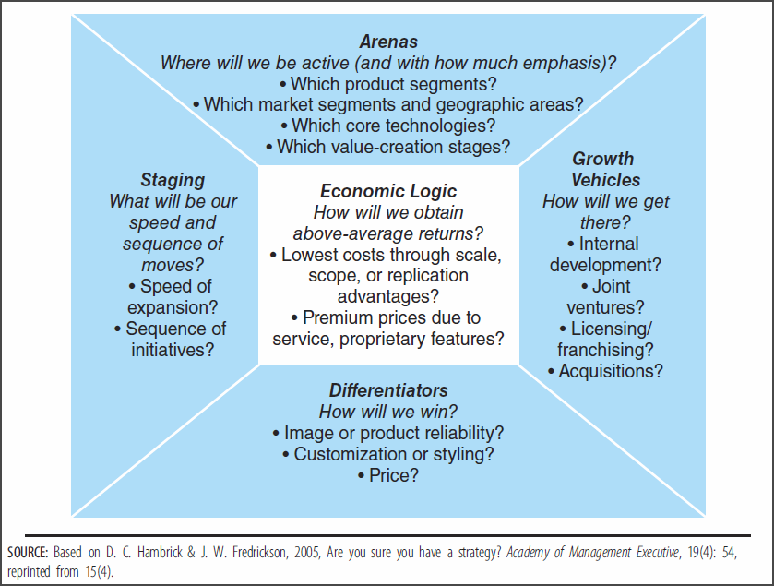
Five Elements of Strategy
Notes:
Figure 2.4: Five Elements that Identify a Firm’s Strategy – revisited from Chapter 2
Business-level strategy should be thought of as the firm’s core strategy in each market or industry.
Discussion points:
Defining the business arenas – critical starting point for strategic planning and management
Commonly used growth vehicles – internal development, joint ventures, licensing, franchising, and acquisitions
Differentiators – help a firm determine how it is expected to win customers in the marketplace
Staging – the timing of strategy and the sequence of moves the firm will take to carry it out (increasingly important because of the speed of change in the competitive environment)
Economic logic – pulls together all of the above elements and focuses on achieving above-average financial returns

Slide 5
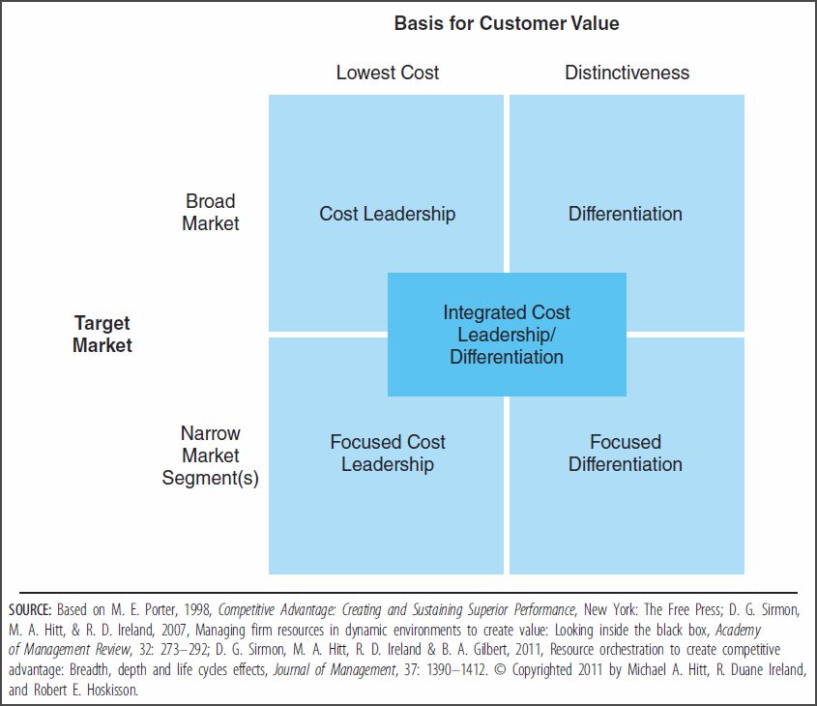
Types of Business-Level Strategy
Notes:
Figure 5.1: Types of Business-Level Strategy – There are five types of “generic” business-level strategies that firms choose among to establish and defend their desired strategic positions against rivals.
Discussion points:
A business-level strategy reflects where and how the firm has an advantage over its rivals.
The firm's business-level strategy is a deliberate choice about how it will perform the value chain activities and support functions in ways that create unique value.
An effectively formulated strategy marshals, integrates, and allocates the firm’s resources, capabilities, and competencies in proper alignment with the external environment.
Sound strategic choices reduce uncertainty, facilitate success, and depend upon continuously-updated competitive advantages to achieve long-term success.

Slide 6
Business-Level Strategy Dimensions
Competitive advantage
  Superior value
Competitive scope
  Target market
Notes:
Features of the Five Business-Level Strategies – The five basic strategies are generic and can be used in any business in any industry. Each business-level strategy helps the firm establish and exploit a competitive advantage within a particular competitive scope.
Discussion points:
None of the five business-level strategies is inherently or universally superior to the others. The effectiveness of each strategy is contingent upon the opportunities and threats in a firm's external environment and the possibilities provided by the firm's unique resources, capabilities, and core competencies.
Regardless of the approach selected, achieving a competitive advantage depends upon offering the customer superior value.
The scope which is selected defines the firm’s intended target market.

Slide 7
Competitive Advantage Dimension
Low Cost
  Efficiency
Differentiation
  Distinctiveness
Integration
  Combined approach
Notes:
Competitive Advantage Dimension – Firms typically select between two distinct forms of competitive advantage (low cost or uniqueness).
Discussion points:
They may choose lower cost than rivals, where the focus is on efficiency.
Or they may choose ability to differentiate and command a premium price relative to the additional cost of differentiating, where the focus is on distinctiveness.
In either case, offering superior value to the customer is required to achieve a competitive advantage.
Firm may elect to develop a combined low cost/differentiation approach to create value for customers in several market segments, but not the whole industry.

Slide 8
Competitive Scope
Dimension
Broad market
  Industry-wide customer base
Narrow market
  Niche customer base
  Focus strategies
Notes:
Competitive Scope Dimension – Selection of the scope (broad or narrow) defines the target market, or the nature and size of the customer group, for the firm.
Discussion points:
Choice determines what customers the firm will use its capabilities to create value for.
Broad scope involves serving multiple customer segments in multiple geographic areas with multiple products.
Narrow scope involves serving one customer segment, geographic region, or product line.
Focus strategies exist within the narrow market approach and can emphasize either low cost or differentiated competitive advantages.
A focus strategy selects a segment or group of segments in the industry and tailors its approach to serving them to the exclusion of others.

Slide 9
Serving Customers
Who will be served
  - market segmentation
What customer needs will be satisfied
  - low cost vs. differentiation
How those needs will be satisfied
  - core competencies
Notes:
Serving Customers – Orientation toward customers is the foundation of all successful business-level strategies. It is necessary to manage all aspects of the firm's relationships with its customers to create superior value, secure customer loyalty, and increase returns. Strategic competitiveness results only when the firm is able to satisfy a group of customers by using its capabilities to compete in individual product markets.
Discussion points:
The most successful companies constantly seek to chart new competitive space in order to serve new customers while finding better ways to satisfy existing customers. Example: Starbuck’s
Customer loyalty is directly related to profitability.
“Winning is not just about closing the sale.” Norm Brodsky, entrepreneur
The art of managing all aspects of customer relationships involves participating in e-commerce.
Competing successfully involves integrating Internet technology with the firm’s strategy, rather than isolating it as a tool.
Example: Amazon
Customer relationships involve answering: who, what, and how.
Who – customers to target for the firm’s goods and services
- Market segmentation is defined on Slide 10.
- Common characteristics on which consumer and industrial customers’ needs vary are outlined in Table 5.1 and on Slide 11.
What – needs of the targeted customer group to satisfy
- Two generalized forms of value
Low cost with acceptable features Example: Walmart
Highly differentiated features with acceptable cost Example: Saks Fifth Avenue
How – manner in which to satisfy customer needs
Addressed through core competencies used to implement value-creating strategies.
Only firms with the capacity to continuously improve, innovate, and upgrade competencies can expect to meet and exceed customer expectations across time. Example: SAS Institute

Slide 10
Who: Determining the Customers to Serve
Key Terms
  Market segmentation
    Process of clustering people with similar needs into individual and identifiable groups to determine which customer segments to target
Notes:
Who: Determining the Customers to Serve – To determine which customers the firm will serve, it must divide them into groups based on differences in customer needs.

Slide 11
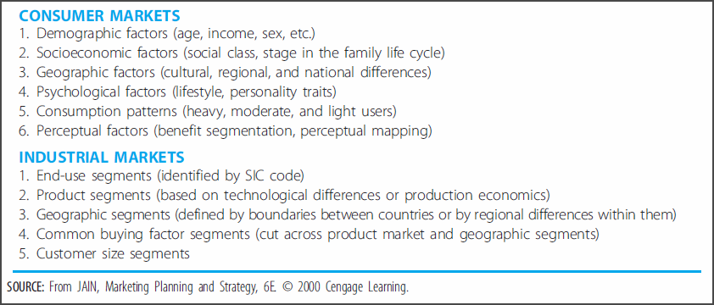
Basis for Customer Segmentation
Notes:
Table 5.1: Basis for Customer Segmentation – factors that aid in segmenting consumer markets based on varying customer needs
Discussion points:
Almost any human or organizational characteristic can be used to subdivide a market into distinct segments.
Selection of target customers as the basis for a business-level strategy must be aligned with the firm’s core competencies and with opportunities in the external environment. Example: Automobile industry

Slide 12
Strategy and Structure
Key Terms
  Organizational structure
    Specifies the firm's formal reporting relationships, procedures, controls, and authority and decision-making processes
Notes:
Strategy and Structure – Reciprocal and influential relationships exist among strategy, organizational structure, and firm performance.
Discussion points:
Developing an organizational structure that will effectively support the firm’s strategy is difficult.
Uncertainty in the global economy and dynamic competitive environments contribute to this difficulty.
Structure should flow from the selection of a business strategy.
Once in place, the structure influences strategic actions and choices for future strategies.
Changes in strategy call for an assessment to determine if the organization has the ability to complete the strategic activities and tasks required of the new strategy and if the structure is consistent with implementation requirements.

Slide 13
Strategy and Structure
Key Terms (cont.)
  Simple structure
    Structure in which the owner-manager makes all major decisions and monitors all activities while the staff serves as an extension of the manager's supervisory authority
  Functional structure
    Structure consisting of a chief executive officer and a limited corporate staff, with functional line managers in dominant organizational areas
  Multidivisional structure
    Structure consisting of operating divisions, each representing a separate business or profit center in which the top corporate officer delegates responsibilities for day-to-day operations and business-unit strategy to division managers
Notes:
Strategy and Structure – Three major types of organizational structures are used to implement strategies.
Discussion points:
Simple structure
Owner-manager typically works in the business on a daily basis
Informal relationships
Few rules
Limited task specialization
Modest information systems
Frequent and informal communications between owner-manager and employees
Functional structure
Evolves from a simple structure as the business expands and becomes more complex
Allows for functional specialization – professional development of functional specialists
Facilitates active sharing of knowledge within functional departments
Can have a negative effect on communication and coordination across functions
CEO must drive decisions and actions to promote the entire firm rather than individual functions
Supports business-level strategies described in this chapter and some corporate-level strategies with low levels of diversification
Multidivisional structure (M-form)
Evolves from a functional structure as the business becomes more diversified
Requires analysis of growing amounts of data and information
Each division represents a distinct, self-contained business with its own functional hierarchy
Supports corporate-level strategies described in Chapter 8

Slide 14
Cost Leadership Strategy
Key Terms
  Cost leadership strategy
    Integrated set of actions designed to produce or deliver goods or services with features that are acceptable to customers at the lowest cost, relative to competitors
Notes:
Cost Leadership Strategy – A strategy of low cost leadership seeks cost advantages while serving a broad customer segment.
Example: Ryanair Holdings

Slide 15
Cost Leadership Strategy – Implementation
No-frills, standardized goods
Acceptable qualities and features
Emphasis on production efficiency
Continuously reduce costs of value chain activities
Notes:
Successful Execution of the Cost Leadership Strategy
Discussion points:
Selling no-frills, standardized goods to the industry’s most typical customer that minimally offer qualities and features acceptable to customers Example: Even lowest cost automobiles must meet minimum standards for safety and include features that all customers expect from automobiles
Use of the value chain analysis to continuously identify ways of reducing the costs of activities in the value chain, while retaining important product/service features

Slide 16
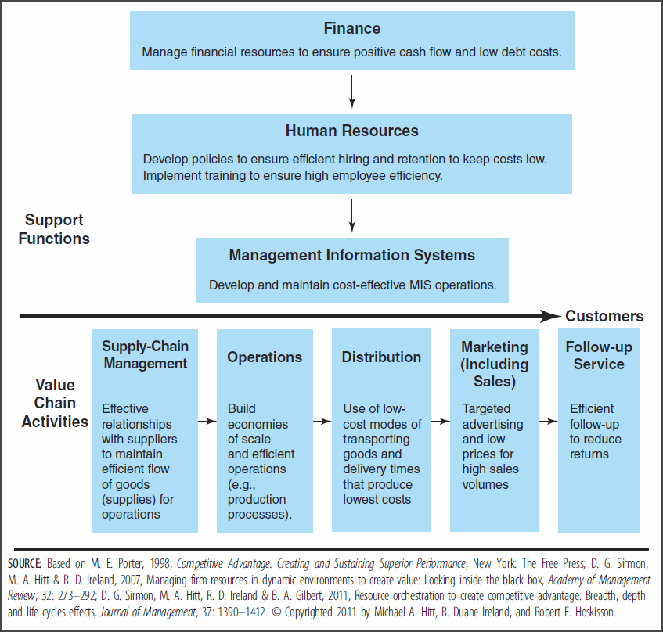
Value-Creating Activities Associated with the Cost Leadership Strategy
Notes:
Figure 5.2: Value-Creating Activities Associated with the Cost Leadership Strategy – value chain activities and support functions that allow a firm to create value through a cost leadership strategy
Discussion points:
If a firm is unable to link the activities shown in Figure 5.2, it probably lacks the resources, capabilities, and core competencies needed to successfully use the cost leadership strategy.
Value chain activities account for a significant portion of the total cost of goods and services.
Research suggests that having a competitive advantage in terms of value chain activities creates more value when using the cost leadership strategy than when using a differentiation strategy.
Support functions should be examined closely to identify additional sources of potential cost reductions.
Management information systems can facilitate successful use of the cost leadership strategy.
Outsourcing has become a common method of reducing costs, often in reaction to competitor moves.
Each of the five forces of competition (model detailed in Chapter 3) can be used to position firms for successful implementation of a cost leadership strategy.
Example: Big Lots, Inc.

Slide 17
Cost Leadership Strategy and the Five Forces of Competition
Low cost position is a valuable defense against rivals.
Powerful customers can demand reduced prices.
Costs leaders can absorb supplier price increases or force suppliers to hold down their prices.
Ever-improving levels of efficiency and cost reduction can be difficult to replicate and serve as a significant entry barrier.
Cost leaders hold an attractive position in terms of product substitutes, with the flexibility to lower prices to retain customers.
Notes:
Cost Leadership Strategy and the Five Forces of Competition – Effective use of the cost leadership strategy allows a firm to create value despite the presence of strong competitive forces described in the five forces model of competition (see Chapter 3). We now turn to how firms are able to do this, examining each of the five forces.
Discussion points:
Rivalry with Existing Competitors – Rivals hesitate to compete on the basis of price. Example: Walmart
Bargaining Power of Buyers (Customers) – Prices can only fall to the point of driving competitors out to of the market, at which point, the power is lost.
Bargaining Power of Suppliers – Cost leader margins exceed competitors’, which makes it possible for them to absorb rising input costs.
Potential Entrants – Only new competitors who are willing to accept below-average returns will enter the market.
Product Substitutes – The value of low cost to the customer reduces the appeal of substitutes. However, at some point, substitute features and characteristics can become so attractive to customers that even lower prices may not incent them to stay with the cost leader’s product.

Slide 18
Using the Functional Organizational Structure to Implement Strategy
Specialization
Centralization
Formalization
Notes:
Using the Functional Structure to Implement the Cost Leadership Strategy – Different forms of the functional organizational structure are used to support implementation of cost leadership, differentiation, and integration strategies. The differences in form are accounted for by the different uses of these three important structural dimensions.
Discussion points:
Specialization – type and number of jobs required to complete work
Centralization – degree to which decision-making authority is retained at higher managerial levels
Formalization – degree to which formal rules and procedures govern work

Slide 19
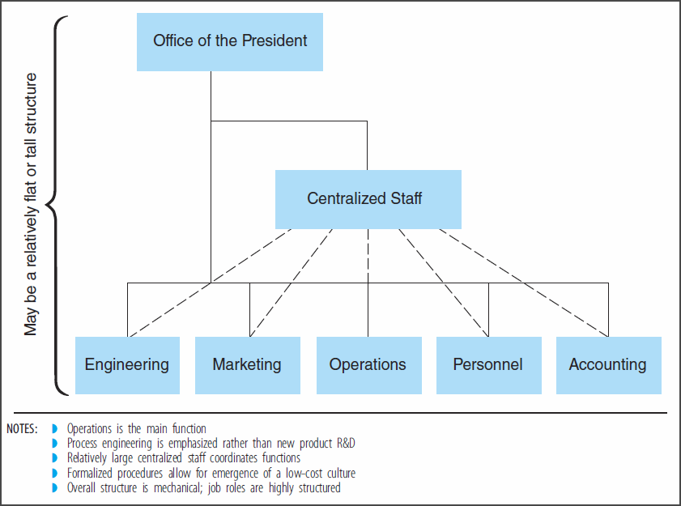
Functional Structure for the Cost Leadership Strategy
Notes:
Figure 5.3: Functional Structure for Implementation of a Cost Leadership Strategy – Firms using the cost leadership strategy want to sell large quantities of standardized products to an industry’s or a segment’s typical customer.
What features characterize the cost leadership form of the functional structure?
Simple reporting relationships
Few layers in the decision-making and authority structure
Centralized corporate staff
Strong focus on process improvements through operational functions
Limited focus on the development of new products through R&D
Low-cost culture in which all employees seek cost reductions
Decision-making authority centralized in a staff function to maintain a cost-reducing emphasis within each organizational function and to ensure that cost cuts in one function do not adversely affect productivity in other functions
Highly specialized jobs, with work divided into homogenous subgroups, to allow increased efficiencies
Highly formalized rules and procedures emanating from a centralized staff who guide the work

Slide 20
Functional Structure for the Cost Leadership Strategy
  Simple reporting relationships
  Few decision-making and authority layers
  Centralized corporate staff
  Strong operational focus on process improvements
  Low-cost culture
  Centralized staff decision-making authority
  Job specialization
  Highly formalized rules and procedures

Slide 21
Competitive Risks of
Cost Leadership Strategy
  Processes can become obsolete
  Focus on cost reductions can be at the expense of understanding customer perceptions and needs
  Strategy can be imitated
  Cost leaders can cut prices too low
Notes:
Competitive Risks of the Cost Leadership Strategy – Some risks exist for firms that select a cost leadership strategy.
Discussion points:
Innovative competitor processes can create lower costs or provide additional distinctions that reduce the value of the cost leader’s processes.
Risk of obsolescence is even greater if the firm outsources major activities, leaving fewer capabilities with which to respond.
Simultaneous focus on competitive levels of differentiation is necessary. Some differentiated features can create value in a low-cost environment. Example: Walmart
Strategy can be learned by competitors, requiring the firm to increase the value offered to retain customers.
Example: Foreign firms in emerging markets
By setting prices at an unrealistically low level, where margins are insufficient over the long term, customer expectations can become difficult to reverse.

Slide 22
Differentiation Strategy
Key Terms
  Differentiation strategy
    Integrated set of actions designed by a firm to produce or deliver goods or services at an acceptable cost that customers perceive as being different in ways that are important to them
Notes:
Differentiation Strategy – A strategy of differentiation also pursues a fairly broad competitive scope while serving a broad customer segment. Through the differentiation strategy, the firm produces non-standardized products for customers who value differentiated features more than they value lowest possible prices.
Example: Nike and Toyota’s Lexus

Slide 23
Differentiation Strategy – Implementation
Target customers who perceive and value differentiated features
Customize products, differentiating on as many features as possible
Notes:
Successful Execution of the Differentiation Strategy
Discussion points:
Differentiators target customers who perceive that value is added by the manner in which the firm's products are differentiated.
The firm must have a thorough understanding of what their target customers value, the relative importance they attach to the satisfaction of different needs, and for what they are willing to pay a premium.
Customers must perceive that the additional cost of a product is offset by the value of its distinct features.
Examples: Ralph Lauren clothing, Caterpillar heavy-duty earth-moving equipment, and McKinsey & Co. consulting services
A firm using the differentiation strategy seeks to be different from its competitors on as many dimensions as possible.
The less similarity between a firm’s goods and its competitors’, the more buffered it is from rival actions.
Firms should also be able to produce their non-standardized products at competitive costs to reduce upward pressure on the price customers pay for them.
The ability to sell goods at prices which substantially exceed the cost of creating differentiated features allows the firm to outperform its rivals.
Use of the value chain analysis can determine if the firm is able to link the activities required to create value and implement a differentiation strategy.
Name some ways that a product can be differentiated.
Unusual features
Responsive customer service
Rapid product innovations
Technological leadership
Perceived prestige and status
Different tastes
Engineering design
Performance

Slide 24
Ways to Differentiate
Unusual features
Responsive customer service
Rapid product innovations
Technological leadership
Perceived prestige and status
Different tastes
Engineering design
Performance
Notes:
Ways to Differentiate – Firms using a differentiation strategy must strive to be different from competitors on as many dimensions as possible.

Slide 25
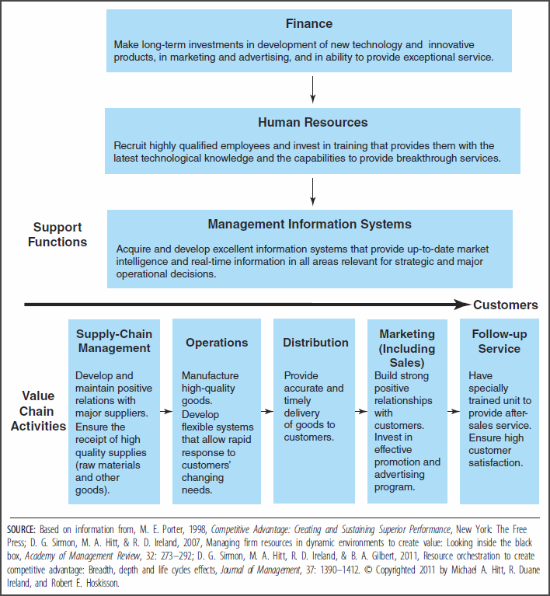
Value-Creating Activities Associated with the Differentiation Strategy
Notes:
Figure 5.4: Value-Creating Activities Associated with the Differentiation Strategy – value chain activities and support functions that are commonly used to execute a differentiation strategy
Discussion points:
If a firm is unable to link the activities shown in Figure 5.4, it probably lacks the resources, capabilities, and core competencies needed to successfully use the differentiation strategy.
Each of the five forces of competition (model detailed in Chapter 3) can be used to position firms for successful implementation of a differentiation strategy.

Slide 26
Differentiation Strategy and the Five Forces of Competition
Customer loyalty provides the most valuable defense against rivals.
Uniqueness reduces customer sensitivity to higher prices.
High margins can absorb high supplier costs or price increases can be passed on to willing customers.
Customer loyalty and product uniqueness serve as significant entry barriers.
Firms with customers loyal to their products are positioned effectively against product substitutes.
Notes:
Differentiation Strategy and the Five Forces of Competition – Firms using the differentiation strategy can successfully position themselves in terms of the five forces of competition (see Chapter 3) to create value.
Discussion points:
Rivalry with Existing Competitors – Customers tend to be loyal purchasers of products that are differentiated in meaningful ways to them. Customer loyalty desensitizes them to price and insulates the firm from competitive rivalry.
Examples: Luxury items, McKinsey & Co., and Bose
Bargaining Power of Buyers (Customers) – Customers are willing to accept a price increase when a product still satisfies their perceived unique needs better than a competitor’s offering can. Examples: Callaway golf clubs, Heinz ketchup, and Kleenex tissues
Bargaining Power of Suppliers – Firms with differentiation strategies need suppliers to provide high-quality components, which can drive up costs. However, because of the high margins that can be charged for differentiated products, the firm is insulated from excessive supplier influence. Higher supplier costs can be either absorbed into the margin or passed along to willing customers.
Potential Entrants – Only patient new competitors who are willing to make significant investments to pursue customers' loyalty will enter the market.
Product Substitutes – Brand loyalty minimizes switching to products offering additional features, lower prices, or attractive functionality.

Slide 27
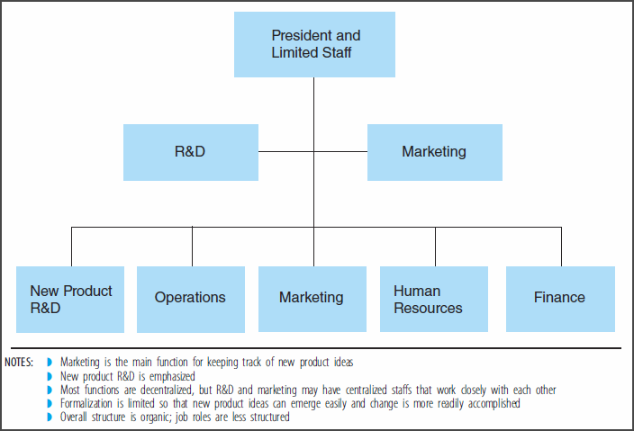
Functional Structure for the Differentiation Strategy
Notes:
Figure 5.5: Functional Structure for Implementation of a Differentiation Strategy – Firms using the differentiation strategy make products that customers perceive as different in ways that create value for them. With this strategy, firms want to sell nonstandardized products to customers with unique needs.
What features characterize the differentiation form of the functional structure?
Relatively complex and flexible reporting relationships
Frequent use of cross-functional product development teams
Strong focus on marketing and product R&D
Limited focus on manufacturing and process R&D
Development-oriented culture in which employees seek ways to further differentiate current or new products.
Continuous innovation through employees able to interpret and take action based on sometimes ambiguous, incomplete, and uncertain information
Information gathered from outside of the firm to incorporate conditions in the external environment.
Decision-making responsibility de-centralized to ensure rapid response to cues from the external environment
Less specialized jobs include a large number of tasks to support creativity and the continuous pursuit of new sources of differentiation
Few formal rules and procedures
Frequent exchange of information throughout the organization to create value for customers

Slide 28
Functional Structure for the Differentiation Strategy
Complex and flexible reporting relationships
Cross-functional product development teams
Strong focus on marketing and product R&D
Development-oriented culture
De-centralized decision-making authority
Broad job descriptions
Informal rules and procedures

Slide 29
Competitive Risks of Differentiation Strategy
  Price differential seen as too large
  Differentiation no longer provides value for which customers will pay
  Narrowing perceptions of the value of differentiated features
  Counterfeiting
Notes:
Competitive Risks of the Differentiation Strategy – Some risks exist for firms that select a differentiation strategy.
Discussion points:
Customers might decide that the price differential between differentiator and cost leader products is too great.
Firm may be offering differentiated features that exceed target customer needs, which makes them vulnerable to competitor offerings.
The firm's means of differentiation may cease to provide value for which customers are willing to pay when rivals have successfully imitated the firm's strategy. Example: Li Ning Company
Experience can narrow perceptions of the value of features. Example: IBM
Counterfeit goods might appear in the marketplace. Example: Callaway golf clubs

Slide 30
Focus Strategy
Key Terms
  Focus strategy
    Integrated set of actions designed to produce or deliver goods or services to satisfy the specific needs of a particular competitive segment
Notes:
Focus Strategies – A focus strategy seeks to serve a particular industry segment or market niche (at the exclusion of others) through the core competencies of an organization.

Slide 31
Specific Market Segments
Buyer group
Product line segment
Geographic market
Notes:
Specific Market Segments – examples of specific market segments that might be targeted with a focus strategy
Discussion points:
Buyer Examples: Youths or senior citizens
Product line Examples: Products for professional painters or "do-it-yourselfers"
Geographic Examples: Southeastern U.S region or a local market

Slide 32
Focus Strategy Drivers
Large firms may overlook or poorly serve small niches.
Firms may lack resources to compete in the broader market.
Niche firms may be able to better satisfy the specialized needs of a narrow market segment.
Focus may allow the firm to direct resources to certain value chain activities that deliver a competitive advantage.
Notes:
Focus Strategy Drivers – reasons that firms choose a focus strategy
The essence of the focus strategy is the exploitation of a narrow target market’s differences from the balance of the industry.
Discussion points:
Niche providers can often serve a segment whose needs are so specialized that broad-based competitors are unable to satisfy the needs or choose not to serve that segment.
Smaller firms may be unable to compete in the broader market.
Firms may be able to serve a narrow market segment more effectively than larger, industry-wide competitors.
Focus directs resources to value chain activities which may become the foundation for a competitive advantage.

Slide 33
Focus Strategies
Focused Cost Leadership Strategy
Focused Differentiation Strategy
Notes:
Focus Strategies – Firms can create value for customers in specific and unique market segments by using one of these two types of focus strategies.
Focused Cost Leadership Strategy Example: Ikea
Value-creating activities required to achieve and sustain a competitive advantage and create value with a focused cost leadership strategy are identical to those shown for the cost leadership strategy in Figure 5.2 or on Slide 16.
Firms using the focused cost leadership strategy can successfully position themselves in terms of the five forces of competition in a manner which parallels the approach outlined on Slide 17.
Focused Differentiation Strategy Example: Harley Davidson
Value-creating activities required to achieve and sustain a competitive advantage and create value with a focused differentiation strategy are identical to those shown for the differentiation strategy in Figure 5.4 or on Slide 25.
Firms using the focused differentiation strategy can successfully position themselves in terms of the five forces of competition in a manner which parallels the approach outlined on Slide 26.

Slide 34
Simple Structure for the Focus Strategy
  A simple structure is appropriate for focus strategies for firms offering a single product line in a single geographic market.
Notes:
Simple Structure for Implementation of a Focus Strategy – A firm using a focus strategy will choose a simple organizational structure when offering a single product line in a single geographic market.

Slide 35
Functional Structure for the Focus Strategy
  A functional structure is appropriate for focus strategies for firms that have grown and expanded beyond offering a single product line in a single geographic market.
Notes:
Functional Structure for Implementation of a Focus Strategy – A firm using a focus strategy will choose a functional organizational structure when the business expands beyond offering a single product line in a single geographic market.
Figure 5.3 or Slide 19 is applicable for focused cost leadership strategies.
Figure 5.5 or Slide 27 is applicable for focused differentiation strategies.

Slide 36
Competitive Risks of
Focus Strategy
  Being “outfocused”
  Entry of large industry-wide companies into an attractive market segment
  Merging of niche customer needs with those of the broader industry
Notes:
Competitive Risks of the Focus Strategy – In addition to the industry-wide cost leadership and differentiation strategy risks presented on Slides 21 and 29, some distinct risks exist for firms that select a focus strategy.
Discussion points:
A competitor may be able to focus on and better serve the unique needs of a more narrowly defined competitive segment and “outfocus” the focuser.
Example: Big Dog Motorcycles and Harley Davidson
A company competing on an industry-wide basis may decide that the market segment served by the focus strategy firm is attractive and worthy of competitive pursuit.
Example: Anne Fontaine and Gap, Inc.
The needs of customers within a narrow competitive segment may become more similar to those of industry-wide customers as a whole, eliminating or reducing the advantages of the focus strategy.
Example: Harley Davidson

Slide 37
Integrated Cost Leadership/
Differentiation Strategy
Key Terms
  Integrated cost leadership/differentiation strategy
    Integrated set of actions designed by a firm to produce or deliver goods or services at an acceptable cost that customers perceive as being different in ways that are important to them
Notes:
Integrated Cost Leadership/Differentiation Strategy – An integration strategy pursues more than one strategy simultaneously, rather than a business-level strategy based on a single competitive dimension. The ability to fuse competitive advantages from low cost and differentiation strategies is particularly important in global markets. Firms now have to work harder and smarter to sustain a competitive advantage, so having multiple competitive advantages can be essential to competing successfully in today’s marketplace.

Slide 38
Integration Strategy Advantages
Quick adaptation to environmental changes
Quick learning of new skills and technologies
Efficient leveraging of core competencies
Notes:
Integration Strategy Advantages
Discussion points:
Evidence suggests a relationship between the use of an integration strategy and the achievement of above-average returns.
Businesses that combine multiple forms of competitive advantage in low-profit-potential industries are shown to outperform businesses that compete with a single form.
Examples: Target and Aaon

Slide 39
Integration Strategy Difficulties
The integration strategy is difficult to implement.
Difficulty stems from the need to emphasize and balance different value chain activities and support functions to succeed.
Notes:
Successful Execution of the Integration Cost Leadership/Differentiation Strategy
Discussion points:
The integration strategy is an increasingly common strategy, although it is difficult to successfully implement.
The value chain model highlights the difficulties of successfully implementing an integration strategy, which stem from the need to emphasize different value chain activities and support functions for success.
Recall, low-cost positions are achieved by focusing on production and process engineering, with frequent product changes.
Recall, differentiated positions are achieved by focusing on marketing and new-product R&D.
Successful implementation of the integration strategy requires a careful combination of activities designed to reduce costs with activities intended to create additional differentiated features.
The balance requires a flexible organizational structure.

Slide 40
Flexible Structure for the Integration Strategy
  Commitment to strategic flexibility
  Flexible decision-making patterns
  Partial centralization
  Less structured jobs
  Sensitivity to balance of objectives
  Modular structures
Notes:
Flexible Structure for Implementation of an Integrated Cost Leadership/Differentiation Strategy – Because of the need to balance possibly conflicting objectives associated with the cost leadership and differentiation components of the strategy, the firm using an integration strategy must have flexibility in its organizational structure.
Characteristics of a flexible structure support its use for a firm pursuing an integration strategy.
Discussion points:
Strategic flexibility (see Chapter 1) results from developing systems, procedures, and methods that enable the firm to quickly and effectively respond to opportunities that reduce costs or enhance differentiation.
Three sources of strategic flexibility:
Flexible manufacturing systems
Information networks
Total quality management systems
Jobs are less specialized than in a traditional functional structure so that workers are sensitized and enabled to balance between low cost and differentiation objectives.
Some use of modular structures to produce modular goods creates differentiation and simultaneously holds down costs.

Slide 41
Tools for Strategic Flexibility
Flexible manufacturing systems
Information networks
Total quality management (TQM) systems
Notes:
Tools for Strategic Flexibility – Three useful tools help managers balance the conflicting objectives of continuous cost reductions and differentiation enhancements.

Slide 42
Flexible Manufacturing Systems
Computer controlled
Capable of producing multiple products in moderate, flexible quantities with minimal manual intervention
Enable quick and easy product adjustments
Increase the flexibility of resources needed to produce differentiated products at low costs
Allow quick response to changes in customer needs, while retaining low costs and consistent quality
Notes:
Flexible Manufacturing Systems – The goal of FMS is to eliminate the “trade-offs” associated with traditional manufacturing processes and the pursuit of blended competitive approaches. These systems are possible and effective due to modern information technologies.
Discussion points:
Eliminate or minimize “low-cost-vs-product-variety” trade-offs.
Increase the flexibility of human, physical, and information resources needed to produce differentiated products at low costs.
Robots are integral when parts are heavy or assembly is complex.
Retain low-cost advantages and consistent product quality, despite lower production quantities and frequent product changes.
With smaller lot sizes, capacity to serve unique needs of a narrow target market is increased.
Can create constraints in terms of material handling and scheduling the flow of supporting resources.
Can help firm effectively integrate machines, computer systems, and people to continuously build knowledge to adapt to market needs.
Process flexibility to increase delivery speed and to satisfy changing customer needs is important in service industries.
Integration of tangible and intangible assets facilitates the implementation of complex competitive strategies.
Examples: Levi Strauss and Anderson Windows

Slide 43
Information Networks
Facilitate efforts to satisfy quality and speed expectations of customers
Include Customer Relationship Management systems
Include Enterprise Resource Planning systems
Notes:
Information networks – another source of strategic flexibility which provides linkages among suppliers, distributors, and customers
Discussion points:
CRM Systems
Information-based network processes used to better understand customers and their needs
Provide a 360-degree view of the company’s relationships with customers, encompassing all contact points, involving all business processes, and incorporating all communication media and sales channels
Vital for determining cost-differentiation trade-off values for customers
ERP Systems
Information systems used to identify and plan the resources required across the firm to receive, record, produce, and ship customer orders
Primary objective is to improve efficiency on a company-wide basis
Efficiency improvements result from systems which integrate and quickly move financial and operational data across departments
Integrate data to link value chain activities and to flexibly respond to customer preferences relative to features and cost
Example: Aviall

Slide 44
Total Quality Management Systems
Focus on doing things right through increased efficiency
Incorporate customer definitions of quality
Guide the firm to the root causes of problems
Customized to fit the firm’s resources and the external environmental context
Notes:
Total Quality Management (TQM) Systems –working quality (as defined by the customer) and accuracy into processes throughout the value chain to eliminate the costs of poor quality at their sources
Discussion points:
Adopted in Western nations in response to the competitive success of Japanese firms at dramatically improving quality (as a differentiating feature) while simultaneously reducing cost structures (through process efficiencies)
Key assumption is that the costs of poor quality (such as inspection activities and lost customers) exceed the costs of developing high-quality products
Involve specific objectives
Increased customer satisfaction
Lower costs
Reduced time to introduce innovate products to the market
Improve firm flexibility
Facilitate the use of all business-level strategies, but outcomes are particularly important for implementing an integration strategy

Slide 45
Competitive Risks of
Integration Strategy
Failure to establish a leadership position can result in a firm being "stuck in the middle" and unable to create value or earn above-average returns.
Notes:
Competitive Risks of the Integration Cost Leadership/Differentiation Strategy – Potential to create value by successfully using the integration strategy is appealing. However, experience shows that substantial risk accompanies this potential.
Discussion points:
Prevents the firm from dealing successfully with competitive forces
Prevents the firm from having a distinguishable competitive advantage
Must be confident in the ability to achieve differentiated features that customers value at relatively low costs
No research evidence indicates that the attributes of cost leadership and differentiation strategies cannot be integrated effectively
Appropriate strategic choice for firms with core competencies to achieve low costs and produce differentiated products

Slide 46
Ethical Question
  Can a commitment to ethical conduct on issues such as the environment, product quality, and fulfilling contractual agreements affect a firm’s competitive advantage? If so, how?

Slide 47
Ethical Question
  Is there more incentive for differentiators or cost leaders to pursue stronger ethical conduct?

Slide 48
Ethical Question
  Can an overemphasis on cost leadership or differentiation lead to ethical challenges?

Slide 49
Ethical Question
  Creating brand image is one way a firm can differentiate its good or service. However, many questions are now being raised about the effect brand images have on consumer behavior. For example, considerable concern has arisen about brand images that are managed by tobacco firms and their effect on the smoking habits of teenagers. Should firms be concerned about how they form and use brand images? Why or why not?

Slide 50
Ethical Question
  To what extent should an individual manager be concerned about the accuracy of the claims the company makes about its products in its advertisements?

