Slide 1
Methodology and Corporate Architecture
The European Statistical Training Programme (ESTP)
European Statistical week, a study visit to Eurostat
Roberto Barcellan – Unit B1

Slide 2

Outline
Methodology and Corporate Architecture
Methodology and Research
Confidentiality and microdata access
Modernisation of the European Statistical System
Information models and standards
Enterprise Architecture

Slide 3
Methodology and corporate architecture
Modernisation of the European Statistical System
Confidentiality and microdata access
Information models and standards
Enterprise Architecture
Methodology and Research

Slide 4

Methodology and Research
METHODOLOGY
&
RESEARCH

Slide 5

Methodology and Research
Support the production of official statistics
Create links with the scientific community
  To provide data
  To get input for innovation and improvement
Create a network of methodologists among official statisticians
Find common methodological
solutions to common problems
Facilitate research opportunities

Slide 6

Research – What?
  Foster research in official statistics
  Liaise with the scientific community
  Organise events on research in official statistics
  Link research in statistics with the
  research programmes of the
  European Commisison
  Global network

Slide 7





Research – How?
Conferences
NTTS New Techniques and Technologies for Statistics
Collaborative site
Networking
Journal

Slide 8
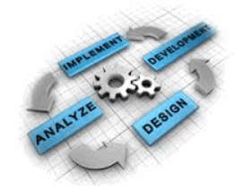
Methodology – What?
Support to Eurostat projects
Support to European Commission
Training
Events
Helpdesk

Slide 9




Methodology – How?
Collaborative mechanisms:
ESSnets and
Centres of Excellence
Collaborative site
Training ESTP
Seasonal Adjustment
Networking

Slide 10

Confidentiality and microdata access

Slide 11
Challenges in a modern society
Digital society
New increasing requirements
Globalisation
Free access vs. personal data protection
Integrated information systems
Rapid changes in the environment
Riding the big data wave
Increasing cost & difficulty of acquiring data
Increasing use of internet and mobile technologies
Role of Legislation

Slide 12
Data – clusters
Enterprises
Persons
Products
Geo
references
Single identifiers?
Same treatment in data protection?

Slide 13
Statistics and confidentiality
Indicators
Accounts
Business – Social – Environmental/ agricultural statistics
Confidentiality issues

Slide 14


Find the right compromise
Full data protection
vs.
Full data acquisition
The free access to Information with at the same time protection of personal data of individuals will become the central task of the information society of the 21st century

Slide 15

Existing legal framework
Regulation (EC) No 223/2009 on European statistics
Ensures:
the protection of individuals as regards the processing of personal data
  Directive 95/46/EC
  Regulation (EC) No 45/2001
the protection of statistical confidential information

Slide 16
Security -
COM (2006) 3602
on security of information
Systems used by EC
Personal data protection
Regulation 45/2001
Statistical data
protection -
Regulation (223/2009)
Data on natural persons – and households
Data on businesses
Sensitive data – e.g. data under embargo, "politically" confidential information

Slide 17

New Challenges for official European Statistics
  Legal framework on the protection of personal data
  Legal framework on the protection of confidential statistical data
  Lift legal access restrictions to the freely available Internet Data sources

Slide 18

Access to confidential data in Eurostat
For statistical purposes:
Eurostat staff
Contractors (only in secure rooms in Eurostat)
For scientific purposes (microdata access):
Researchers affiliated with recognized research entities
  Access on site (Eurostat safe centre)
  Access off-site (data sent on CDs)

Slide 19
Modernisation of the ESS

Slide 20
Towards modernisation
Legal framework
Methodology
Infrastructure
How
Flagship projects
Top-down architecture for development
Bottom-up components
Strategic plans in business domains

Slide 21
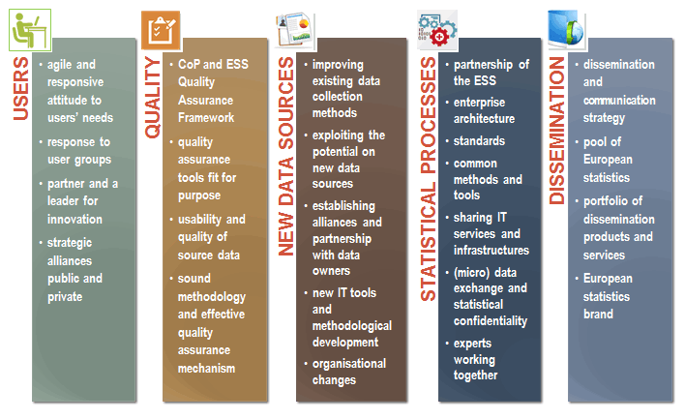
Strategic aims – ESS Vision 2020

Slide 22
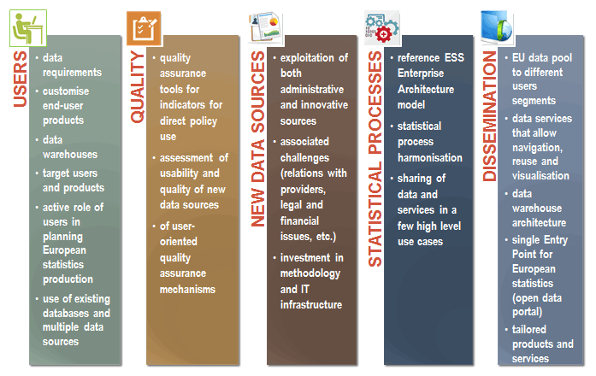
Objectives – ESS Vision 2020

Slide 23
Portfolio of actions
Selection and prioritisation criteria
Strategic alignment and relevance
Potential contribution to building infrastructure and services that could be used across several statistical domains
Effective use of integrated data sources, including new data sources
Statistical products enhancement
Implementation through a portfolio of
Projects
Programs
Other actions
to enable the
accomplishment
of the Vision goals

Slide 24
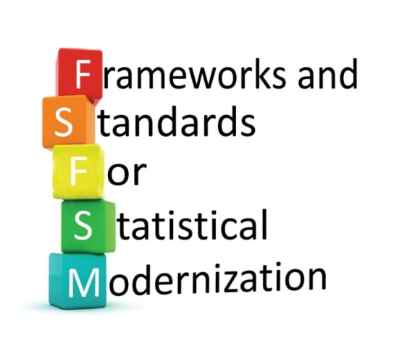
Information Models and Standards

Slide 25
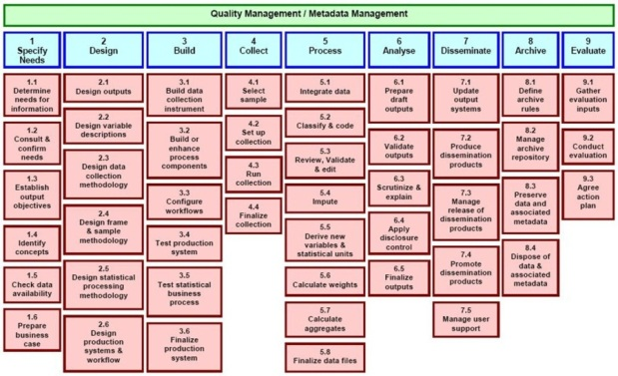
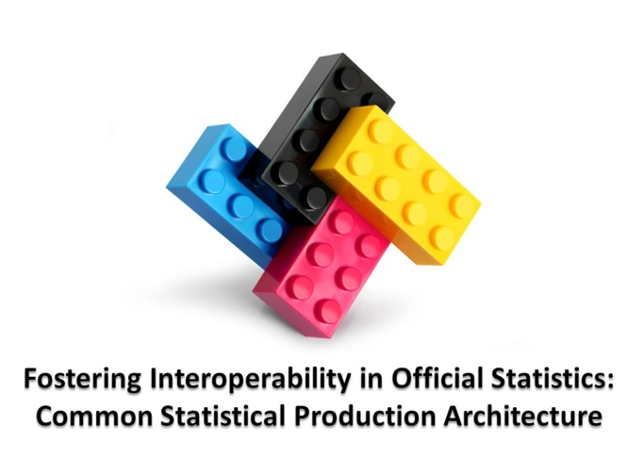



Standards-based modernisation
CSPA
GSBPM
Generic Statistical Business Process Model
Data Documentation Initiative
Generic Statistical
Information Model

Slide 26


Layers of Architecture
=
Business Layer
=
Information Layer
=
Implementation Layer

Slide 27
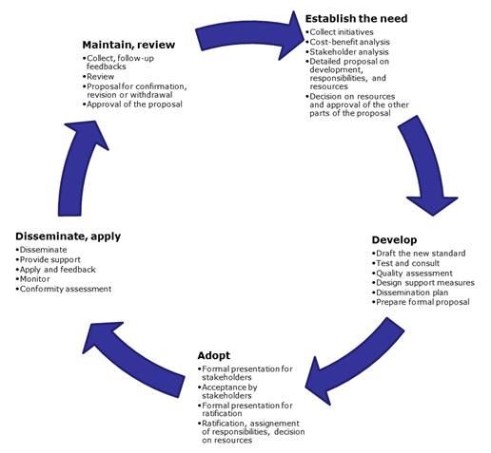
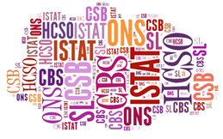
But also …
Sponsorship on Standardisation
Process to define a standard
Guidelines
Standardisation cycle

Slide 28

Enterprise Architecture

Slide 29
What is Enterprise Architecture?
Enterprise Architecture is a systematic language to describe the way our business wants to operate and how the various components fit together.
It serves to translate our vision into implementation strategies and priorities in a systematic way.
It is based on Principles of standardisation and interoperability, reuse, Business Function-independent standard processes, metadata driven business chains and service-oriented data-based outputs of statistical processes

Slide 30
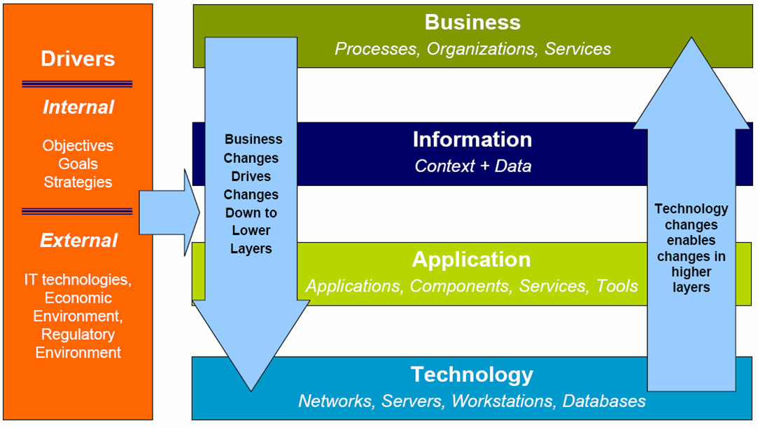
EA layers

Slide 31
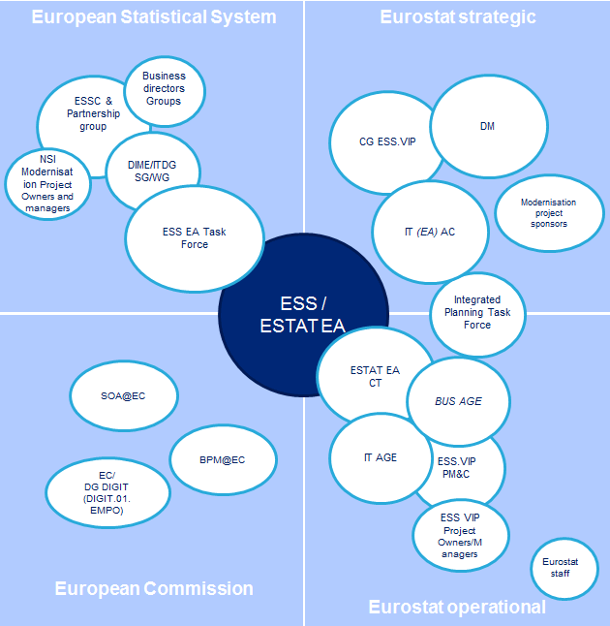
EA stakeholders

Slide 32
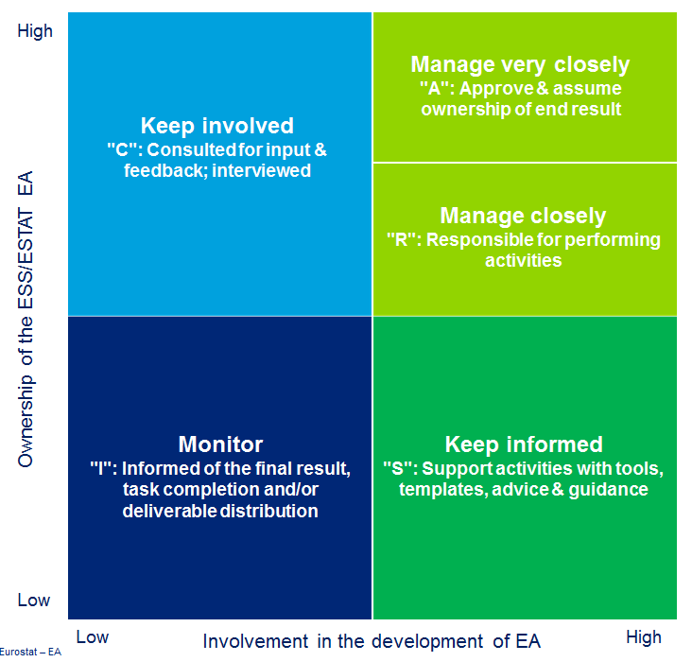
EA roles

Slide 33
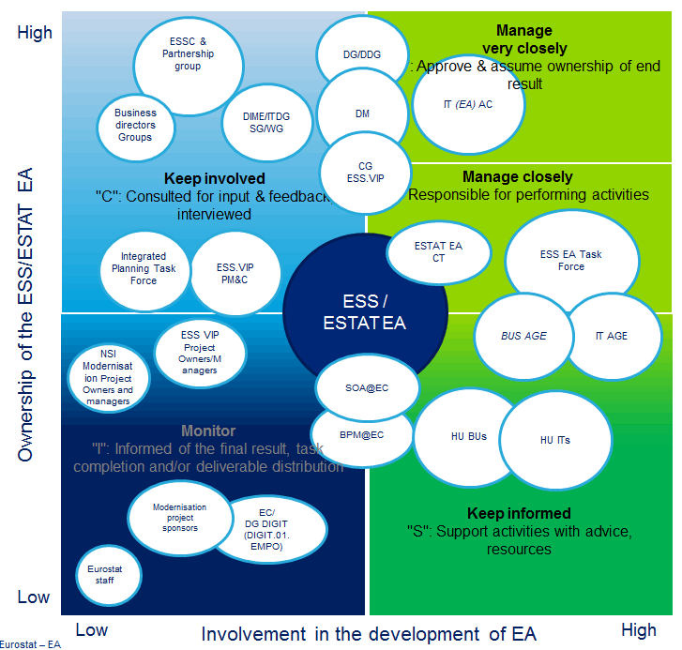
Who does what in
ESS EA

Slide 34
Useful links
CROS portal: http://www.cros-portal.eu/
ESS Vision 2020: http://epp.eurostat.ec.europa.eu/portal/page/portal/pgp_ess/0_DOCS/estat/ESS_Vision_2020.pdf
High-Level Group for the Modernisation of Statistical Production and Services: http://www1.unece.org/stat/platform/display/hlgbas/High-Level+Group+for+the+Modernisation+of+Statistical+Production+and+Services
Confidentiality: http://epp.eurostat.ec.europa.eu/portal/page/portal/research_methodology/statistical_confidentiality
Research in Eurostat: http://epp.eurostat.ec.europa.eu/portal/page/portal/research_methodology/research
Methodology in Eurostat:

Slide 35
Thank you for your attention!

