Slide 1
VM0017 Adoption of Sustainable Agricultural Land Management
Introduction to an approved methodology
VCS Association

Slide 2
Who’s on this webinar?
VCSA:
Sam Hoffer, Program Officer
World Bank:
Neeta Hooda, Senior Carbon Finance Specialist, Carbon Finance Unit
UNIQUE forestry and land use GmbH:
Matthias Seebauer, Climate Finance & Project Development
Scientific Certification Systems:
Christie Pollet-Young, Senior Verification Forester

Slide 3
Agenda
Methodology Approval Process
Presentation of VM0017
Perspective from the validation/verification body
Q&A

Slide 4
PART 1: Methodology Approval Process
Public comment period
First assessment
Second assessment
Final approval

Slide 5
Methodology Approval Process
Methodology submitted
6 October 2009
30-day public comment period
16 October 2009 – 15 November 2009
2 comments received
First assessment
Scientific Certification Systems (SCS)
First assessment report issued: 5 October 2011
Second assessment
Det Norske Veritas (DNV)
Second assessment report issued: 3 October 2011
Final VCS approval
21 December 2011

Slide 6
PART 2: Presentation of VM0017
About the methodology
Baseline and additionality
Quantification
Monitoring

Slide 7
About the methodology
To what project activities is the methodology applicable?
Project activities that promote adoption of sustainable agriculture management practices on croplands or grasslands.
Projects can choose from diverse management practices that increase soil carbon stocks such as:
Residue management
Grassland management
Agro-forestry
Applicability conditions:
Land is either cropland or grassland at the start of the project;
The project does not occur on wetlands;
The land is degraded and will continue to be degraded or degrade;
The area of land under cultivation in the region is constant or increasing in absence of the project;
Forest land, as defined by the national CDM forest definition, in the region is constant or decreasing over time;
Demonstrate that the use of the Roth-C model is appropriate for the climatic region or the agro-ecological zone in which the project is situated.

Slide 8
About the methodology
What does this methodology do?
Agricultural activities in the baseline will be assessed and adoption of SALM practices will be monitored as a proxy of the carbon stock changes using activity-based model estimates;
Uses Roth-C Model to quantify changes in soil C;
Possible to use other models;
Direct measurements of soil C pool are not required. Activity based monitoring used to get the model inputs.
Where might projects be developed that use this methodology?
One project already developed in Kenya (over 45000 ha);
Primary objective is increasing productivity in croplands;
Developing country situation with large number of small holder farmers with scarce data availability and with barriers to adoption of sustainable practices;
More cost effective way of incentivizing sustainable practices.

Slide 9
Baseline and additionality
How is the baseline scenario and additionality determined?
A/R CDM tool;
The activity baseline and monitoring survey (ABMS) is used to identify the baseline conditions within the total project area;
Assessment of alternate land use scenarios:
Land use and management prior to the implementation of the project activity
Adoption of sustainable agricultural land management without the incentives from the carbon market
Abandonment of the land followed by natural regeneration or assisted reforestation
What is the baseline scenario?
Land use and management prior to the implementation of the project activity.
Why are these projects additional?
Barrier analysis (technological, up-scaling) and common practice analysis;
The proposed AFOLU SALM project activity is not the baseline scenario and, hence, it is additional;
Dissemination of know-how to farmers

Slide 10
Quantification
How do you quantify the emission reductions?
Baseline emissions (BE) and removals:
Existing tools are used:
CDM A/R Tool “Estimation of direct nitrous oxide emissions from nitrogen fertilization”
“Estimation of emissions from the use of fossil fuels in agricultural management”
“Estimation of non-CO2 emissions from the burning of crop residues”
CDM A/R Tool “Estimation of carbon stocks and change in crabon stokcs of trees and shrubs in A/R CDM project activities”
BE
Total Baseline emissions & removals
BEF
BE use of
nitrogen fertilizer → Tool
BEBB
BE biomass burning → Tool
BRWP
BEFF
BE use of fossil fuels → Tool
BR woody perennials → Tool

Slide 11
Quantification
How do you quantify the emission reductions?
Actual project GHG emissions and removals by sinks
In addition to the tools in the baseline:
“Estimation of direct nitrous oxide emission from N-fixing species and crop residues”
Activity based Roth-C modeling: Activity Baseline and Monitoring Survey (ABMS) to identify agricultural management practices for croplands and grasslands
All data needed for application of the tools
Input values to run Roth-C soil organic carbon model to estimate SOC changes (project equilibrium SOC density in mgmt. systems)
PE
Total Project emissions & removals
PRS
PR changes in soil organic carbon → Activity based RothC modeling
Increased use of N-fixing species → Tool
PEN
PEF + PEFF + PEBB
PRWP
Same as baseline → Tools
PR woody perennials → Tool

Slide 12
Quantification
How do you quantify the emission reductions?
Net anthropogenic GHG emissions and removals:
Leakage:
Switch to non-renewable biomass use attributable to the project.
If the project plan includes the diversion of biomass used for cooking and heating to the fields (for example, manure or agricultural residuals) then the project proponent should estimate the possible leakage.
If survey data show that 10% or fewer project households use non-renewable biomass from outside the project or fossil fuels to replace the biomass diverted to agricultural fields, then the leakage is considered insignificant and ignored.
∆R
Net anthropogenic GHG emissions & removals
BE
Baseline emissions & removals
LHE
Leakage fossil fuel switch
PE
Project emissions & removals

Slide 13
Monitoring
What data is required to determine the net GHG reductions?
Activity Baseline & Monitoring Survey (ABMS), project dependent:
Area of project activities (crops, grazing, tillage, agroforestry)
Farming systems and baseline practices per area (project adoption)
Average annual biomass production (yield is used as a proxy for biomass production, for the yield to biomass ratio IPCC default values are used)
Average biomass extracted from or left in the field in %
Amount of biomass burned
Existence and amount of woody perennials (trees/bushes)
Average number and type of grazing animals
Manure input
Fertilizer input considering the type and concentration
Future management practices that will be implemented with the project

Slide 14
Roth-C modeling
The Rothamsted C soil decomposition model (Roth-C)
Calculates the SOC changes due to changes of inputs of e.g. crop residues and manure in the soil. The increase or decrease of soil organic matter in the soil is the result of the decomposition of the added organic materials.
Soil model must have been validated for the project climate zone.
Possible applications:
Modifying amounts of organic inputs (plant residues, compost);
Soil cover changes; and
Influencing the decomposition rate (tillage)
Model inputs needed:
Soil clay content in %
Climate parameters
Additional residue/ manure inputs in tC ha-1
Soil cover in each month (bare or covered)

Slide 15
Roth-C modeling
Model Outputs
Local default SOC emission factors based on parameterized model that has been validated via research
Model uncertainty
The project proponent should calculate the soil model response using the model input parameters with the upper and lower confidence levels. The range of model responses demonstrates the uncertainty of the soil modeling.
Adjustment of the soil carbon sequestration estimate based on model output uncertainty
< 15% (of the mean value) → no adjustment
15 – 30% deduction of SOC estimate
 | Introduction of mulching (tCO2/ha/year) | Composted manure (tCO2/ha/year) | Cover crops (tCO2/ha/year)
Example from the Kenya project
1st season | 0.29 | 0.25 | 0.41
2nd season | 0.20 | 0.27

Slide 16
Activity Baseline and Monitoring Survey (ABMS)
Project requirements | ABMS | Examples | Synergies with project management & extension
Project boundaries | Identification of project areas (GPS farm tracking) | High residue crops areas, tillage areas, | Land use classification & prioritization
Baseline - activities | Identify the actual agricultural management practices | Residue management practices, tillage, manure management practices , crop area, existing trees | Training needs assessment, identification of primary fields for extension and training, sensitization
Project - activity monitoring | Identify adoption of SALM practices | Improved crop land management , mulching, composting… | Project impact assessment, farmer’s commitment
Baseline - soil model input data | Organic matter inputs (biomass and manure); soil cover | Annual crop yields, rotational patterns, crop areas, livestock & grazing assessment | Livelihood assessment, Livestock management
Project - soil model input data | Organic matter inputs (biomass and manure); soil cover | Changes in crop productivity, manure management, crop areas | Food security monitoring

Slide 17
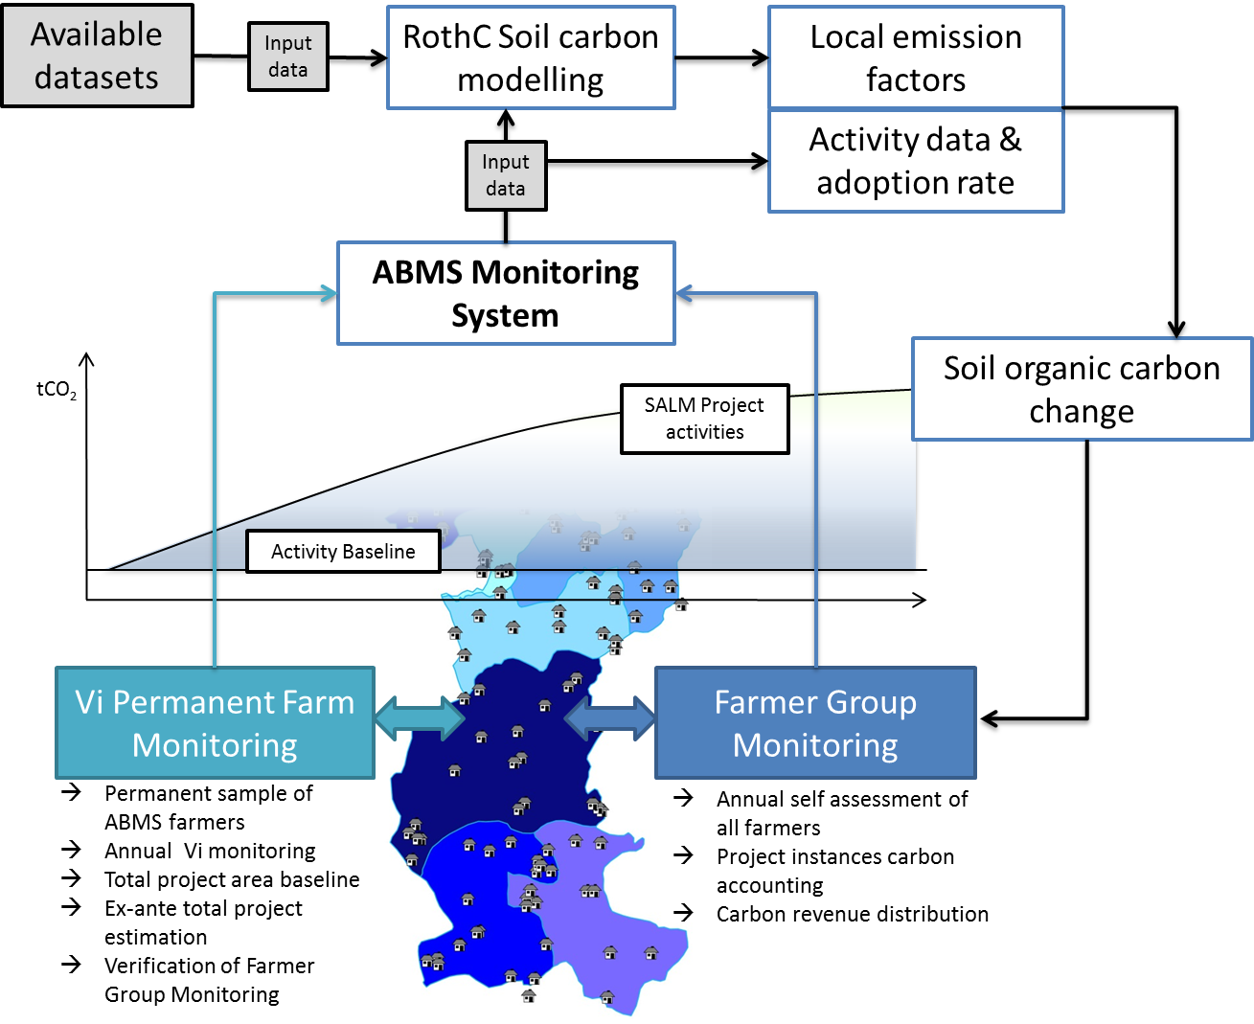
Monitoring example: Kenya project

Slide 18
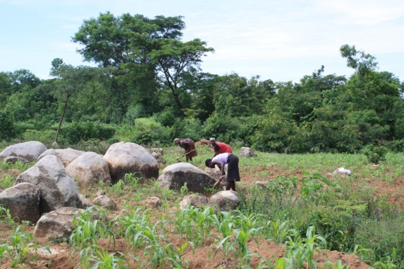
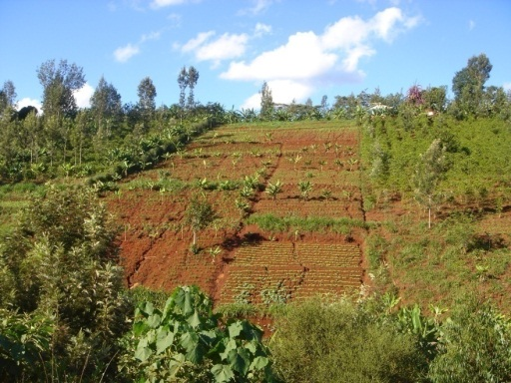
Monitoring results: Kenya project
The “average farm” based on the ABMS

Slide 19
PART 3: Perspective from VVB
Scientific Certification Systems

Slide 20
Perspective from SCS
What we look for during validation/verification:
The Project Validation/Verification commences with a detailed review of the PD & supporting documentation
Review of the applicability conditions, project boundaries, baseline determination, and additionality to assure conformance to the VCS requirements and VM0017
Ensure that the estimates of the Baseline Scenario, Project Scenario, Leakage, and Monitoring are accurate, complete and compatible with VCS requirements
Verify that the uncertainty of the soils model is in conformance with the VCS requirements and when necessary, a confidence deduction is applied

Slide 21
Perspective from SCS
Data requirements:
Ensure that the use of the Roth C Model is appropriate for the Project Area
Ensure that the parameters values (sampled, modeled or collected from larger datasets) in the PD and Monitoring Plan are complete and transparent to verify accurate implementation
Ensure that the data are appropriate, reliable, and the correct units have been used

Slide 22
PART 4: Q & A
Send us your questions
We will consolidate and try to answer all questions right now
More questions after today?
shoffer@v-c-s.org

Slide 23
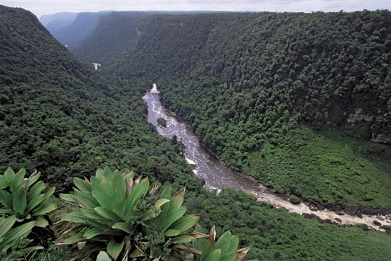
Thank you
Sam Hoffer
shoffer@v-c-s.org

