Slide 1
Risk & Return

Slide 2
Topics
Chapter 10:
Looked at past data for stock markets
There is a reward for bearing risk
The greater the potential reward, the greater the risk
Calculated averages so we have typical value
Calculated standard deviation to measure volatility or risk
Chapter 11
Make Predictions About Unknown Future In Stock Markets
Expected Returns, E(R), and Standard Deviation Based on E(R)
New Information, Risk & Stock Returns
Beta (Market or Systematic Risk)
Treynor Index (Reward to Risk Ratio)
Security Market Line
Capital Asset Pricing Model
Chapter 12
WACC
Chapter 13
Leverage

Slide 3
Make Predictions About Unknown Future In Stock Markets
When we use past historical data to help to predict the future, if events in the future are not like the events in the past, the models may not work at all…
If we apply models and theories (like bell curve and efficient market theory), that do not reflect the patterns from the past, the models may not work at all…

Slide 4
Make Predictions About Unknown Future In Stock Markets
Expected Returns for one stock
Standard Deviation for one stock
Expected Return for portfolio of stocks
Standard Deviation for portfolio of stocks

Slide 5
Expected Returns For One Stock (A Type Of Average)

Slide 6
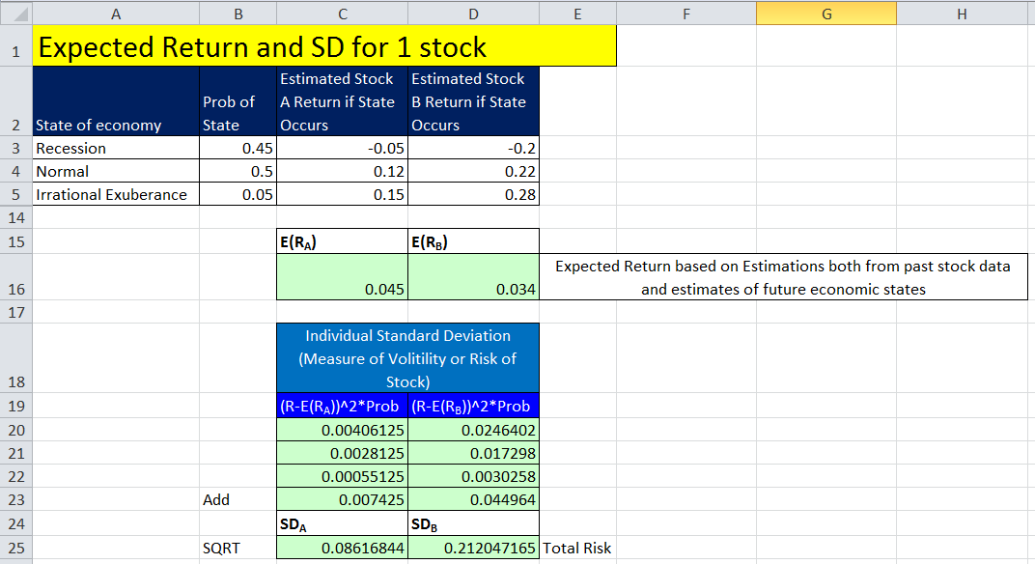
Standard Deviation For One Stock

Slide 7
Expected Return & Standard Deviation For Portfolio Of Stocks

Slide 8
Expected Returns & Actual Returns
We have calculated the returns we expect to get based on past data.
But:
Actual Returns = Expected Returns?
If new unexpected information comes out about publically traded stocks, prices can change and Expected Returns can be Different than Actual Returns.

Slide 9
New Information & Stock Price
Unexpected new information (surprise) affects stock price (up or down)
What happens to stock prices if the government announces lower than expected economic growth numbers?
Most stocks would tend to go down.
What happens to Boeing stock if they get an unexpected new contact for planes?
Boeing stock would probably go up.
Unexpected announcement that Ireland and Spain Credit Rating went down?
Unexpected announcement that Boeing employee strike was not settled?
Sep 30, 2004, Merck announced recall VIOXX, stock went from $45 to $33. 33/45-1 = -0.27
Notes:
On September 30, 2004, Merck announced a voluntary recall of its arthritis and acute pain medication VIOXX following a reported increased incidence of cardiovascular events. The stock dropped from $45.07 to $33 (a 37% drop)

Slide 10
Expected Information
Announcements that do not contain new expected information should not affect stock price much.
The information is already “priced” in to stock price, or “discounted” into stock price.
What happens to stock prices if the government announces low economic growth numbers, but everyone expected this?
What happens to Boeing stock if they sign a new contact for planes, but everyone expected it?

Slide 11
New Information & Risk
Unexpected New Information is the Risk of holding a stock
Risk is either:
Market risk (systematic risk)
Market risk affects many stocks
GDP
Interest Rates
Country Credit Rating changes
Asset specific risk (unsystematic risk)
Asset specific risk affects 1, 2, or a few stocks only
Boeing example
Liability Law Suit against a company
New Product Announcement
Company has credit rating downgrade

Slide 12
Market Efficiency
Efficient markets are a result of investors trading on the unexpected portion of announcements.
The easier it is to trade on surprises, the more efficient markets should be.
Efficient markets involve random price changes because we cannot predict surprises.
Market Efficiency assume that information is assimilated into stock prices quickly and accurately.
History shows that markets do not always assimilate new information quickly and accurately into prices.
Periods in history where there has been a lot of debt that fuels asset prices and or just “irrational exuberance”.

Slide 13
Portfolio of Stocks
Portfolio diversification is the investment in several different asset classes or types of stock
Diversification is not just holding a lot of assets
For example, if you own 30 banking stocks, you are not diversified
However, if you own 30 stocks that span 20 different industries and sectors, then you are diversified

Slide 14
Risk & Portfolios of Stocks
Holding portfolio of different types of stocks lowers the asset specific risk (they tend to wash each other out), but does not reduce the amount of systematic risk.
When people hold diversified portfolios of stocks, the true risk is the market risk (systematic risk).
Therefore, market risk (systematic risk) is the only risk that is rewarded

Slide 15
Table 11.7

Slide 16
Figure 11.1

Slide 17
Beta
Beta is the Measure of market risk (systematic risk)
What does beta tell us?
A beta of 1 implies the asset has the same systematic risk as the overall market
A beta < 1 implies the asset has less systematic risk than the overall market
A beta > 1 implies the asset has more systematic risk than the overall market

Slide 18
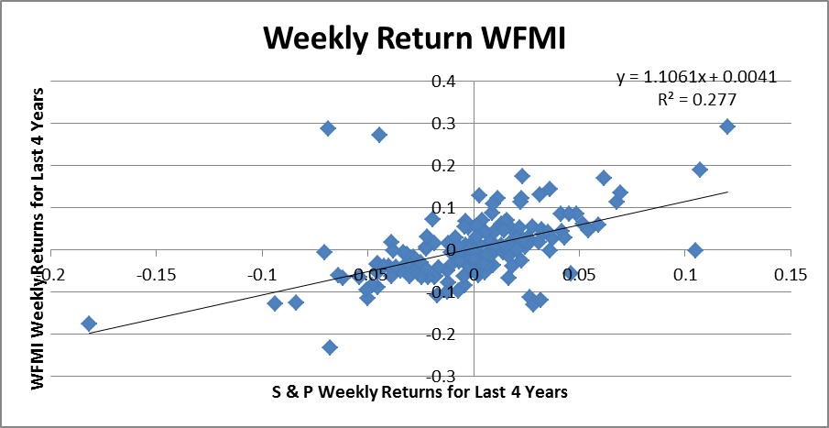
Beta
For a particular Stock, you can plot the returns on the market (like S&P 500) against your stock and see how your stock moves in relation to the market.

Slide 19
Beta For Portfolio Market Risk (SR) For Portfolio

Slide 20
Reward To Risk Ratio
Risk Premium = R - R_{f}
Reward to Risk Ratio = Treynor Index =
% Return per 1 unit of Systematic Risk
Treynor Index can be used to see if stock returns seen in market are too high or too low. Is stock priced correctly?

Slide 21
Is Stock Correctly Priced?

Slide 22
Security Market Line (SML)
In well-functioning markets, competition amongst investors causes prices to converge to the SML.
Tells us the reward for bearing risk in the financial markets.
Since Beta of Market = 1 SML Slope = Market Risk Premium = E(R_{M}) - R_{f}

Slide 23
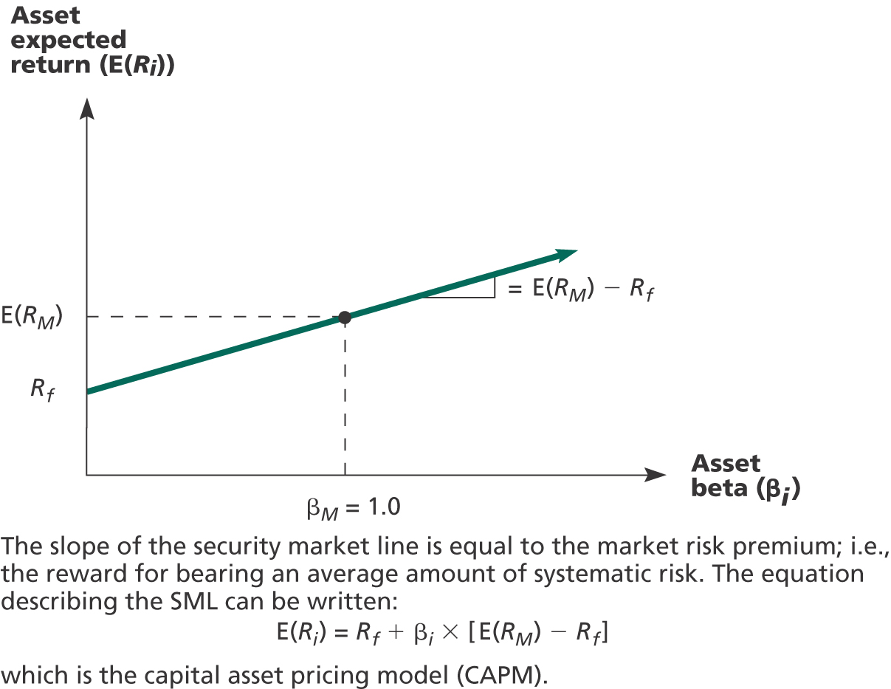
SML tells us the reward for bearing risk in the financial markets

Slide 24
SML into CAPM

Slide 25
Capital Asset Pricing Model
CAPM ➔ E(R_{A}) = R_{f} + (E(R_{M}) – R_{f})*B_{A}
SML and CAPM tells us the minimum return we should expect at a given systematic risk level

Slide 26
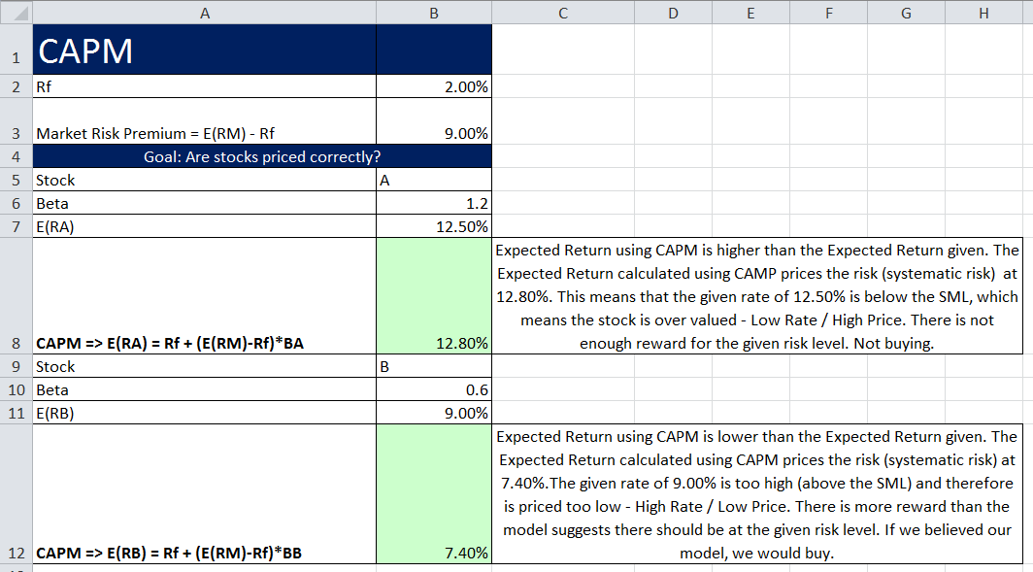

Slide 27
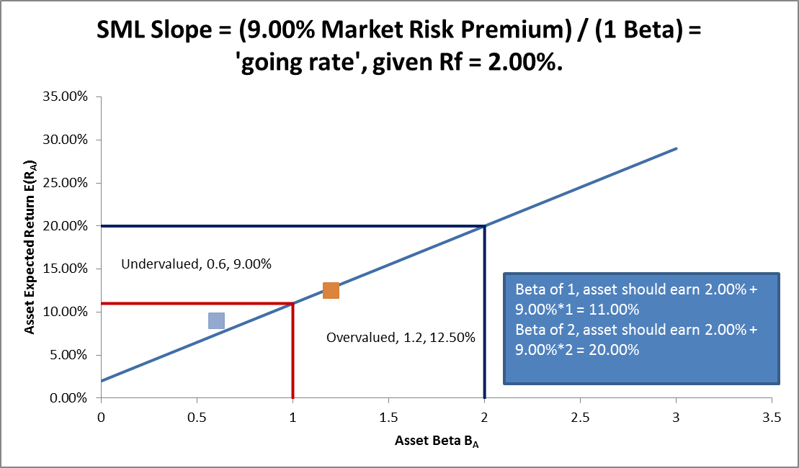

Slide 28
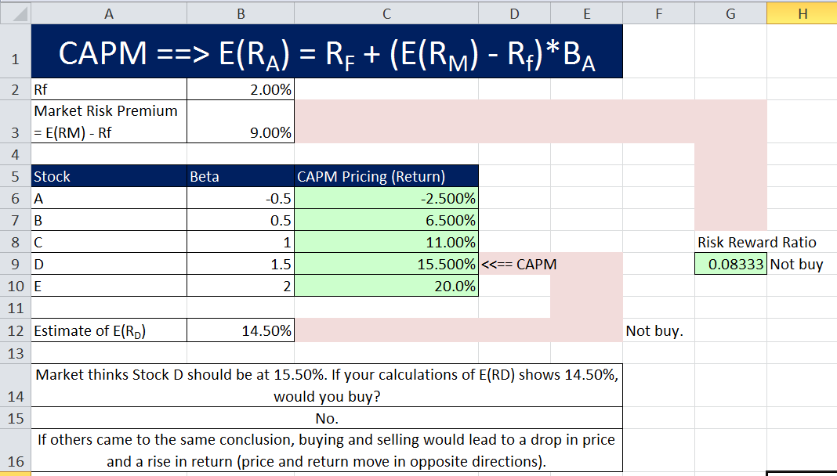

Slide 29
CAPM
If we know an asset’s systematic risk, we can use the CAPM to determine its expected return
This is true whether we are talking about financial assets or physical assets
Financial Market’s “going rate at a given risk level” can be used as bench mark, an “opportunity cost”, or the “discount rate for a project with a given systematic risk level”.

Slide 30
WACC Overall Required Return For Firm Discount Rate For Cash Flows Similar In Risk To Overall Firm
WACC = (E/V) x R_{E} + (P/V) x R_{P +} (D/V) x R_{D x} (1- T_{C})
Where:
(E/V) = % of common equity in capital structure
(P/V) = % of preferred stock in capital structure
(D/V) = % of debt in capital structure
R_{E} = firm’s cost of equity (CAPM or Dividend Model)
R_{P} = firm’s cost of preferred stock (D/P₀)
R_{D} = firm’s cost of debt (YTM)
T_{C} = firm’s corporate tax rate
Weights
Component costs

Slide 31
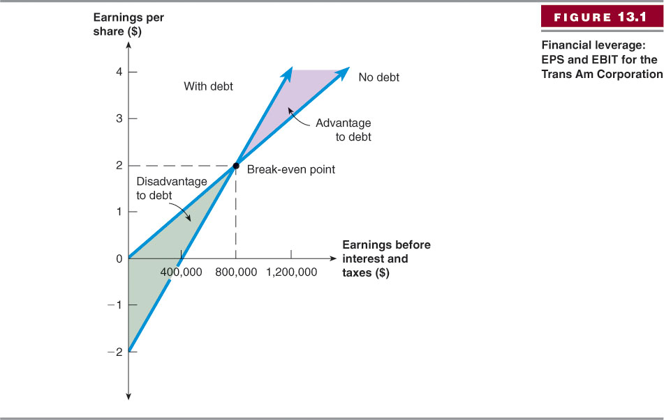
Break-Even EBIT
If we expect EBIT to be greater than the break-even point, then leverage is beneficial to our stockholders
If we expect EBIT to be less than the break-even point, then leverage is detrimental to our stockholders

