Slide 1
Implement IT Asset Management
Create a proactive program that can respond to the dynamic nature of ITAM.

Slide 2
ANALYST PERSPECTIVE
IT asset data impacts the entire organization. It’s time to harness that potential.
Asset management is like exercise: everyone is aware of the benefits, but many struggle to get started because the process seems daunting. Others fail to recognize the integrative potential that asset management offers once an effective program has been implemented.
A proper asset management program will allow your organization to cut spending, eliminate wasteful hardware and software, and improve your organizational security. More data will lead to better business decisions made across the organization.
As your program matures and your data gathering and utility improves, other areas of your organization will experience similar improvements. The true value of asset management comes from the rising tide of improved IT services built upon the foundation of a proactive asset management program.
Sandi Conrad,
Senior Research Director, Infrastructure Practice Info-Tech Research Group

Slide 3
Who benefits from this research and how?
CIOs and CFOs who want to reduce hardware and software lifecycle costs.
IT directors who want to mitigate the risks inherent in licensing audits.
Information security officers who need to mitigate the risk of sensitive data loss due to insecure assets.
Asset managers and service desk managers tasked with developing an asset management program who do not know where to start.
Draw on Info-Tech’s diagnostics to establish baseline project metrics.
Develop an IT asset management standard operating procedure that documents:
Process roles and responsibilities.
Data classification scheme.
Procurement standards, processes, and workflows for software and hardware.
Hardware and software deployment policies, processes, and workflows.
Processes and workflows for IT asset security and disposal.
Draft a list of technical requirements for an ITAM solution to help generate a shortlist.
Develop an asset management implementation roadmap.
Draft a communication plan for the initiative.

Slide 4
Executive summary
Executives are aware of the numerous benefits asset management offers, but many organizations lack a defined ITAM program.
However, efforts to implement ITAM are stalled because organizations cannot establish a defined asset management process.
ITAM is a cornerstone program. ITAM’s real value doesn’t emerge from compliance; it comes from the strengthening of other IT services.
Don’t just wait for the knock on the door; make sure it rarely happens. Proactive asset management can prevent a software audit from happening.
Treat ITAM like a process, not a project. ITAM is a dynamic process that must react and adapt to the needs of the business.
Asset management programs yield a large amount of useful data. Unfortunately, this data is often underutilized. Departments within IT become data siloes, preventing effective use of the data.
Organizations often implement an asset management program and let it stagnate, but asset management is a dynamic process, not a one-off project.
Assess IT’s maturity in order to properly define what assets will be involved in your ITAM program.
Use ITAM data to make IT proactive. An effective ITAM program makes organizations more agile.
Pace yourself: it’s tempting to tackle everything at once, but a staged implementation will make your ITAM program a success.
Automate as many processes involved in your ITAM program as possible.
Involve an ITAM team in the process from the beginning; dictating change will cause people to follow the process blindly.

Slide 5
Executives know IT asset management is an important process and they want it fixed
Importance Scores
No Importance: 1.0-6.9
Limited Importance: 7.0-7.9
Significant Importance: 8.0-8.9
Critical Importance: 9.0-10.0
Effectiveness Scores
Not in Place: N/A
Not Effective: 0.0-4.9
Somewhat Ineffective: 5.0-5.9
Somewhat Effective: 6.0-6.9
Very Effective: 7.0-10.0
Source: Info-Tech; N=3,285
Info-Tech Research Group’s IT Management and Governance Diagnostic (MGD) program assesses the importance and effectiveness of core IT processes. Since its inception, the MGD has consistently identified IT asset management as an area for immediate improvement.

Slide 6
Poor IT asset management practices increase costs and risks
Risk #1: High cost of undiscovered IT assets
Needless procurement of new equipment and software for new hires can be costly.
Replacement of hardware that could have performed sufficiently following a new operating system release can also increase operating costs.
15%
According to IDC,¹ organizations that practice IT asset management had an average of 15% or lower total cost of operations (TCO).
Risk #2: Licensing, liability, and legal violations
Legal actions and penalties that result from ineffective ITAM processes can severely impact an organization’s financial performance and corporate brand image.
Failing to secure systems with personal data, transactions, or account information can violate federal regulations and lead to severe penalties.
53%
Express Metrix found that 53% of organizations had been audited within the past two years. Of those, 72% had been audited within the last 12 months.
$49,246
The average value of a lost laptop, according to the Ponemon Institute is $49,246. Fully 80% of cost when a laptop is stolen is for cleaning up the resulting data leakage, leaving 20% for actual hardware replacement and other costs. This applies to organizations regardless of their size.
Risk #3: Compromised security
Not knowing what hardware and software assets you have, their location, who is using them and how, can compromise the security of sensitive information.
1. NetSupport DNA, 2011

Slide 7
To help you make quick progress Info-Tech Research Group parses IT asset management into its essential processes
Focus on IT asset management essentials
IT Asset Procurement: Define procurement standards for hardware and software, and related warranties and support options. Develop processes and workflows for purchasing, and work out financial implications to inform budgeting later.
IT Asset Intake and Maintenance: Define policies, processes, and workflows for hardware and software receiving, inventory, and tracking practices. Develop processes and workflows for managing imaging, change and moves, harvests and redeployments, service requests, and large-scale roll-outs.
IT Asset Security and Disposal: Manage the employee termination and equipment recovery cycle. Develop processes, policies and workflows for asset tracking, security, and disposal.
IT Contract and Audit Management: Develop processes for data collection and validation to prepare for an audit. Define metrics and reporting processes to keep asset management processes on track.
Retire
Plan
Contract and Audit Management
Procurement
Manage
Implement IT
asset management
Request
Security
and Disposal
Intake and
Maintenance
Receive
Procure

Slide 8
The business case for ITAM is built on cost and risk avoidance
You can estimate the return even without tools or data.
Benefit | Calculate the return
Compliance How many audits did you have in the past three years? How much time did you spend in audit response? | Suppose you had two audits each year for the last three years, each with an average $250,000 in settlements. A team of four with an average salary of $75,000 each took six months to respond each year, allocating 20% of their work time to the audit. You could argue annual audits cost on average $530,000. Increasing ITAM maturity stands to reduce that cost significantly.
Efficiency How much do you spend on software, hardware, and maintenance by supplier? | Suppose you spent $1M on hardware and $1M on software last year. What if you could reduce the spend by just 10% through better practices? ITAM can help reduce the annual spend by simplifying support, renegotiating contracts based on asset data, reducing redundancy, and reducing spend.
Compliance: Managing audits and meeting legal, contractual, and regulatory obligations.
Efficiency: Reducing costs and making the best use of assets while maintaining service.
Agility: Anticipate requirements using asset data for business intelligence and analytics.

Slide 9
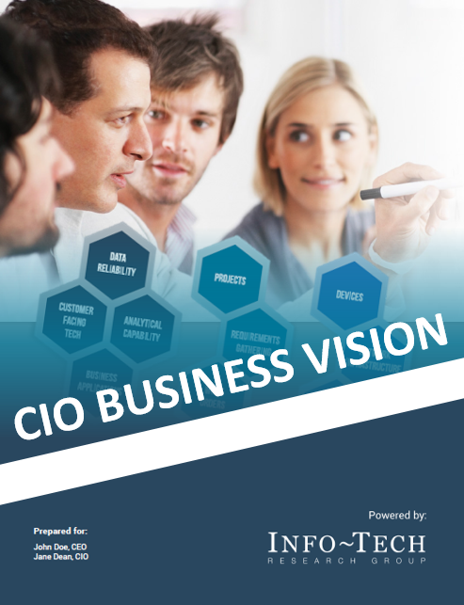
IT asset management will also improve the performance of the most important IT services
Since 2013, Info-Tech has surveyed over 20,000 business stakeholders as part of our CIO Business Vision program.
Business stakeholders ranked the following 12 core IT services in terms of importance.
Top IT Services for Business Stakeholders
An ITAM program implements contractual and financial management processes to support core IT services with:
Improved software license compliance.
Reduced total cost of ownership.
More effective contact management.
Reduced maintenance costs.
More effective reuse of licensed software and hardware.
Improved hardware visibility.
Business decision support.
Technology refresh.
Software license management.
Asset tracking.
Compliance support.
1
Network Infrastructure
Service Desk
Business Applications
Data Quality
Devices
Analytical Capability
Client-Facing Technology
Work Orders
Innovation Leadership
Projects
IT Policies
Requirements Gathering
2
3
4
5
6
7
8
Learn more about the CIO Business Vision program.
9
10
11
12
Info-Tech; N=21,367

Slide 10
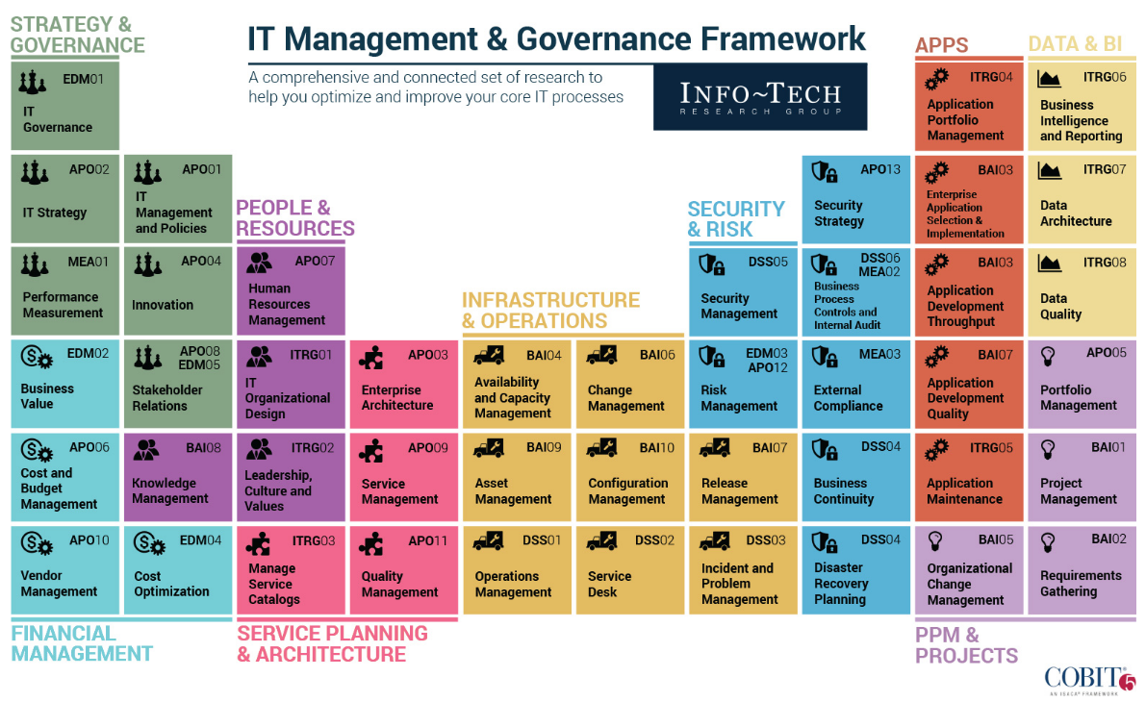
Info-Tech draws on the COBIT framework, which focuses on consistent delivery of IT services across the organization

Slide 11
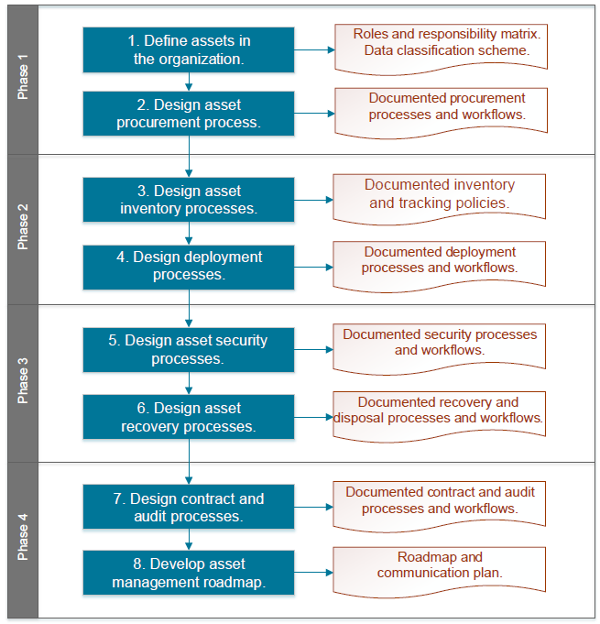
Project structure and deliverables
Key deliverables
An asset management SOP, which includes policies, processes, and workflows for:
Data collection and validation
Procurement
Inventory and tracking
Deployment and maintenance
Asset security
Recovery and disposal
Contract and audit management
An roadmap and communication plan to implement the program.
Outcome
An asset management program that helps your organization meet its legal, contractual, and regulatory obligations, and make the best of assets.

Slide 12
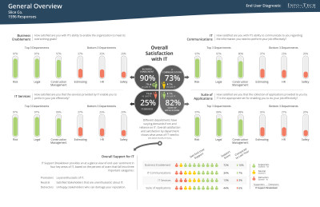
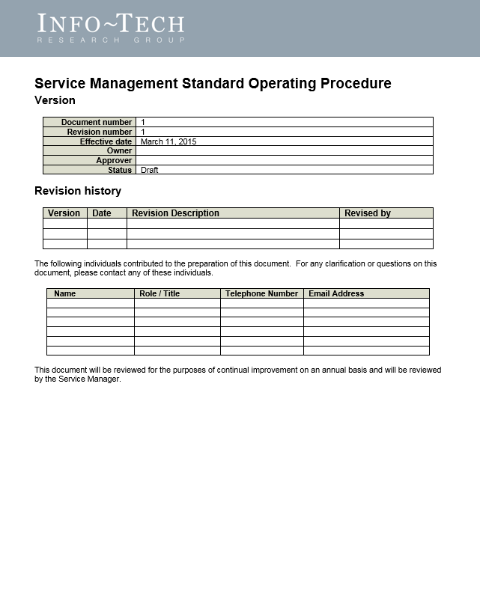
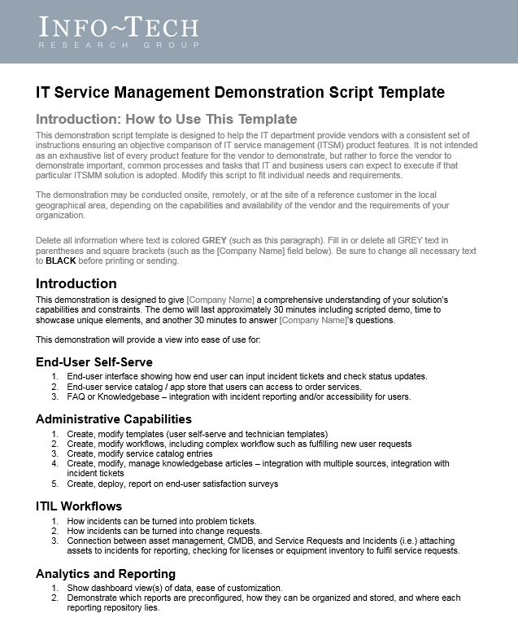
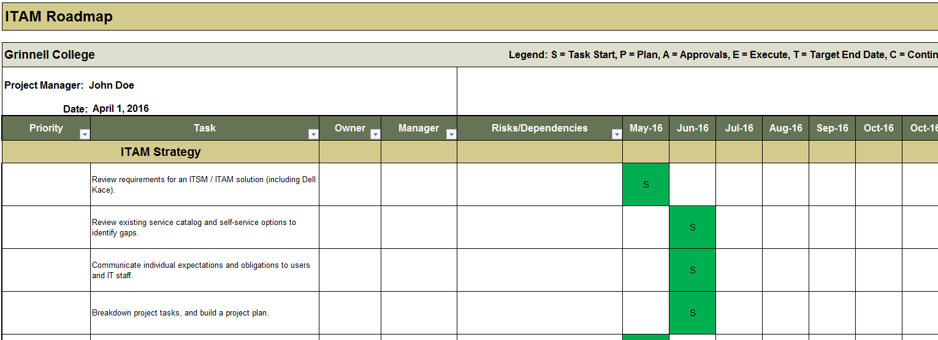
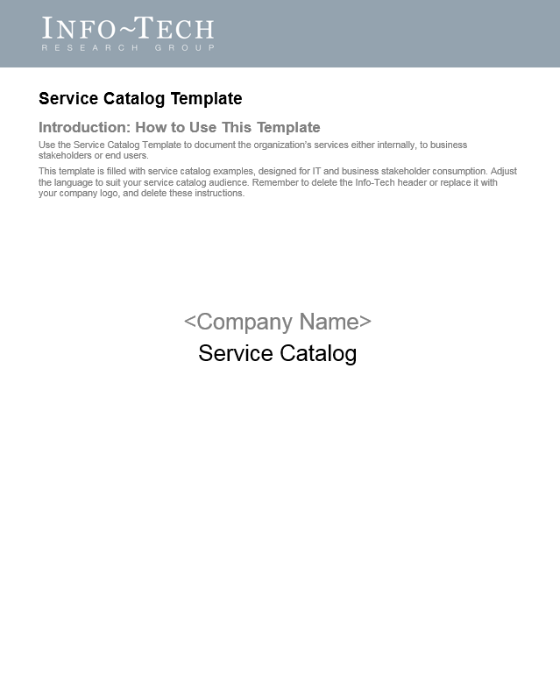
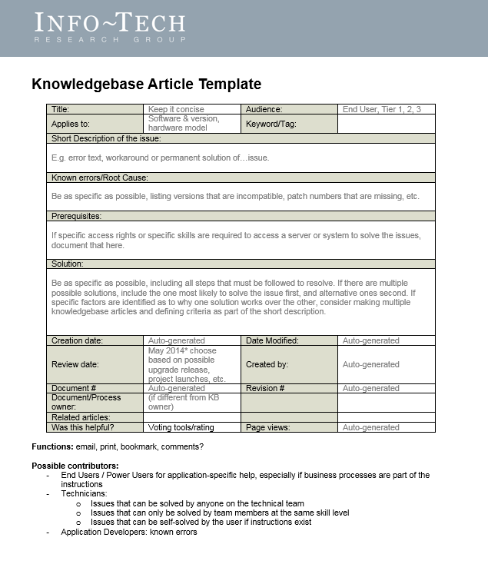
Info-Tech delivers
Diagnostic Tools
ITAM Standard Operating Procedures (SOP)
IT Asset Management Roadmap
A Collection of IT Asset Management Policies

Slide 13
Implementing IT asset management is done over two projects
The first is all about process. Design the procurement, deployment, disposal, and audit processes that make up an asset management program. Use the current project blueprint to design and implement the process part of the equation.
Vendor Landscapes: Guided implementations
Section 1: Shortlist Assistance and Requirements
Get off to a productive start: Discuss the market space and how vendors are evaluated. Decide on which deployment option suits you best and narrow down the options based on customized requirements.
Section 2: RFP and Budget Review
Interpret and act on RFP results: Review vendor RFPs and ensure the solution meets your needs. Discuss average pricing of solutions and what can fit into your budget.
Section 3: Negotiation and Contract Review
Purchase optimization: Review contracts and discuss best practices in negotiation tactics to get the best price for your solution.
The second is all about technology. Select and implement an ITAM solution to support the processes you build. Book a Guided Implementation to have our analysts walk you through recommended vendors, explain our method, review your material, and answer your questions.
Info-Tech Research Group is a vendor-neutral organization. We have no financial relationship with vendors we evaluate.

Slide 14
The project blueprint illustrates the scope of each phase of the project with relevant case studies
A large networking company used asset management to implement a cultural shift to cut hardware spend by 50%.
This case study illustrates the full scope of the project.
Procurement
The State of California enacted a Green IT asset management policy that predicts $40M in savings per year.
This case study illustrates the scope of the procurement phase.
Intake and deployment
A major health care provider implemented an automated ITAM program and recovers 50% of its ROI in one year.
This case study continues throughout the blueprint, and illustrates the scope of the Intake and Deployment phase.
Security and disposal
A major government department was fined £180,000 for the loss of sensitive prisoner data.
This case study illustrates the scope of the security and disposal phase.
Contract
and audit management
A major US financial institution used ITAM and internal audits and reporting to save nearly $1.5 million.
This case study illustrates the scope of the contract and audit phase.

Slide 15
Measure the value of guided implementations (GIs)
Engaging in GIs doesn’t just offer valuable project advice, it also results in significant cost savings.
GI | Measured Value
Phase 1: Design IT procurement processes | Time, value, and resources saved by using Info-Tech’s methodology to define IT assets, and the tools and templates to define your IT procurement processes. For example, 2 FTEs * 5 days * $80,000/year = $6,400
Phase 2: Design IT asset intake and maintenance processes | Time, value, and resources saved by using Info-Tech’s tools and templates to define your IT asset intake and maintenance processes. For example, 2 FTEs * 5 days * $80,000/year = $6,400
Phase 3: Design IT asset security and disposal processes | Time, value, and resources saved by using Info-Tech’s tools and templates to define your IT asset security and disposal processes. For example, 2 FTEs * 5 days * $80,000/year = $6,400
Phase 4: Design IT contract and audit management processes | Time, value, and resources saved by using Info-Tech’s tools and templates to define your IT contract and audit management processes. For example, 2 FTEs * 5 days * $80,000/year = $6,400
Total savings | $25,600

Slide 16
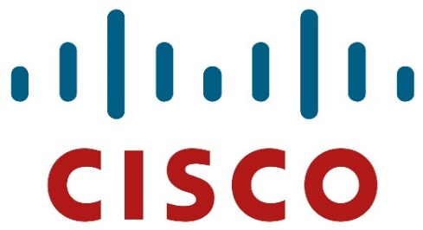
Cisco IT reduced costs by upwards of $50 million through implementing ITAM
CASE STUDY
Industry
Source
IT
Cisco Systems, Inc.
Cisco Systems, Inc.
Cisco Systems, Inc. is the largest networking company in the world. Headquartered in San Jose, California, the company employees over 70,000 people.
Asset Management
As is typical with technology companies, Cisco boasted a proactive work environment that encouraged individualism amongst employees. Unfortunately, this high degree of freedom combined with the rapid mobilization of PCs and other devices created numerous headaches for asset tracking. At its peak, spending on hardware alone exceeded $100 million per year.
Results
Through a comprehensive ITAM implementation, the new asset management program at Cisco has been a resounding success. While employees did have to adjust to new rules, the process as a whole has been streamlined and user-satisfaction levels have risen. Centralized purchasing and a smaller number of hardware platforms have allowed Cisco to cut their hardware spend in half, according to Mark Edmondson, manager of IT services expenses for Cisco Finance.
Asset Data
4
Asset Protection
3
Asset Distribution
ITAM Program Maturity
2
Asset Gathering
1
This case study continues in phase 1

Slide 17
Use these icons to help direct you as you navigate this research
Use these icons to help guide you through each step of the blueprint and direct you to content related to the recommended activities.
This icon denotes a slide where a supporting Info-Tech tool or template will help you perform the activity or step associated with the slide. Refer to the supporting tool or template to get the best results and proceed to the next step of the project.
This icon denotes a slide with an associated activity. The activity can be performed either as part of your project or with the support of Info-Tech team members, who will come onsite to facilitate a workshop for your organization.

Slide 18
Info-Tech offers various levels of support to best suit your needs
Guided Implementation
DIY Toolkit
Workshop
Consulting
“Our team has already made this critical project a priority, and we have the time and capability, but some guidance along the way would be helpful.”
“Our team knows that we need to fix a process, but we need assistance to determine where to focus. Some check-ins along the way would help keep us on track.”
“We need to hit the ground running and get this project kicked off immediately. Our team has the ability to take this over once we get a framework and strategy in place.”
“Our team does not have the time or the knowledge to take this project on. We need assistance through the entirety of this project.”
Diagnostics and consistent frameworks used throughout all four options

Slide 19
Implement Asset Management – Project overview
Scope and Procurement
Intake and Maintenance
Security and Disposal
Contracts and Audits
Best-Practice Toolkit | Step 1: Define organizational IT assets. Step 2: Design IT asset procurement processes. | Step 3: Design IT asset receiving and inventory processes. Step 4: Design IT asset deployment and maintenance processes. | Step 5: Design IT asset security processes. Step 6: Design IT asset recovery and disposal processes. | Step 7: Design contract and audit processes. Step 8: Develop IT asset management roadmap.
Guided Implementations | Define organizational assets and program goals. Design IT asset procurement processes. | Design IT asset receiving and inventory processes. Design IT asset deployment and maintenance processes. | Design IT asset security processes. Design IT asset recovery and disposal processes. | Design contract and audit processes. Develop IT asset management roadmap.
Onsite Workshop | Module 1: Procurement | Module 2: Intake and Maintenance | Module 3: Security and Disposal | Module 4: Contracts and Audits
 | Phase 1 Results: Procurement standards and workflows for hardware and software. | Phase 2 Results: Policies, processes, and workflows for hardware and software receiving, inventory, and tracking. | Phase 3 Results: Develop processes, policies and workflows for asset tracking, security, and disposal. | Phase 4 Results: Develop processes for data collection and validation to prepare for an audit. Define metrics and reporting processes to keep asset management processes on track.

Slide 20
Implement Asset Management – Workshop overview
Contact your account representative or email Workshops@InfoTech.com for more information.
 | Workshop Day 1 | Workshop Day 2 | Workshop Day 3 | Workshop Day 4
Activities | Define Scope and Procurement 1.1 Define assets in your organization. 1.2 Define ITAM roles and responsibilities. 1.3 Define standards for hardware procurement. 1.4 Define standards for software procurement. | Manage Usage Lifecycle 2.1 Draft workflows for hardware receiving, inventory, and tracking. 2.2 Draft workflows for software receiving, inventory, and tracking. 2.3 Draft workflows for hardware deployment and maintenance. 2.4 Drat workflows for software deployment and maintenance. | Protect Against Data Loss 3.1 Develop asset security policy. 3.2 Define policies, processes, and workflows for hardware disposal/recovery. 3.3 Define policies, processes, and workflows for software retirement/harvest. | Develop the Roadmap 4.1 Define contract management processes. 4.2 Develop audit management processes. 4.3 Develop an asset management roadmap. 4.4 Develop a communications plan.
Deliverables | Reporting requirements Asset management goals RACI chart Hardware procurement workflow Software procurement workflow | Target state output for hardware inventory Target state output for software inventory Target state output for hardware deployment and maintenance Target state output for software deployment and maintenance | Asset security policy Hardware disposal workflow Software disposal workflow | Contract management policy Audit defense policy Asset management roadmap ITAM communication plan

