Slide 1
Business Intelligence (BI)
By: Tom Markley

Slide 2
Overview
What is Business Intelligence?
When did Business Intelligence begin?
How is Business Intelligence used today?
Where is Business Intelligence headed?

Slide 3
What is Business Intelligence?
Business Intelligence (BI) refers to computer-based techniques used in analyzing business data.
BI technologies provide historic, current, and predictive views to business operations.
Common Functions: Reporting, Analytical Processes, Data Mining, Benchmarking, Predictive Analysis.
Data + BI = Better Decision Making

Slide 4
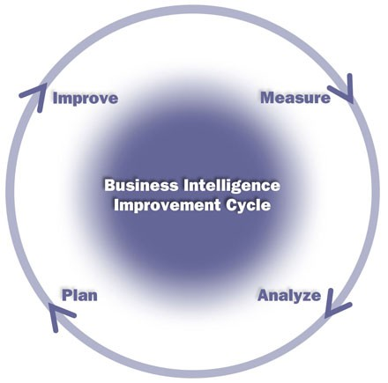
BI Cycle

Slide 5
History of “Business Intelligence”
1958 – IBM researcher Hans Peter Luhn used the term “business intelligence” and defined the word “intelligence” as “the ability to apprehend the interrelationships of presented facts in such a way as to guide action towards a desired goal.”
1989 – Howard Dresner proposed BI as an umbrella term to describe “concepts and methods to improve business decision making by using fact-based support systems.”

Slide 6
BI In The World Today
Raw Data → Useful Information
Measurement
Progress towards goals.
Analysis
Quantitative processes for better decision making.
Reporting
Building/Visualizing strategies and results.
Collaboration
Sharing information to external branches of business.
Knowledge
Using what you learn.

Slide 7
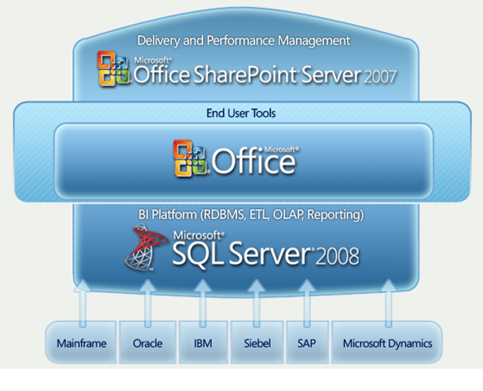
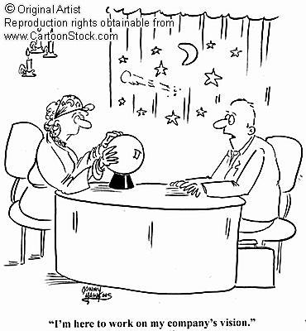
Business Intelligence Tools
Business Objects
SAS
Cognos
Microsoft
Hyperion

Slide 8
Future of BI
As technology expands, so does BI
More accurate predictive analysis
More platforms and vendors
Software as a Service (SaaS)
Real-Time Business Intelligence
Fix “drowning in terabytes of data”

Slide 9
Potential Problems
User resistance
Users do not believe the results
Poor data and poor data warehouses.
Lack of understanding within business.

Slide 10
IBM "Sketching the Future"

Slide 11
What Did We Learn?
BI – Computer-based techniques used to analyze data, form reports, make predictions, and allow for quality decision making.
Mid 1990’s – Howard Dresner
Potential Problems exist, but are workable.
Will grow quickly in the near future.

Slide 12
References
Business Intelligence Solutions
www.cio.com
Microsoft Business Intelligence
www.microsoft.com/bi
Cognos BI and Performance Management
www.ibm.com

