Slide 1
Stage-Gate Process & Qualify Function Deployment
Rev: Dec, 2012
POSTECH Strategic Management of Information and Technology Laboratory
(POSMIT: http://posmit.postech.ac.kr)
Dept. of Industrial & Management Engineering POSTECH

Slide 2
Stage-Gate Process (1/4)
Stage-Gate Process
Introduced by Robert G. Copper in 1990
Conceptual and operational road map for moving a new-product project from idea to launch
Blueprint for managing the new-product process to improve effectiveness and efficiency
Generic flow of the Stage-Gate Process
Stages
Stages are where cross-functional action occurs: There is no R&D or marketing stage
Each stage consists of a set of parallel activities undertaken by people from different functional areas in the firm, working together as a team and led by a project team leader
Gates
At the entrance to each stage is a gate, which serves as the quality control and Go/Kill check point in the process
Idea Screen
Second
Screen
Decision
to Develop
Decision to Test
Decision to Launch
Post-Launch
Review
Idea
Gate
1
Stage 1
Gate
2
Stage 2
Gate
3
Stage 3
Gate
4
Stage 4
Gate
5
Stage 5
$
Scoping
Building Business case
Development
Testing &
Validation
Launch

Slide 3
Stage-Gate Process (2/4)
Stage 1: Scoping
A quick investigation and sculpting of the project
Stage 2: Building business case
The detailed homework and up-front investigation work leading to a business case; a defined product, a business justification and a detailed plan of action for the next stages
Stage 3: Development
The actual design and development of the new product
The manufacturing (or operations) process is mapped out, the marketing launch and operating plans are developed, and the test plans for the next stage are defined
Stage 4: Testing and validation
The verification and validation of the proposed new product, its marketing and production
Stage 5: Launch
Full commercialization of the product - the beginning of full production and commercial launch and selling
Idea
Screen
Second
Screen
Decision
to Develop
Decision to Test
Decision to Launch
Post-Launch
Review
Discovery
Stage
Gate
1
Stage 1
Gate
2
Stage 2
Gate
3
Stage 3
Gate
4
Stage 4
Gate
5
Stage 5
$
Scoping
Building Business Case
Development
Testing &
Validation
Launch

Slide 4
Stage-Gate Process (3/4)
Common roles of gate
Quality-control checkpoints: Checking whether this project is being executed in a quality fashion
Go/Kill and prioritization decision points: Gates provide the funnels where mediocre projects are successively culled out
Path forward for the next stage decision points: Gate meetings are usually staffed by senior managers from different functions, who own the resources the project leader and team require for the next stage
Common formats related to each gate
Criteria (input): Questions or metrics on which the project is judged in order to make the Go/Kill and prioritization decision
Decision (output): Results of the gate review - a decision (Go/Kill/Hold/Recycle)
Approved action plan (output): Date and deliverables for the next gate
Idea
Screen
Second
Screen
Decision
to Develop
Decision to Test
Decision to Launch
Post-Launch
Review
Discovery
Stage
Gate
1
Stage 1
Gate
2
Stage 1
Gate
3
Stage 3
Gate
4
Stage 4
Gate
5
Stage 5
$
Preliminary Investigation
Detailed
Investigation
Development
Testing &
Validation
Launch

Slide 5
Stage-Gate Process (4/4)
Action items of each stage and gate in Stage-Gate process
Stage/Gate | Action Items
Gate 1. Idea Screen | • Does the idea merit any work?
Stage 1. Scoping | • Prelim market assessment • Prelim technical assessment • Prelim financial & business assessment • Action plan for Stage 2
Gate 2. Second Screen | • Does the idea justify extensive investigation?
Stage 2. Building Business Case | • User needs & wants study • Competitive analysis • Value proposition defined • Technical feasibility assessment • Operations assessment • Product Definition
Gate 3. Decision to Develop | • Is the business case sound?
Stage 3. Development | • Technical development work • Rapid prototypes • Initial customer feedback • Prototype development • In-house product testing • Operations process development • Full launch & operations plans
Gate 4. Decision to Test | • Should the project be moved to external testing?
Stage 4. Testing & Validation | • Extend in-house testing • Customer field trials • Acquisition of production equipment • Production/operation trials • Test market/trial sell • Finalized launch and operations plans • Post-launch & life cycle plans
Gate 5. Decision to Launch | • Is the product ready for commercial launch?
Stage 5. Launch | • Market launch & roll-out • Full production/operations • Selling begin • Results monitoring • Post-Launch & life cycle plans under way

Slide 6
Quality Function Deployment (1/6)
Quality Function Deployment (QFD)
Method to transform user demands into design quality, to deploy the functions forming quality, and to deploy methods for achieving the design quality into subsystems and component parts, and ultimately to specific elements of the manufacturing process
Developed by Yoji Akao in 1966

Slide 7
Quality Function Deployment (2/6)
Benefits of QFD
Customer Driven
Creates Focus On Customer Requirements
Uses Competitive Information Effectively
Prioritizes Resources
Identifies Items That Can Be Acted On
Structures Resident Experience/Information
Reduces Implementation Time
Decreases Midstream Design Change
Limits Post Introduction Problems
Avoids Future Development Redundancies
Identifies Future Application Opportunities
Surfaces Missing Assumptions

Slide 8
Quality Function Deployment (3/6)
Benefits of QFD (Cont’d)
Promotes Teamwork
Based On Consensus
Creates Communication At Interfaces
Identifies Actions At Interfaces
Creates Global View-Out Of Details
Provides Documentation
Documents Rationale For Design
Is Easy To Assimilate
Adds Structure To The Information
Adapts To Changes (Living Document)
Provides Framework For Sensitivity Analysis

Slide 9
Quality Function Deployment (4/6)
Voice of the Customer
Driving Force Behind QFD
Customer Dictates Attributes Of Product
Customer Satisfaction
Meeting Or Exceeding Customer Expectations
Customer Expectations Can Be Vague & General In Nature
Customer Expectations Must Be Taken Literally, Not Translated Into What The Organization Desires
Collecting Customer Information
What Does Customer Really Want?
What Are Customer’s Expectations?
Are Customer’s Expectations Used To Drive Design Process?
What Can Design Team Do To Achieve Customer Satisfaction?

Slide 10
Quality Function Deployment (5/6)
House of Quality
Introduced by John R. Hauser and Don Clausing in 1988
Interrelationship
between
Technical Descriptors
Technical Descriptors
(Voice of the organization)
Customer Requirements
(Voice of the Customer)
Relationship between
Requirements and Descriptors
Prioritized Customer
Requirements
Prioritized Technical
Descriptors

Slide 11
Quality Function Deployment (6/6)
Building A House Of Quality
List Customer Requirements (What’s)
List Technical Descriptors (How’s)
Develop Relationship (What’s & How’s)
Develop Interrelationship (How’s)
Competitive Assessments
Prioritize Customer Requirements
Prioritize Technical Descriptors

Slide 12
QFD Matrix
Relationship between
Customer Requirements and
Technical Descriptors
WHATs vs. HOWs
Technical Descriptors
Primary
Interrelationship between
Technical Descriptors
(correlation matrix)
HOWs vs. HOWs
Secondary
+9
Strong
Secondary
+3
Medium
Primary
+1
Weak
+9
Strong Positive
+3
Positive
-3
Negative
-9
Strong Negative
Prioritized Customer
Requirements
Customer Requirements
Technical
Competitive
Assessment
Our
A’s
B’s
Our
A’s
B’s
Customer Importance
Target Value
Scale-up Factor
Sales Point
Absolute Weight
Degree of Technical Difficulty
Target Value
Absolute Weight and Percent
Customer
Competitive
Assessment
Relative Weight and Percent
Prioritized Technical Descriptors

Slide 13
Customer Requirements (What’s)
Secondary
Tertiary
Primary
Customer Requirements
(WHATs)

Slide 14
Technical Descriptors (How’s)
Secondary
Tertiary
Primary
Technical Descriptors
(HOWs)

Slide 15
L - Shaped Diagram
Technical Descriptors
Primary
Secondary
Secondary
Primary
Customer Requirements

Slide 16
Relationship Matrix
Technical Descriptors
Primary
Secondary
Secondary
Primary
Relationship between
Customer Requirements and
Technical Descriptors
WHATs vs. HOWs
Customer
Requirements
+9
Strong
+3
Medium
+1
Weak

Slide 17
Correlation Matrix
Interrelationship between Technical
Descriptors (correlation matrix)
HOWs vs. HOWs
Technical Descriptors
+9
Strong Positive
Primary
+3
Positive
-3
Negative
Secondary
-9
Strong Negative
Secondary
Primary
Relationship between
Customer Requirements and
Technical Descriptors
WHATs vs. HOWs
Customer Requirements
+9
Strong
+3
Medium
+1
Weak

Slide 18
Customer Competitive Assessment
5
3
1
2
5
1
4
4
Relationship between
Customer Requirements and
Technical Descriptors
WHATs vs. HOWs
Customer Requirements
+9
Strong
+3
Medium
+1
Weak
Ours
A’s
B’s
Customer
Competitive
Assessment

Slide 19
Technical Competitive Assessment
5
3
1
2
5
1
4
4
Relationship between
Customer Requirements and
Technical Descriptors
WHATs vs. HOWs
Customer Requirements
+9
Strong
Our
A’s
B’s
1 3 4 2
1 2 1 4
+3
Medium
Technical
Competitive
Assessment
+1
Weak
Our
A’s
B’s
Customer
Competitive
Assessment

Slide 20
Technical Descriptors
Primary
Relationship between
Customer Requirements and
Technical Descriptors
WHATs vs. HOWs
Secondary
Secondary
Primary
+9
Strong
5
3
1
2
5
1
4
4
7
3
9
10
2
4
8
1
5
3
2
3
5
2
4
4
+3
Medium
1.2
1.5
1
1
1.5
1
1.5
1
+1
Weak
Prioritized Customer
Requirements
Customer Requirements
1.5
1
15
3
Technical
Competitive
Assessment
Our
A’s
B’s
1 3 4 2
1 2 1 4
Our
A’s
B’s
Customer Importance
Target Value
Scale-up Factor
Sales Point
Absolute Weight
Customer
Competitive
Assessment

Slide 21
Relationship between
Customer Requirements and
Technical Descriptors
WHATs vs. HOWs
Technical Descriptors
Primary
Interrelationship between
Technical Descriptors
(correlation matrix)
HOWs vs. HOWs
Secondary
+9
Strong
Secondary
+3
Medium
Primary
+1
Weak
+9
Strong Positive
+3
Positive
5
3
1
2
5
1
4
4
7
3
9
10
2
4
8
1
5
3
2
3
5
2
4
4
1.2
1.5
1
1
1.5
1
1.5
1
-3
Negative
-9
Strong Negative
Prioritized Customer
Requirements
Customer Requirements
1.5
1
15
3
Technical
Competitive
Assessment
Our
A’s
B’s
1 3 4 2
1 2 1 4
Our
A’s
B’s
Customer Importance
Target Value
Scale-up Factor
Sales Point
Absolute Weight
Degree of Technical Difficulty
1 8 4 2
9 8 2 5
Target Value
2 3 4 3
1 3 1 5
Absolute Weight and Percent
90
Customer
Competitive
Assessment
Relative Weight and Percent
133
Prioritized Technical Descriptors

Slide 22
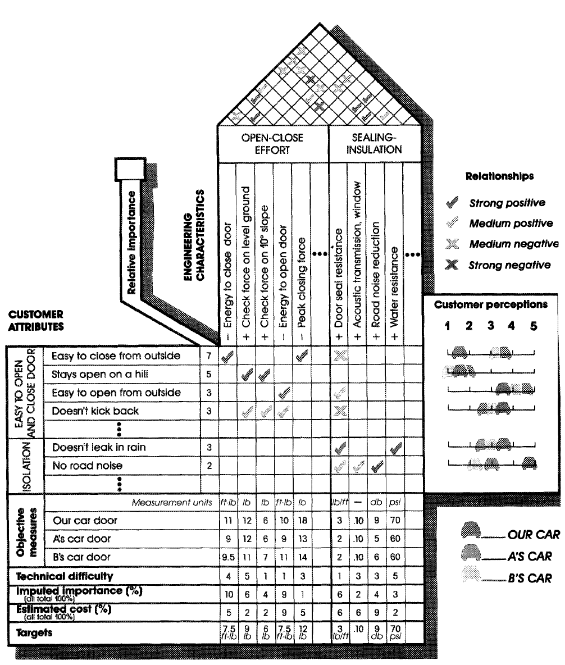

Slide 23
QFD Process
HOWs
HOWs
WHATs
WHATs
HOW MUCH
HOW MUCH

Slide 24
Phase I Product Planning
Design
Requirements
Customer
Requirements

Slide 25
Phase II Part Development
Part Quality
Characteristics
Design
Requirements

Slide 26
Phase III Process Planning
Key Process
Operations
Part Quality
Characteristics

Slide 27
Phase IV Production Planning
Production
Requirements
Key Process
Operations
Production Launch

Slide 28
QFD Summary
Orderly Way Of Obtaining Information & Presenting It
Shorter Product Development Cycle
Considerably Reduced Start-Up Costs
Fewer Engineering Changes
Reduced Chance Of Oversights During Design Process
Environment Of Teamwork
Consensus Decisions
Preserves Everything In Writing

Slide 29
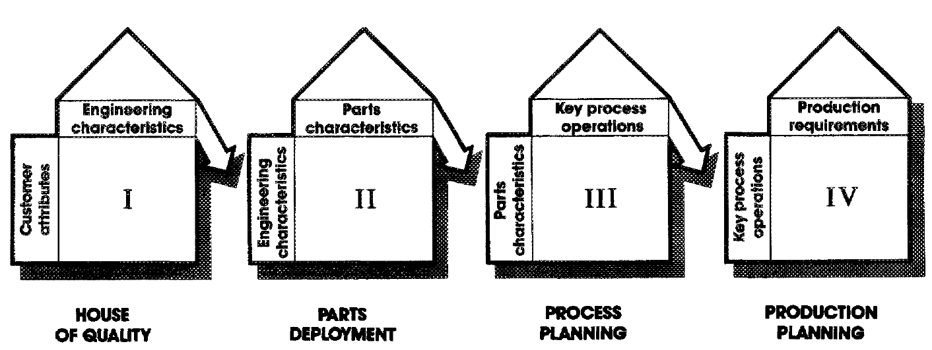
Beyond the House
Setting target value for closing energy gives us a goal, but not a door.
To get the door, we need the right parts, the right process to manufacture the parts and assemble the product, and the right production plan to get it built.
If our team is truly interfunctional, we can eventually take the “hows” from our house of quality and make them the “whats” of another house.

